Slide 1



The Location of Switchgear Partial Discharge by Panel and
Techniques to Correlate Switchgear and Cable Partial Discharge with Load and Substation Environment
Cliff Walton and Sarah Carter - PPA Energy
Colin Smith - IPEC
Matthieu Michel - UK Power Networks
Cliff Walton – UK – Session 1 Network Components – 0862

Slide 2
Introduction
UK Power Networks on line monitoring switchgear and cable partial discharge updates:
  Early warning of potential switchgear failure
  Understanding of effect of substation environment on switchgear partial discharge
  Relationship between switchgear and cable partial discharge and load and techniques for enhanced criticality measurement
Cliff Walton – UK – Session 1 Network Components – 0862

Slide 3
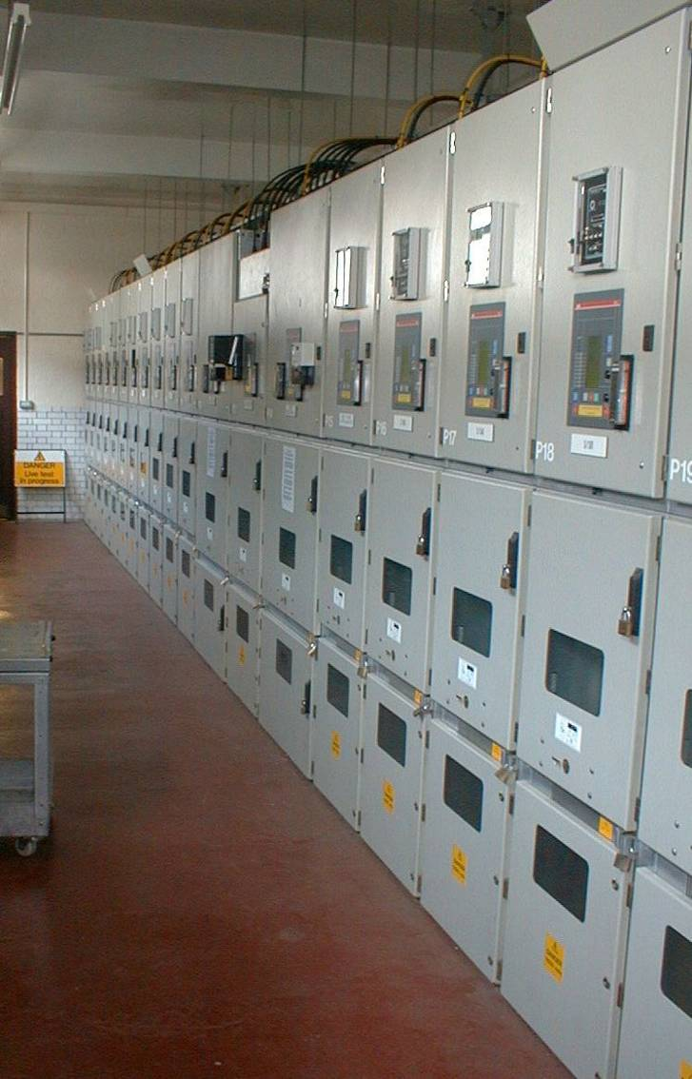
63 substation sites monitored
> 1000 feeders
> 2200 sensors
HF CTs
Capacitive couplers
Ultrasonic
5-10 years of data
6.6kV-225kV

Slide 4
Switchgear pd and precedence detection
Switchgear pd signal spreads along busbar
Can be detected on multiple panels
Panel in South of England, single source of activity P14
Cliff Walton – UK – Session 1 Network Components – 0862
Notes:
Air insulated switchgear,
PD induces transient voltages which propagate rapidly over metal panels
High frequency , skin effect, move to adjacent panels
PD magnitude generally diminishes with distance
Complex \RF energy dissipation, amplitude is unreliable way of determining source
Further complicated when more than one source

Slide 5
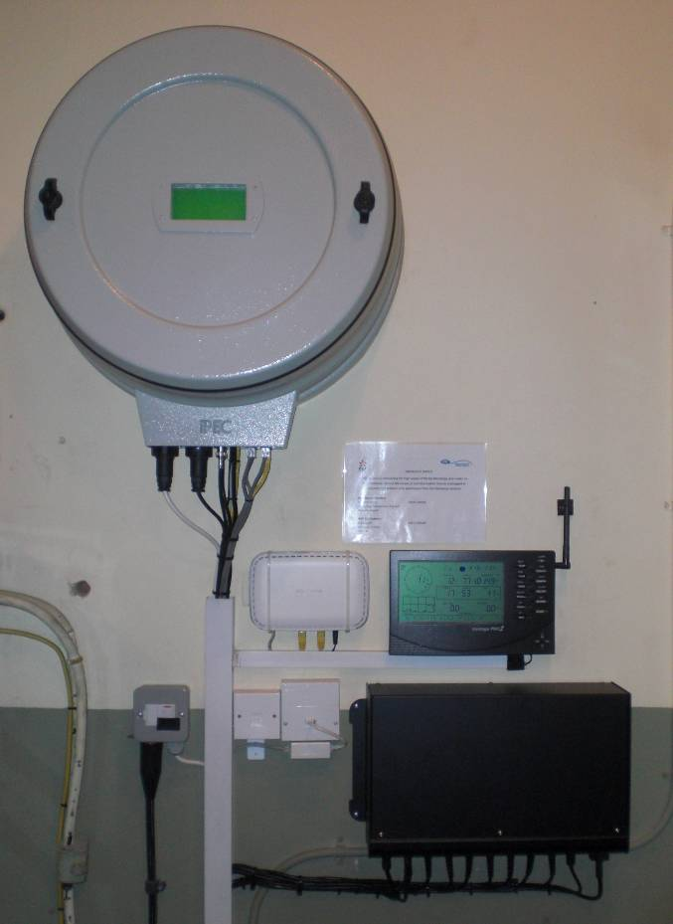
Precedence solution
Precedence unit
Corrects for signal cable lengths
Detects which channel was first to see pd signal
Eliminates signals which are not precedent
Trials in 10 substations show accurate to within 400 mm
Cliff Walton – UK – Session 1 Network Components – 0862

Slide 6
Precedence solution
PD in site with two pd sources
Before precedence:
After precedence:
2 discharging panels – P14 and P5 confirmed
Cliff Walton – UK – Session 1 Network Components – 0862

Slide 7

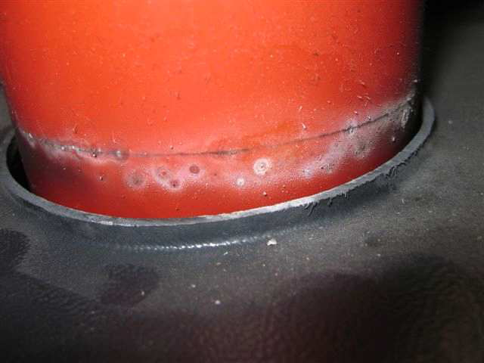
Examples of switchgear discharges

Slide 8
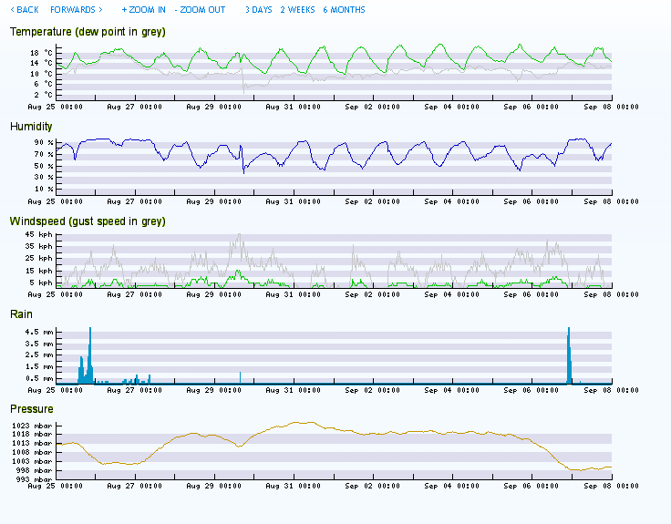
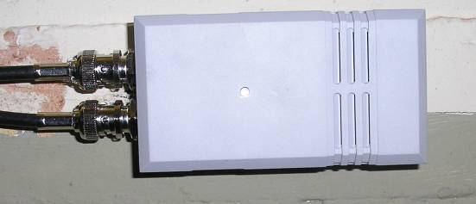
Switchgear pd and the environment
Indoor substations equipped with temperature and humidity sensors
Weather station installed externally
Substation in southwest London
Cliff Walton – UK – Session 1 Network Components – 0862

Slide 9
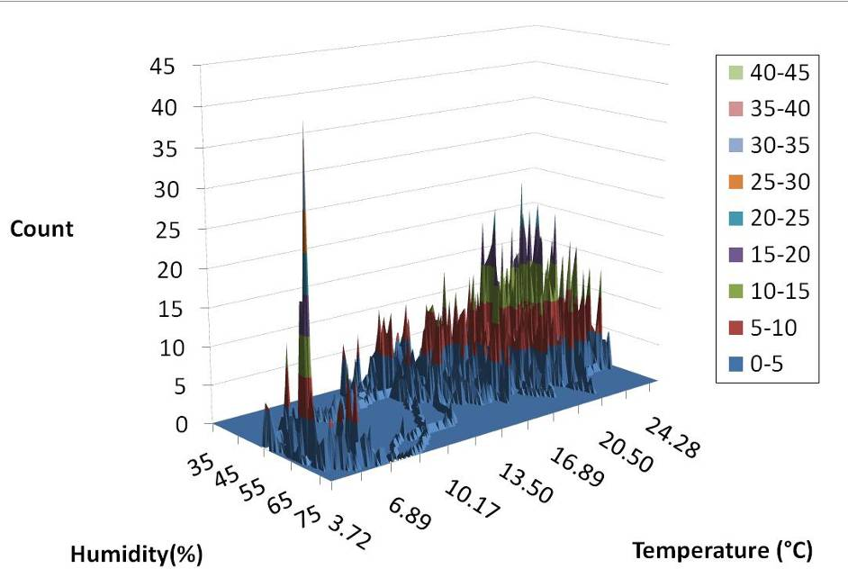
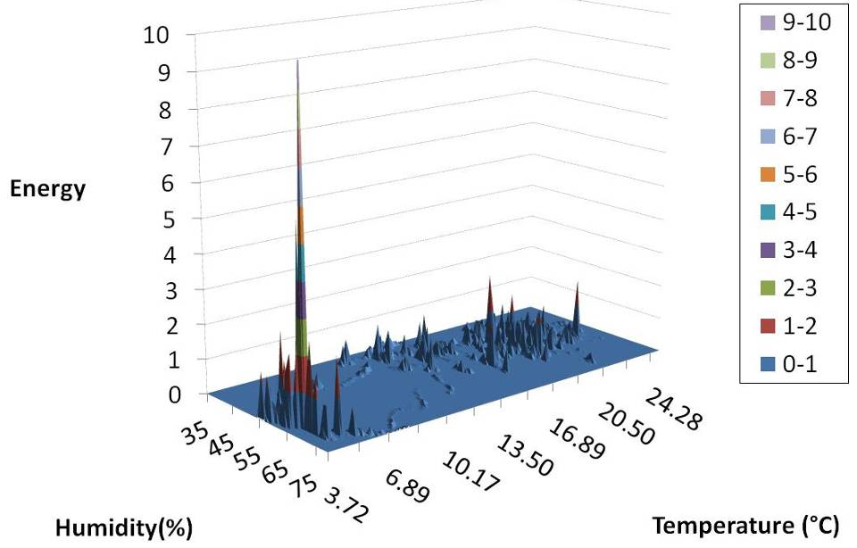
Switchgear pd and the environment
Observed strong interrelationships between temperature, humidity and switchgear type
Large number of discharges at higher temperature can have lower energy
Count
PD Activity
PD Energy
Cliff Walton – UK – Session 1 Network Components – 0862

Slide 10
Switchgear pd and the environment
Model
PD
Environmental dependency determined
Yes
Predict occurrences of PD
Load
Temperature
No
Actively control substation environment
Humidity
96% correlation
Pressure
Historic pd data and switchgear type – used to establish boundaries within model
Reduce pd, improve switchgear health and life
Cliff Walton – UK – Session 1 Network Components – 0862

Slide 11
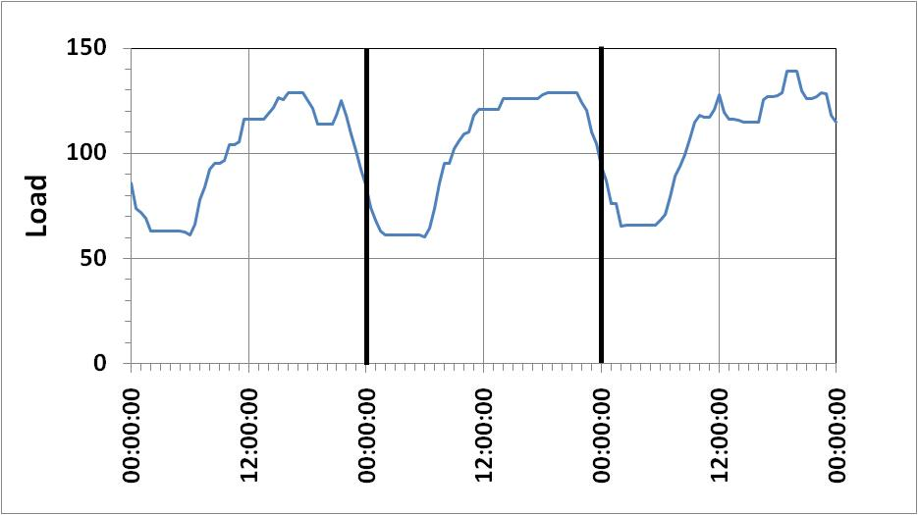
The relationship between pd and load
Cable and switchgear PD associated with load profiles
In some instances failures follow and load increase or decrease
(a) On the falling edge (cooling)
(b) At a minimum
(c) On the rising edge (heating)
Or Independent of load.
A Key input into assessment of Event Criticality
Cliff Walton – UK – Session 1 Network Components – 0862
Notes:
On falling edge – transition 1
On rising edge – transition 2
At a minimum – transition 3
Continuous and independent of load

Slide 12
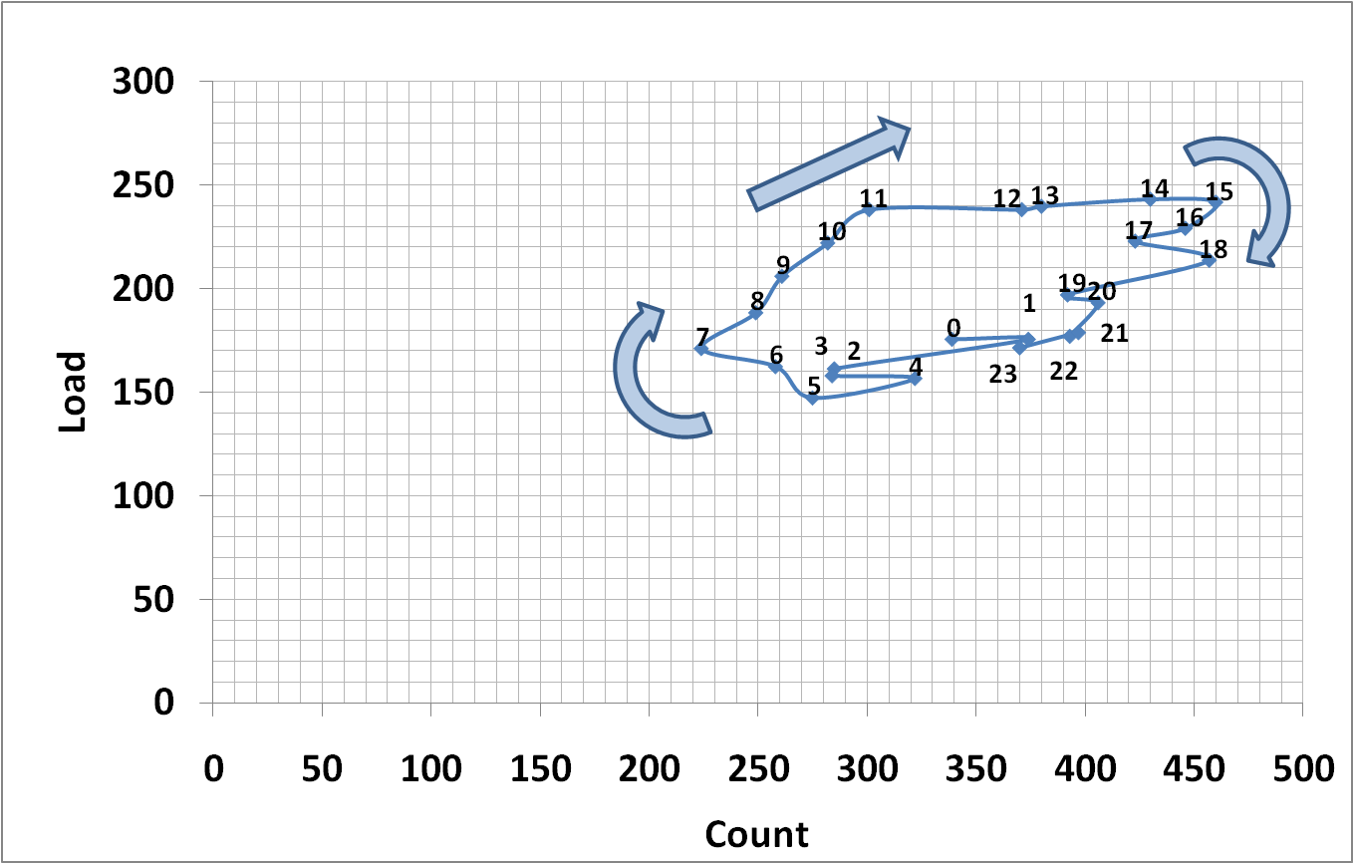
The relationship between pd and load
Online event location
Cliff Walton – UK – Session 1 Network Components – 0862

Slide 13
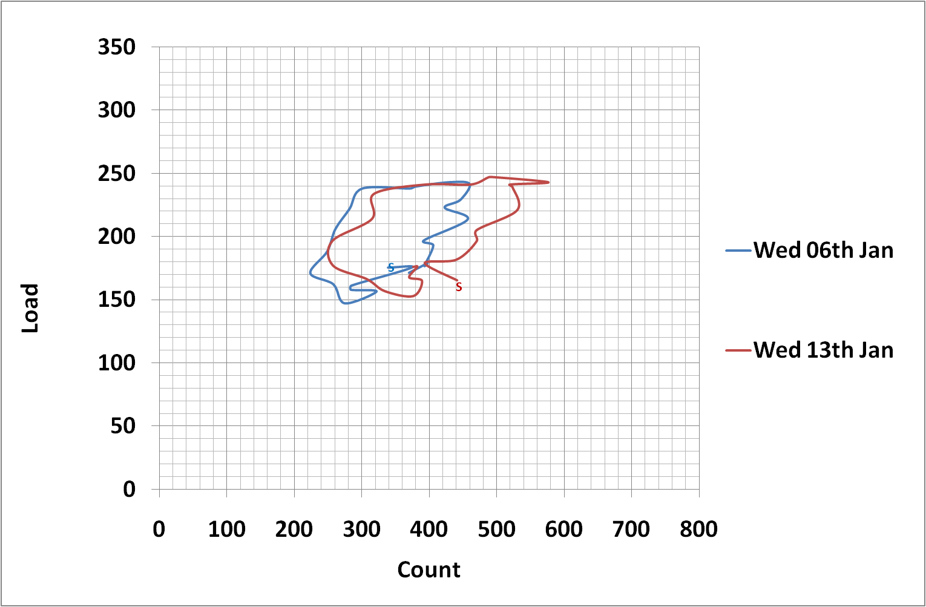
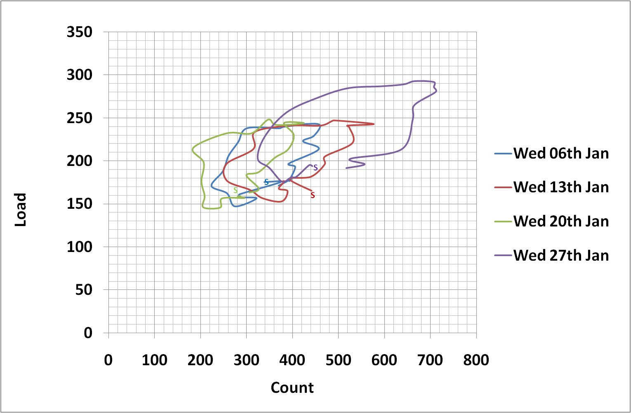
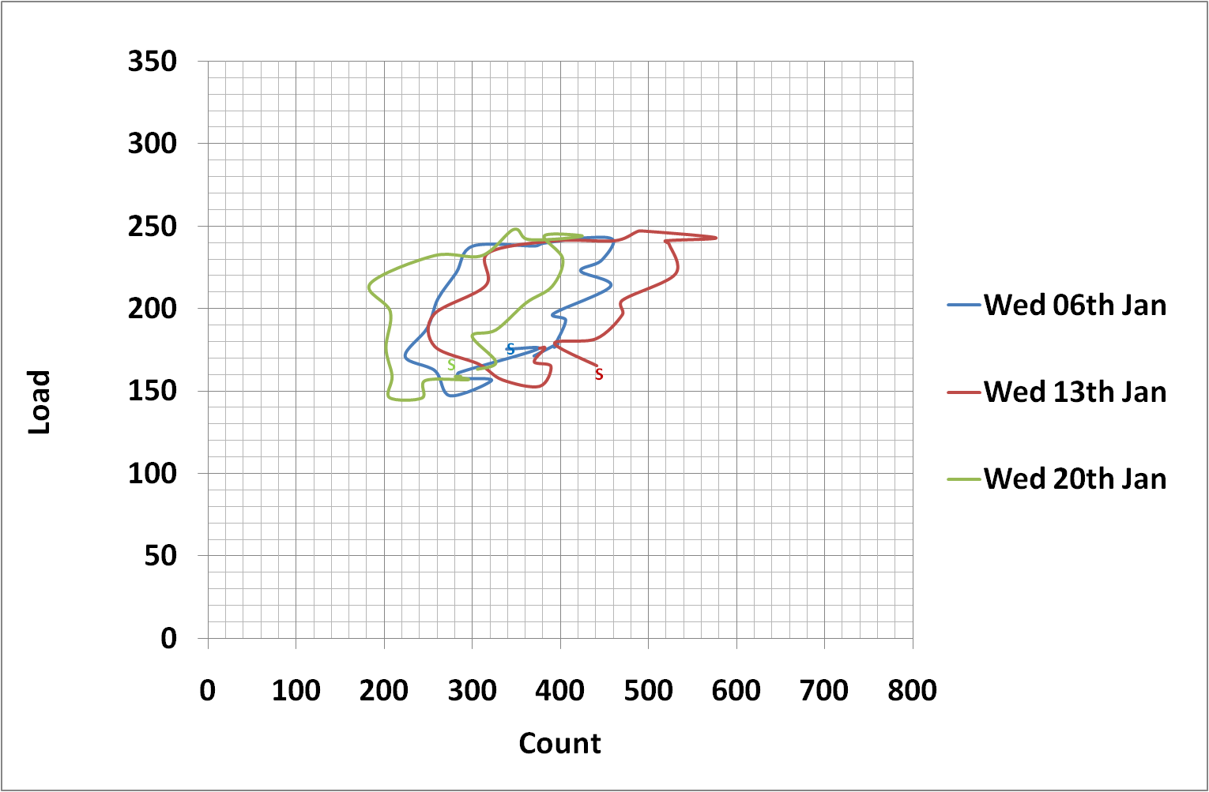
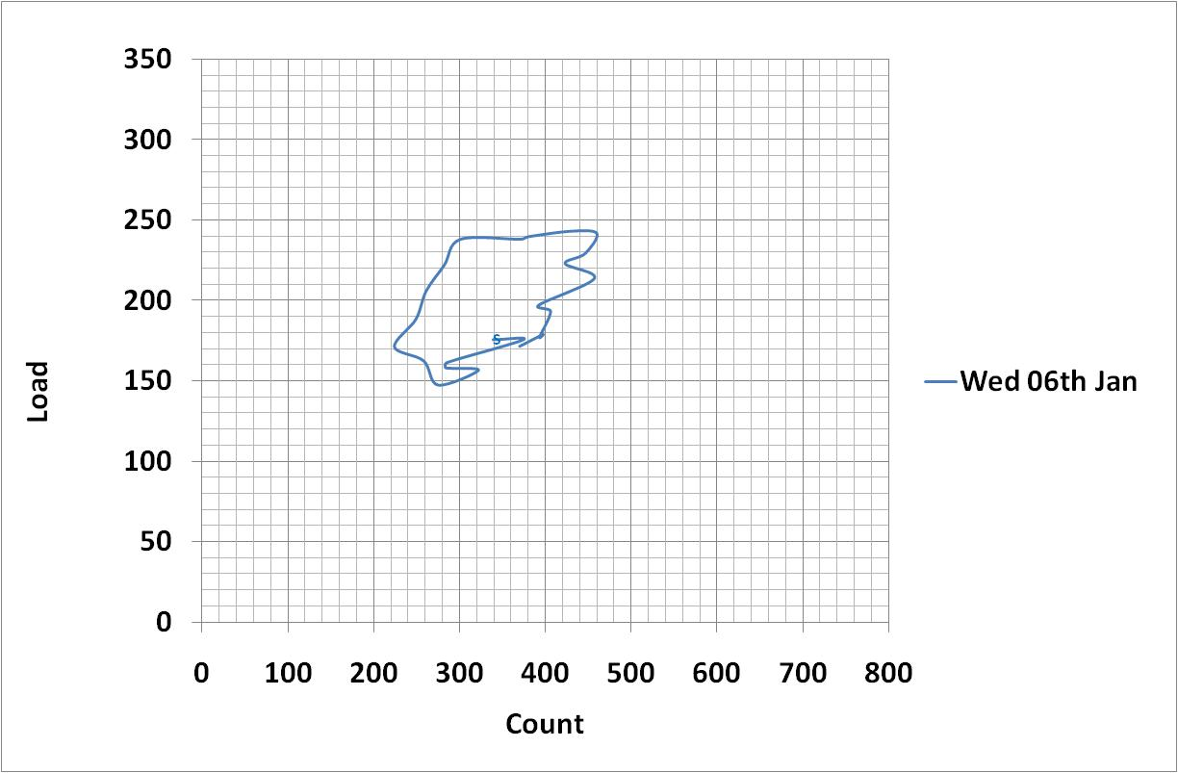
Evolution of pd and load hysteresis
Higher likelihood of failure
Cliff Walton – UK – Session 1 Network Components – 0862

Slide 14
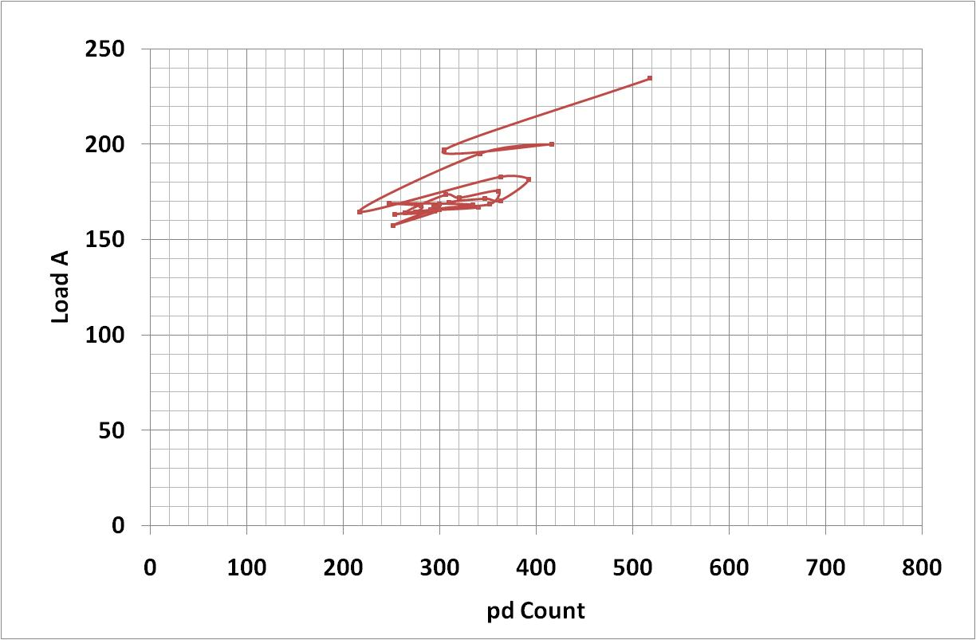
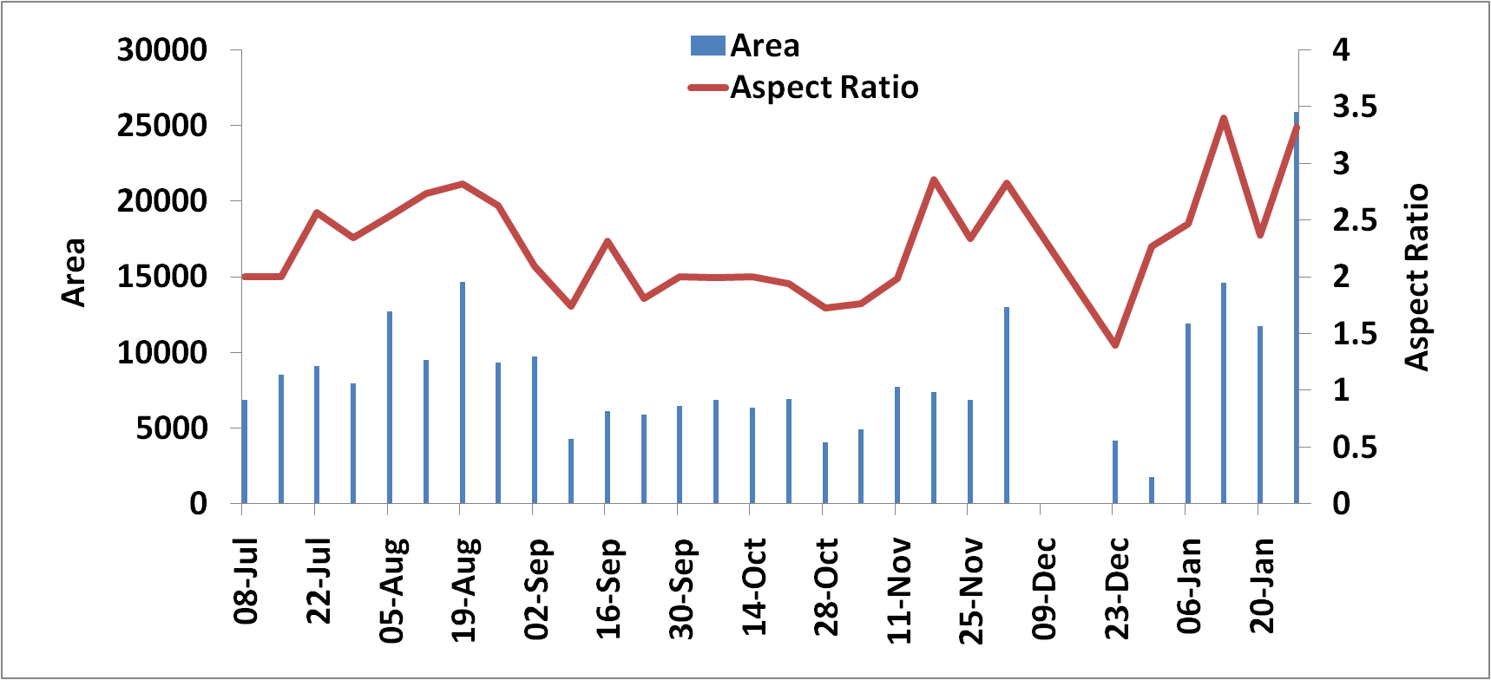
The relationship between pd and load
January
2010
Measures of hysteresis
  Shape – Aspect Ratio
  Area
  Position Displacement
July
2009
Monitor evolution of incipient fault
Knowledge of load dependency – operational considerations
Cliff Walton – UK – Session 1 Network Components – 0862

Slide 15
Conclusions
Precedence detection remotely locates discharging switchgear panels to within 400mm
Active control of substation environment to prevent discharge and improve asset health
PD and load relationship indicators determined to enhance assessment of event criticality
Cliff Walton – UK – Session 1 Network Components – 0862

