Slide 1
Unbalanced rural LV networks in France
In France, LV customers are mostly < 18 kVA and single-phase.
Some LV networks are unbalanced and it generates important voltage drops
It is not a problem in urban zone
bulking effect
But a real problem in rural zone
long LV network and few customers
So far usual solutions are network reinforcement
Yves ZONTA & Christophe GAUDIN – France – S1 – 0170

Slide 2
An alternative to reinforcement
4 equipments are developed to compensate the unbalance currents effects
Two old systems : from the early 2000s.
Two new systems : quite recently
The firsts are efficient but heavy and expensive
VAS (Voltage Adapter Slipper) and TMC (Tri-Mono Converter)
The new ones are thinner and less expensive (/3)
BMC (Bi-Mono Converter) and TNB (Three-phase Network Balancer)
Yves ZONTA & Christophe GAUDIN – France – S1 – 0170

Slide 3
Voltage Adapter Slipper (VAS)
Electronic control load regulator : maintains the output voltage within the range of 230V +10/-10%.
Capacity of the equipment :
1 single-phase customer up to 18 kVA
Cost : 15 to 25 k€ (including installation)
Weight : 200 to 450 kg
for single & three phase systems
Switched transformer
Serial
transformer
Ph
Customer
Network
Switches
N
Electrical service connection
Single Phase VAS
Customer
Yves ZONTA & Christophe GAUDIN – France – S1 – 0170

Slide 4
Tri/Mono Converter (TMC)
Allows the network to see the customer as a three-phase well-balanced customer
Capacity of the equipment :
1 single-phase customer up to 12 kVA
Cost : around 10 k€ (including installation)
Weight : 250 kg.
Network
Ph3
Ph
Customer
Ph2
Ph1
N
N
Network
TMC
Customer
Yves ZONTA & Christophe GAUDIN – France – S1 – 0170

Slide 5
Bi/Mono Converter (BMC)
Allows to distribute the power of the single-phase customer on two phases
Capacity of the equipment :
1 single-phase customer up to 9 kVA
Cost : only 5 k€ (including installation)
Weight : only 70 kg
Network
Ph3
Customer
400 / 230
Ph2
Ph
Ph1
N
N
Network
BMC
Customer
Yves ZONTA & Christophe GAUDIN – France – S1 – 0170

Slide 6
Three-phase Network Balancer (TNB)
A coupling ZIGZAG creates a neutral point & rebalances the network with a current circulation in the resistor Zn & neutral
Capacity of the equipment :
Single-phase and three-phase customers up to 45 A on each phase.
Cost : only 5 k€ (including installation)
Weight : only 70 kg
Ph1
Ph2
Ph3
N
Zn
I ≤ 40A
Network
TNB
Yves ZONTA & Christophe GAUDIN – France – S1 – 0170

Slide 7
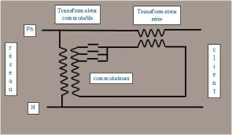
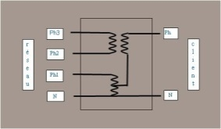
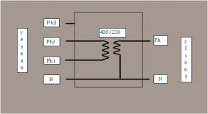
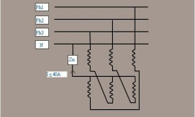
C H A R A C T E R I S T I C S | Materials | Voltage drop corrections | Capacity | Weight | Cost
 | Three-phase VAS | till 20 % | 12 kVA /phase | 400 kg | 25 k€
 | Single-phase VAS | till 20 % | 18 kVA | 220 kg | 15 k€
 | TMC | / 6 | 12 kVA | 250 kg | 10 k€
 | BMC | /3 | 9 kVA | 70 kg | 5 k€
 | TNB | / 2 | up to 45 A /phase. | 70 kg | 5 k€
Yves ZONTA & Christophe GAUDIN – France – S1 – 0170

Slide 8
Some Points to take into account
Economic conditions
Network should last at least 10 years
No new customer expected or load increase
Should cost half of network reinforcement (best capitalized cost approach)
Electric conditions
Possible difficulties in case of upstream customers
Need of tool for electric calculation (unbalanced network)
Conclusion : a good solution for long LV networks with few customers but there are the above limitations to consider
Yves ZONTA & Christophe GAUDIN – France – S1 – 0170

