Slide 1
Dynamic var compensation of mine hoists for improvement of power quality and increase of productivity at LKAB Sweden
Authors:
Lennart Mukka | Natan Gothelf | Christian Payerl
LKAB Sweden | Harmonizer PQC Sweden | ABB Sweden
MUKKA – SE – Session 2 – 0552

Slide 2
Content
Introduction
Function
Design features
Results of Performance Tests
Operating experience
MUKKA – SE – Session 2 – 0552

Slide 3
Luossavaara Kiirunavaara AB
LKAB
LKAB is the largest producer of iron ore products in EU
Annual production last year was 26 million tonnes
The customers are steelworks in Sweden, Europe, Far East and Middle East
MUKKA – SE – Session 2 – 0552

Slide 4
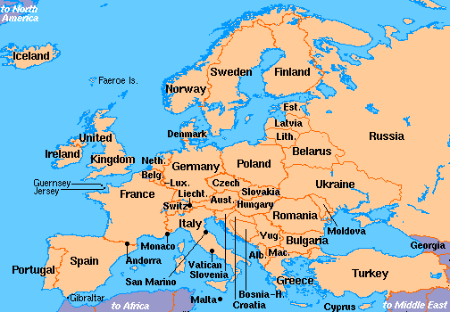
Kiruna
MUKKA – SE – Session 2 – 0552

Slide 5
Network model
MUKKA – SE – Session 2 – 0552

Slide 6
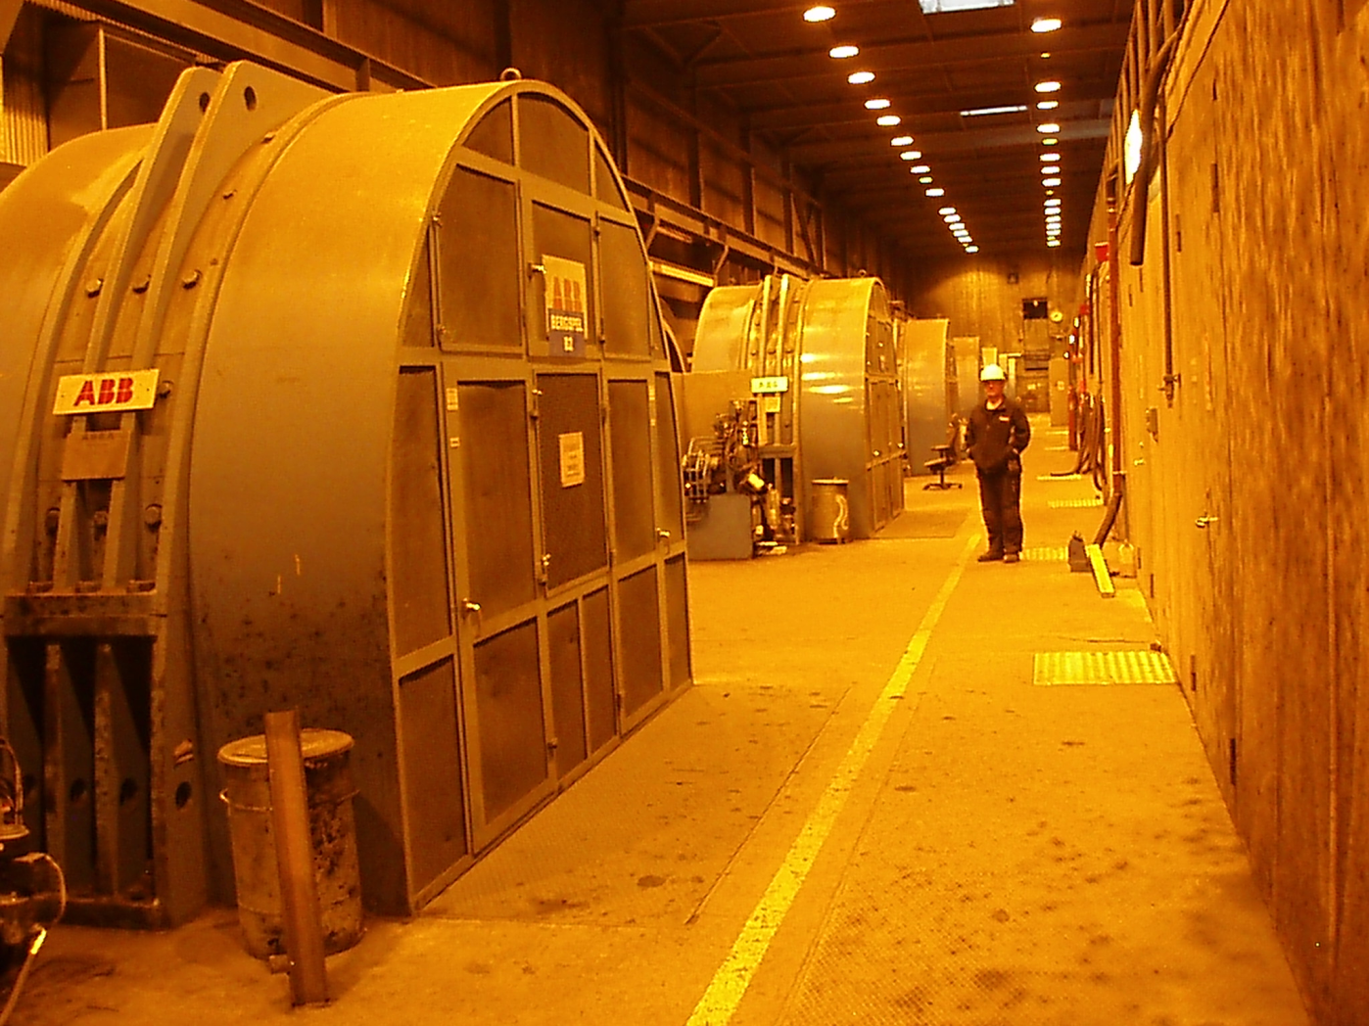
Hoist motors
MUKKA – SE – Session 2 – 0552

Slide 7
Load characteristics
Reactive Power per phase
MUKKA – SE – Session 2 – 0552

Slide 8
Load characteristics
Active Power per phase
MUKKA – SE – Session 2 – 0552

Slide 9
Limitations of the hoisting system
Large voltage variations and high harmonic distortion enforcing start of only one hoist motor at a time

Slide 10
Purpose of the SVC installation
Increase of production capacity by enabling simultanous start of 4 motors
Reduction of voltage variations
Reduction of harmonic distortion
MUKKA – SE – Session 2 – 0552

Slide 11
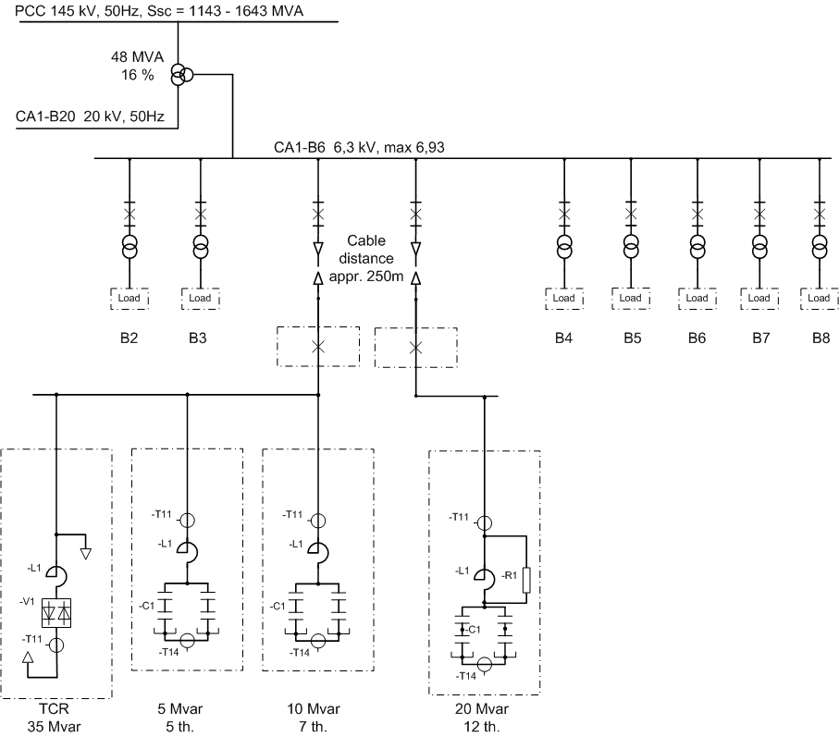
Selected SVC solution
MUKKA – SE – Session 2 – 0552

Slide 12
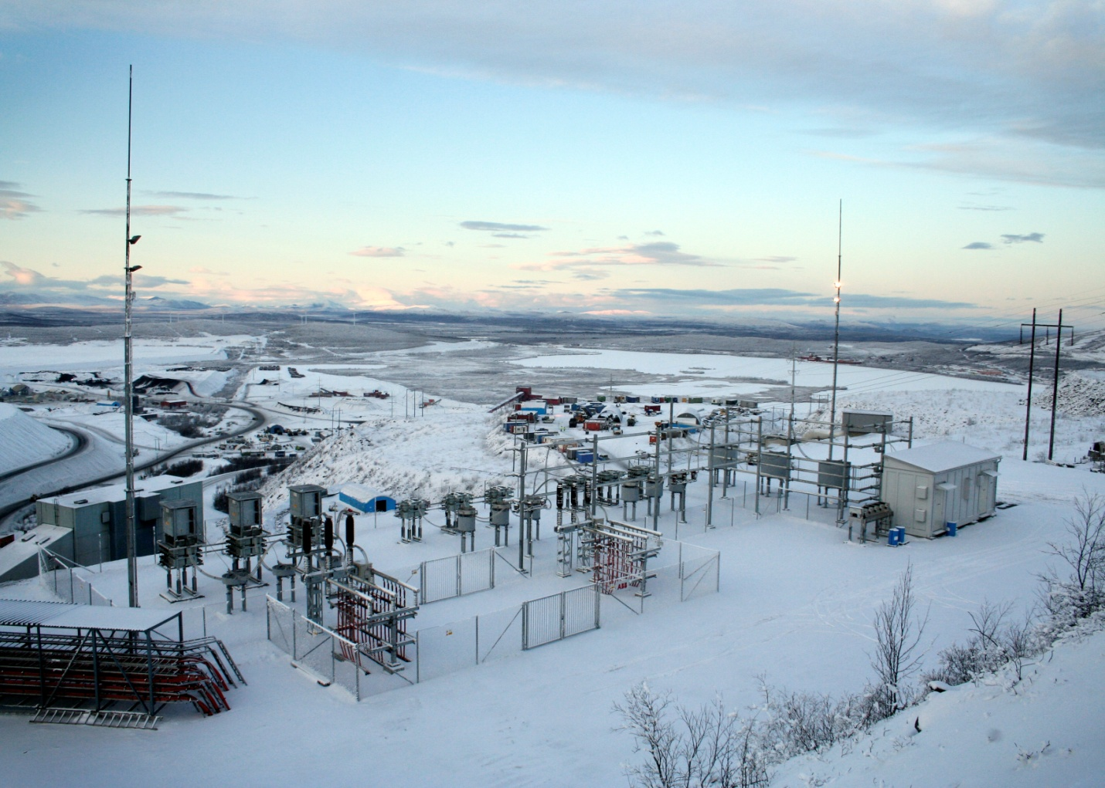
Selected SVC solution
MUKKA – SE – Session 2 – 0552

Slide 13
Special design considerations
Effect of long cables on filter tuning
Effects of temperature range –50/+40deg.C
Selection of air clearances and creepage distances with regard to ice, snow and air pollution

Slide 14
Performance tests
Measurements of:
Flicker
Voltage variations
Active power, Reactive power, Power factor
Harmonic voltage distortion
Transformer Fundamental- and Harmonic currents
Filter Fundamental- and Harmonic currents

Slide 15
Performance tests’ results
Active Power
Voltage variations
Reactive Power
Harmonic distortion

Slide 16
Performance tests summary (1)
Parameter
Limit
Result
Flicker
1,0
0,9
Max. voltage variations
3%
3%
Power factor
0,98
0,998
Voltage distortion UTHD
4,8%
3,2%
Individual voltage distortion, odd harmonics
<60% of compatibility limits acc. to EN 50160
< Limit
Individual voltage distortion, even harmonics
<60% of compatibility limits acc. to EN 50160
< Limit
Total current distortion ITHD
5%
2%
Individual current distortion
3%
≤ 1,6 %
6 kV bus bar

Slide 17
Performance tests summary (2)
Parameter
Limit
Result
Flicker
1,0
0,3
Max. voltage variations
3%
1,3%
Power factor
n.a
n.a.
Voltage distortion UTHD
1,5%
0,84%
Individual voltage distortion, odd harmonics
1,0%
0,75%
Individual voltage distortion, even harmonics
0,2%
0,05%
Total current distortion ITHD
5%
2%
Individual current distortion
3%
≤ 1,6 %
145 kV bus bar

Slide 18
Conclusions from the performance tests
The results of the verification measurements have proved that all performance requirements have been met or exceeded. It has been also verified that the ratings of the SVC and SVC components are correctly selected in order to withstand the fundamental- and harmonic load during the most severe operation conditions.

Slide 19
Operation experience
Voltage variations without SVC
due to 29 MW hoist load
Voltage variations with SVC
due to 33 MW hoist load
Result: 30% increase of hoist capacity

Slide 20
Thank you for your attention

