Slide 1
Finding maintenance project to priority
M.Sc. Terje Pynten,
Dr. Jan Andor Foosnæs,
M.Sc. Johan G Hernes,
M.Sc. Erling Tønne
NTE Nett AS
Paper 0696

Slide 2
Ageing of the power system
Installed MV lines per year
Presumptions:
Lifespan of lines ~ 40 år NTE Nett AS must replace 108 km/year.
Lines are replaced 1:1 This is a 400 % increase from today.

Slide 3
Wide and sparsely populated area
Number of customers per transformer
(cumulative distribution)
80 % of the transformers supplies less than 17 customers.
Approximately 19 customers per km MV line.

Slide 4
Efficiency
The annual income cap does not give good enough incentives to do reinvestments.
The network companies must be able to build more MV lines per Euro.
Simplifying the grid structure.
New technologies and new solutions
Choosing the right projects and implementing them in the optimum order.
Effective data acqusition and processing with quality and accuracy.

Slide 5
New technologies – new solutions
New and improved building material
  Reducing construction, maintenance and operation costs
New solutions
  Reduced operational costs
  More optimal usage of grid capacity / increased control of the power flow
  Improved state estimation
  Extended life span in parts of the network

Slide 6
Framework
Priority process
Typical parameters in the assessment process
Safety of supply
Regulatory requirements
Regulation of revenue
Terms of concession
Basis for decision making
Condition monitoring and inspections
Technical state / indicators
Fault and interruption statistics
Technical calculation / LCC
Climatic and environmental factors
Experience and local knowledge
Maintenance friendliness
New technology
Load composition
Costs of energy not supplied
Age
Aesthetics
Analysis methodology
Criteria:
  HSE
  Technical
  Risk
Technical and economic analyses
Decisions
Preventive maintenance
Expected corrective maintenance
Renewal / Reinvestments

Slide 7
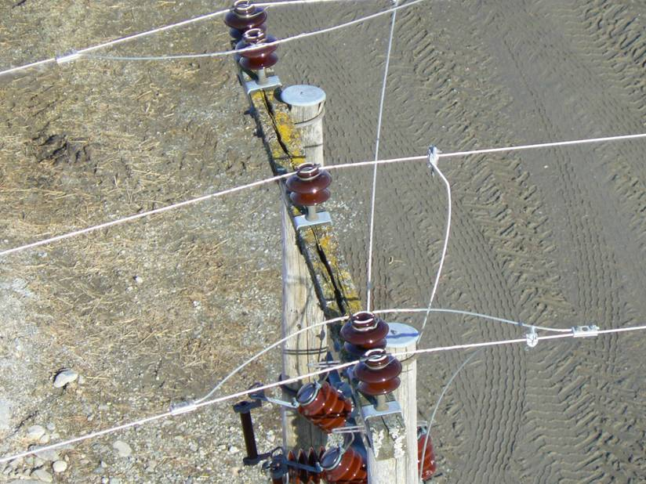
Data acquisition
Present:
Manual data acquisition/state estimation.
External resources are used.
Large variation in data quality (experience, character references and accuracy).
Future:
Smart technology (automatic data acquisition)
New methods
Photo of a rotten traverse taken from a helicopter

Slide 8
Smartgrid pilot in Steinkjer
NTE in partnership with The Norwegian Smartgrid Centre.
Main scope:
  To gain knowledge and practical experience by using smartgrid technologies to operate the energy system more effectively regarding:
    Economy
    System reliability
    Quality of delivery
    Occupational health and safety
    Environment, aesthetics

Slide 9
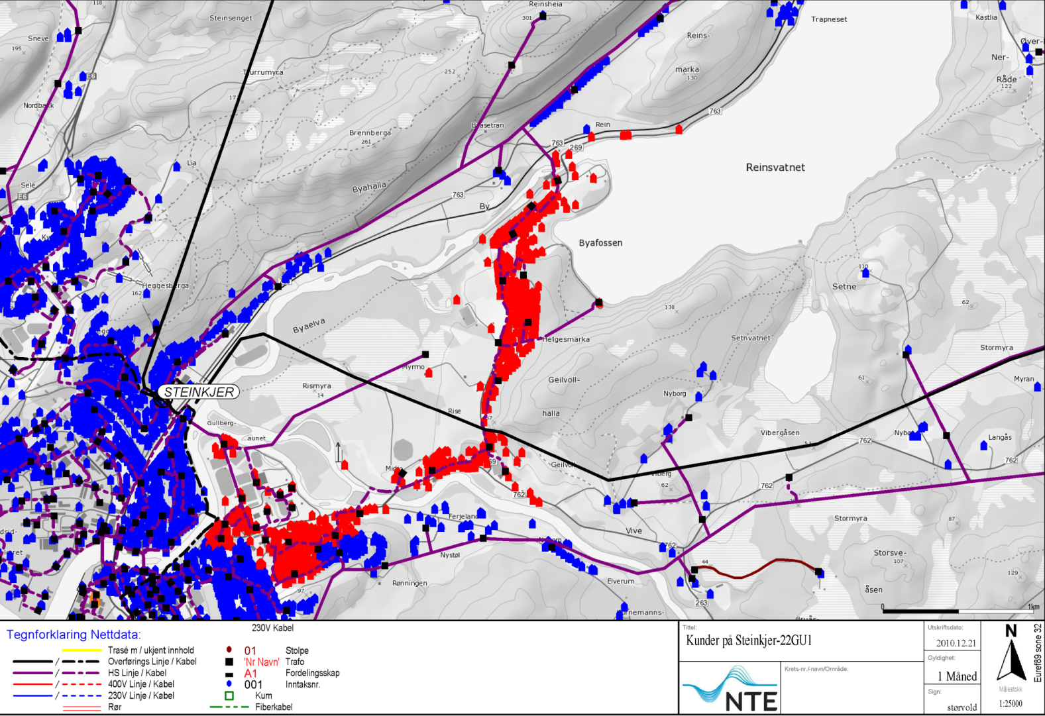
Smartgrid pilot in Steinkjer - Location
772 customer og 30 substations

