Slide 1
Evolutions in the Grid Operation
In Carinthia
Distribution Grid of Carinthia - Overview
Organization, Control Centre, Back Office
System Integration
Software Implementations
Ignaz Hübl – Austria – Session 3 – Paper 0358
Notes:
I will give you an overview where we are located - I’m sure everyone knows Carinthia
Then we take a look to understand our organization how to operate our grid.
The aims and system requirements are the next part of my presentation
And how we did implement this into a running system

Slide 2
380/220 kV Power Lines in Austria
CZ
Slavetice
Sokolnice
Pleinting
Bisam-
SK
Altheim
Pirach
Aschach
Dürnrohr
berg
Simbach
St. Peter
Wallsee
Etzersdorf
Kle-
WIEN
dering
Hausruck
ERNSTHOFEN
Ybbsfeld
SÜDOST
Györ
D
Salzach-Neu
Neusiedl
Györ
Memmingen
Salzach
Klaus
Obermooweiler
Leupolz
Pyhrn
Ternitz
Weißenbach
H
Zell am
TAUERN
Pongau
Hessenberg
Südburgenland
Meiningen
Ziller
Westtirol
Kaprun
Bürs
Hauptstufe
Oststeiermark
CH
OBER-
Kainachtal
Pradella
Lienz
Malta Hauptstufe
SIELACH
I
Soverzene
Maribor
KELAG Netz GmbH
Podlog
SLO
Ignaz Hübl – Austria – Session 3 – Paper 0358
Notes:
Here you can see the high voltage grid of Austria in the south there is the Province of Carinthia (now everyone knows).

Slide 3
Power Grid in Carinthia
Austria
Pongau
Centre of Operation
SALZBURG
Malta –
STYRIA
Oberstufe
Rennweg
Zirknitz
Feldsee
Innerfragant
St. Leonhard
Außerfragant
EASTTIROL
Reißeck
Malta –
Treibach
Wölla
Hauptstufe
Lieserhofen
Gurk
Wietersdorf
Wolfsberg
Malta – Unterstufe
Lieserbrücke
Radenthein
Kleinkirchheim
Lienz
Steinfeld
Spittal/Drau
St. Veit/Glan
St. Andrä
Oberdrauburg
Feldkirchen
Brückl
Kamering
Windischbach
Ettendorf
Würmlach
Landskron
Nord
Ost
Lassendorf
Völkermarkt
Obersielach
Tröpolach
Hermagor
Gummern
Kirchengasse
Schwabeck
Koralpe
Vorderberg
Seebach
Forstsee
West
Klagenfurt
Edling
Bleiburg
Lavamünd
Warmbad
Rosegg
Gailitz
Fürnitz
Siemens
Freibach
ITALY
St. Martin
Annabrücke
Klagenfurt
Feistritz
Ferlach
St. Margareten
Ignaz Hübl – Austria – Session 3 – Paper 0358
SLOVENIA
Notes:
In Carinthia we are operating the 110 kV grid down to MV and LV to the customers.
Our utility is divided into 6 Organization units responsible for mounting and maintenance and even to operate the MV and LV Grid in the past
The Control Centre, situated in Klagenfurt, only did operate the 110 kV Grid and the 110/20 kV Substations (about 50)

Slide 4
Organization Requirements
Centre of Operation
Centre of Control
Front Office
Back Office
Support Services
Crises Room
New Organization
Operation, Documentation
Ignaz Hübl – Austria – Session 3 – Paper 0358
Notes:
The Operation Centre is divided into 2 parts – control centre for monitoring and operation the grid in a 24/7 working shift
The back office to handle the calls from our customers in case of faults and to prepare a “switching letter” to operate in the front office.
This are only few examples what our employees are doing there.
For technical support we have our own support services
In case of crises or bigger disturbances in the power grid we established a separate room with all the infrastructure we need to coordinate the crew, to communicate with the media an so on.

Slide 5
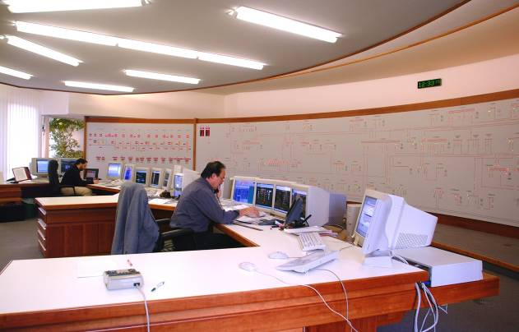
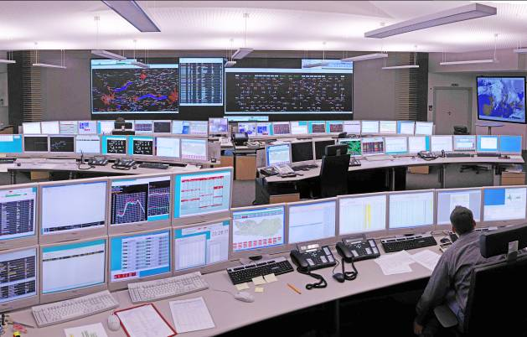
Control Centre at the KELAG Netz GmbH
Front Office
Old Control Centre
New Control Centre
Ignaz Hübl – Austria – Session 3 – Paper 0358
Notes:
The old control centre had an active wall to operate the circuit breaker in the 110/20 kV substations since 1996
In 2007 the new adopted control centre in the same room started with operation
We had to renew everything inside this room. Beginning with the switchboard to the acclimatization and all working desks and screens.
In the front we have a large screen to gif an overview and common information about the grid. Voltage, Frequency and the weather for example
All you can see here is build up in redundancy but also in back behind you cannot see.

Slide 6
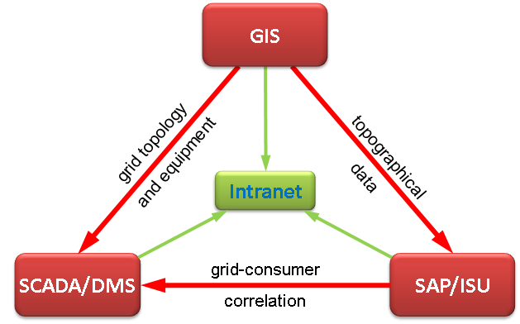
System Integration
Ignaz Hübl – Austria – Session 3 – Paper 0358
Notes:
At first we have a SCADA system with integrated DMS and OMS
The topology of the grid and all the equipment is imported from the GIS
The GIS is the base of all Grid-data and Transformer stations
The SAP/ISU is our financial program we get from there all consumer related data
Only for management information reports are generated and transferred to our intranet

Slide 7
Software Implementation
Import of GIS data into SCADA/DMS
GIS export, Tiling and incremental update
SCADA import, Graphic import
Schematization
Outage Management System
“switching letter” - ANOP
Reporting Systems, handover
Ignaz Hübl – Austria – Session 3 – Paper 0358

Slide 8
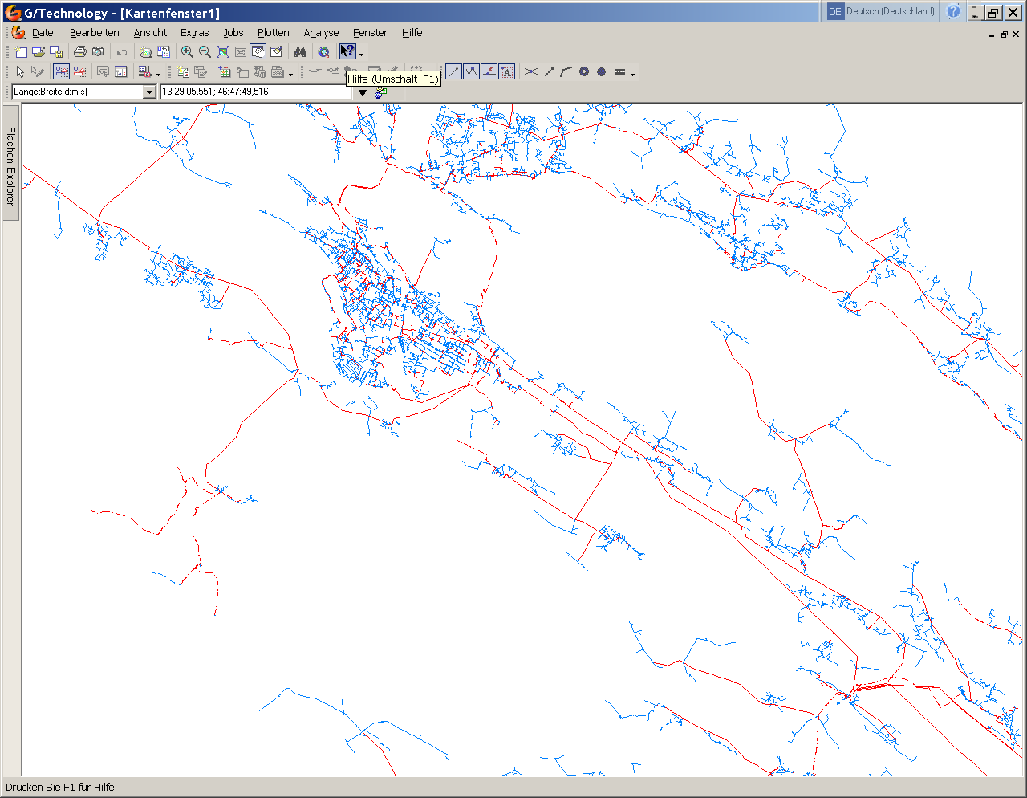
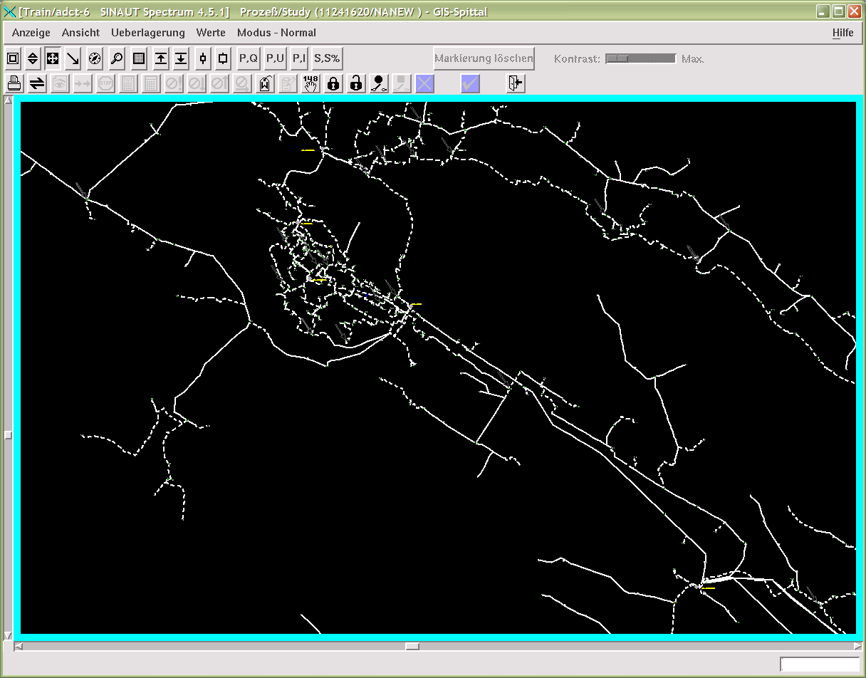
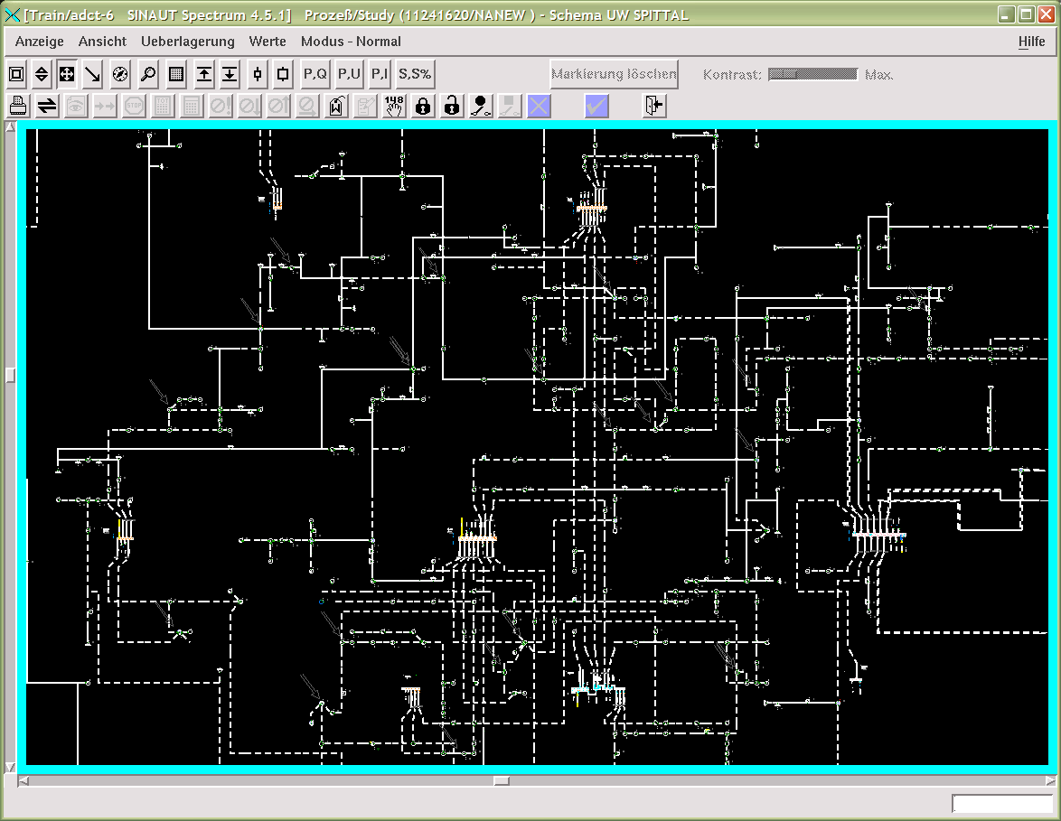
Data Import to SCADA/DMS
GIS
SCADA
SCADA
SCADA-
Import
Schematization
Ignaz Hübl – Austria – Session 3 – Paper 0358
Notes:
First it is very important to but in all data to the GIS. All devices must be connected in the physical right way.
The import of data from GIS to SCADA is an incremental import. To handle this very big volume of data and make it comfortable the hole grid is segmented in more than 300 tiles. The comparison between the data of the existing file and the new generated file is setting a flag for the incremental update.
One time a week data from GIS are imported to SCADA, Geographic few and the second few is the schematic MV grid – first in the testing system – before setting in operation.

Slide 9
Conclusion
Project Aims
Organization
Rebuilding the Control Room
System Integration
Software Implementation
Outage Management System
Reporting System
Fault location
SCADA/DMS
Ignaz Hübl – Austria – Session 3 – Paper 0358
Notes:
To realize a new system to operate the grid and all other needs of our utility we had to fix the project aims.
First we saw that we must reorganize some parts in our utility to get a high quality documentation of the grid and all the equipment.
We had to rebuild the control room to realize all hardware requirements of a new system.
The next step was how to integrate all used systems to one optimized operating system.
The need we had where software implementations and interface programs.
The result is one system to operate all our requirement - first we can operate our HV and MV-grid as before.
But we had to learn how to use all the new functions in a 24/7 working-shift.
Beside all other requirements we should not forget the basic requirement how to handle disturbances and faults in our grid - SCADA/DMS
Now we have a very powerful system but the requirements did grow with the system, therefore the evolution did not stop now.
But I must stop with my presentation and thank you for your attention.

Slide 10
Thank you for your Attention
Ignaz Hübl – Austria – Session 3 – Paper 0358

