Slide 1

Broadband wireless connectivity in automation and remote control of the DSO infrastructure
Fiorenza – IT – S3 – 0471

Slide 2
Enel Distribuzione data trasmission network background (SCADA and AMM)
Enel-Cisco Smart Grid Pilot Project:
    building a new TLC infrastructure in the MV grid
    transparent trasport/traslation of SCADA protocols over the new IP network
    integration of a new IP sensor in the grid
Pilot Project Results
Fiorenza – IT – S3 – 0471

Slide 3



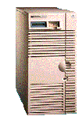
The current Enel data network and SCADA application
Control Center
L.V. customers
STM (SCADA)
M.V. customer
GSM e POTS
modem
PS A
UP (RTU)
SS1
SS2
SS3
SS4
WAN
SAT o ISDN
PS B
UP (RTU)
SS1
SS2
SS3
SS4
TPT2K (RTU)
M.V. producer
Fiorenza – IT – S3 – 0471

Slide 4
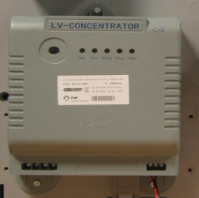

The current Enel data network for AMM
AMM (Automatic Meter Management)
GSM/GPRS
PSTN
MV/LV
Concentrator
DLC 2.4 Kbps
Meters
Total: 350.000
Total: 32,5 Milioni
Fiorenza – IT – S3 – 0471

Slide 5
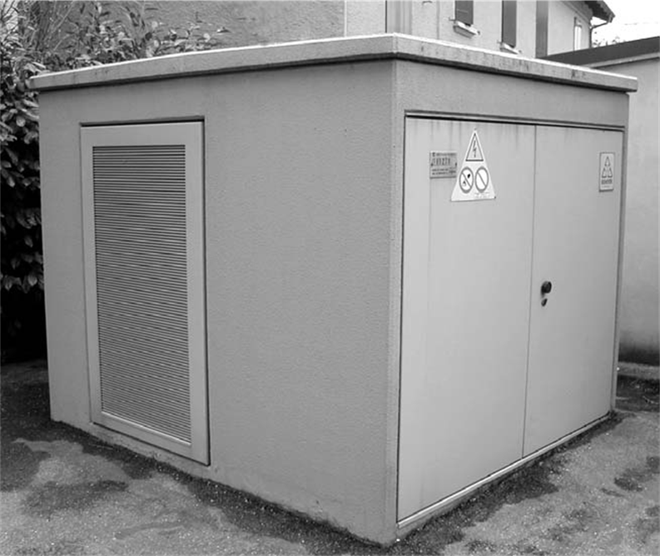
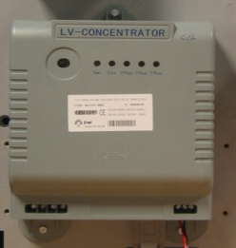
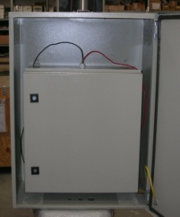
Devices in Enel Secondary Substations (AS IS)
LVC
modem #1
UP
GSM/GPRS
PSTN
modem #2
RGDAT
The total of SS is 400,000
LVC (AMM concetrator) is
in 350,000 CS
UP (RTU for MV) is in 100,000 SS
Line
Modules
Fiorenza – IT – S3 – 0471

Slide 6
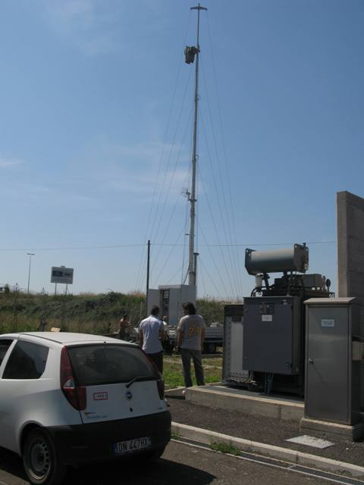
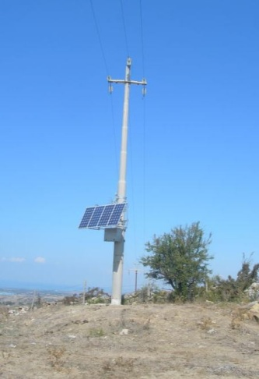
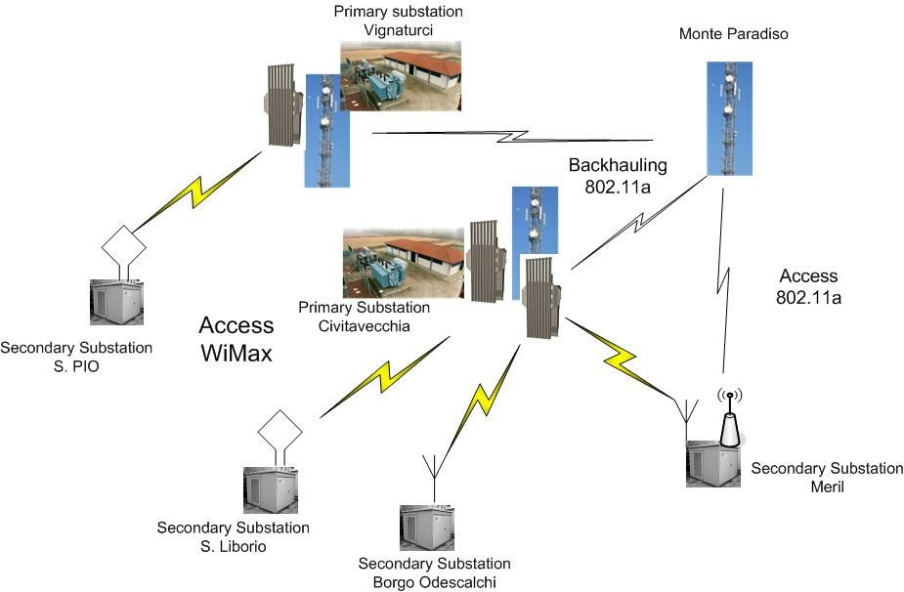
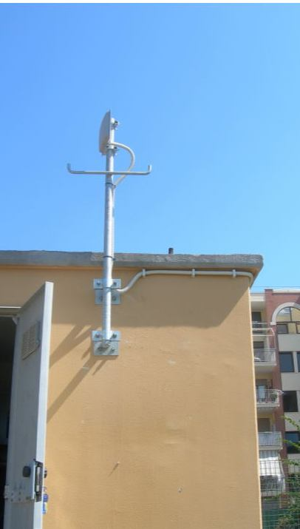
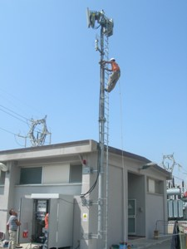
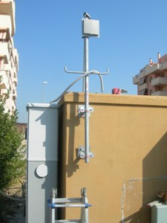
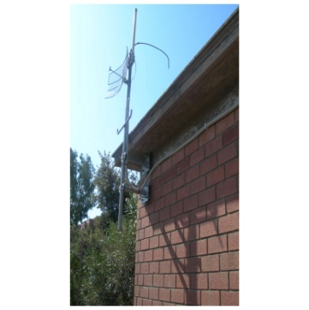
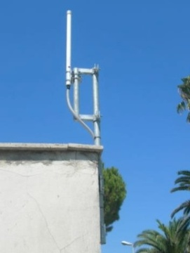
ENEL-CISCO Pilot SmartGrid: installation in Civitavecchia
Fiorenza – IT – S3 – 0471

Slide 7


ENEL-CISCO Pilot SmartGrid: new equipments in SS
router serial connection
LVC
Hyperlan, WiMax
WAN
(TCP/IP)
router ethernet connection
IP RGDAT
router serial
connection
Line
Modules
UP
Router replaces two different modems
Introduction of IP Sensor (IP RGDAT) for data acquisition (by router) of signals and measures.
Transformation of current “wired link communication” of SS into a LAN based on Ethernet technology!
Fiorenza – IT – S3 – 0471

Slide 8
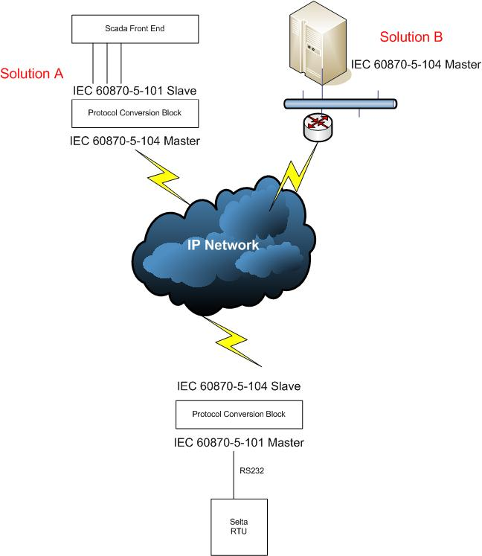
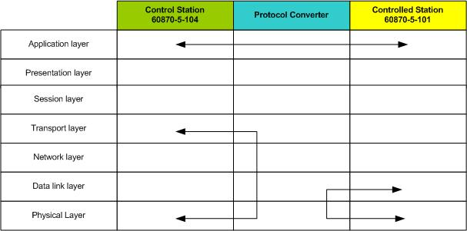
ENEL-CISCO Pilot SmartGrid: transparent transport and translation of ENEL SCADA protocol
CISCO BSTUN offers the trasparent transport of the current IEC 60870-5-101 byte stream between RTUs and SCADA
A new CISCO IOS experimental release on the routers provides protocol conversion 101/104
Fiorenza – IT – S3 – 0471

Slide 9
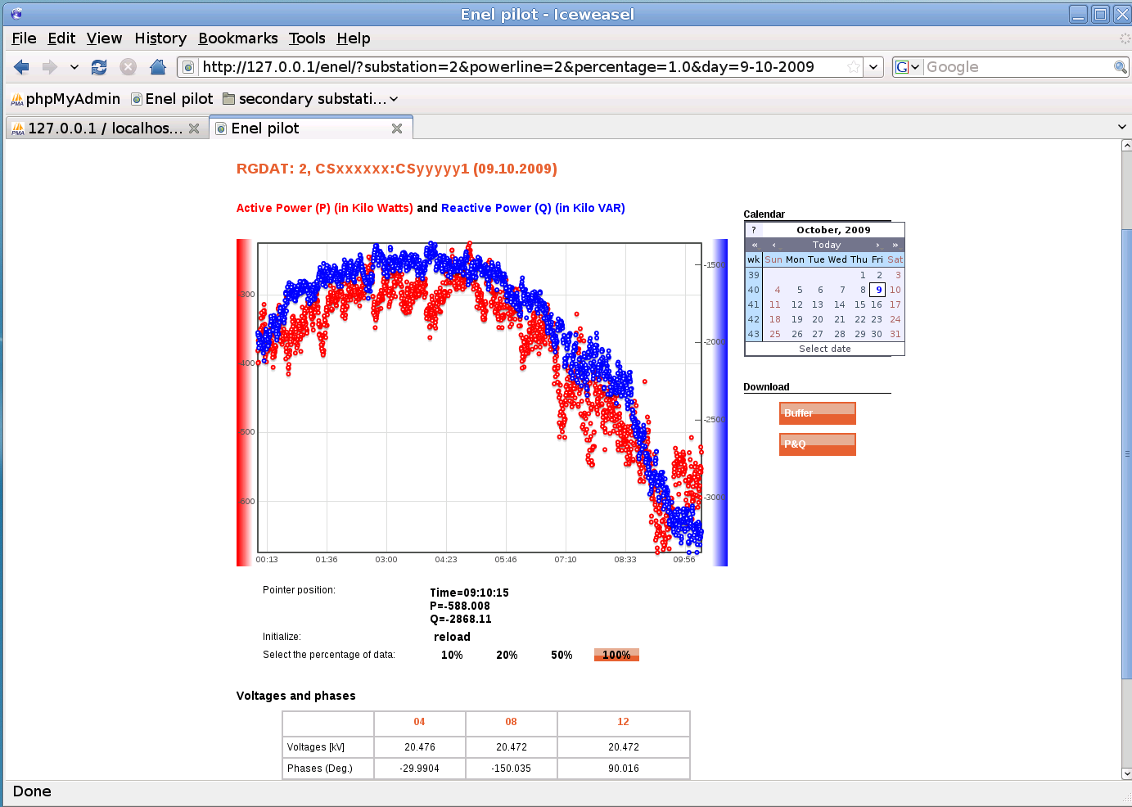
ENEL-CISCO Pilot SmartGrid: the prototype of IP sensor for the MV grid
The current ENEL fault detector (RGDAT) was equipped with a daughter-board to enable 104 communication with CISCO router.
All the RGDAT signals and measurements were available to the router for the network transmission.
CISCO IOS experimetal release was able to store and correlate electric measurements.
Fiorenza – IT – S3 – 0471

Slide 10
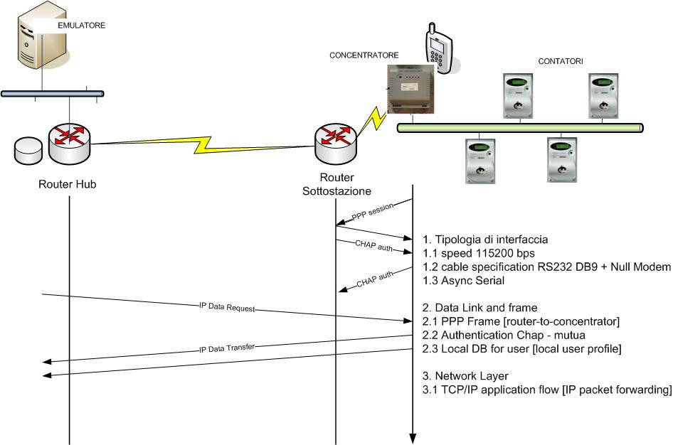
ENEL-CISCO Pilot SmartGrid: the new IP network for the current AMM system
Fiorenza – IT – S3 – 0471

Slide 11
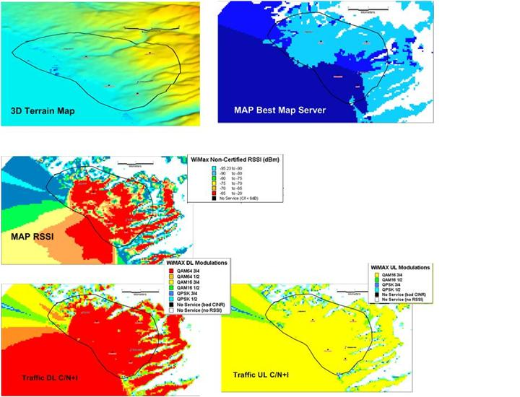
ENEL-CISCO Pilot SmartGrid: results about WiMax
Radio Planning and field tests show us:
current radio (3.5 GHz) coverage is 2.3 km² per single cell in urban environment
some hundreds (from 200 up to 400)* Secondary Substations per BTS could be connected
* RF design based on outdoor CPE (13dBi) at 3 m of height and results referred to outdoor coverage
Fiorenza – IT – S3 – 0471

Slide 12
ENEL-CISCO Pilot SmartGrid: performance testing of the network on WiMax infrastructure
Network Performance Tests have been focused on:
  - network availability
  - latency
  - throughput
PS-SS link | requirement | result
throughput | 128 kbps | met
RTT | 300 ms | from 49 to 115 ms
jitter | Minimum (computation) | from 8 ms DOWN to 50 ms UP
P2P on meshed grid (stronger RTT) | < 120 ms (60 ms one way) | met
of the link between Primary and Secondary Substation.
Fiorenza – IT – S3 – 0471

Slide 13
ENEL-CISCO Pilot SmartGrid: conclusions
Ethernet as a reliable technology in harshed environment through on field tests.
WIMAX as a great opportunity to have a large and distributed broadband connectivity in the field. Performance and availability meet ENEL AMM and SCADA needs.
The IEC 60870-5-101 protocol between Enel SCADA and MV RTUs was
- transported (CISCO BSTUN) trasparently on the IP network
- converted by the routers into T104.
The first successfully experimental attempt to find synergies among communication equipments and electric equipments.
Fiorenza – IT – S3 – 0471

Slide 14
…thank you for your attention!...
…and special thanks to
Mr. Tullio Zannoni
Mr. Michele Festuccia
and the whole ENEL-CISCO Team!
Fiorenza – IT – S3 – 0471

