Slide 1
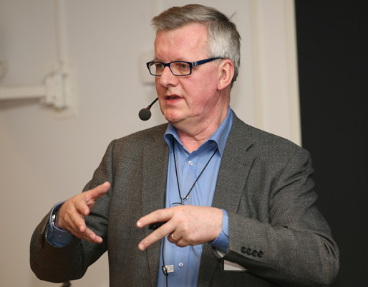
Experience from construction of a Smart Grid RD² Platform
Agenda
Background
System Design
Experience
Future work
Henrik Stomberg– Sweden – Session No 4 – Paper No 0325

Slide 2
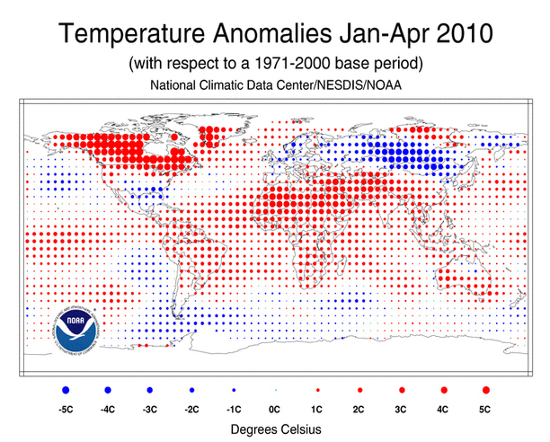
Background
NOAA National Oceanic and Atmospheric Administration

Slide 3
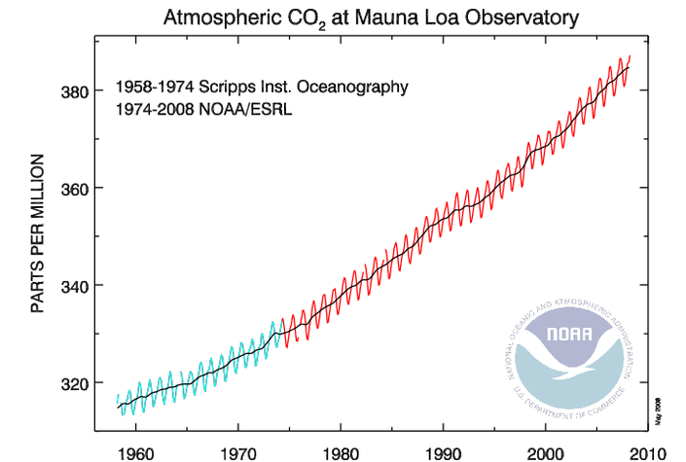
Background

Slide 4
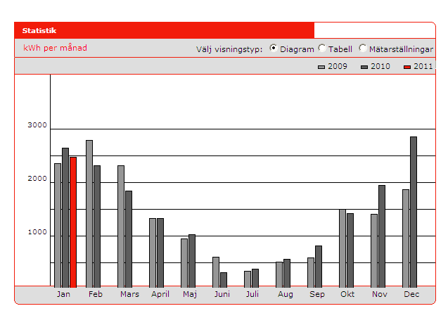
Background: Power consumption pattern in private residence

Slide 5
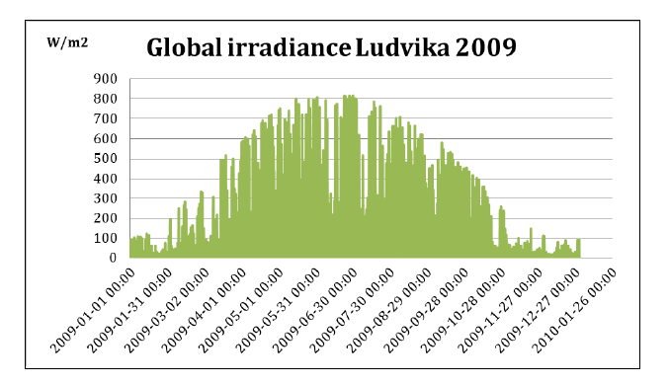
Background: Global irradiance, Ludvika, Sweden

Slide 6
Experience from construction of a Smart Grid RD² Platform
Agenda
Background
System Design
Experience
Future work
Henrik Stomberg– Sweden – Session No 4 – Paper No 0325

Slide 7

VINNOVA is a Swedish government agency
under the Ministry of Enterprise, Energy and Communications and the national contact agency for the EU Framework Programme for R&D

Slide 8







Project: Smart Grid Energy Storage
Solutions for optimized control in real time
of distributed renewable power production,
storage and demand response

Slide 9
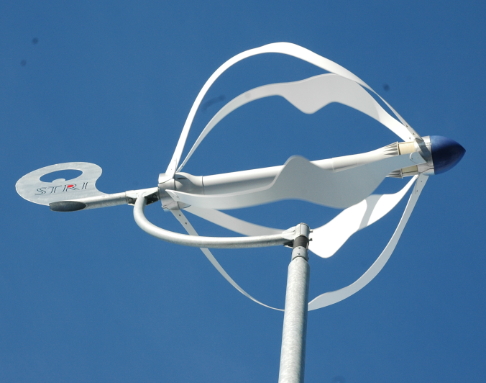
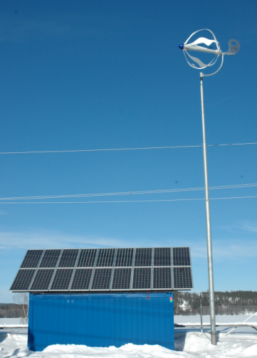
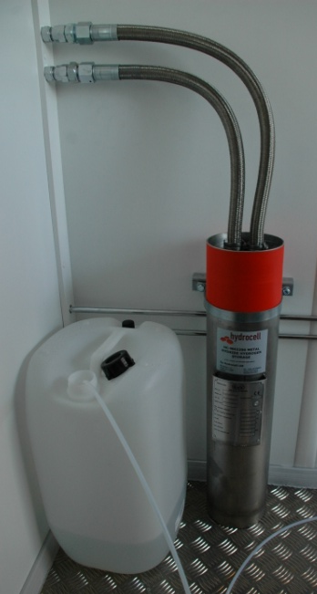
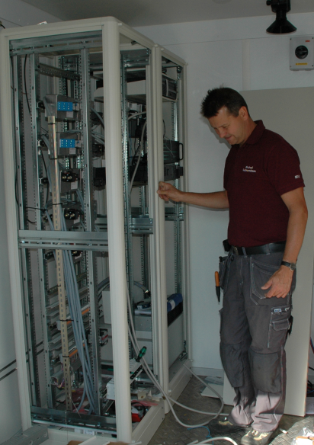
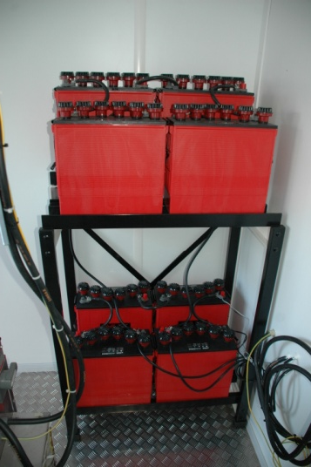
Energy storage & Control

Slide 10
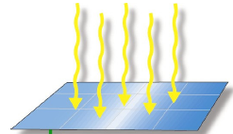
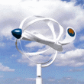
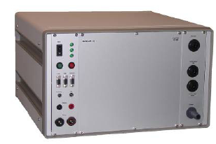
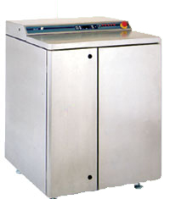
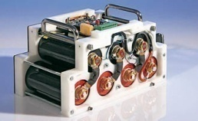
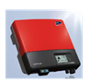
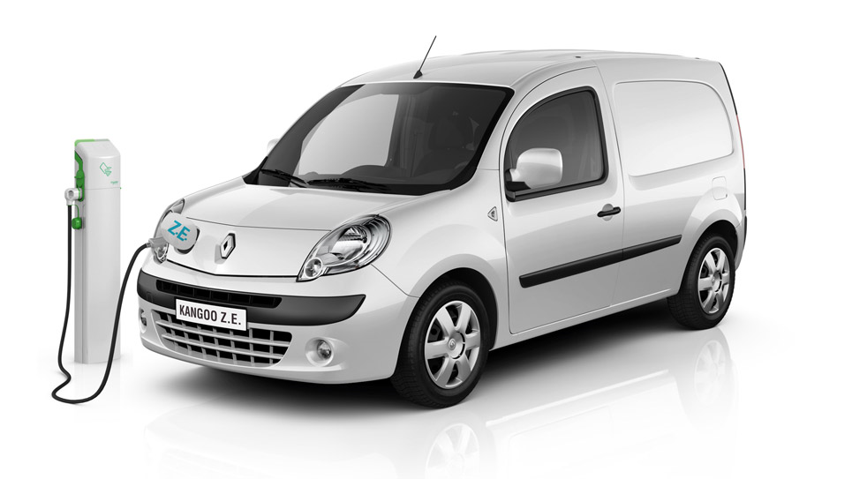
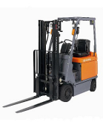
System Design, STRI Smart Grid RD²
Wind
Solar
Fuel cell
H₂electro- lizer
Battery
Capacitor
2 kW 3 kW 2 kW 1kW
48 V DC
Converter
Meter
230 VAC
AC system
eCar charg.
H₂fill.
Truck charger
STRI 380 V
PQuality

Slide 11
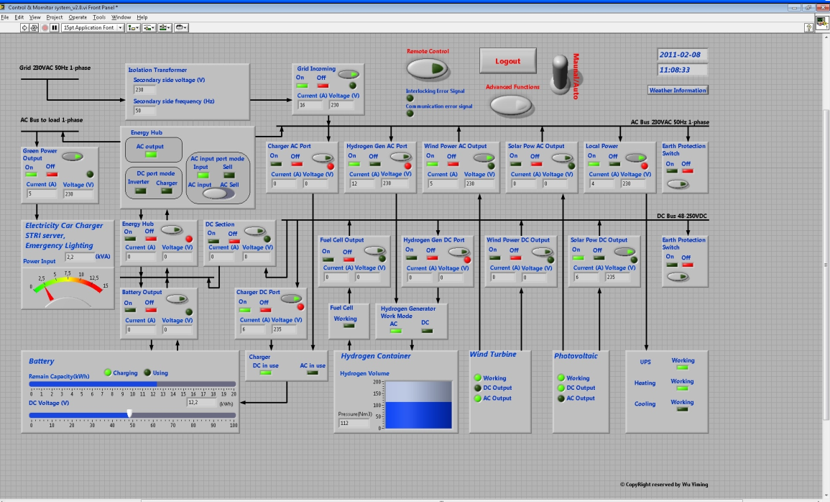
“Cell Agent” LAB View Supervisory CS

Slide 12
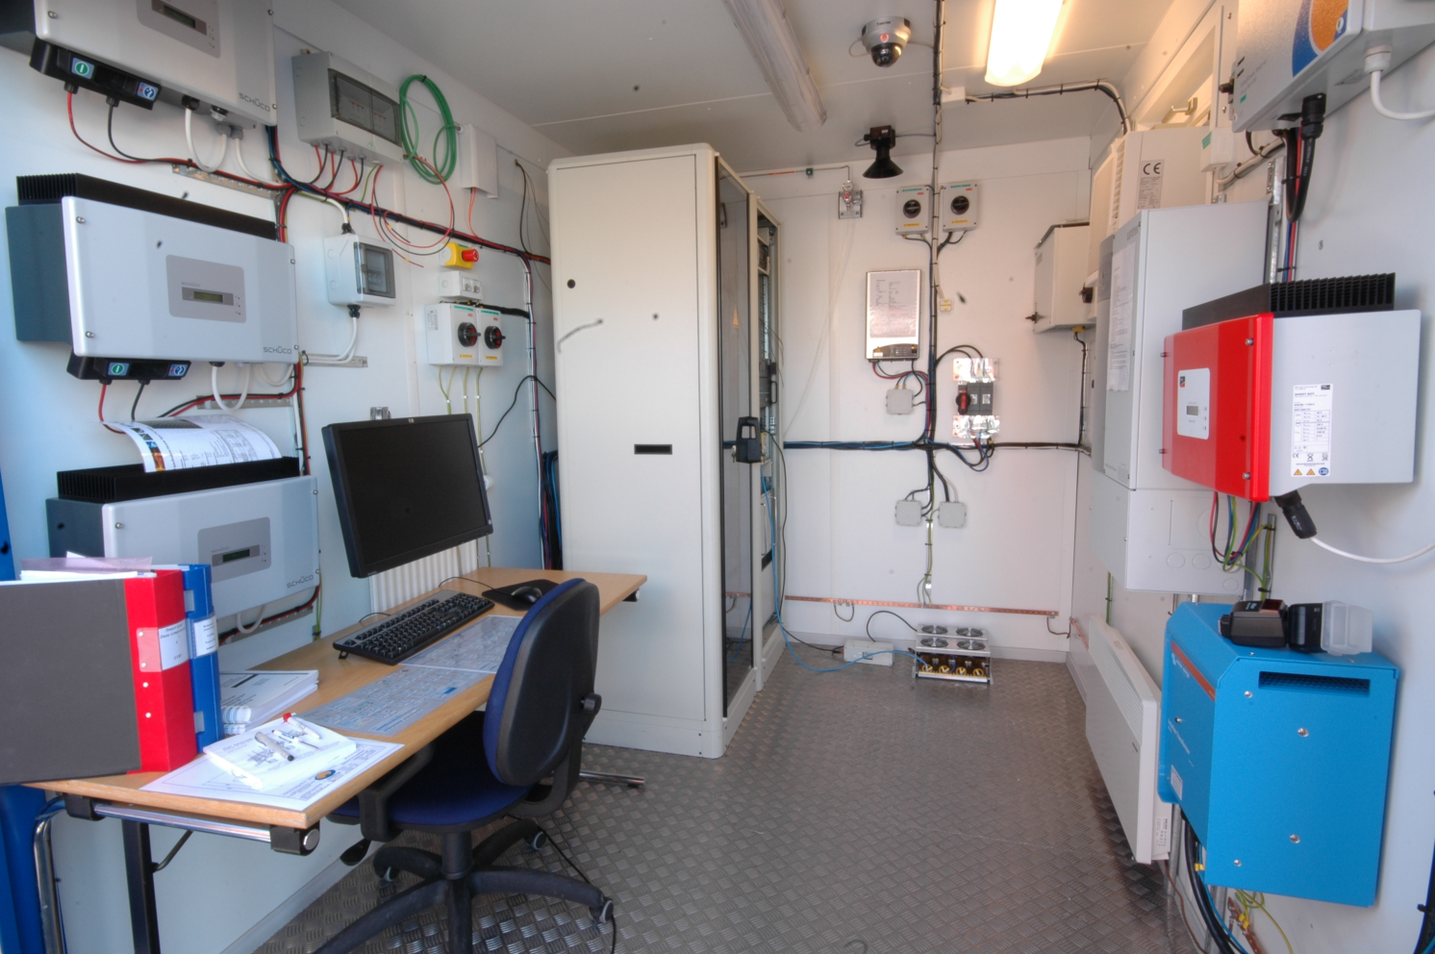
CCR – Container Control Room

Slide 13
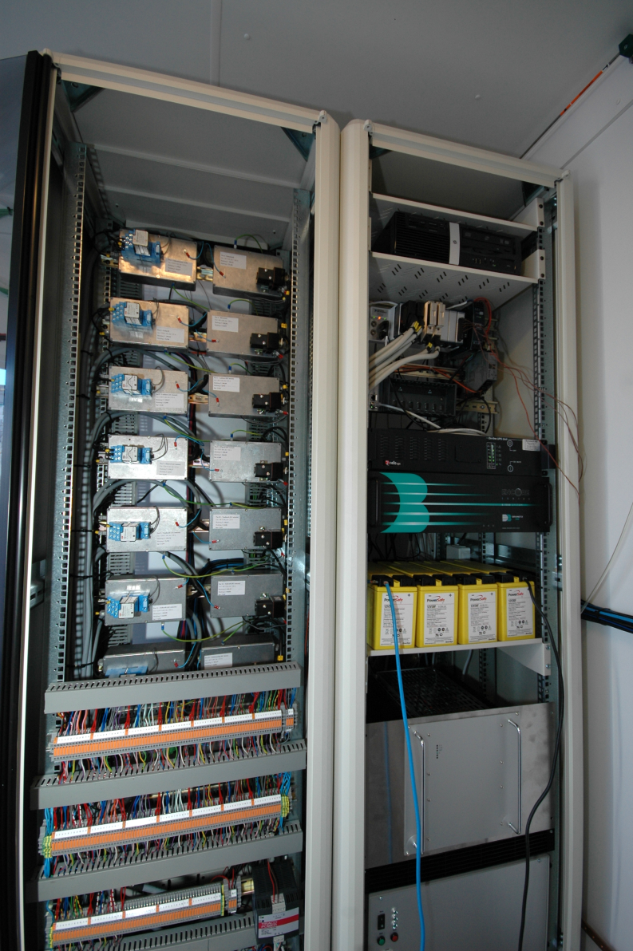
Control Modules and Control System
- Combined switching and measuring control modules (CM) (left)
- Computer for the control system (right)

Slide 14
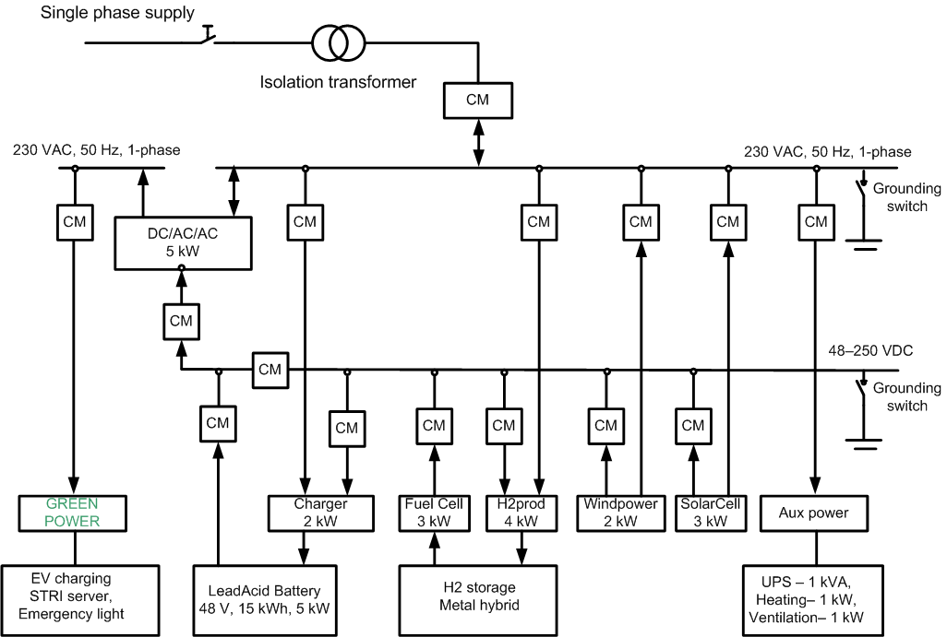
Single line diagram RD²

Slide 15
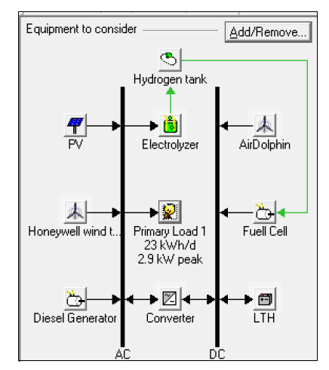
Homer optimization model
Hourly consumption
Hourly production
Monthly consumption
Monthly production

Slide 16
System Design for the RD²
Grid-connected to a 10 kV/380 V multi-vender IEC 61850 station
Standardized communication and control of the RD²
AC and DC bus system backbone
Remote operated AC/DC switch and measurement sensors
Ethernet communication

Slide 17
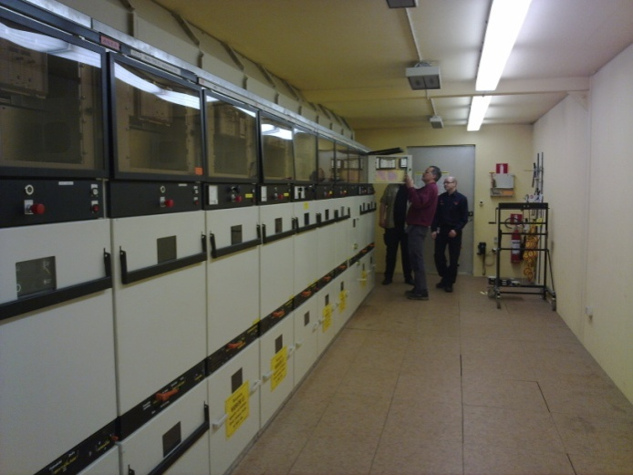
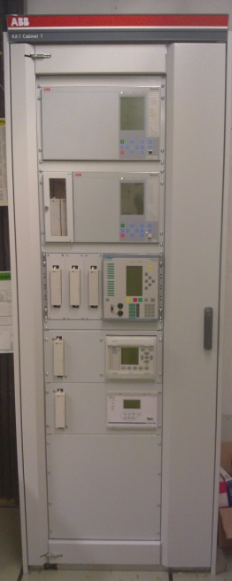
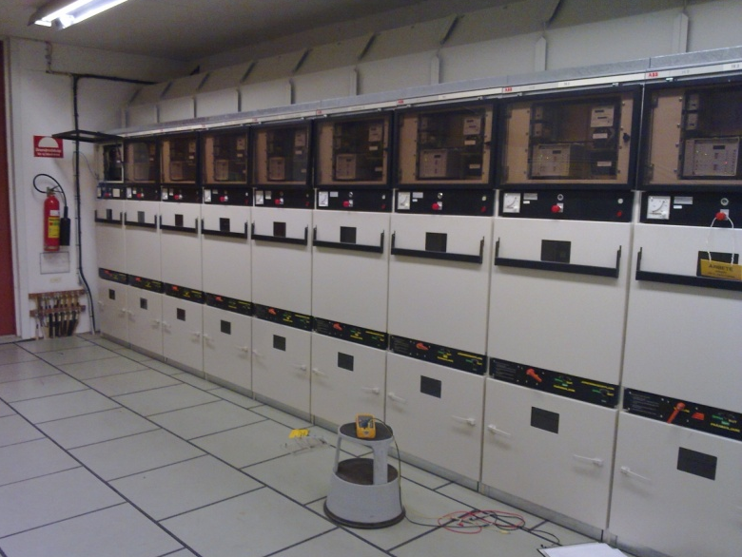
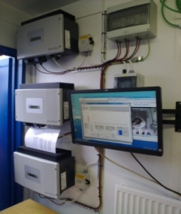
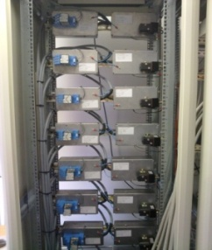
STRI Active Substation
11 cubicles 10 kV switchgear
Integrated protection and control
IEC 61850 from 4 suppliers
Max 4 cells each for the IEDs (Intelligent Electronic Device)
Connected to the control system for local production and storage of energy
Analog values from the supply
station via IEC 61850-9-2

Slide 18
Experience from construction of a Smart Grid RD² Platform
Agenda
Background
System Design
Experience
Future work
Henrik Stomberg– Sweden – Session No 4 – Paper No 0325

Slide 19
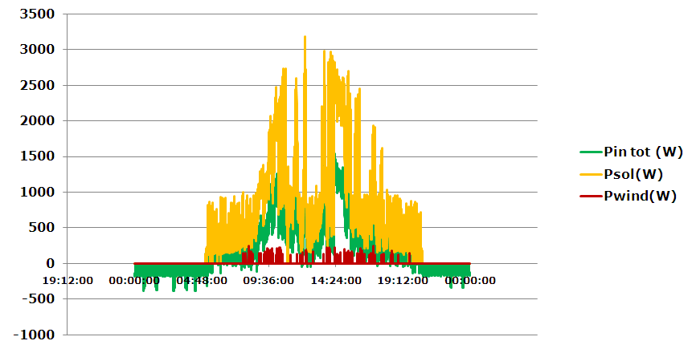
Power generation during 24 hours

Slide 20
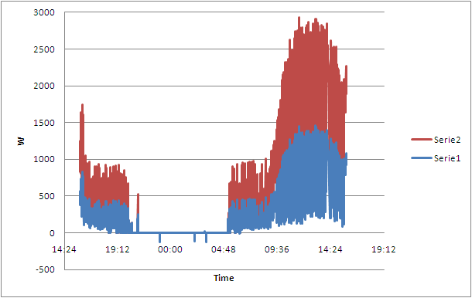
Power generation during 24 hours
Serie 2 = PV power (W), Serie 1= Power delivery (W)

Slide 21
Our experience are to:
Specify the application and load
Decide DC and/or AC Bus
Communication standard decition
Use Standarized equipment
Optimize energy storage system; (battery, H₂, Fly-Wheel, biogas etc.)
Energy conversion optimization
Measuring equipment and software

Slide 22
Experience from construction of a Smart Grid RD² Platform
Agenda
Background
System Design
Experience
Future work
Henrik Stomberg– Sweden – Session No 4 – Paper No 0325

Slide 23
Future work
Power Quality measurements
Energy storage test bench
Microgrid and virtual power plant
Interuniversity cooperation
Optimized solutions for DER and energy storage
Applications for residentials, office, shopping centers, regions etc
Verification of communication
Develpment of software forMicro Grid CA Controller
Development of algoritmes for the operation

