Slide 1
ENERGY RESOURCES SCHEDULING IN COMPETITIVE ENVIRONMENT
Authors
Zita Vale, Hugo Morais, Narciso Pereira
Presenter
Bruno Canizes
hgvm@isep.ipp.pt
Hugo Morais – Portugal – Session 4 – 0810

Slide 2
Outline
Introduction
SmartGrids
Players Negotiation
Case Study
Conclusion
Hugo Morais – Portugal – Session 4 – 0810

Slide 3
Introduction
Increasing use of distributed generation units
Demand response consideration
Operation in the scope of competitive electricity markets
Important changes in the way that power systems are operated
Hugo Morais – Portugal – Session 4 – 0810

Slide 4
Introduction
New distributed resources require an entity capable to make them able to participate in electricity markets
Virtual Power Player (VPP)
Hugo Morais – Portugal – Session 4 – 0810

Slide 5
Introduction
Manages the resources of producers and costumers
Consider all the business opportunities available to their resources
Considering all the relevant players
Market and/or other VPPs
Accomplish their goals
Hugo Morais – Portugal – Session 4 – 0810

Slide 6
SmartGrids
Extremely important for the future power systems
Smart grids aim at providing an adequate infrastructure
New Grid Management Players
New Business Opportunities
New Energy Resources
New Operation Methodologies
Hugo Morais – Portugal – Session 4 – 0810

Slide 7
PLAYERS NEGOTIATION
Energy Resources Management
VPPs Negotiation
Electricity Market
Hugo Morais – Portugal – Session 4 – 0810

Slide 8
Energy Resources Players Management
Hugo Morais – Portugal – Session 4 – 0810

Slide 9
VPPs Negotiation
Hugo Morais – Portugal – Session 4 – 0810

Slide 10
Electricity Market - MASCEM
Hugo Morais – Portugal – Session 4 – 0810

Slide 11
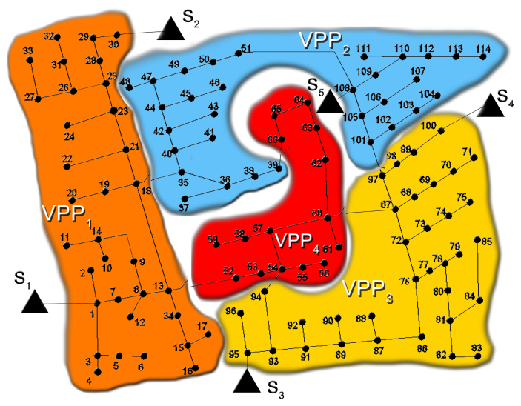
Case Study
114 Bus
97 DG units
84 Loads
9 Storage
Hugo Morais – Portugal – Session 4 – 0810

Slide 12
Case Study
 | No. Load | No. DG | No. Storage | No. Bus | Substations | Interconnections
VPP 1 | 23 | 27 | 2 | 34 | S₁ e S₂ | VPP2; VPP4
VPP 2 | 24 | 25 | 2 | 31 | S₅ | VPP1; VPP3; VPP4
VPP 3 | 25 | 28 | 1 | 34 | S₃ e S₄ | VPP2; VPP4
VPP 4 | 12 | 17 | 4 | 15 | ---- | VPP1; VPP2; VPP3
Hugo Morais – Portugal – Session 4 – 0810

Slide 13
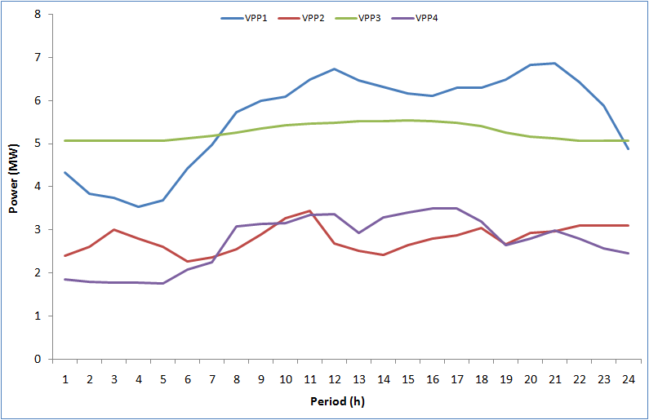
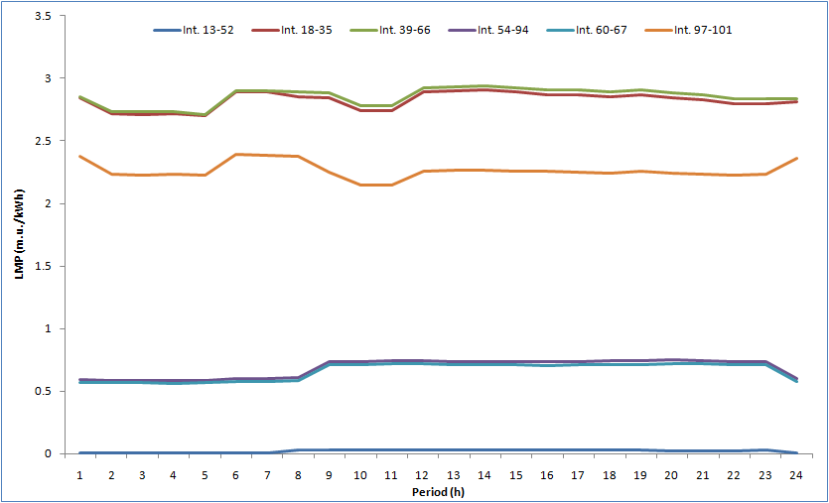
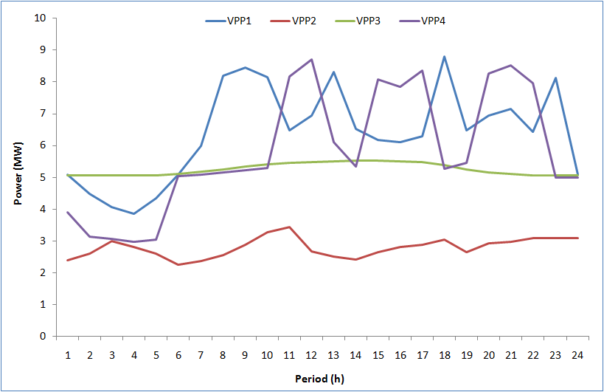
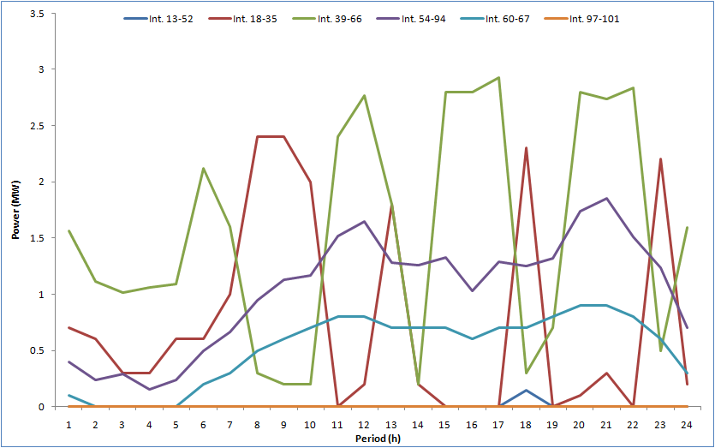
Initial VPPs generation resulting
ΔLMP after energy resources management process
VPPs generation after VPPs negotiation
Interconnections load flows
Hugo Morais – Portugal – Session 4 – 0810

Slide 14
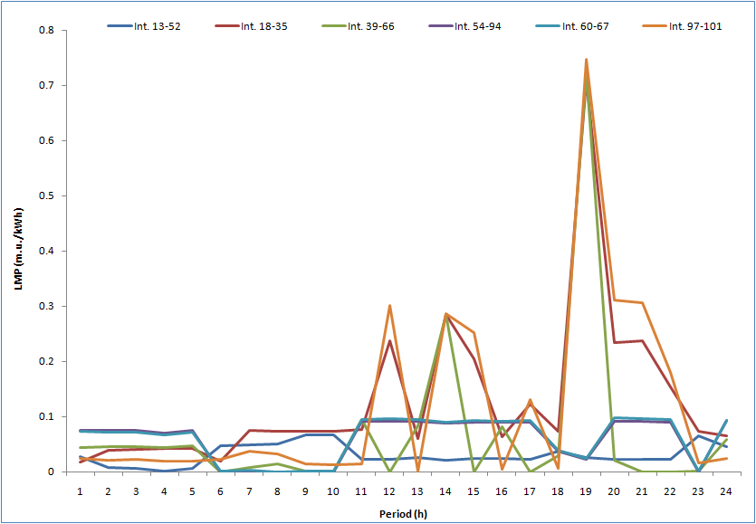
Case Study
ΔLMP after VPPs negotiation
Hugo Morais – Portugal – Session 4 – 0810

Slide 15
Conclusion
Each player has different generation resources and different operation strategies.
Consider a complex and realistic environment of dynamic and competitive/collaborative nature.
New light on the ways in what the players can use the new opportunities in the context of future SG.
Hugo Morais – Portugal – Session 4 – 0810

Slide 16
ENERGY RESOURCES SCHEDULING IN COMPETITIVE ENVIRONMENT
Thank you !
Authors
Zita Vale, Hugo Morais, Narciso Pereira
Presenter
Bruno Canizes
hgvm@isep.ipp.pt
Hugo Morais – Portugal – Session 4 – 0810

