Slide 1
FLEXIBLE THERMAL LOAD MANAGEMENT FOR ANCILLARY SERVICES MARKET: EXPERIENCE OF SWISS SMART GRID PILOT PROJECT
Elvira Kaegi¹ Daniel Berner² Adrian Peter²
¹ Neo Technologies SA – Switzerland
² BKW FMB Energie AG – Switzerland
Elvira Kaegi – Switzerland – Session 4 – Paper 0481

Slide 2
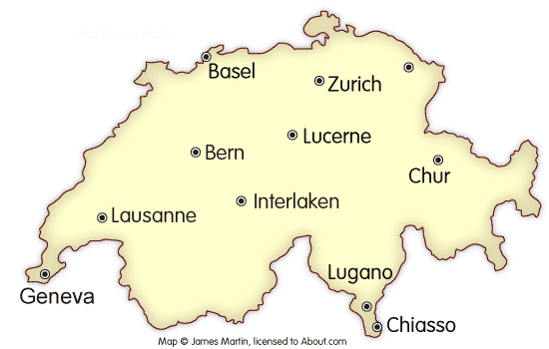
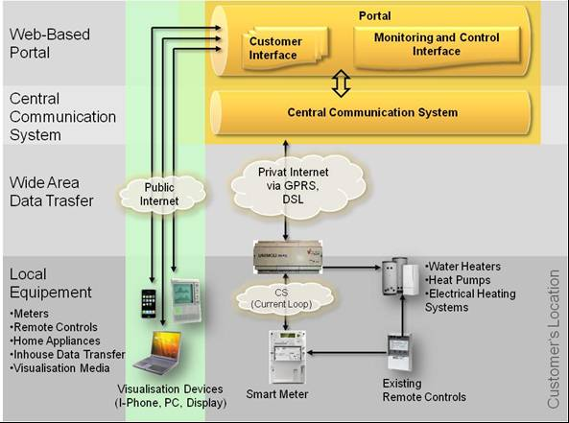
Smart Grid Pilot-Project iSMART
Project-Leader: BKW
Regional Power Supply Company of Cantons Bern and Jura, Switzerland.
Participants:
200 residential customers.
Time-horizon:
2010-2012.

Slide 3
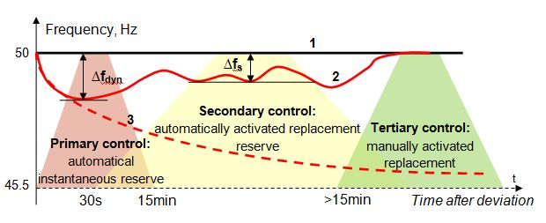
Product FLEX: loads provide ancillary services
Scope:
flexible dispatch of thermal loads (water heaters, heatings, heat pumps) in order to provide tertiary control on demand of ISO (Swissgrid)
Elvira Kaegi – Switzerland – Session 4 – Paper 0481

Slide 4
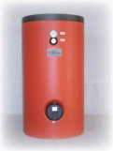
Participation in Swiss Tertiary Reserve Market
Qualification criteria for Pool- Tertiary Reserve Provider of Swissgrid:
Minimal power: ±1MW
Bid blocks: 6 fixe blocks of 4 hours
(0:00 – 4:00 – 12:00 – 16:00 - 20:00 – 24:00)
Request: anytime during a bid block (per mail/phone)
Duration: on request till the end of the block
Potential BKW:
Power drawn by water heaters 140 MW x 8 h=1120 MWh Now: fixed time-frame ripple control group switching
Flexible use allows for 1120 MWh/24h= 47 MW / hour
Elvira Kaegi – Switzerland – Session 4 – Paper 0481

Slide 5
Smart Grid Approach to Thermal Appliances Management
Pilot installation conditions:
No change in existing internal appliance controlling (thermostat-controlled Water Heater operation)
No temperature measurements
Low tariff forced for commutations during the HT time periods
State Estimation-Based Control
For 50 Pilot domestic Water Heaters:
50 x 5kW = 250 kW
Practical availability assumption: about 10-100 kW
Elvira Kaegi – Switzerland – Session 4 – Paper 0481

Slide 6
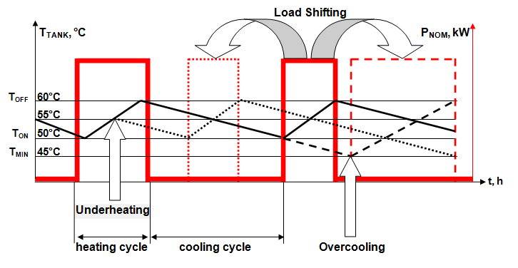
Water heater Load Control Principle
The heating / cooling cycle duration of Water Heater is modified resulting in different Tertiary Reserve Potential
Elvira Kaegi – Switzerland – Session 4 – Paper 0481

Slide 7
Definition of Tertiary Reserve Potential
Tertiary Reserve Potential is defined as forced power consumption reduction or increase during requested time interval without comfort reduction of the appliance owner (residential water heater user)
This potential depends on:
Water-Heater Hysteresys: T_{min ON} ≤ T(t) ≤ T _{OFF}
Definition of minimal water temperature T_{min}
Individual hot water usage patterns
Learning phase required
Elvira Kaegi – Switzerland – Session 4 – Paper 0481

Slide 8
Water heater load control algorithm
START, t=0
Boiler-Dispatch Update
t<96
End-Temperature Estimation T(t=96)
END, t=96
TR-Potential Calculation for 96 Intervals (15min samples)
For t=[t : t+16] : calculate max TR-Potenzial
Combine Water Heater Groups
Bidding in the TR Auction
Boiler-Ranking calculation
Any TR Request ?
NO
Follow actual dispatch
YES
YES
Send control signals according to the ranking table
(„first in – first out“ principle)
NO
t_{START} ≤ t ≤ t_{END}
Measure actual power

Slide 9
Tank temperature estimation for water heater dispatch
T,°C
Heating Cycle=50 min
Heating Cycle=15 min
Tmax OFF=60°
Tmin ON=55°
T (t)
Tmin =45°
0 2 4 6 8 10 12 14 16 18 20 22 24
Heating Cycle
Hot Water Usage
Hot Water Usage
Thermal Losses (Standby)
Standby
Standby
Elvira Kaegi – Switzerland – Session 4 – Paper 0481

Slide 10
Tank temperature estimation for water heater dispatch
T,°C
Possible TR bid blocks
Tmax OFF=60°
Tmin ON=55°
T (t)
Tmin =45°
0 2 4 6 8 10 12 14 16 18 20 22 24
Heating Cycle
Hot Water Usage
Hot Water Usage
Thermal Losses (Standby)
Standby
Standby
Elvira Kaegi – Switzerland – Session 4 – Paper 0481

Slide 11
Example: Water Heater 300l, 6kW TR-Bid Block 10:00-11:00 a.m.
No TR Request
T,°C
TR Bid
t_{Max HC}= 52 min
TR Request
T_{END}=60°C
Tmax OFF=60°
Tmin ON=55°
T (t)
Tmin =45°
Last Value Day d-1
0 2 4 6 8 10 12 14 16 18 20 22 24
T _{START} = 45°C
Heating Cycle
k_{HC} =17°C/St
T_{START} >=55°C
k_{HWU} = - 12 °C/ St
T_{ENDE} >=45°C
k_{HWU}= - 12 °C/ St.
Standby
k_{TL}= - 0.33°C/h
Standby
k_{TL}= -0.33°C/h
Standby
k_{TL}= -0.33°C/h

Slide 12
Current State of the Implementation
Water Heater tank temperature estimator implemented (Matlab-Simulink)
Interface for manual version of dispatch programs implemented and successfully tested
Water Heater control substituted for FLEX at Pilot Customers’ locations
Algorithm implementation under contruction
Planned full version introduction: Fall 2011
Results evaluation: Fall 2012
Elvira Kaegi – Switzerland – Session 4 – Paper 0481

Slide 13
Thank you for your attention!
Elvira Kaegi – Switzerland – Session 4 – Paper 0481

