Slide 1
Demand Side Management potential - a case study for germany
Martin Stötzer*
Phillip Gronstedt**
Prof. Dr. Zbigniew Styczynski*
* Otto-von-Guericke University Magdeburg
** TU Braunschweig

Slide 2
Outline
Motivation
Objectives of the ETG Task Force DSM
Methodology
Results
Conclusion

Slide 3
Motivation
2020 high load condition
2020 low load condition
P, %
Pump load
Pump storage
P, %
Pump load
Pump storage
100
100
75
75
50
50
Maximal generation from CHPs and renewable generation
25
25
GEN surplus
h
6 12 18 24
6 12 18 24
Medium generation
from CHPs and renewable
generation 50 %
conventional
generation
-25
conventional
generation
Generation CHPs and RG
Load management
Storage
Notes:
The European Union aims for a significant increase of decentralized generation, mainly based on renewable generation. Regarding the EU SET Plan the installed capacity will increase up to 650GW by 2020. For power system stability two main scenarios can be considered here. First the load exceeds the generation and conventional power plants are needed to balance the system. Assuming that there are sufficient transmission capacity, especially for cross-border trading, this scenario can be handled with the current control regime. But if there is a low load condition there will be times, in particular in the morning, when generation exceeds demand. That would lead to an unstable situation in the power system due to an increasing frequency. In this case new control strategies have to be implemented if the large-scale reduction of renewable generation shall be avoided. Main issue is how the demand can follow the generation. The presented work focuses on the potential for load management in Germany.

Slide 4



Objectives of the ETG Task Force DSM
Customer classes
Households
Trade, commercial and services
Industry
Part of total German electricity demand
Notes:
All three main classes of demand are considered in the study. Main part of the German demand is covered by the industry. It can be expected that the highest DSM potential can be found there.

Slide 5
Methodology
Synthetic model region
City with 500’000 inhabitants
Industry
1 Pers.
40%
Trade
27%
Chemisty
20%
2-3 Pers.
47%
Public baths
5%
Metall
20%
4+ Pers.
13%
…
…
Notes:
Most studies that have been carried out in the past years calculated only the total DSM potential. These published numbers seemed to be very high and one can be believe that demand response itself can address the challenges of the integration of renewable generation into the grid. In this study a synthetic model region is defined presenting a typical large-scale city in Germany. Within that model region the typical distribution of residential and commercial demand in Germany is applied to estimate the load profile. Industry stands apart due to the very unequal distribution of sites.

Slide 6
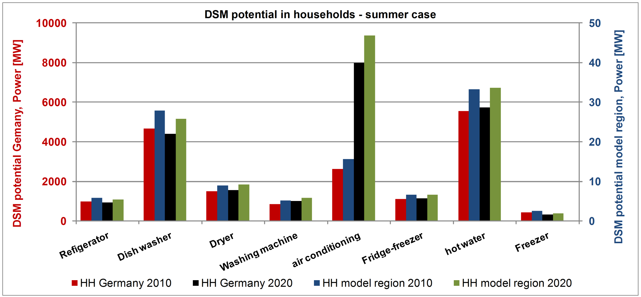
Results
Total potential in households – summer case
17.7 GW in total (2010)
23.1 GW in total (2020)
Notes:
For households all applications are taken into account that fulfil the requirement of DSM. They have to be shiftable in terms of thermal storage or interupting the process as well as by shifting the start of the not interuptable process. To calculate the theoretical technical potential the typical applications and concurrencies are considered here. For the summer case the total potential is estimated to about 18GW. Main application are all kind of cooling devices although the potential seems to be low in case of Refigerators and Freezer but it is possible to offer positive as well as negative reserve energy. Dish washer and washing machines have a higher potential but they can only provide negative reserve energy. Until 2020 it is expected that more electrified air conditioning systems will be installed in residential areas. That offers a significant potential for DSM.

Slide 7
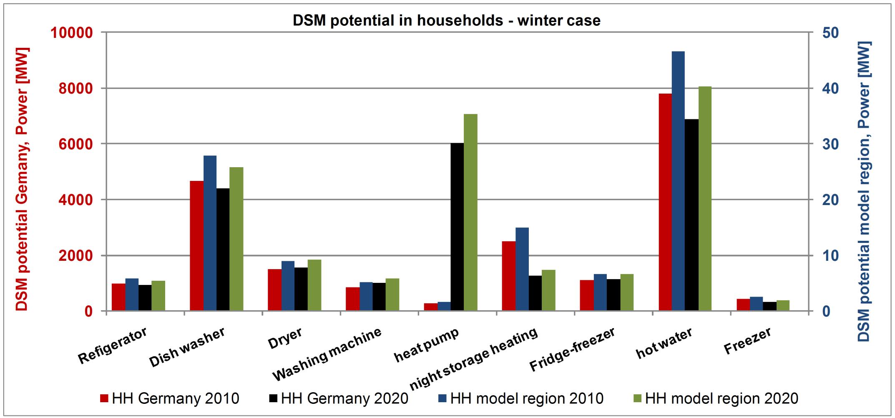
Results
Total potential in households – winter case
20.1 GW in total (2010)
23.5 GW in total (2020)
Notes:
During the winter the load is typical higher than in the summer due to the high demand for heating. So the DSM potential increases compared to the summer. Main applications are all heating devices with and without storage capacities. It is expected that conventional heating by oil will be substituted by heat pumps in the coming years. That devices will represent a main part of the available load that can be shifted. The part of night-storage heating will decrease probably due to legal adjustments.

Slide 8
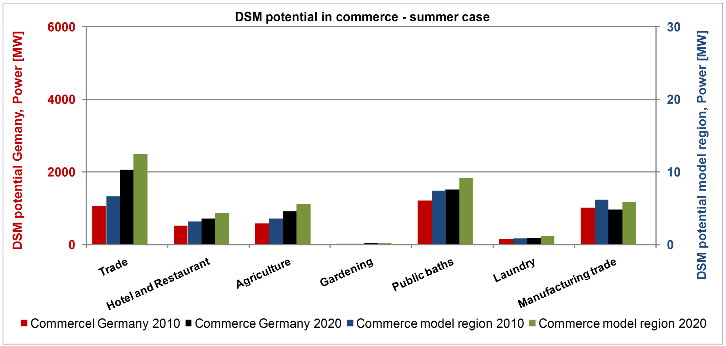
Results
Total potential in commerce – summer case
4.6 GW in total (2010)
6.4 GW in total (2020)
Notes:
In the demand class trade, commercial and services the most important types are chosen firstly. The basis of the choice is the kind of end energy that is used. Here, the already mentioned requirements for DSM ready applications is taken into account. So, process that need cooling and heating are prefered for load shifting. Further there is a potential in processes that need sort of mechanical energy. Finally electrical heating is an important issue. For the summer case the total DSM potential can be estimated up to 4.6GW. Taken into account the increasing part of electrified heating and cooling (heat pumps and air conditioning) in contrast to the increasing efficiency of consumption the DSM potential will increase at about 6.4GW.

Slide 9
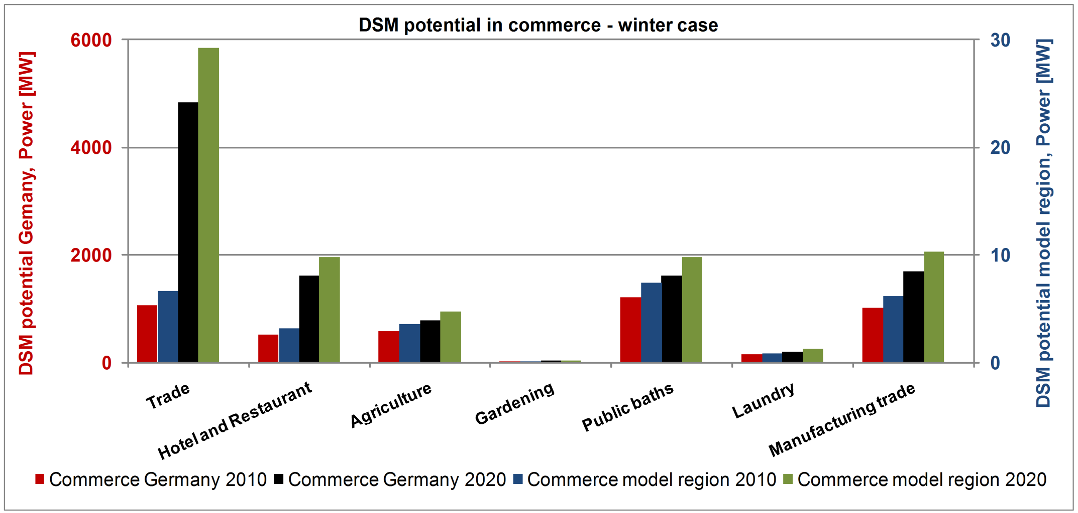
Results
Total potential in commerce – winter case
4.6 GW in total (2010)
10.8 GW in total (2020)
Notes:
Using the same conditions for the winter case the DSM potential will increase at about 10.8GW by 2020. Most interesting types of commerce are trade (refigerated warehouse), public baths and the producing business.

Slide 10
Results
Optimized load profile – Summer, working day (2010)
Reduction by 5MW
Power [MW]
Increase by max. 10MW
→ Germany: 1,6 GW
Time in 15min blocks
Notes:
As I mentioned before a model region has been defined to interpret the findings of the large DSM potentials . Therefore an optimization tools was developed that is used to optimize the daily load profile with focus on filling the valley in the morning ours. In the same context the peak load shall be reduced. Every type of consumer is modelled as load block and the behaviour is defined by setting the time of use, the time of interruption and the break after an interruption of shifting. The tool is now trying to create the load profile based on the new conditions.
Here you can see, that the promising DSM potential has less impact on the load profile as widely expected. The load valley in the morning can be increased by 10 MW or 1.6GW for Germany. The peak load can be constantly reduced by 5MW or 0.8 GW for Germany. So it shall be possible to homogenize slighty the current load profile. I can be assumed that the usage of DSM on a certain period of daytime has a more remarkable impact on reducing or increasing the load taken the individual comfort requirements into account. I have to mention that industry is not included in that model.

Slide 11
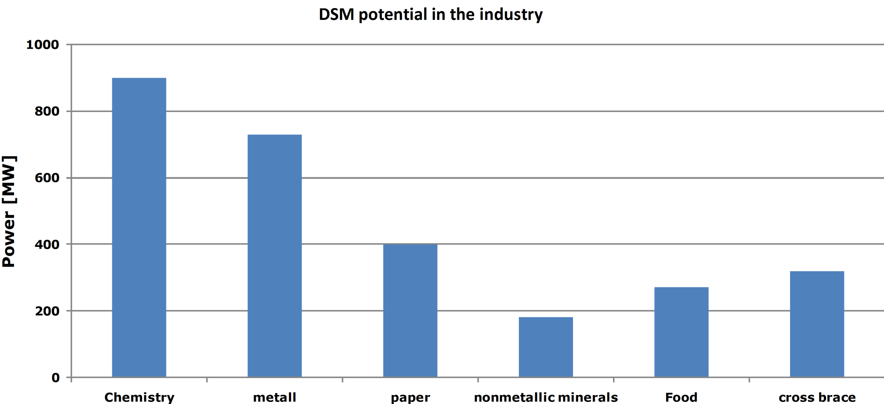
Results
Total potential in the industry
2.8 GW in total (2010)
Source: M. Klobasa, 2007, Dynamische Simulation eines Lastmanagements und Integration von Windenergie in ein Elektrizitätsnetz auf Landesebene unter regelungstechnischen und Kostengesichtspunkten, ETH Zurich, Zurich, Switzerland
Notes:
The study and analysis of the DSM potential in the industry is still in process. Industrial facilities are quite heterogeneous even within the same type of industry, so it is hardly possible to estimate the DSM potential precisely by a general approach. In the past the facilities has been optimized on maximal operating hours. So actually there is currently no real potential for load shifting because it is more profitable to produce goods than shifting the electricity demand. The approach in this case would be to add further storage devices that allow to shift the electricity demand without reducing the production output. That would lead to less optimized facilities but the load shifting can be major income of the high demand customers in the future, such as metal and chemical industry. The study group is now in discussion with experts from industry to find a technical and economical potential for DSM. Former studies found a DSM potential of nearly 3 GW.

Slide 12
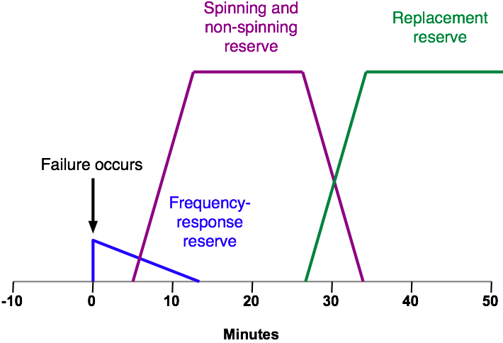
Conclusion
Potential for power grid control
High theoretical DSM potential
High uncertainty of availability in case of grid instability
Aggregation of multiple home applications necessary
1
2
3
Less theoretical DSM potential
Better forecast about availability
Aggregation of the loads necessary
[1]
1 Primary reserve
2 Secondary reserve
Comparable low DSM potential
Already in use for tertiary control (very good forecast of available DSM potential)
Able to provide other ancillary services
3 Tertiary reserve
[1] Source: B. J. Kirby, Spinning Reserve From Responsive Loads, Oak Ridge National Laboratory, March 2003.

Slide 13
Conclusion
High theoretical and technical DSM potential in Germany (up to 30GW in 2010)
Practical potential about 3.6GW (2010)
Increasing DSM potential in 2020 and later due to substitution of fossil fuels (for heating, etc.)
Home application usable for balancing group management
Commercial and industrial loads able to provide further ancillary services

Slide 14
Thank you for your kind attention.

Slide 15
Back-up – 1
Air cond.
Fridge-freezer
Hot water
Freezer
Power [MW]

Slide 16
Back-up 2
Average Power demand of the single applications [W]
Annual energy demand [TWh/a)
Application with DSM potential
Energy demand of the customer classes [%]
Part on the total load profile
final energy [%]
Process heat
Process cooling
El. heating
Mechanical energy
Limitations
Begrenzungen
Time to shift
Break after shifting
Average daily usage
Concurrency factor
Time to shift
Break after shifting
Average daily usage
Concurrency factor
Load block
Load block

