Slide 1


FIELD TEST OF GRID ORIENTED MICRO CHP UNITS
FOR DOMESTIC ENERGY SUPPLY
Dipl.- Wirtsch. Ing. Arne Dammasch
Prof. Dr.-Ing. Michael Kurrat

Slide 2
Project phases
phase 1:
conception and development of a schedule planning algorithm for a grid oriented operation mode of micro CHP units
phase 2:
computer-based simulation of a virtual power plant consisting of micro CHP units is implemented
test starts on the micro CHP unit at the TU Braunschweig and further improvements of the control interface are accomplished
phase 3: (since January 2011)
testing and validation of simulation results within a field trial
Arne Dammasch – Germany – Main Session 4 – Paper 1080

Slide 3
Grid oriented operation mode of micro CHP units
electrical load
time
grid load without CHP
grid load with CHP
Arne Dammasch – Germany – Main Session 4 – Paper 1080
Notes:
A smoothening of the grid load can be achieved by operating the CHP units grid oriented.
The operation times are mostly in peak load times of the electrical grid.

Slide 4
Project phases
phase 1:
conception and development of a schedule planning algorithm for a grid oriented operation mode of micro CHP units
phase 2:
computer-based simulation of a virtual power plant consisting of micro CHP units is implemented
test starts on the micro CHP unit at the TU Braunschweig and further improvements of the control interface are accomplished
phase 3: (since January 2011)
testing and validation of simulation results within a field trial
Arne Dammasch – Germany – Main Session 4 – Paper 1080

Slide 5
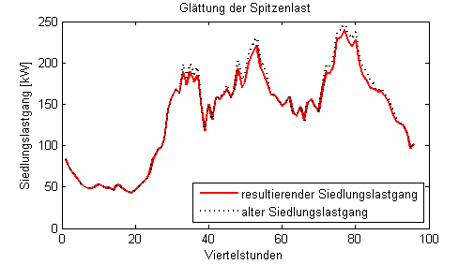
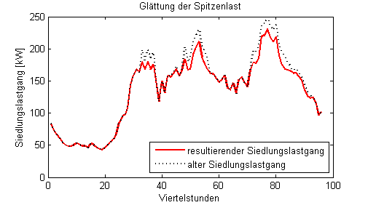
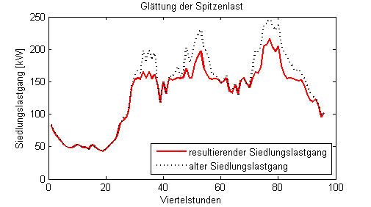
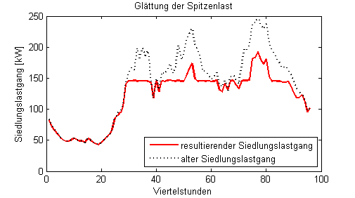
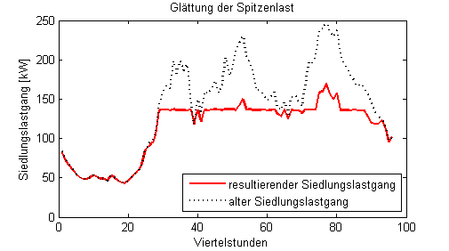
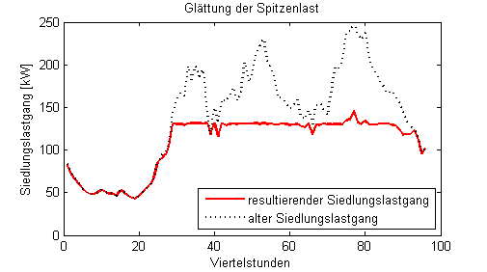
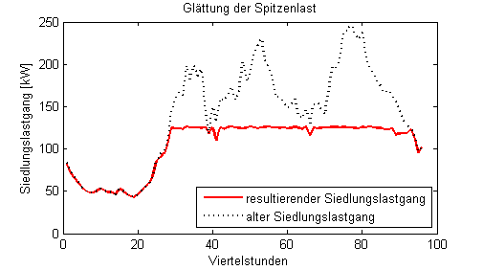
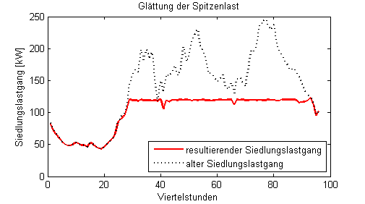
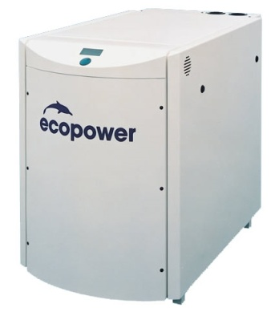
Simulation results
simulated settlement with 30 micro CHP units and 100 house connections
1
micro CHP unit
2
micro CHP units
5
micro CHP units
10
micro CHP units
15
micro CHP units
20
micro CHP units
25
micro CHP units
30
micro CHP units
electrical load in kW
resulting residential load
original residential load
time in ¼ h
Arne Dammasch – Germany – Main Session 4 – Paper 1080

Slide 6
Project phases
phase 1:
conception and development of a schedule planning algorithm for a grid oriented operation mode of micro CHP units
phase 2:
computer-based simulation of a virtual power plant consisting of micro CHP units is implemented
test starts on the micro CHP unit at the TU Braunschweig and further improvements of the control interface are accomplished
phase 3: (since January 2011)
testing and validation of simulation results within a field trial
Arne Dammasch – Germany – Main Session 4 – Paper 1080

Slide 7
Information about the field test
two apartment buildings in Braunschweig /Germany , each is equipped with a micro CHP unit
micro CHP unit: EcoPower e4.7 (4.7 kWel / 12.5 kWth )
thermal storage tank (1,000 liter)
existing boiler remains as a peak load boiler
measurement and control system:
central schedule management
data aquisition for one building: 18 temperature sensors
4 fluid-flow meters
1 control unit per micro CHP unit
1 UMTS-Router
daily amount of logged data
for one building:
198,720 measured values!
Arne Dammasch – Germany – Main Session 4 – Paper 1080

Slide 8
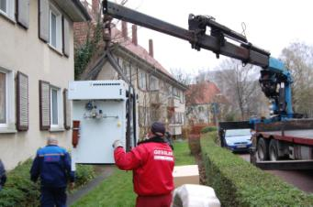
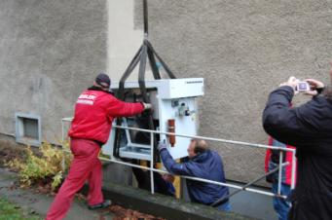
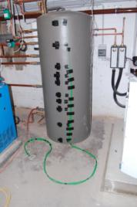
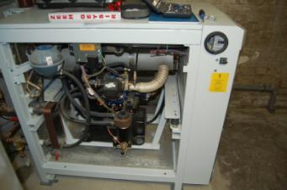
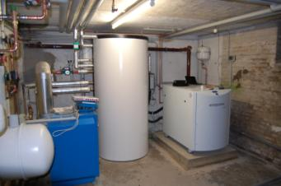
Installation and start of the field test
Braunschweig
11/23/2010
and
01/04/2011
thermal storage tank
micro CHP unit
peak load boiler
Arne Dammasch – Germany – Main Session 4 – Paper 1080

Slide 9
Structure of the heating-system
control unit
measurement hardware
thermal storage
micro CHP unit
heating circut
peak load boiler
hot water
fluid-flow meter
temperature sensor
data interconnection
heating supply
heating return
Arne Dammasch – Germany – Main Session 4 – Paper 1080

Slide 10


Information infrastructure
each micro CHP unit is equipped with an UMTS-router
fixed IP-address
secure VPN-connection
centralized schedule management
VPN
UMTS
VPN
DSL/LAN
VPN Area
VPN
UMTS
centralized schedule management
VPN
UMTS
Arne Dammasch – Germany – Main Session 4 – Paper 1080

Slide 11
Thermal load and temperature in February 2011
thermal load
in kW
temperature
in °C
time
Arne Dammasch – Germany – Main Session 4 – Paper 1080
time

Slide 12
Thermal load and hot water load for
February 8, 2011
the measurement system acquires data with high resolution quality
measurement intervall = 10 seconds
thermal load
hot water load
thermal load
in kW
thermal load
in kW
time
time
Arne Dammasch – Germany – Main Session 4 – Paper 1080

Slide 13
Load forecast and schedule management
forecast of thermal and
grid load
based on historically data
generation of a
day-ahead-schedule
for each micro CHP unit of
the virtual power plant
load in kW
time in hh:mm
scheduled feed-in of the micro CHP unit (February 4, 2011)
grid load (February 2, 2011)
thermal load (February 2, 2011)
Arne Dammasch – Germany – Main Session 4 – Paper 1080

Slide 14
Quality of the load forecast
load forecast is not one hundred percent accurate
grid load (February 2, 2011)
grid load (February 4, 2011)
thermal load (February 2, 2011)
thermal load (February 4, 2011)
Arne Dammasch – Germany – Main Session 4 – Paper 1080

Slide 15
Quality of the schedule
despite less accuracy in the
load forecast…
results only in minor deviations
from the schedule
results:
ΔP_{d} | -11.22%
Δs_{d} | -8.47%
ΔP_{d}: change of peak load
Δs_{d}: change of peak spread
real feed-in of the micro CHP unit
real grid load without CHP
real grid load with CHP
initial CHP schedule
Arne Dammasch – Germany – Main Session 4 – Paper 1080

Slide 16
Conclusion
grid oriented operation mode can be realized
load forecast directly effects the quality of the operation schedule
optimization of the schedule generation algorithm
development of better load forecasting systems
integration of electrical storage systems
Outlook
Arne Dammasch – Germany – Main Session 4 – Paper 1080

Slide 17
Dipl.-Wirtsch.-Ing. Arne Dammasch
Working Group Energy Systems
Technische Universität Braunschweig
Institute for High Voltage Technology and Electrical Power Systems – elenia
Schleinitzstraße 23 | 38106 Braunschweig | Germany
Email: a.dammasch@tu-braunschweig.de
Thank you!
Arne Dammasch – Germany – Main Session 4 – Paper 1080

