Slide 1
ARCHITECTURE AND FUNCTIONAL SPECIFICATIONS OF DISTRIBUTION AND TRANSMISSION CONTROL SYSTEMS TO ENABLE AND EXPLOIT ACTIVE DEMAND
Giovanni Valtorta et alii– Italy – Session 5 – Paper 1171

Slide 2
ADDRESS PROJECT
ADDRESS (“Active Distribution networks with full integration of Demand and distributed energy RESourceS”) is a 4-year large-scale R&D project launched in June 2008 receiving funding from the European Community's Seventh Framework Program
(FP7/2007-2013) under grant agreement n° 207643.
Scope: to deliver a comprehensive commercial and technical framework for the development of “Active Demand” (AD) in the smart grids of the future.
ADDRESS is about enabling the active participation of domestic and small commercial consumers in power system markets and in the provision of services to different power system players.
The customers’ flexibility is offered to the energy market through Aggregators

Slide 3
System Operators and Active Demand
The ADDRESS project deals with the electricity consumption flexibilities of domestic and small commercial consumers, including the flexibilities of micro-generation and storage that may be
present at their premises.
The behavior of customers can be different from expected and the providers of AD products could be concentrated in such a way to determine network violations
In this framework SOs have to ensure, anyway, a reliable operation of their networks.
SOs control systems have to be upgraded introducing new functions to enable and exploit AD business

Slide 4
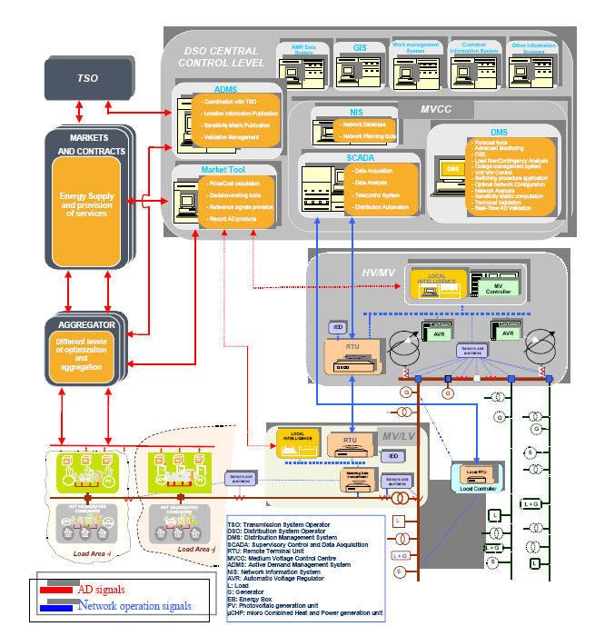
DSO Functional Architecture
Three main Control Levels:
DSO Control Centre
HV/MV substation
MV/LV substation

Slide 5
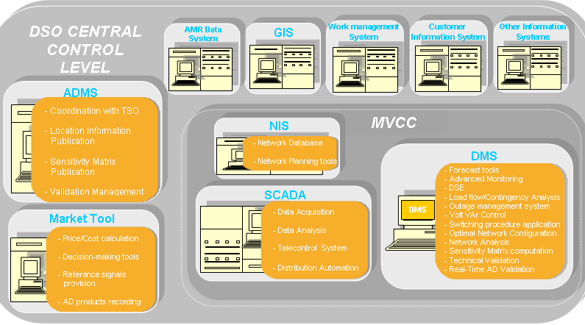
1. DSO Control Centre Level
Active Demand Management System
Market Tools
Distribution Management System new functions
Location information
Flexibility table
AD products validation
AD product recording
Coordination with TSO
Forecast tools
Distribution State Estimation
Volt/Var control
Decision making process to buy AD
DSO functions to enable and exploit
AD business

Slide 6
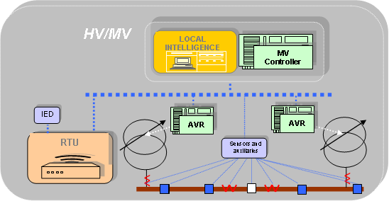
2. HV/MV substation level
Voltage Regulation/Power Flow Control
Centralised/decentralised functions
New functionalities for the primary substation devices

Slide 7
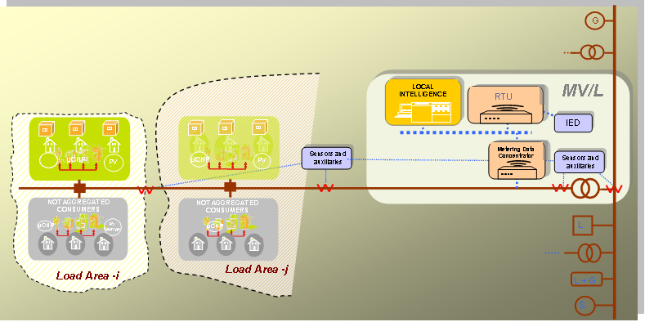
3. MV/LV substation level
Measurement equipment (sensors, transducers, auxiliaries,…).
RTU, in order to send and to receive data to/from the upper levels and receive data from the lower level.
MV/LV intelligence in order to control part or the whole underlying LV network.

Slide 8
TSO simplified Functional Architecture
Many functionalities needed to fulfill the AD requirements are already available.
The new ones are:
- Location information (macro load area)
- Flexibility Table computation
AD products validation
Coordination with DSO

Slide 9
DSO and Active Demand
DSO provides services to enable AD Business:
Location information
Flexibility table
AD products validation
DSO buys AD products for network operation:
Calculate AD need to solve network problems
Decision making process
ADDRESS developed algorithms and prototypes to allow DSO to perform these functions

Slide 10
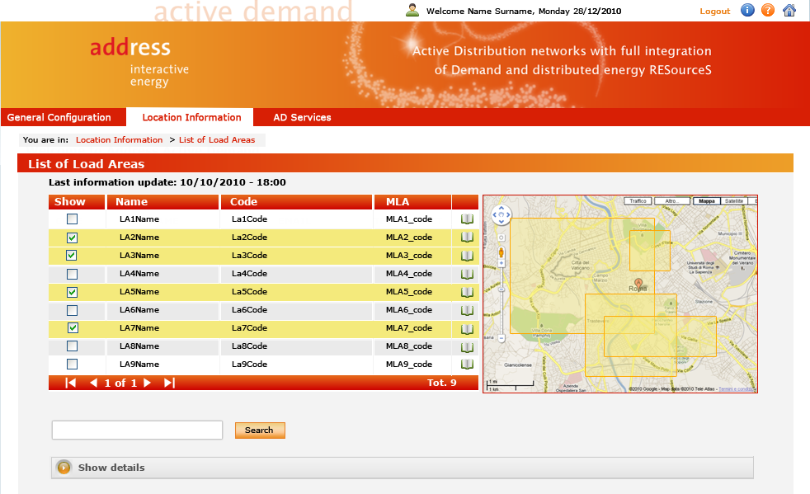
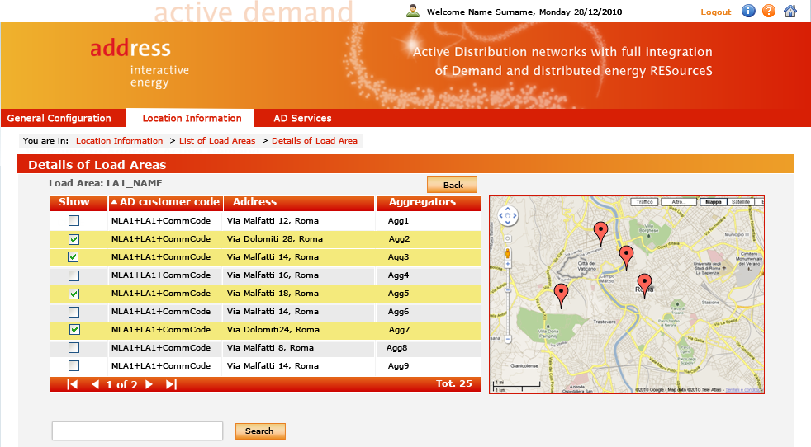
DSO: Location information provision (1)
Load areas:
Group of consumers “equivalent” from network operation point of view;
Part or whole LV lines,
one or more MV/LV substations,
MV feeders, busbars...
Service localization
Technical validation
Macro Load Areas: aimed for the TSO needs

Slide 11
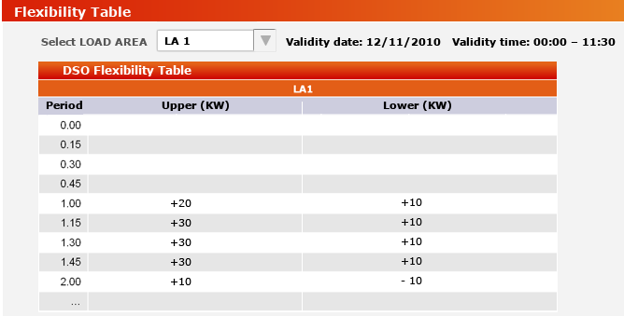
DSO: Flexibility Table Pubblication (2)
Definition based on DSO/TSO needs
Values given at load area level
No DSO/TSO commitment, guidelines for facilitating approval
Periodically updated by DSO/TSO
TSO coordination
TSO algorithms and processes
DSO network and historical measurement database
DSO algorithms and processes
TSO FT
DSO FT
Available to market players

Slide 12
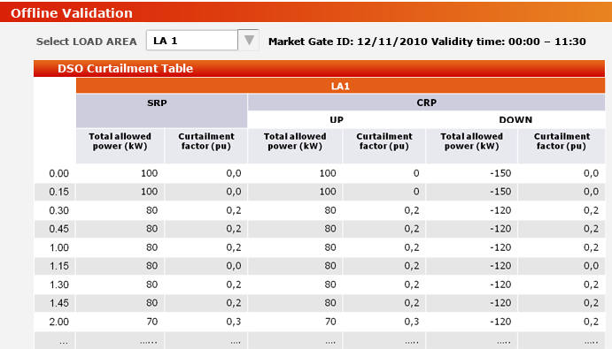
DSO: AD products validation (3)
Technical Validation needs:
Ensure coordination between
DSO and TSO
Ensure stability of the services
provided by DSO and TSO
How is the technical validation process established?
Interaction between Aggregator and DSO/TSO on service activation: Approval needed
The flexibility table, periodically updated by DSO/TSO, for helping the market players to formulate their bids
The need for regulation in order to establish a transparent and non discriminatory framework

