Slide 1


Integration of electric vehicles to the distribution grid
Nina Wahl Gunderson and
Kjell Sand
SINTEF Energy Research
Norway

Slide 2
Introduction
Strong Norwegian incentives promoting electric vehicles (EVs)
EV load may cause power quality (PQ) problems
Study on car pool in downtown Trondheim
Energy, power and PQ measurements
Load characteristics
Nina Wahl Gunderson – Norway – Session 5 – 0785

Slide 3
Measurement instruments
Power Detective energy meter
Elspec G4500 Blackbox advanced PQ recorder
Nina Wahl Gunderson – Norway – Session 5 – 0785

Slide 4
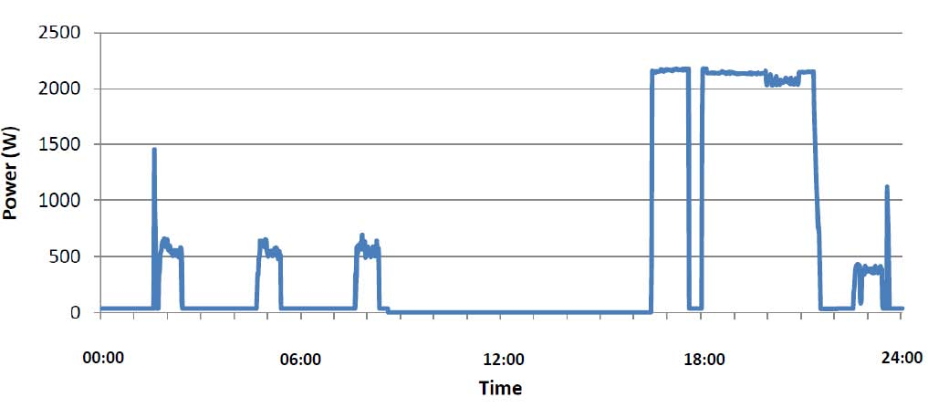
Charging pattern single vehicle
Nina Wahl Gunderson – Norway – Session 5 – 0785

Slide 5
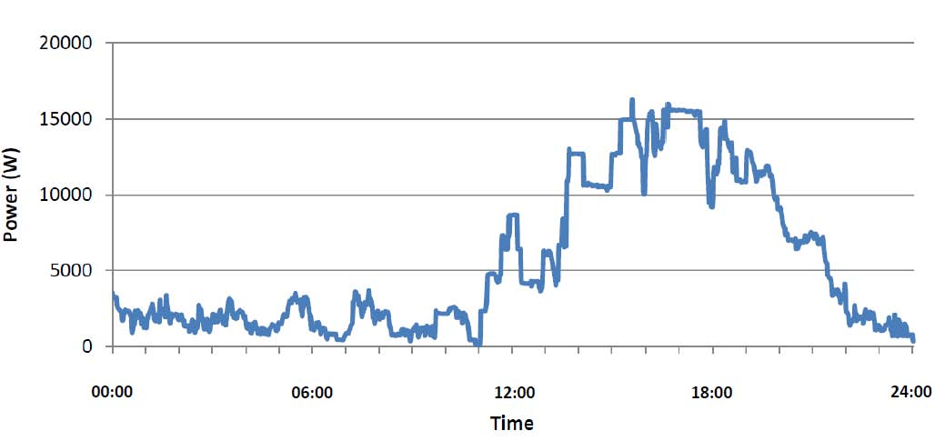

Total load 11 charging stations
Coincidence factor =
Nina Wahl Gunderson – Norway – Session 5 – 0785

Slide 6

Utilization time single vehicle
Nina Wahl Gunderson – Norway – Session 5 – 0785

Slide 7
PQ measurements: voltage THD
Nina Wahl Gunderson – Norway – Session 5 – 0785

Slide 8
PQ measurements: Voltage unbalance
Nina Wahl Gunderson – Norway – Session 5 – 0785

Slide 9
Conclusions
Afternoon power peak
No values close to PQ code limits
Low voltage THD values
Some voltage unbalance
EVs may cause problems in weak grids
Fast chargers require further studies
Nina Wahl Gunderson – Norway – Session 5 – 0785

