Slide 1
Enel Smart metering in Endesa
Meters and More technology
Valerio Vadacchino
Business Development of Smart Grids and New Technologies
Infrastructures and Networks Division
ENEL DISTRIBUZIONE Spa

Slide 2
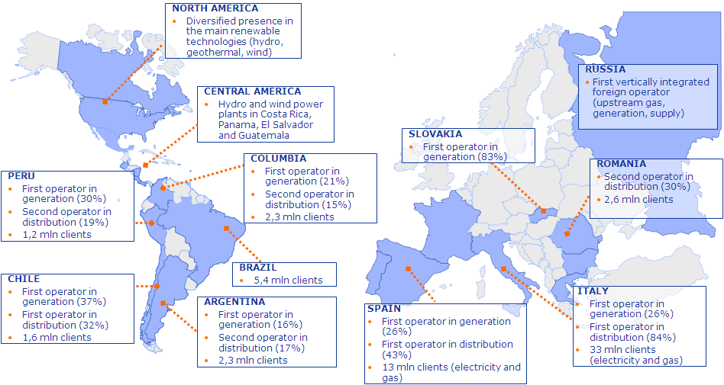
Enel: an international energy operator Core business: electricity and gas
61 Mln Customers
95 GW Installed Capacity
290 TWh Annual Output
40 Countries
Data as of Dec ember 2010
Notes:
- Enel Group is present in more than 20 countries over 4 continents for generation, distribution and selling of electricity and gas
- Few numbers about Enel Group: ….

Slide 3
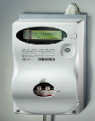
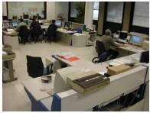
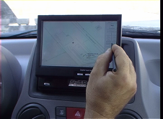
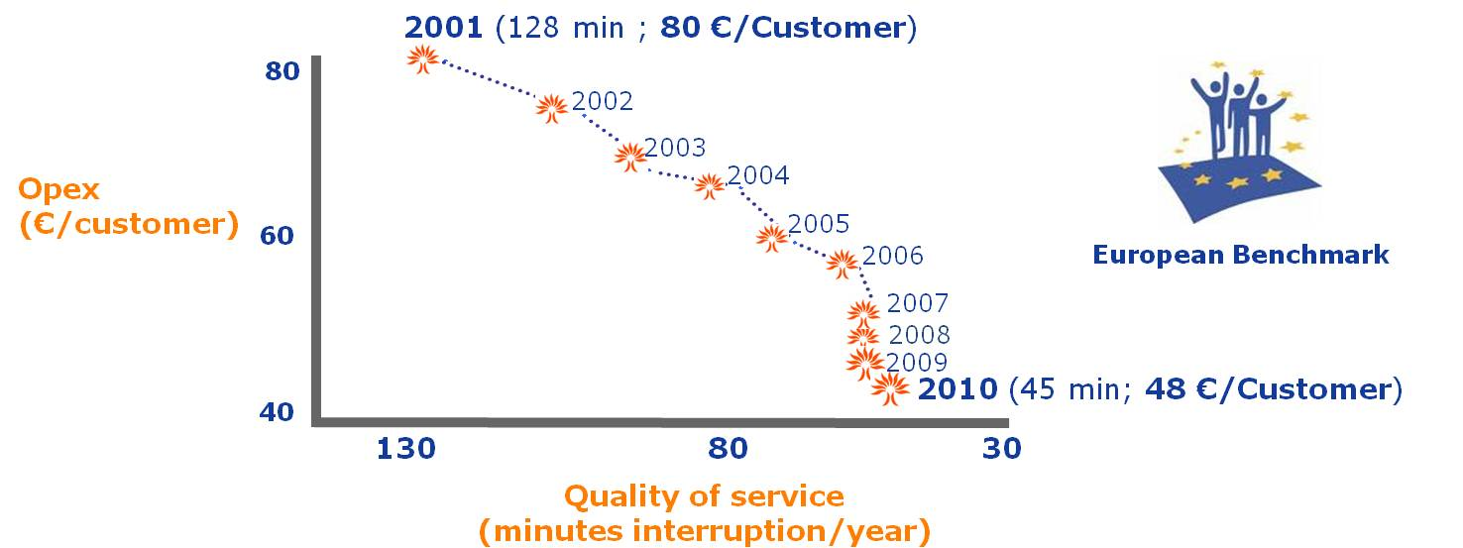
The future will follow Enel leadership on Smart Grids technologies
Automatic Meter Management
Network automation
Work Force Management
Asset Management
Notes:
Innovation technology has always been a pillar in Enel vision, first of all in the management of electricity network.
Operational excellence, cost savings, customer satisfaction and sustainability are the main drivers moving such approach to innovation.
In this slide a brief description of the last most important innovation installed on Enel network in Italy….
This makes Enel network the first and largest Smart Grids in operation worldwide.

Slide 4
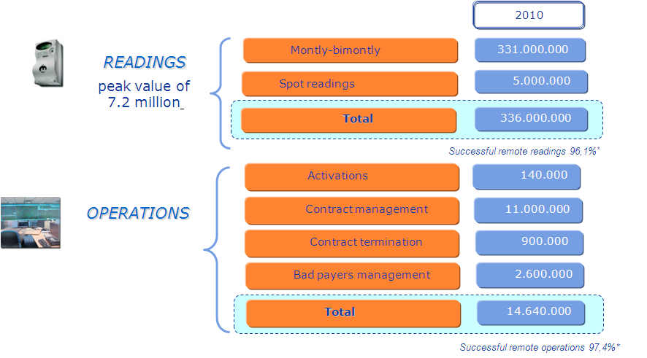
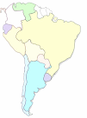
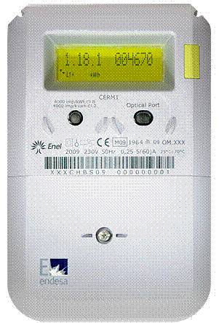
Smart metering solution Enel Group pioneering experience and worldwide leadership
Digital meters installed, controlled and read in December 2010: 33 mln
Remote activities and readings
(mln)
13 million Customers in Spain
New Generation based on Enel 10-years operating system
with state of the art functionalities
Notes:
This picture shows what kind of revolution has been possible in Enel through the Telegestore in terms of commercial and operational aspects.
Having a smart metering system in operation allows a company not only to do its activities better then before, but also to do additional activities not possible managing network and customers “manually”.
COMPLETARE

Slide 5
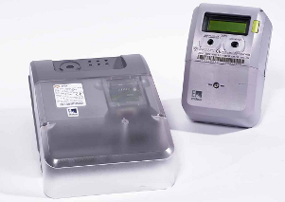
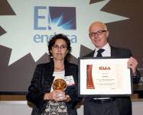
Creating value from synergies
Joint development of new generation by Enel and Endesa compliant with Spanish smart metering regulation
Creation of a more advanced solution, adapted to:
Spanish and European regulations.
Endesa's business requirements.
The latest technologies.
Based on both companies' experience:
Better cost efficiency and rollout timeline.
Minimized impact on users during replacement.
Award received at Metering Europe 2009: European Utility Award in the “Business Performance and Innovation” category.
5
Notes:
5

Slide 6
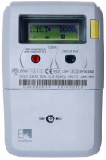
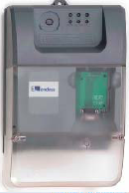
Technology state-of-the-art
New generation of smart metering solution
• designed on a field-proven technology
• cost effective
• reach in advanced funcionalities:
power control and management.
2 contracts management.
load curves for active and reactive energy.
energy balance.
self commissioning (Plug&Play).
automatic adaptation to network topology changes.
remote update of field components firmware
data protection: encryption y authentication.
ready to be integrated with other Smart Grids devices
modem GPRS on board
able to work on “real time” base or on a time schedule base
automatic meter detection and network topology definition.
Notes:
the functionalities required by Spanish Authority are listed in this slide.
The Cervantes solution, developed jointly by Enel and Endesa, includes also additional functionalities matching specific business requirements of Endesa.

Slide 7
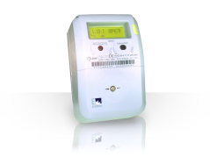
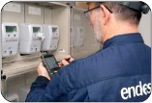
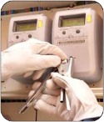
Definition and Development of field components and systems.
Preparation of massive Roll-Out plan.
2008-2009
Certification of meters in accordance with MID and Spanish rules
Enel and Endesa homologation of data concentrators.
1st controlled Roll-Out for 100,000 customers.
System in operation from day-1.
Awarded tenders for first 3,5 meters of mass roll-out:
2 different meter manufacturers for 1-phase meters
2 different meter manufacturers for 3-phase meters
Launch of Endesa’s Smart Metering Management and Operation Centre.
2010
Meters from different manufacturers fully interchangeable
185k meters already installed
To be installed in all roll-out areas 1.2 million meters 16k concentrators
Advanced system functionalities
2011
Completion Full-scale Roll-Out 3 years before regulation schedule
13 million meters
2012-2015
Notes:
In this slide, I have listed the activities already completed by Endesa in the roll out phase.
A first pilot test with 25000 meters has been successfully completed. It was carried out to test all the installation, activation and customer management operations before to start with mass roll out.
Up to now, 150.000 meters have been installed all over Spain in the areas operated by Endesa.

Slide 8
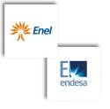
Meters and More Open protocol for smart metering solution
Meters and More is an open communication protocol for Smart Metering solutions.
World leading companies from different business sectors have already joined the Association:
Main characteristics:
Open technology, built on the specifications of the Enel Telegestore protocol.
Efficiency and robustness.
Strong data security.
Flexibility.
Already available and field-proven.
www.metersandmore.eu
8
Notes:
8
8
Just to conclude my speech, I would spend few words about an other important innovation introduced in the Cervantes project: the opening of communication protocol applied in the solution, named Meters and More.
To do this, Enel and Endesa have faunded a no-profit association based in Bruxelles to manage, evolve, spread this technology.
Moreover, Meters and More protocol is one of the 3 proposal standards in phase of evaluation by CEN-CENELEC-ETSI to be applied in all European smart metering projects.

Slide 9
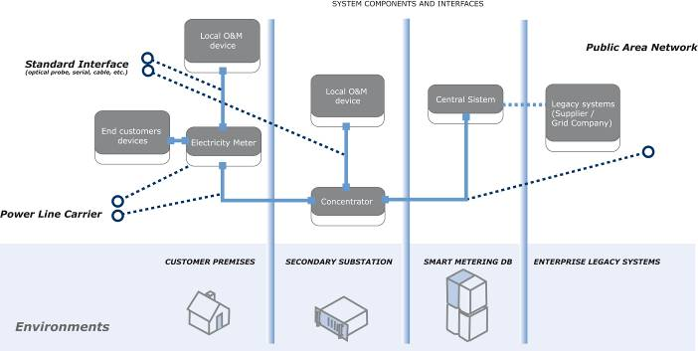
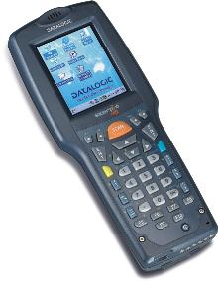
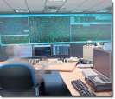
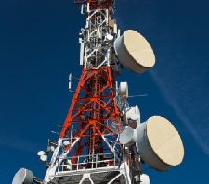
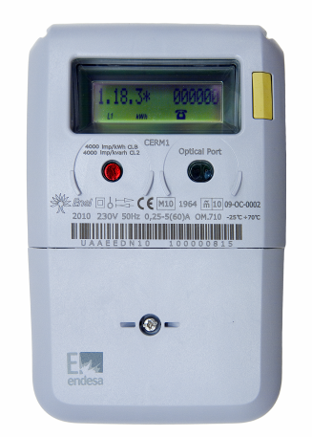
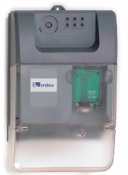
Meters and More Ready for Smart Grids appliances
The Meters and More protocol defines the communication between:
In process of being standardized at European level
Hand held devices
9

Slide 10
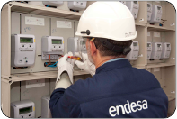
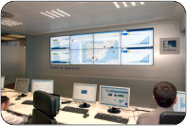
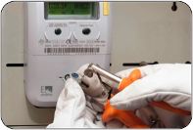
Final remarks
Enel Group confirms its leadership worldwide on Smart Metering and Smart Grids deployment → Endesa is currently the only company in Europe with an on-going roll-out of 13 million of smart meters.
Endesa and Enel have developed the latest technological generation of Smart Metering, based on the open, field-proven Meters and More protocol (in the process of being standardized).
Endesa have started from the day-1 to achieve the benefits a fully functional system
the synergies in Enel Group will allow Endesa to complete the roll out of all its meters before the deadline set by the Spanish regulation.
10

Slide 11
Enel Smart metering in Endesa
Meters and More technology

