Slide 1

The recharging infrastructure to support the mobility development in Italy optimising the impact on the network
Valentinetti – IT – S6 – 0838

Slide 2
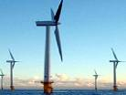
Electric Vehicles
Main drivers for development
Benefits for the environment
  Electric vehicles (EV) allow to save about the 40% of primary energy with respect to the ICE (Internal Combustion Engine) ones (WTW analysis)
  An electric car generates up to 46% less CO₂ than a ICE one (WTW analysis)
  A strong use of Renewables could improve these estimations
  Benefits for utilities
Benefits for customers
  A new market for energy selling
  Possibility to use off-peak hours: advanced Grid and generation park management
  V2G: EVs like a perfect device for Smart Grids
  Economic saving in fueling
  Possibility of a strong reduction for the total cost of ownership
Source: Enel processing from data
- Deutsche Bank, FITT Research “Electric Cars: Plugged In”, June 2008
- Boston Consulting Group, “The Comeback of the Electric Car?”, 2009
- Roland Berger 2008
Valentinetti – IT – S6 – 0838

Slide 3
Business model
ENEL is evaluating both the business model more suitable and the infrastructure more versatile and cost effective.
ENEL is now promoting a business model that allows:
the customer to pay the recharges depending on the tariff offered by her/his energy supplier
the asset owner to recover the huge investment, needed to implement a widespread infrastructure, without adding high mark-up cost over energy fess.
VALENTINETTI – IT – S6 – 0838

Slide 4
EV recharging infrastructures
ENEL is now installing EV recharge infrastructures aimed at :
Covering private and public areas ;
Ensuring user friendly access and safe standard conditions;
Enabling secure different payment procedures;
Fulfilling the compliance with the current rules of the energy free market,
allowing the customer access with its energy tariff provided by her/his energy supplier;
Linking the charging stations to the remote control system of the DSOs networks in order to check the capability of the grid during all the recharging procedure and to enable electric cars to adapt the charging curve of the battery according to new levels of available current.
VALENTINETTI – IT – S6 – 0838

Slide 5
EV recharging infrastructures
Thanks to this new infrastructure, The customer will be able to:
find and book an available charging point close to his current position;
recharge his car, choosing the faster or cheaper mode in relation to the contract subscribed with its energy supplier and to the current grid availabilities;
recharge its electric vehicle in all new charging point installed in different cities;
pay all the recharges done both in private and public areas in only one invoice, according to the tariffs subscribed with its energy supplier
VALENTINETTI – IT – S6 – 0838

Slide 6
Business model
Reference model
INFRASTRUCTURE MANAGED
BY DISTRIBUTOR (DSO)
Recharging points as part of the Grid
EV with it’s own POD and identified everywhere to bill
Energy supply in a competitive market
Dedicated contract for each EV-POD
Coordinated grid infrastructure development and impacts optimization
Common standard
Rates and access regulated by AEEG
Interoperability among DSOs grids
VALENTINETTI – IT – S6 – 0838

Slide 7
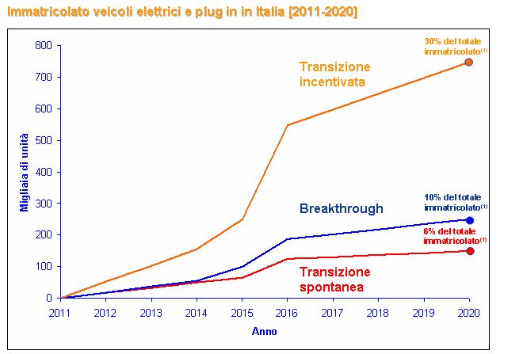
Italian EVs market forecast
DSOs shall support EVs adoption
Total fleet expected within 2020
3.800.000
Forced adoption
Government forces customers to adopt EVs
1.300.000
Commercial breakthrough
850.000
Spontaneous adoption
VALENTINETTI – IT – S6 – 0838

Slide 8
EV drivers
Benefits for clients
The most important driver for customers is economic saving
Engine Type | Quantity (15.000 km / y) | Cost | Yearly cost
Fuel | 900 l / y | 1,5 € / l | 1.350
Electricity | 2.250 kWh / y | 0,15 € / kWh | 338 € + Markup for Infrastructure
Distributor business model could limit additional markup over energy cost allowing clients to save up to 75% on fuel costs

Slide 9
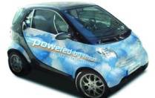
The need for infrastructure
Clients parking facilities in Italy
32%
Private box
66% of clients will usually charge their EV at home
34%
Private parking
indoor or outdoor
(e.g. apartment)
34% of clients will depend on public charging infrastructure
34%
No private parking
Clients shall always be confident they can find an available public charge point when needed.
Source: Roland Berger; average Italian parking facilities

Slide 10
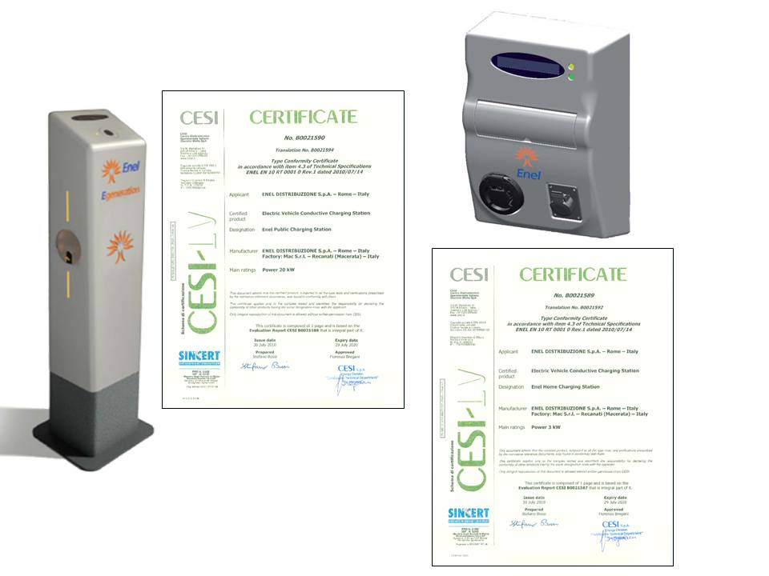
The ENEL charge spots
Public Station
Home Station
Single phase
Up to 3,3 kW
2 different EV sockets – MODE 3
a charge once a time
EV powerline communication (vehicle)
GPRS Comunication (Clearing House)
Polyphase
Up to 20 kW
2 different EV sockets - MODE 3
a charge once a time
EV powerline communication (vehicle)
GPRS comunication (Clearing house)

Slide 11



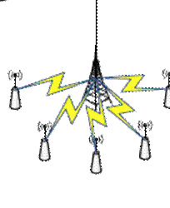

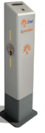

Overall architecture
E-Mobility Control System
DB
Web server
Internet
GSM/GPRS
Intranet
SMS
External stakeholders
Corporate stakeholders
EV
System operator
Mail
server
SCADA Systems
Customer

Slide 12

Billing for EV supply energy which is being tested in DSO model
30 kWh on POD 1
50 kWh on POD 6
EV SUPPLY ENERGY CONTRACTS
Contracts A, B, C…M
20 kWh on POD 1
(Contract A)
(Contract B)
(Contract C)
(Contract M)
Energy Vendor 1
Energy Vendor 2
….
Energy Vendor N
20 kWh Contract A
30 kWh Contract C
EMM
Clearing House
50 kWh Contract C
POD 1
POD 2
POD 3
POD 4
Contract A
POD 5
Contract B
POD 6
Contract C
PUBLIC CONNECTION
POD 1, 2, 3
PRIVATE CONNECTION
POD 4, 5, 6
DSO’s Public Station
(Enel Distribuzione)
Private Home Station
(Customer)

Slide 13
Italian Autority measure
ARG/elt 56/10
  AEEG measure ARG/elt 56/10 has eliminated in April 2010 regulatory constraints to the installation of a second meter for electric vehicle recharge in private households, the new act will also facilitate solutions for recharging in publicly accessible premises;
  AEEG measure ARG/elt 242/10 outlines, in particular, a new tariff, effective from 1st January 2011, for network services offered by the public charging stations and provides simplified methods for testing the same services through competitive criteria in order to facilitate six pilot projects.

Slide 14
  Thank you for your kind attention
  tiziano.valentinetti@enel.com

