Slide 1
FAULT LIMITING TECHNOLOGIES IN DISTRIBUTION NETWORKS
David KLAUS, Adrian WILSON - Applied Superconductor Ltd, UK; Joachim BOCK, Achim HOBL - Nexans SuperConductors, DE; Darren JONES - Electricity North West, UK; Jamie McWILLIAM – ScottishPower, UK; Alan CREIGHTON CE Electric UK, UK;
Larry MASUR, Franco MORICONI - Zenergy Power plc, UK
Klaus D.W. et al. – United Kingdom – RIF Session 1 – 0456

Slide 2
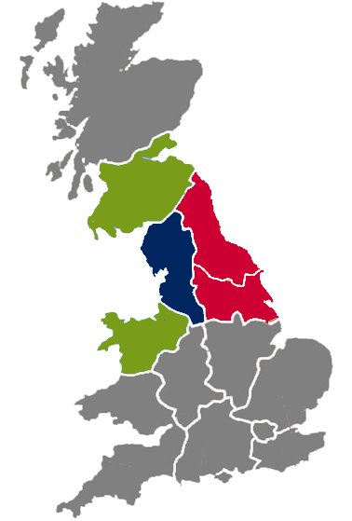
Collaboration Agreement for 1 pilot installation each with ScottishPower, Electricity North West and
CE Electric UK
Klaus D.W. et al. – United Kingdom – RIF Session 1 – 0456

Slide 3
Applied Superconductor’s Role
Understand Network Operator’s Problems
Secure Order and Prepare Specification
Undertake Network Response Studies
Define Routine and Type Test Requirements
Design and Assemble Protection, Control, Monitoring
and Cooling Systems for Pilots 1&2
Deliver, Install, Commission, Monitor and Maintain
Klaus D.W. et al. – United Kingdom – RIF Session 1 – 0456

Slide 4
Pilot 1 - Electricity North West
11kV resistive SFCL
Normal current 100A
Prospective Fault 20kA rms; 50kA pk
86% clamping
09 2008 Type Tested
03 2009 Installed at site
04 2010 Trial Complete
Klaus D.W. et al. – United Kingdom – RIF Session 1 – 0456

Slide 5
Pilot 2 – Scottish Power
11kV resistive SFCL
Normal current 400A
Prospective Fault 20kA rms; 50kA pk
85% clamping
12 2010 Type Tested
Klaus D.W. et al. – United Kingdom – RIF Session 1 – 0456

Slide 6
Pilot 3 – CE Electric UK
11kV pre-saturated core SFCL
Normal current 1250A
Prospective Fault 6.2kA rms; 17kA pk
20% clamping
06 2011 Type Testing in progress
Klaus D.W. et al. – United Kingdom – RIF Session 1 – 0456

Slide 7
Pilot 4 – CE Electric UK
33kV pre-saturated core SFCL
Normal current 800A
Prospective Fault 8.5kA rms; 23kA pk
40% clamping
06 2011 Design in progress
Klaus D.W. et al. – United Kingdom – RIF Session 1 – 0456

Slide 8
Pilot 1 - Electricity North West
11kV resistive SFCL
Normal current 100A
Prospective Fault 20kA rms; 50kA pk
86% clamping
09 2008 Type Tested
03 2009 Installed at site
04 2010 Trial Complete
Klaus D.W. et al. – United Kingdom – RIF Session 1 – 0456

Slide 9
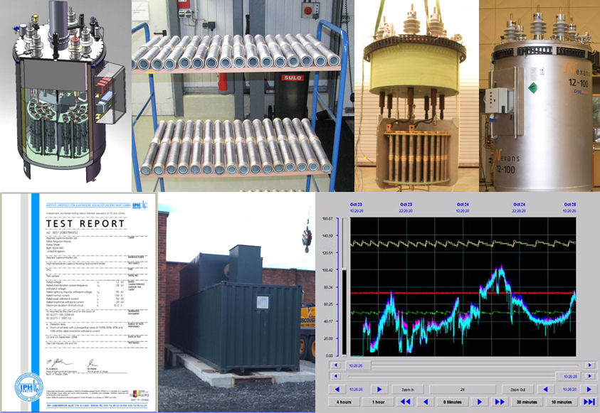
Klaus D.W. et al. – United Kingdom – RIF Session 1 – 0456

Slide 10
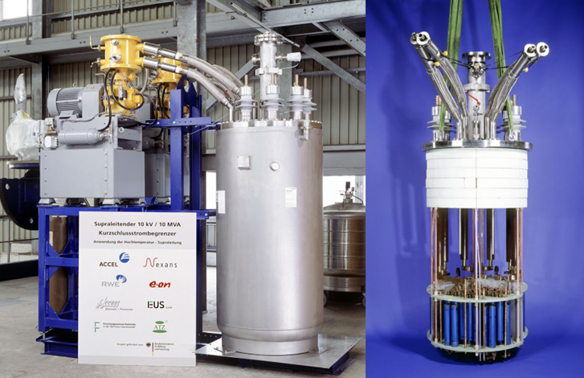
Klaus D.W. et al. – United Kingdom – RIF Session 1 – 0456

Slide 11
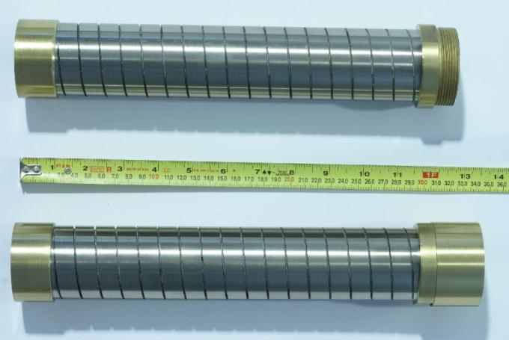
48 of the BSCCO components connected in series constitute each phase of the limiter. The series assemblies are immersed in liquid nitrogen cooled to below its boiling point. The nitrogen head pressure is below atmospheric pressure.
Klaus D.W. et al. – United Kingdom – RIF Session 1 – 0456

Slide 12
Resistive Fault Current Limiter
Up to 90% clamping
Clamps within 1.5 ms
Normal current → 800A
Recovery within 3 mins
Removes DC component
fault current
limited fault current
Klaus D.W. et al. – United Kingdom – RIF Session 1 – 0456

Slide 13
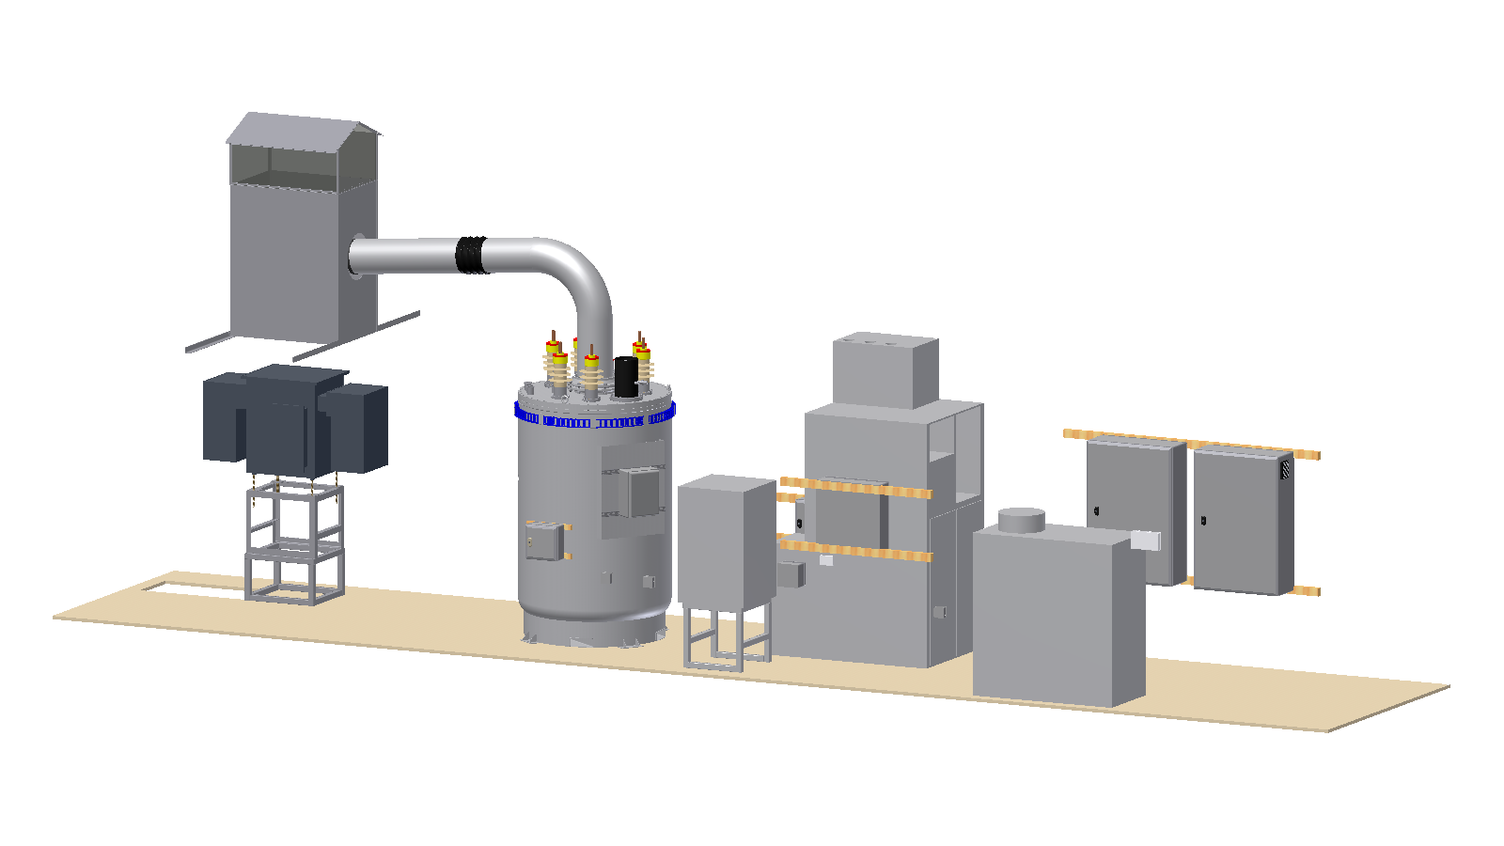
Klaus D.W. et al. – United Kingdom – RIF Session 1 – 0456

Slide 14
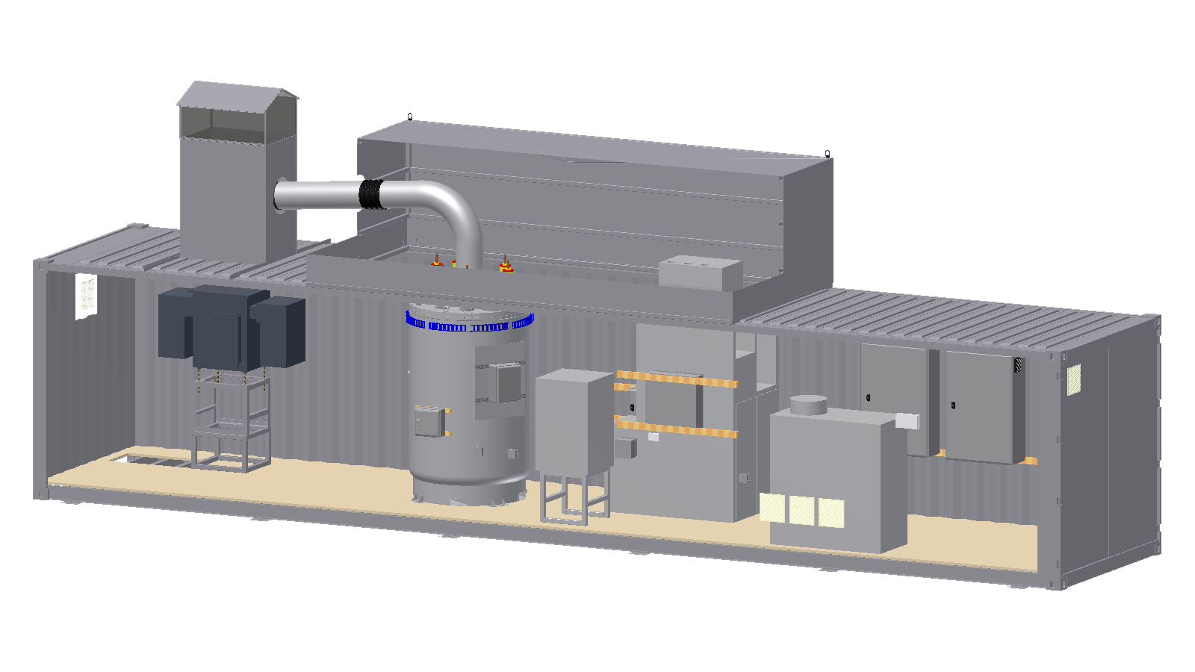
Klaus D.W. et al. – United Kingdom – RIF Session 1 – 0456

Slide 15
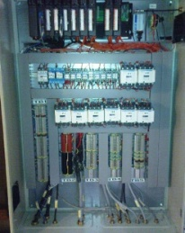
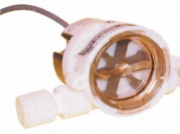
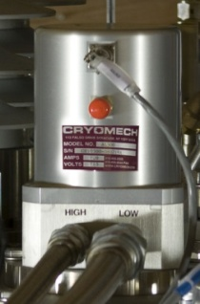
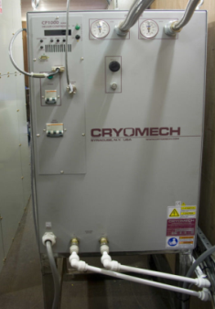
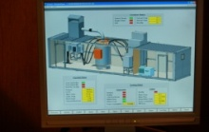
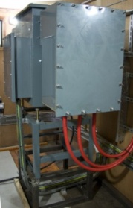
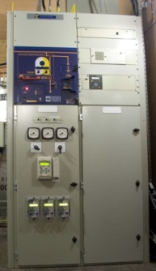
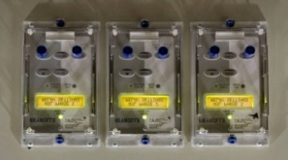
Interlocking
Alarms
Temperature Control
Text Reports
SCADA Interface
T in
T out
H in
Coldhead
Helium Compressor
Flow
T3
Programmable
Logic Controller
Remote Control / Monitoring
Data Storage and display
Platform for Relay, PLC programming tools.
T4
Water Chiller
I 1,2,3
PC
Fault Recorder
Va
Vb
3G Modem
Internet
P
T1
L1
L2
L3
T2
Protection Relays
Klaus D.W. et al. – United Kingdom – RIF Session 1 – 0456

Slide 16
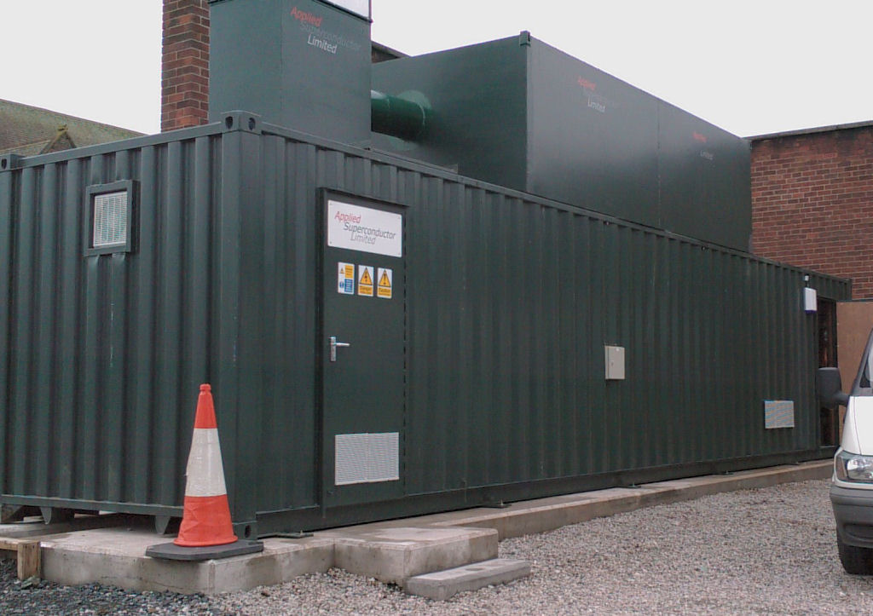
Klaus D.W. et al. – United Kingdom – RIF Session 1 – 0456

Slide 17
Successful trial with good availability of limiter
Noise primarily from cooling system requires mitigation
Cryocooler compressor requires cooling water and ambient air temperatures to be maintained within a narrow range
Liquid nitrogen handling straightforward and safe with appropriate training
Limiter impedance has negligible effect on current sharing
Means for remote reset of modems and PC required
Klaus D.W. et al. – United Kingdom – RIF Session 1 – 0456

Slide 18
Pilot 2 – Scottish Power
11kV resistive SFCL
Normal current 400A
Prospective Fault 20kA rms; 50kA pk
85% clamping
12 2010 Type Tested
Klaus D.W. et al. – United Kingdom – RIF Session 1 – 0456

Slide 19
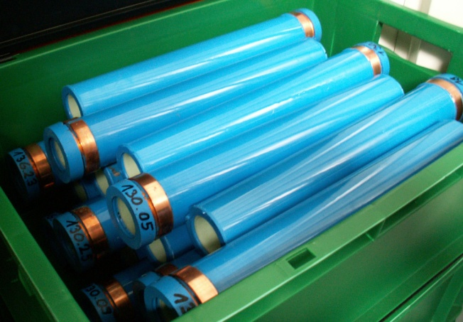
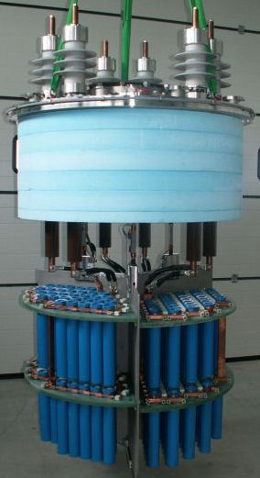
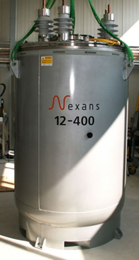
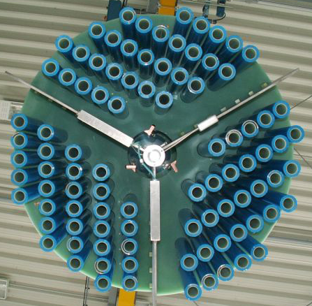
Klaus D.W. et al. – United Kingdom – RIF Session 1 – 0456

Slide 20
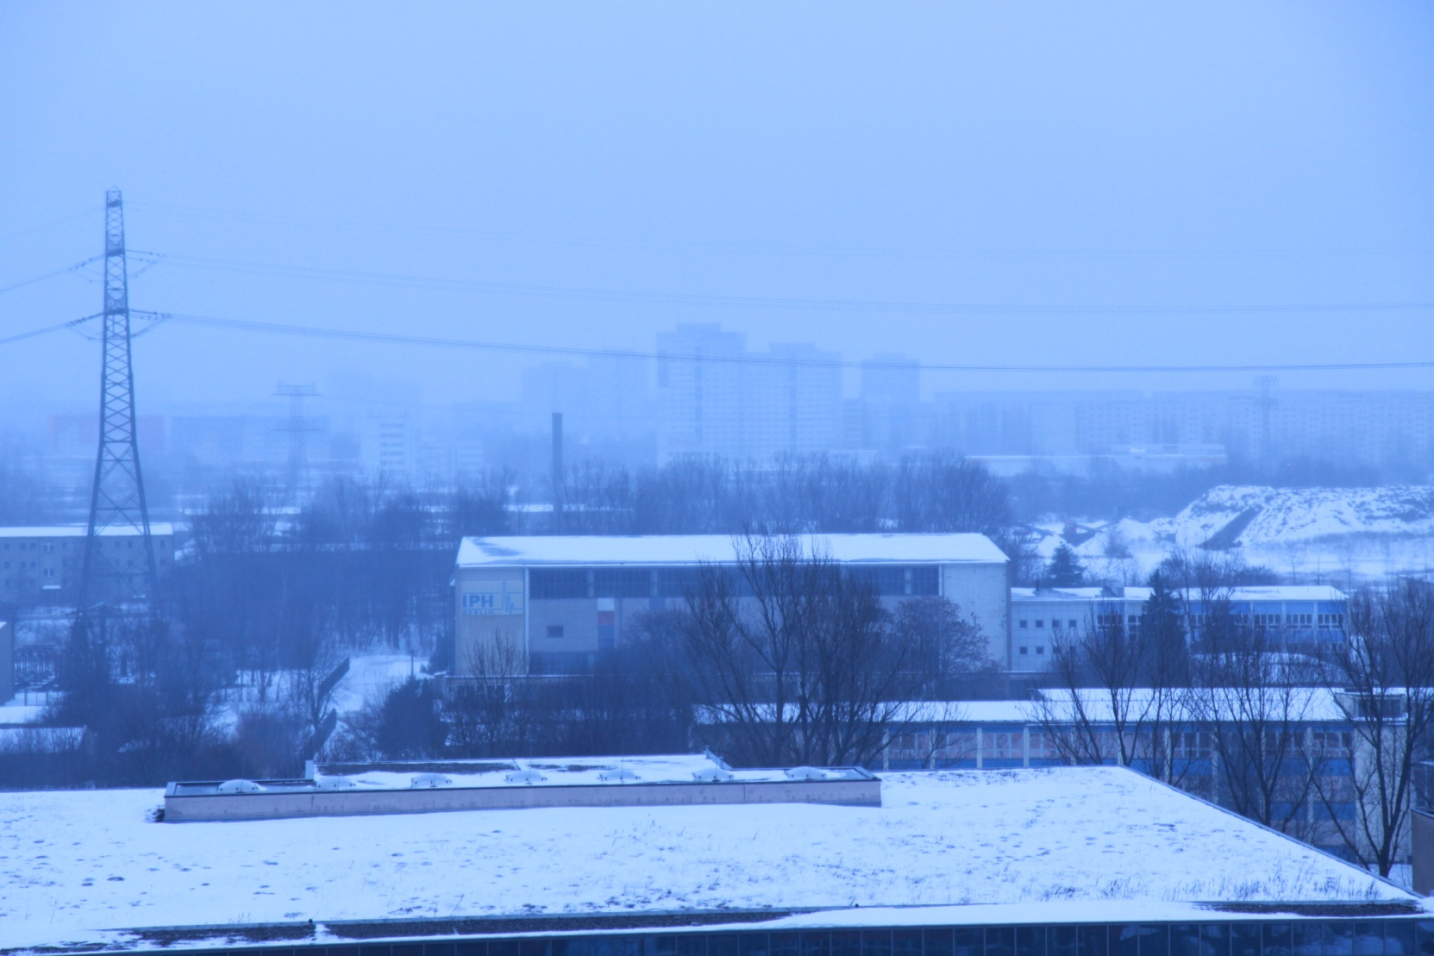
Klaus D.W. et al. – United Kingdom – RIF Session 1 – 0456

Slide 21
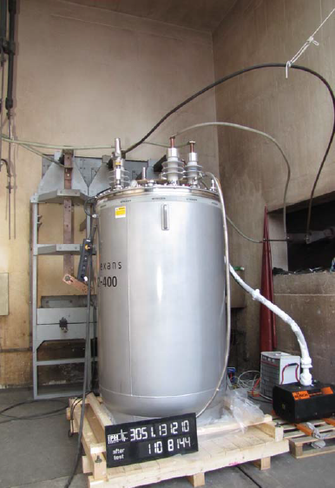
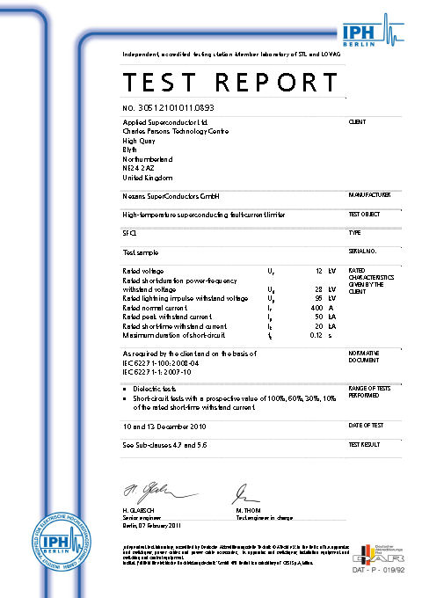
Klaus D.W. et al. – United Kingdom – RIF Session 1 – 0456

Slide 22
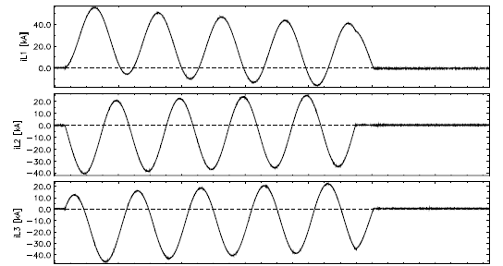
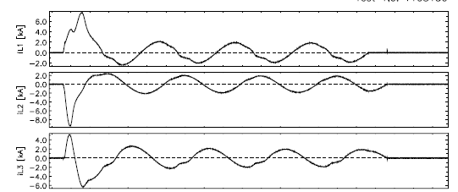
Klaus D.W. et al. – United Kingdom – RIF Session 1 – 0456

Slide 23
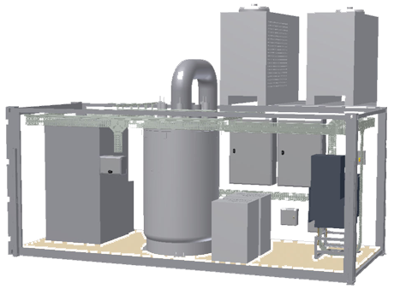
Klaus D.W. et al. – United Kingdom – RIF Session 1 – 0456

Slide 24
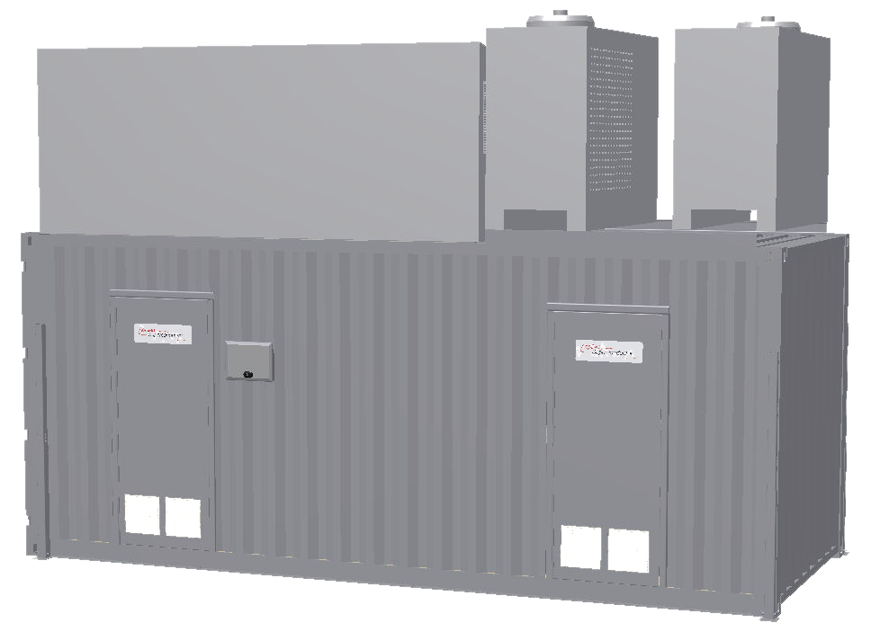
Klaus D.W. et al. – United Kingdom – RIF Session 1 – 0456

Slide 25
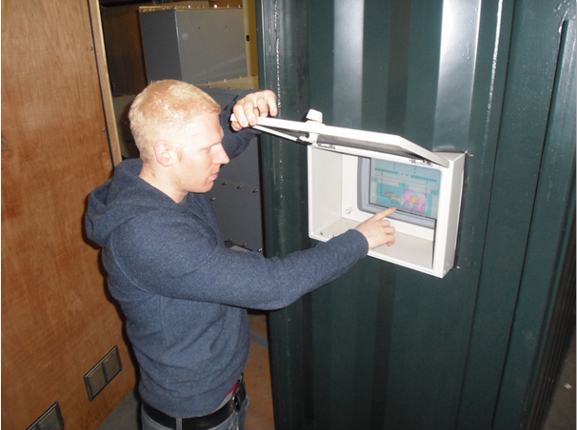
Klaus D.W. et al. – United Kingdom – RIF Session 1 – 0456

Slide 26
Pilot 3 – CE Electric UK
11kV pre-saturated core SFCL
Normal current 1250A
Prospective Fault 6.2kA rms; 17kA pk
20% clamping
06 2011 Type Testing in progress
Klaus D.W. et al. – United Kingdom – RIF Session 1 – 0456

Slide 27
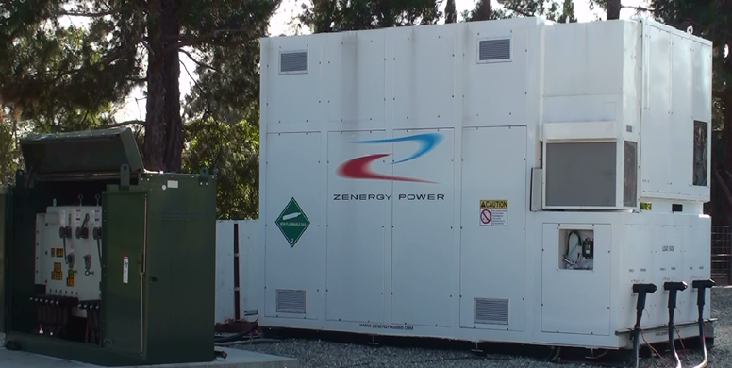
Klaus D.W. et al. – United Kingdom – RIF Session 1 – 0456

Slide 28
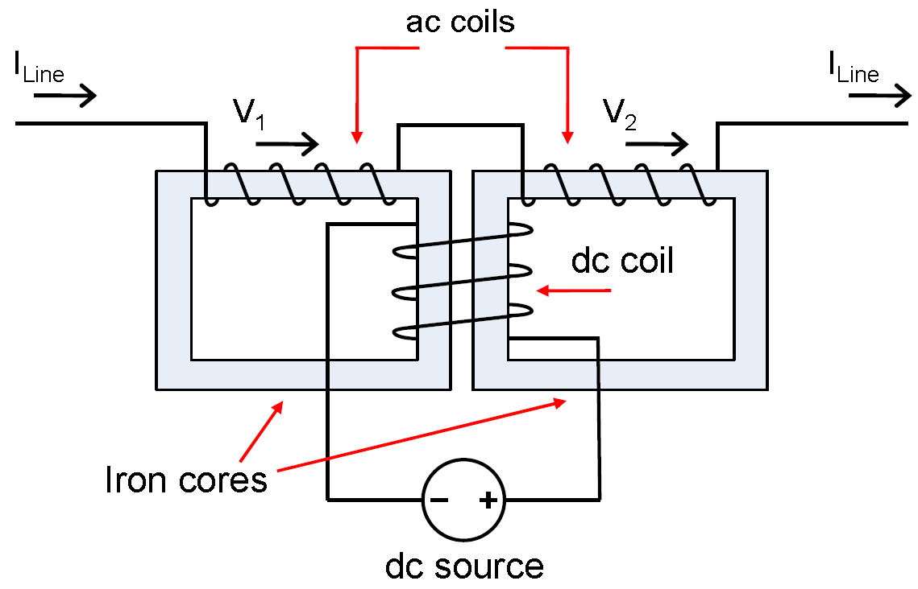
Klaus D.W. et al. – United Kingdom – RIF Session 1 – 0456

Slide 29
Pre-saturated Core Fault Current Limiter
Up to 50% clamping
Instantaneous Recovery
Normal current →2000A
fault current
limited fault current
Klaus D.W. et al. – United Kingdom – RIF Session 1 – 0456

Slide 30
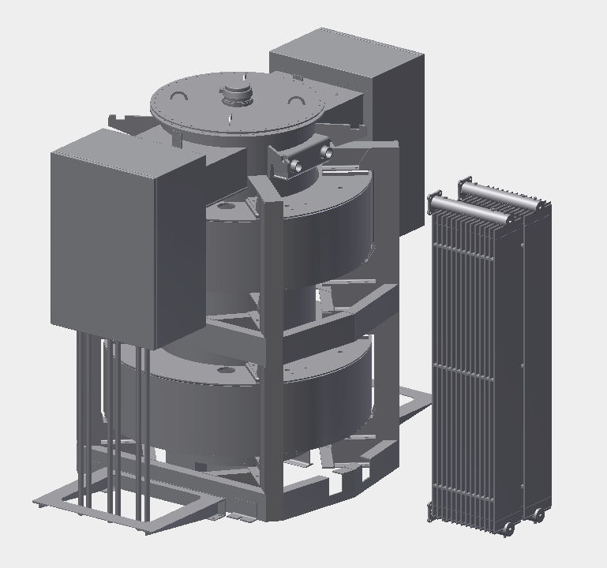
Klaus D.W. et al. – United Kingdom – RIF Session 1 – 0456

Slide 31
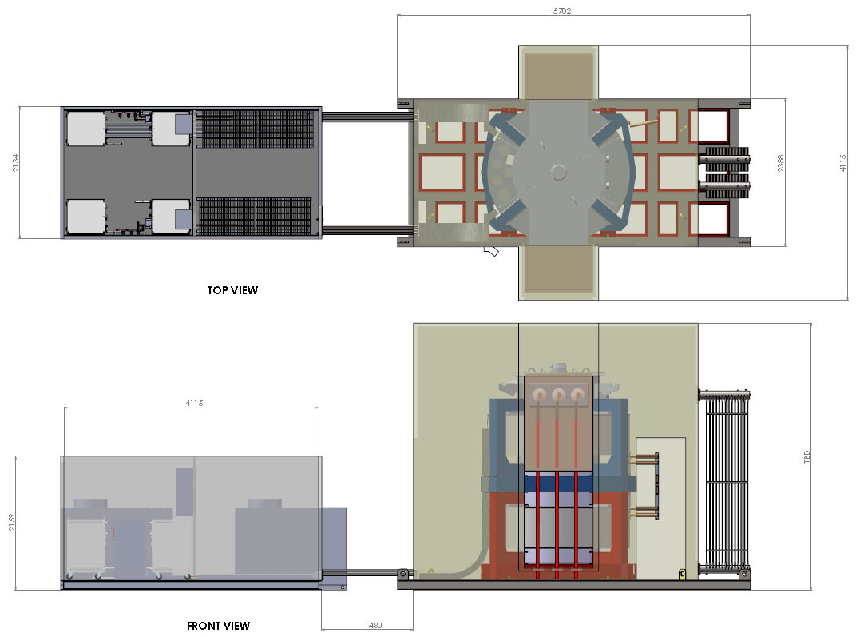
Klaus D.W. et al. – United Kingdom – RIF Session 1 – 0456

Slide 32
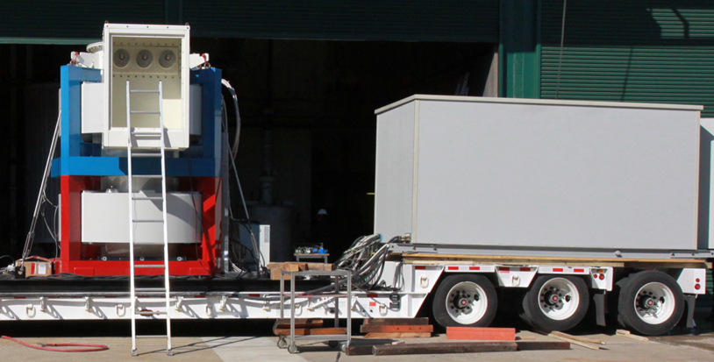
Klaus D.W. et al. – United Kingdom – RIF Session 1 – 0456

Slide 33
Klaus D.W. et al. – United Kingdom – RIF Session 1 – 0456

Slide 34
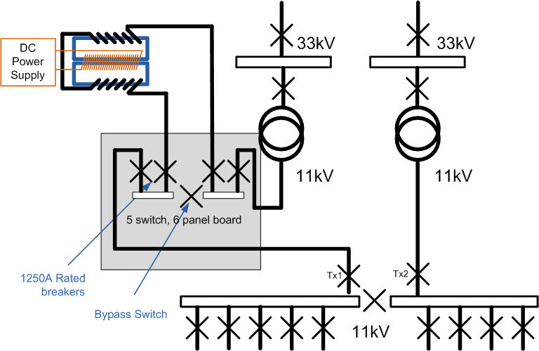
Klaus D.W. et al. – United Kingdom – RIF Session 1 – 0456

Slide 35
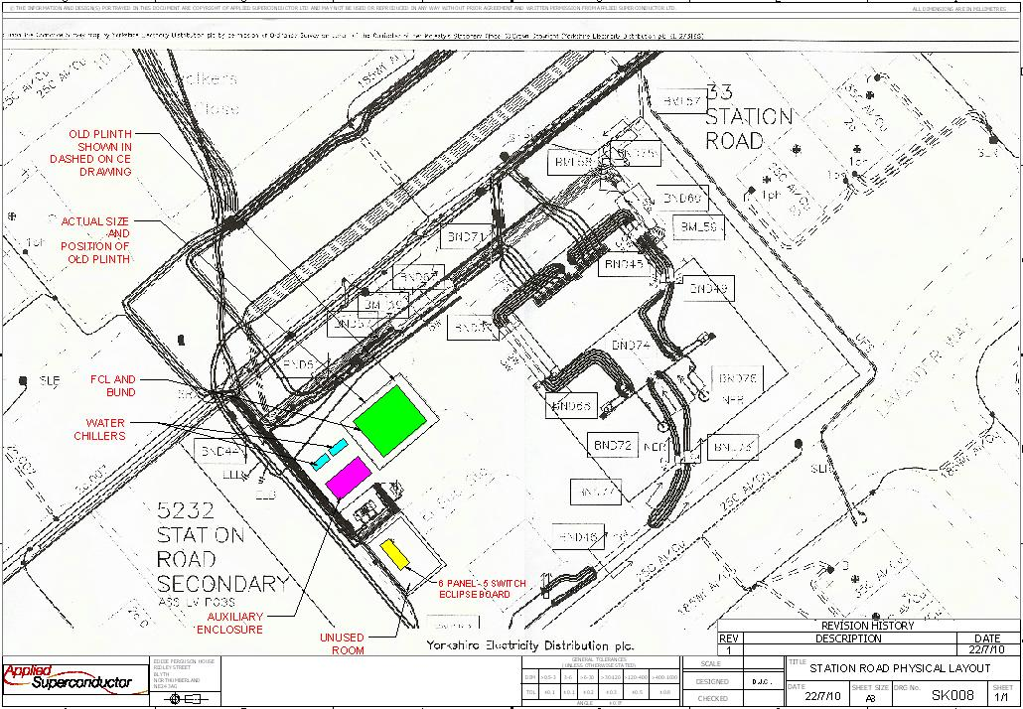
Klaus D.W. et al. – United Kingdom – RIF Session 1 – 0456

Slide 36
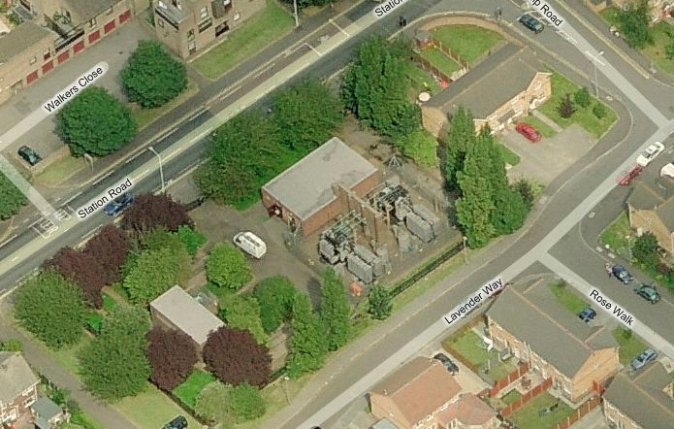
Klaus D.W. et al. – United Kingdom – RIF Session 1 – 0456

Slide 37
Pilot 4 – CE Electric UK
33kV pre-saturated core SFCL
Normal current 800A
Prospective Fault 8.5kA rms; 23kA pk
40% clamping
06 2011 Design in progress
Klaus D.W. et al. – United Kingdom – RIF Session 1 – 0456

Slide 38
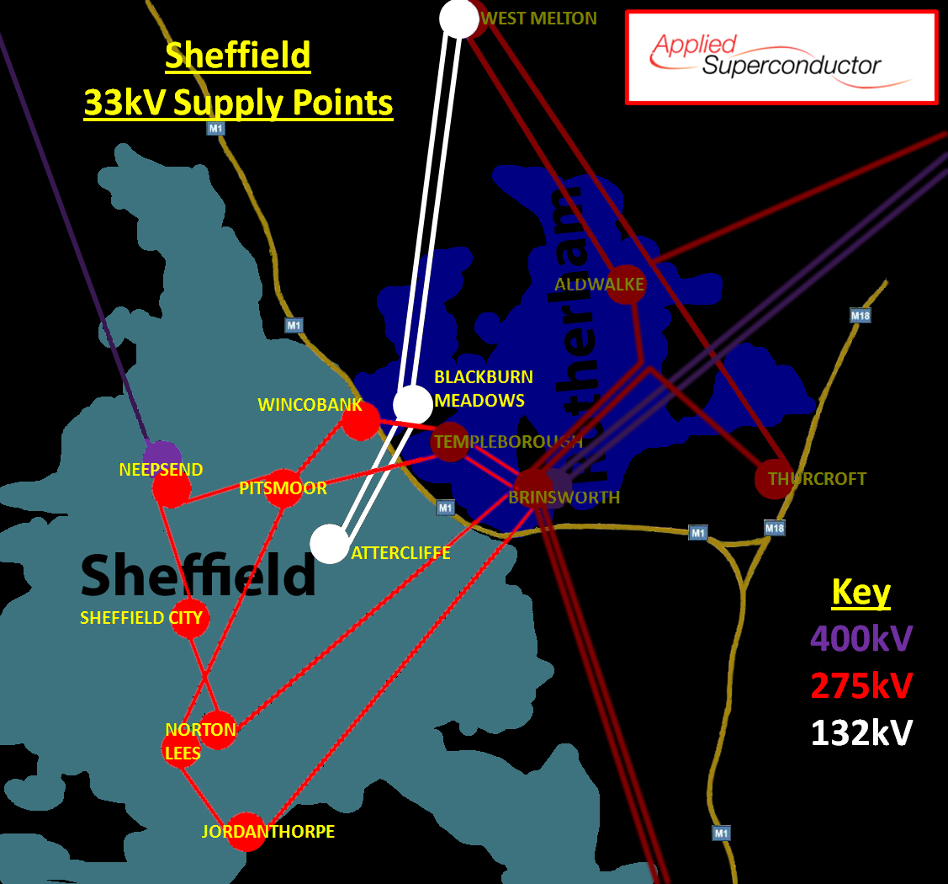
Klaus D.W. et al. – United Kingdom – RIF Session 1 – 0456

Slide 39
FAULT LIMITING TECHNOLOGIES IN DISTRIBUTION NETWORKS
David KLAUS, Adrian WILSON - Applied Superconductor Ltd, UK; Joachim BOCK, Achim HOBL - Nexans SuperConductors, DE; Darren JONES - Electricity North West,UK; Jamie McWILLIAM – ScottishPower, UK; Alan CREIGHTON CE Electric UK, UK;
Larry MASUR, Franco MORICONI - Zenergy Power plc, UK
Thank You!
Klaus D.W. et al. – United Kingdom – RIF Session 1 – 0456

