Slide 1
Saturated-Core Fault Current Limiter Field Experience at a Distribution Substation
Franco Moriconi, Francisco De La Rosa,
Albert Nelson, Larry Masur, Zenergy Power Inc., US;
Detlev Kirsten, Zenergy Power GmbH, DE
CIRED
Frankfurt (Germany)
6-9 June 2011
RIFS1, 0680

Slide 2
Outline
Zenergy Power
FCL Operating Principle and Advantages
FCL Program Overview and Roadmap
Field Experience at Distribution Substation
The Compact FCL design for HV applications
Summary & Conclusions

Slide 3
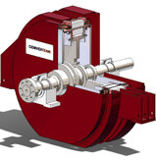

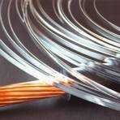
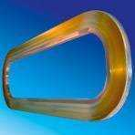
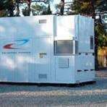
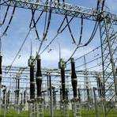

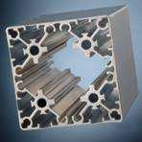












Zenergy’s Business Fields and Markets
Expertise in superconductive materials
Expertise in products and services
End markets
Low-cost
large-scale
Renewable
Energy
Generation
Coils
for Generators
Image Courtesy of Converteam
Fault Current
Limiter
(‘FCL’)
Smart Grid
Hardware
Next generation
low cost wire (2G)
In-house coiling
of superconductor
wire
Magnetic Billet Heater
(‘MBH’)
Industrial
Heating
of Metals

Slide 4
Inherently fail safe and self healing devices for electric utilities
Grid Protection with Fault Current Limiters
Typical applications of Fault Current Limiters:
Network reinforcement
Protection of network components (transformers, switchgear, busbars)
Distributed Generation connection
Power quality
G
Incoming
Feeder
Embedded
Generation
Bus Tie
Faulty network
Fault Current Limiter

Slide 5
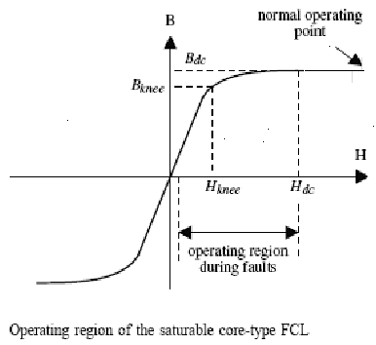
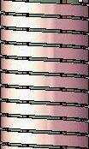

Operating Principle of Saturated-Core FCL
Trade Name “Magnetic Fault Current Limiter” (MFCL)
Picture-Frame Iron Cores
AC Coil
AC Coil
Buck
Boost
Boost
Buck
Configuration for single phase MFCL.

Slide 6
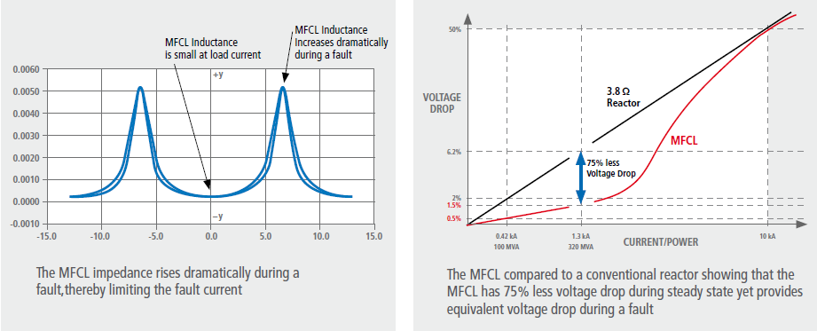
Operating Principle of MFCL

Slide 7
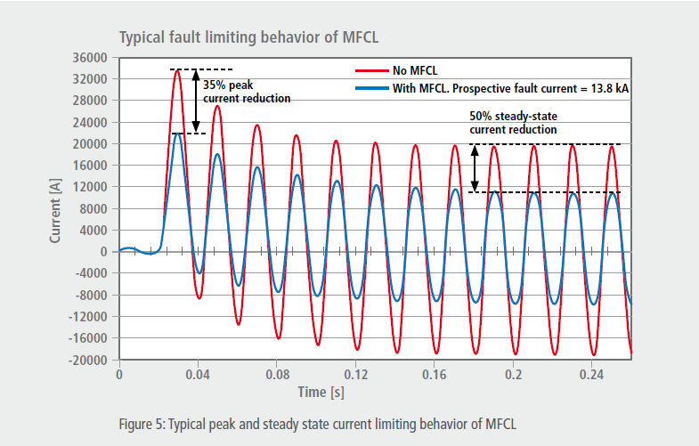
Advantages
– Fast: acts within the first ¼ cycle
– Self-triggering: passive device
– Self-recovering: does not interrupt current
– Scalable: MV to HV applications
– Robust: designed for 3s short circuit currents
and CB automatic reclosing
– Reliable: 24/7 operation
– Fail Safe: fails in high impedance state ensuring protection at all times
– Automatic: full remote monitoring/data
– Transparent: reduce or eliminate issues associated with reactors. This includes transient recovery voltages and high insertion impedances.

Slide 8

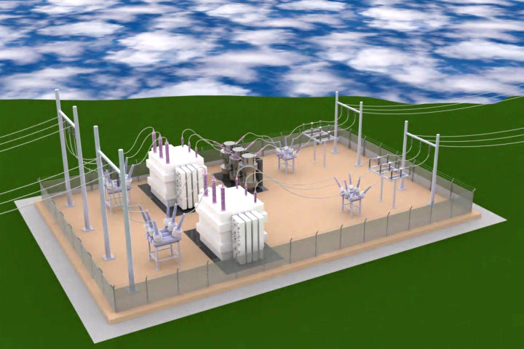
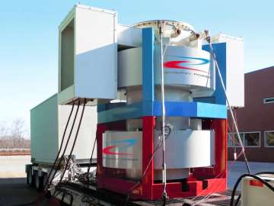
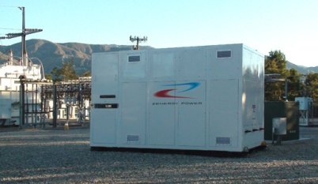
Zenergy Power Milestones of
„Magnetic Fault Current Limiter“ Development
HV Prototype
138kV prototype landmark operation
10-36kV com
138kV prototype three-phase #2&3
MV Prototype
138 kV prototype manufacturing phase #1
Demonstrator
138kV lab-scale prototypes tested
33kV commercial design started Q2 2011
Lab-Test
11kV commercial prototype landmark operation
11kV commercial prototype high power tested
11kV commercial prototype built
15kV compact design demonstrators #1,2,3&4 built and tested
12kV prototype installed & on the grid from 03.2009 to 11.2010
12kV prototype built & tested
MV lab-scale demonstrator built and tested
2007
2008
2009
2010
2011
2012
2013
2014
2015

Slide 9
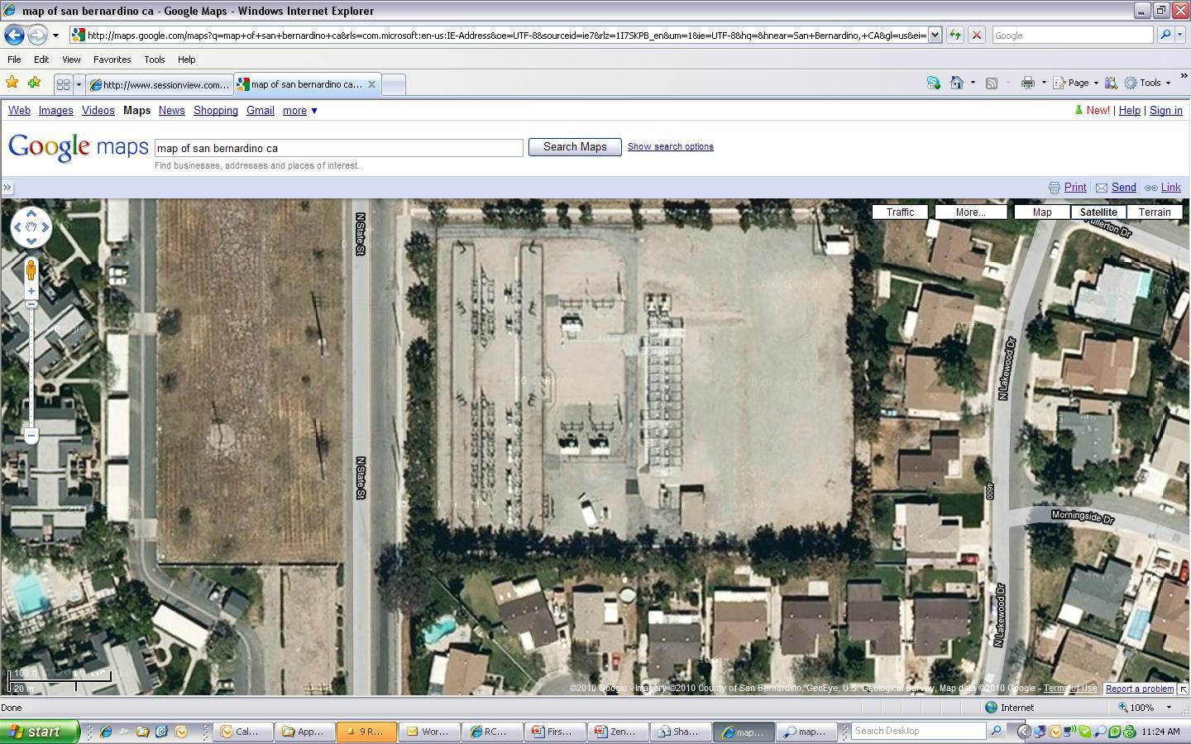
- Serving 1400 commercial and residential customers
- Online March 9, 2009, collecting data continuously since installation
- Scheduled decommissioning in November 2010
Experience at Distribution Substation
MFCL 15kV Class at SCE Shandin Substation,
San Bernardino, California
Zenergy Power
MFCL

Slide 10
Experience at Distribution Substation
115 kV LINE
115/12kV
Transformer
AUTO-BYPASS
SWITCH
First installation in U.S. electricity grid
Operated by Southern California Edison
Supported by U.S. Department of Energy and California Energy Commission
Notes:
10

Slide 11
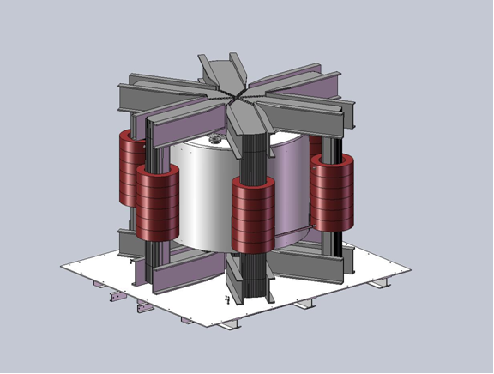
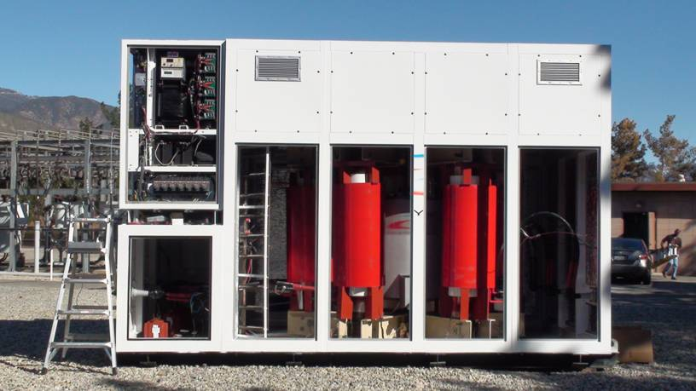
Experience at Distribution Substation
Notes:
11

Slide 12
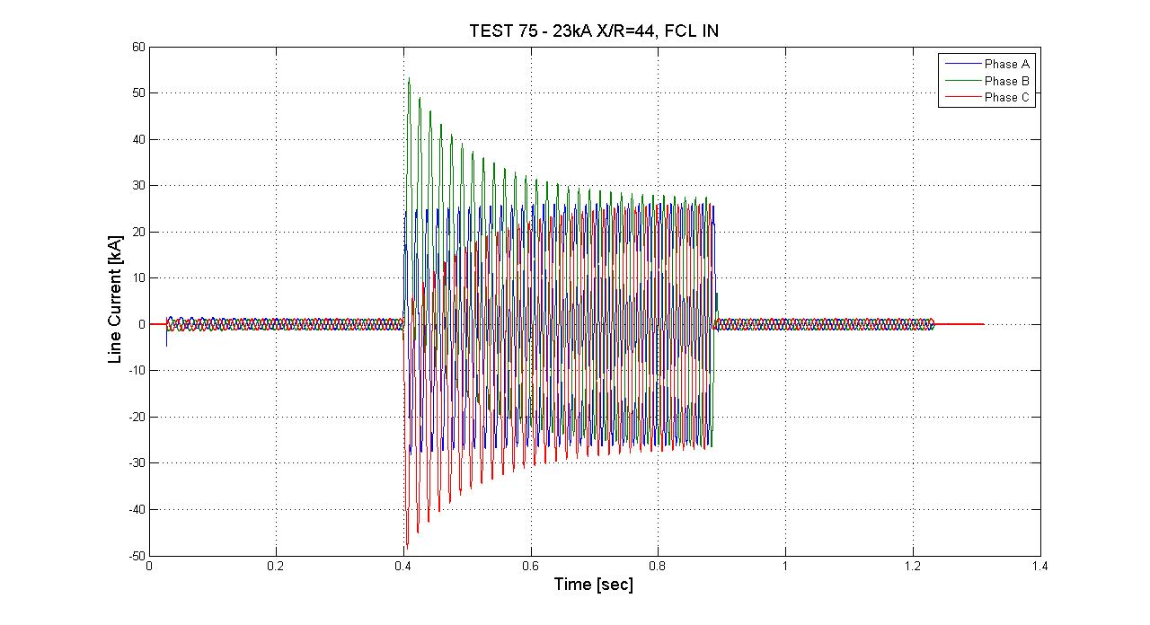
Fully Tested
Double Fault
Recovery Under Load
20 kA rms X/R = 22
3-phase to Ground
20 Cycles
Recovery Under Load
23 kA rms X/R=44
3-phase to Ground
30 Cycles
Endurance Test
20 kA rms X/R=22
3-phase to Ground
82 Cycles
Notes:
12

Slide 13
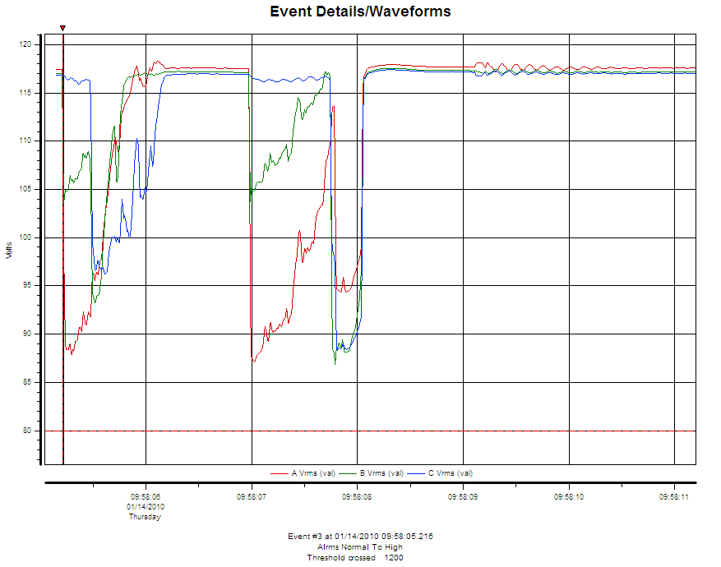
Experience at Distribution Substation:
In-grid fault events
three seconds phase-to phase fault

Slide 14
Summary of Operating Experience:
MFCL at Southern California Edison´s Shandin substation
MFCL has operated continuously since Mar 2009 and was decommissioned in Dec 2010
Operating in a hot, windy, and dusty outdoor environment (-1°C to +42°C)
Experienced one loss of DC Bias with consequent “resonance” condition (see IEEE paper)
Successful integration with automatic bypass switch by utility
Experienced one fault event with multiple faults in quick succession
on 14 January 2010
Rode through two “Loss of Station Power” events
    Effective bypass of MFCL and shut-down of the HTS coil (as expected)
    “Station power failures” caused by grid disturbances not on Avanti circuit
    Instantaneous bypassing sought by SCE
Performed routine maintenance on cryogenics compressors

Slide 15
Compact MFCL Design
Picture frame single phase
Compact single phase
AC input
AC output
HTS coil

Slide 16
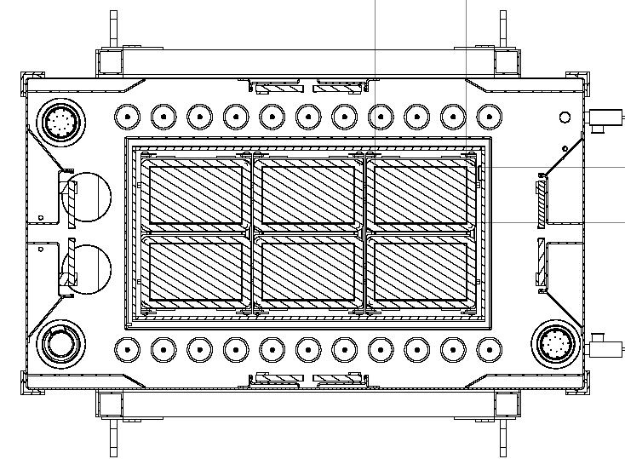
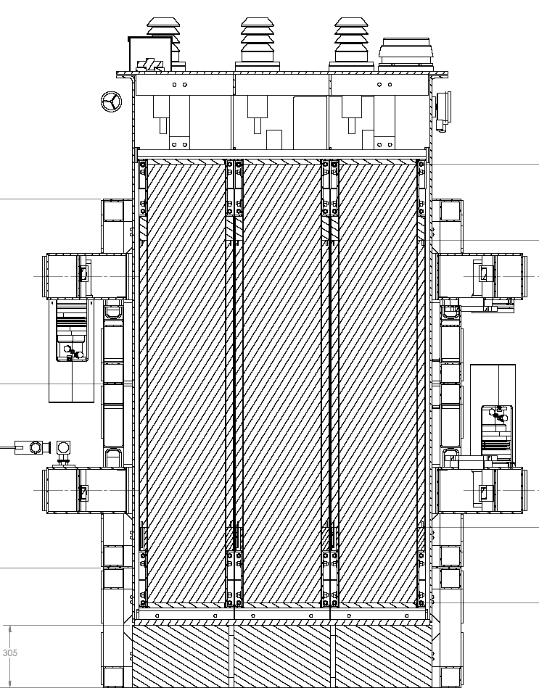
Compact MFCL – Fully Tested

Slide 17
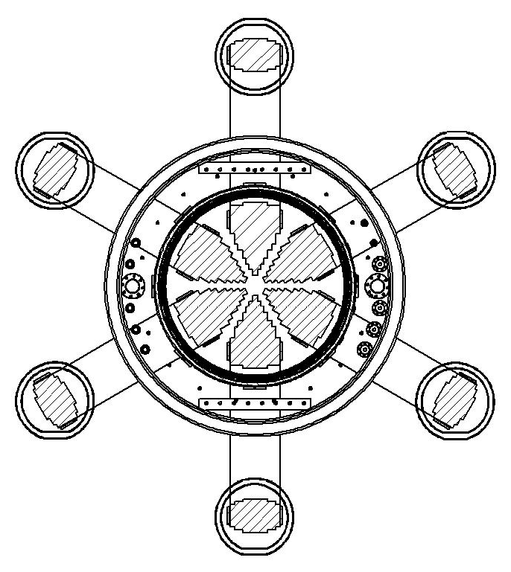
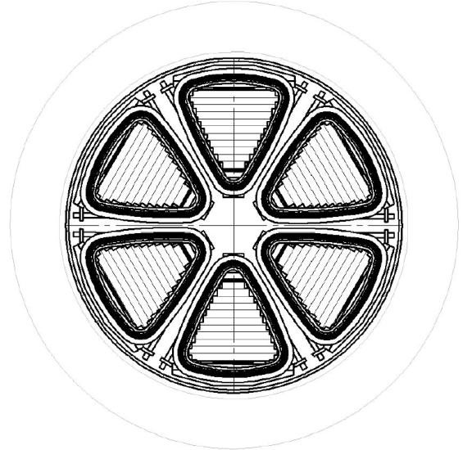
Path from DEMONSTRATOR to COMMERCIAL DESIGN
FROM
DEMONSTRATOR
TO
PROTOTYPE
TO
COMMERCIAL
PRODUCT
SPIDER:
2.5x2.5 m footprint
Effective core 300 cm²
Rectangular COMPACT:
2.0x1.3 m footprint
Effective core 860 cm²
ROUND COMPACT:
1.8m OD footprint
Effective core 750 cm²

Slide 18
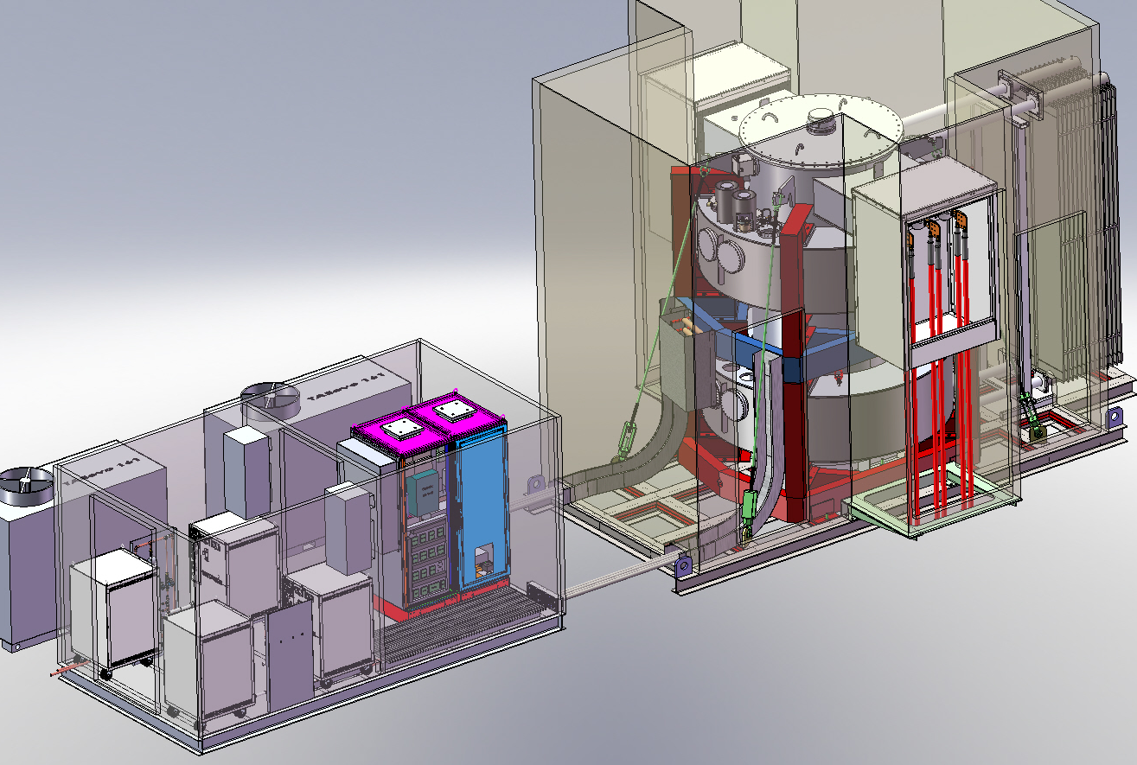
MFCL System for CE Electric substation, UK
Customer: ASL
Operator: CE Electric, UK
15 kV Voltage Rating
3-Phase, 50 Hz
1.25 kA Nominal Current
17 kA_{peak} Prospective Fault Current
3 Second Fault Duration
<1% Insertion Impedance
Reduce Fault by 23% => 13.25 kA_{peak}
Recovery Under Load
Notes:
18

Slide 19
Compact MFCL – Fully Tested – 3 seconds

Slide 20
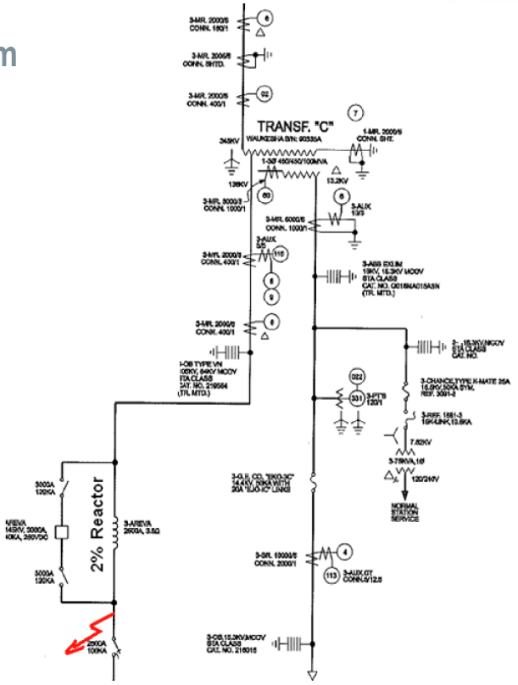
High Voltage MFCL 138kV at AEP Tidd Substation, Ohio
  Requirements Summary
    Rated 138 kV, 1,300 A
    ~ 20 kA prospective fault
    Reduce fault by 50%
    Recovery under load required
    Fault test single-phase end 2011
    Install 3-phase device mid 2012
MFCL will replace Air Core Reactors
FCL

Slide 21
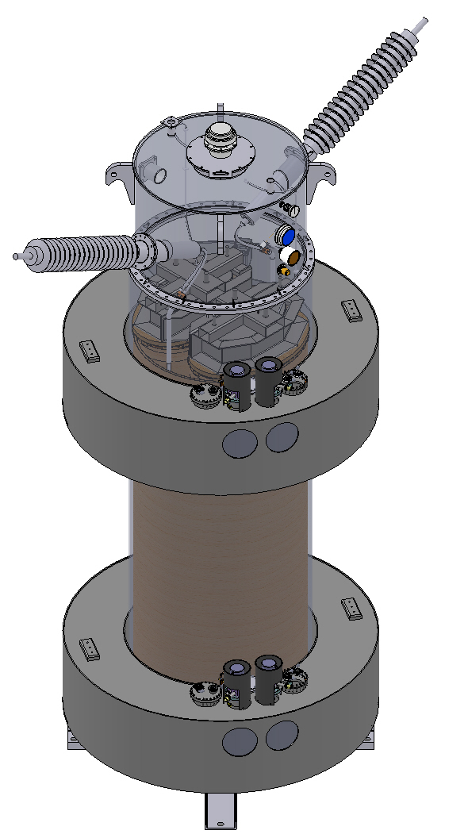
138kV MFCL Design:
3 single-phases

Slide 22
SUMMARY: Zenergy Power´s MFCL
1st installation of the MFCL in March 2009 at Avanti circuit of Southern California
Edison, utility serving Los Angeles/San Bernardino county, for 1.5 year operation
name plate rating 15 kV / 1,200 A
20% clipping of max. 23 kA_{peak} prospective fault current
Compact MFCL prototype for ConEd in New York City, 2009
rated 13.8 kV / 2,500-4,000 A
successful testing in July 2009, data are confidential to ConEdison
Distribution class MFCL underway for deployment and commissioning in Q3 2011
for ASL/CE Electric in UK
name plate rating 12 kV / 1,250-1,600 A
23% clipping of max. 17 kA_{peak} prospective fault current
2011: ASL ordered 33kV FCL engineering study for CE Electric UK.
Transmission class MFCL in manufacturing for deployment in Mid-2012
for AEP American Electric Power in Ohio
rated 138 kV / 1,300 A
43% clipping of max. 20 kA_{peak} prospective fault current

