Slide 1
The Test and Installation of Medium Class(22.9kV) Hybrid type Fault Current Limiter in KEPCO Grid
Wonjoon Choe
Jungwook Sim
Gyeong-ho Lee
Seung-hyun Bang
Kwon-Bae Park
Young-keun Kim
Ok-Bae Hyun
LS Industrial Systems. Korea
KEPCO/KEPRI. Korea

Slide 2
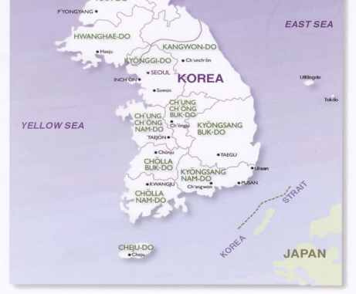
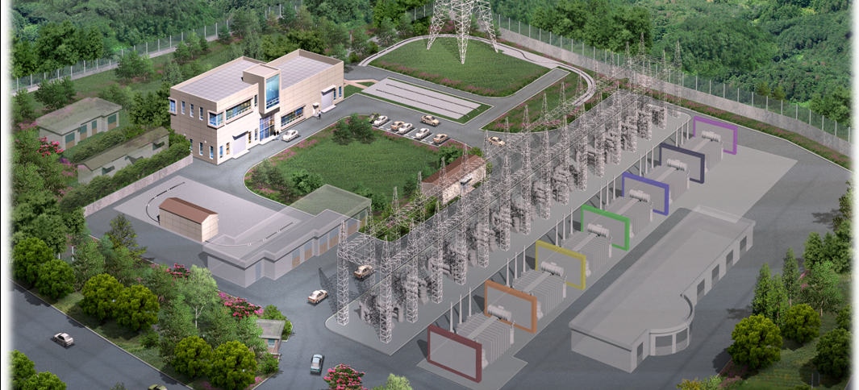
Real Grid Project of FCL and SC Cable
SEOUL
Application Site : ICHEON 154kV Substation, KEPCO
Installation Location: D/L of M.Tr(154kV/22.9kV) secondary
ICHEON
HTS hybrid FCL
Cooling System for HTS Cable
Control and Monitoring System
Termination
of HTS Cable
Intermediate connection
of HTS Cable
Offset
Main Transformer
170kV GIS
25.8kV GIS

Slide 3
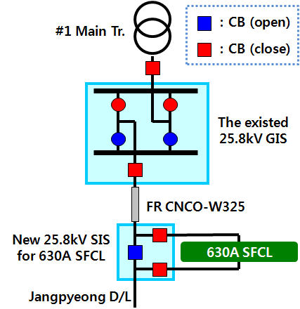
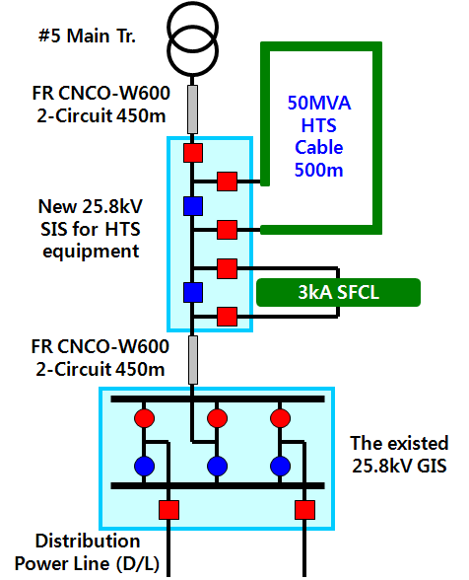
Configurations of FCL & SC Cable

Slide 4
Circuit of Hybrid-type FCL
Switch Mech.
Actuator
Reactor
HTS
VI
HTS Backup Switch
Actuator

Slide 5
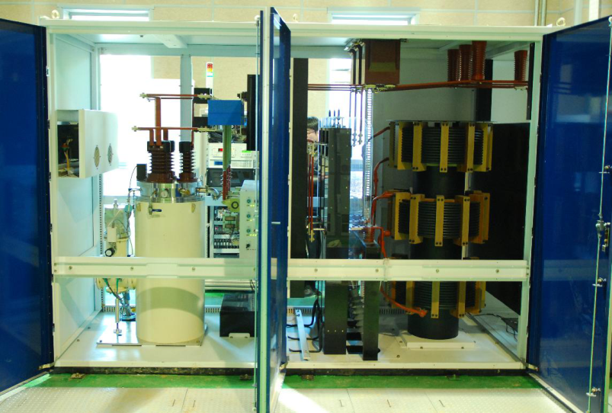
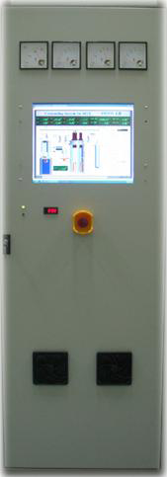
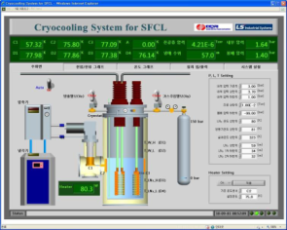
Configurations
Cryocooling System
Switch
Cryocooling
Monitoring & Control System
Current Limiting Reactor

Slide 6
Specification
Parameter | Specification
Rated Voltage (rms) | 25.8 kV
Rated Current (rms) | 630 A
Rated Power Frequency | 60 Hz
Rated Power Frequency withstand voltage (rms) | 70 kV
Rated Impulse withstand voltage | 150 kV. BIL
Rated short circuit current (rms) | 12.5 kA/1.0 sec
Insulation type | Air
Minimum Limiting Current (rms) | 1.4 kA
Current Limiting Reactor | 0.4 [Ω]
Recovery time | < 0.5 sec
Critical Current of HTS | > 2,000 A
Cooling Power | 220W at 80K
Operation temperature | 75~77K

Slide 7
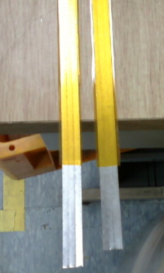
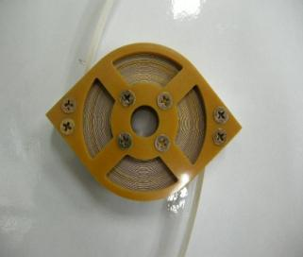
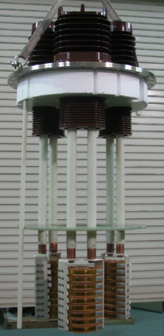
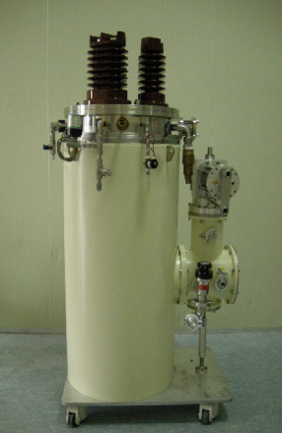
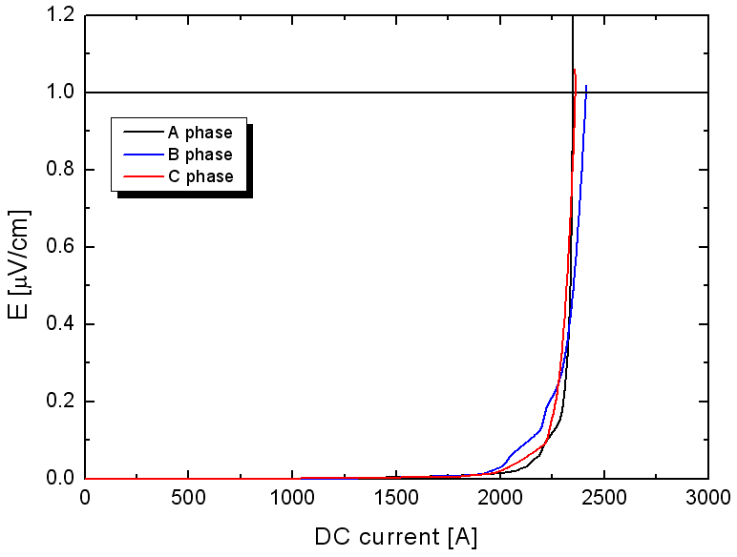
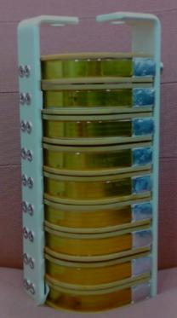
Fabrication of HTS trigger module
Winding
HTS wire(CC)
Critical Current
Stacking
Assembly

Slide 8
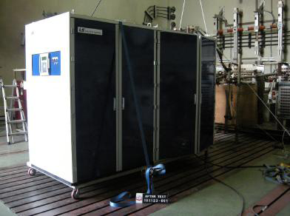
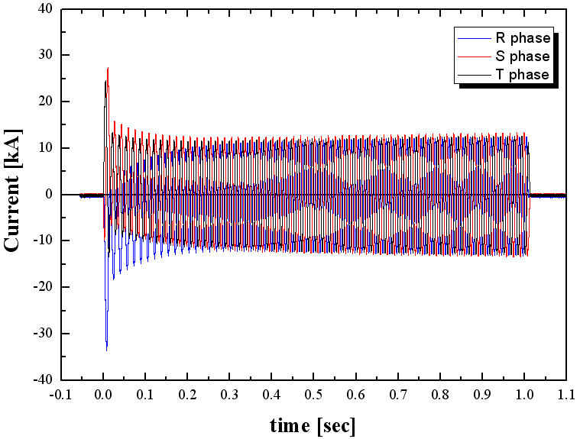
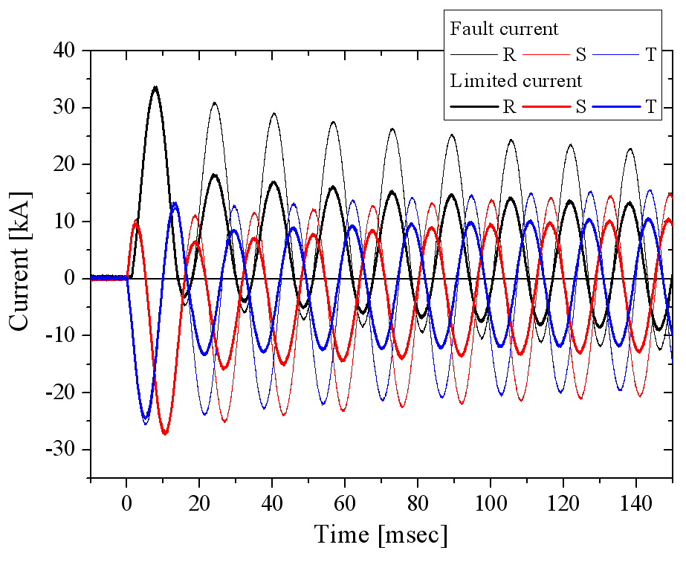
Test of FCL
•Test voltage(rms): 22.9/13.2kV
•Test current(rms): 12.5kA
•Fault duration time: -3 phase: 1.0 sec

Slide 9
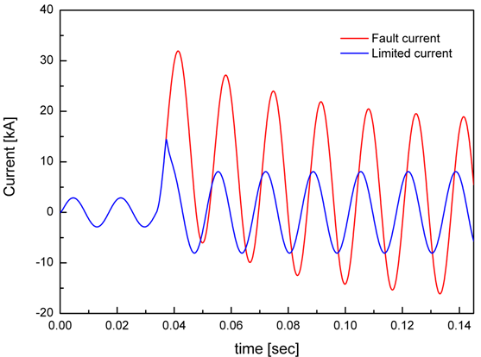
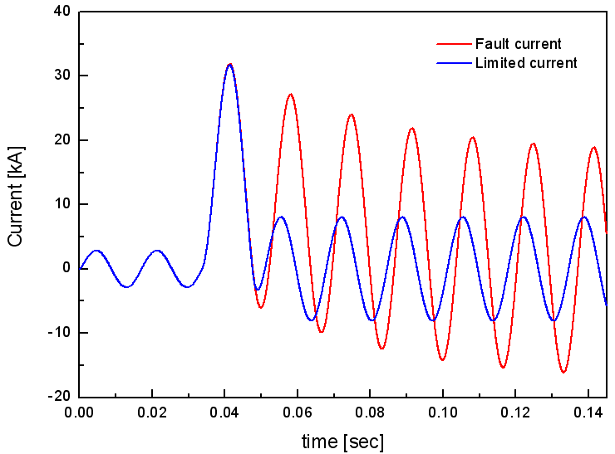
Limiting types of fault current limiters
Type1
Type2
Non-limited region

Slide 10
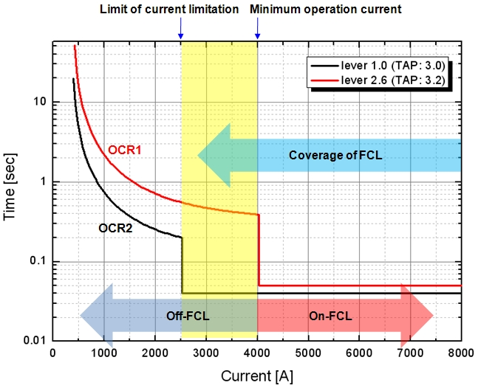
Protective Coordination in DL
154/22.9kV
FCL
M.Tr
154kV
22.9kV
OCR1
OCR2
1

Slide 11
Future Plan
• Commercial operation of 25.8kV/630A HTS hybrid FCL 2011.6~ (Planned)
• Development of Fault Current Limiter for Biz. Model ~2011.12(Planned)
Biz. Model 1: 25.8kV/600A FCL
- Application site: KEPCO DL (Underground grid)
Biz. Model 2: 22kV/5,000A FCL
- Application site : POSCO (Steel plant in Korea)

