Slide 1


Decentralised Controller for Flicker Mitigation in Converter-Connected DG Networks
Piyadanai Pachanapan, Adam Dysko,
Olimpo Anaya-Lara, Graeme Burt, Kwok L. Lo
Institute for Energy and Environment
University of Strathclyde, Glasgow, UK
21st CIRED, 7th June 2011
RIF Session 2 – Paper ID 1139

Slide 2
Introduction
New Grid Codes require DG to export reactive power (Q) into MV networks
V/Q support from DG→ Local Voltage Control
Can Voltage Source Converter (VSC) interfaced DG provide dynamic voltage compensation similar to a STATCOM?
Piyadanai Pachanapan– UK – RIF Session 2 – Paper ID 1139

Slide 3
Objectives
Use converter-connected DG as decentralised voltage controller to mitigate voltage flicker in MV networks
Reduce the requirements for the deployment of new reactive power compensation devices such as STATCOMs and SVCs.
Piyadanai Pachanapan– UK – RIF Session 2 – Paper ID 1139

Slide 4
Decentralised Control Structure of a DG network
P-V control scheme of grid-side interfaced VSC

Slide 5
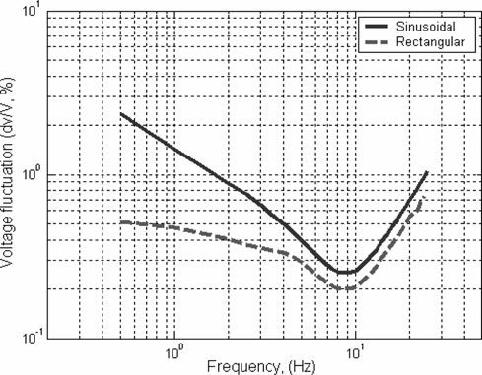
Voltage flicker mitigation
IEC 61000-3-7
Normalised flickermeter response (P_{st} = 1.0)

Slide 6
Test System
Determine controllable area using voltage sensitivity to Q support from bus 07
Bus voltages inside the zone can receive voltage compensation from DG sufficiently
#2
#1
Q-V curve is plotted to consider the possible value of V/Q support
Bus 11: 1 MW fixed speed wind turbine
Bus 7: 1 MW p.f. ±0.95(ΔQ = ±0.33 Mvar)

Slide 7
Controllable Zone
Guarantee V compensation 0.5-0.7 %
#2
#1
Bus 11: 1 MW fixed speed wind turbine
Bus 7: 1 MW p.f. ±0.95(ΔQ = ±0.33 Mvar)

Slide 8
Case Study
Flicker is assumed as “Sinusoidal” at bus 11
(ΔV ≈ ±1.0 %, 2 Hz)
Case 1: using converter-connected DG to control the flicker at a remote bus (bus 11)
Case 2: using converter-connected DG to control the flicker at a local bus (bus 7)
Case 3: using only a STATCOM (0.3 MVar) at the flicker source bus 11
Piyadanai Pachanapan– UK – RIF Session 2 – Paper ID 1139

Slide 9
(Flicker Source)
(VSC-DG Bus)
2 kHz Sinusoidal flicker → ΔV/V < 0.8 % (IEC 61000-3-7)

Slide 10
Calculate Short term Flicker Index (Pst)
AC Sinusoidal
Waveform
X
Flicker meter
Simulator
Pst
RMS flicker
input
IEC 61000-4-15
(via MATLAB)
Pst < 1
IEC 61000-3-7
10 Minutes
Bus | P_{st}
 | No compensation | case 1 (remote) | case 2 (local) | case 3 (STATCOM)
6 | 0.3466 | 0.1656 | 0.0709 | 0.0771
7 | 0.6116 | 0.2594 | 0.1659 | 0.1707
11 | 1.0325 | 0.4516 | 0.5870 | 0.3640
17 | 1.0325 | 0.4516 | 0.5870 | 0.3640
24 | 0.0836 | 0.0372 | 0.0383 | 0.0385
25 | 0.3156 | 0.1291 | 0.1145 | 0.1159

Slide 11
Discussion
Using STATCOM at flicker source bus provides the best flicker mitigation.
Using remote measurement (flicker source) gives better mitigation than using only local measurement (PCC bus of DG), but need communication link.
If voltage sensitivity inside the zone is high, using only local bus control of DG may be sufficient.
Piyadanai Pachanapan– UK – RIF Session 2 – Paper ID 1139

Slide 12
Conclusions
Converter-connected DG with voltage control ability can mitigate voltage flicker with similar results as using a STATCOM.
Flicker mitigation using converter-connected DG is very effective without communication system requirements, when it is connected near the flicker source.
Piyadanai Pachanapan– UK – RIF Session 2 – Paper ID 1139

