Slide 1
Potential of Demand Side Management in Nonresidentual Buildings
Cired Conference 2011
Johannes Jungwirth
Lehrstuhl für Energiewirtschaft und Anwendungstechnik, TU München
Louis von Mandach
Siemens Building Technologies
Timm Rössel
Lehrstuhl für Bauklimatik und Haustechnik, TU München

Slide 2
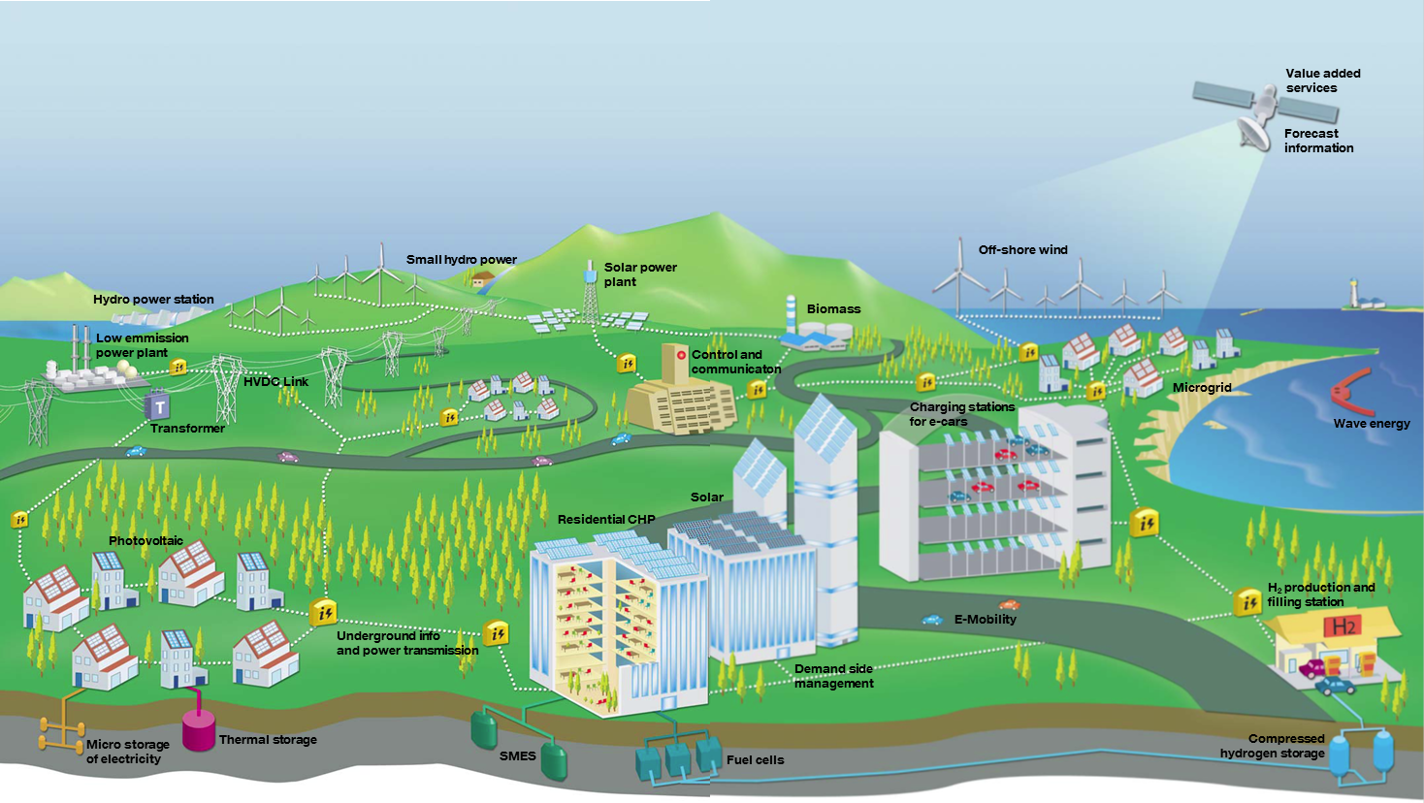
Smart Grid Vision
Source: EC

Slide 3
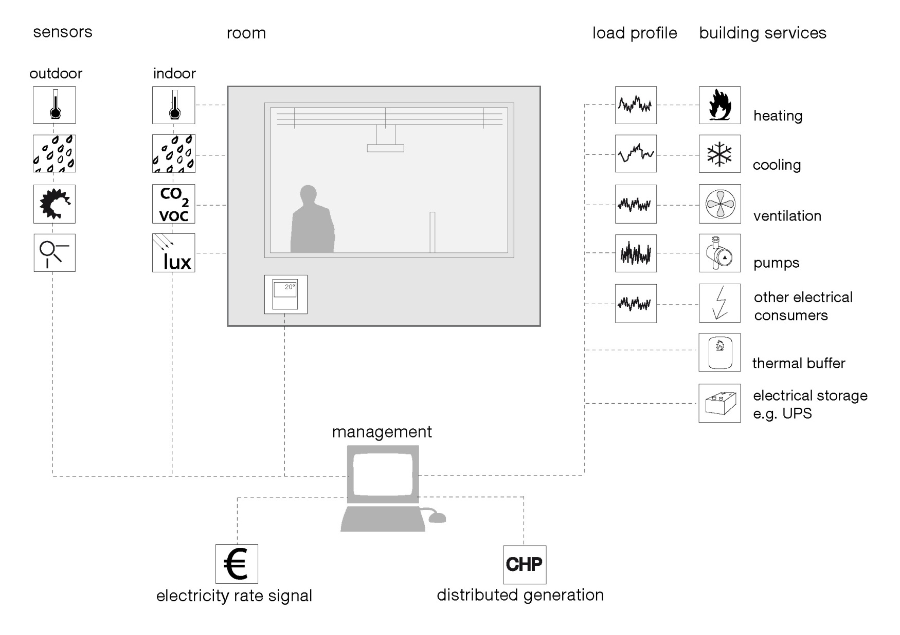
Demand-Side-Management with Building Automation Systems

Slide 4
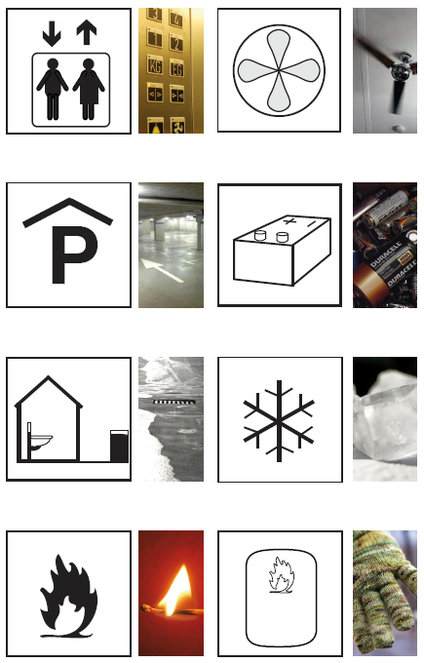
Analysed Consumers
elevators
ventilation
ventilation parking deck
uninterruptable power supply (UPS)
greywater
cold supply
heating
thermal storages
water conditioning
steriliser

Slide 5
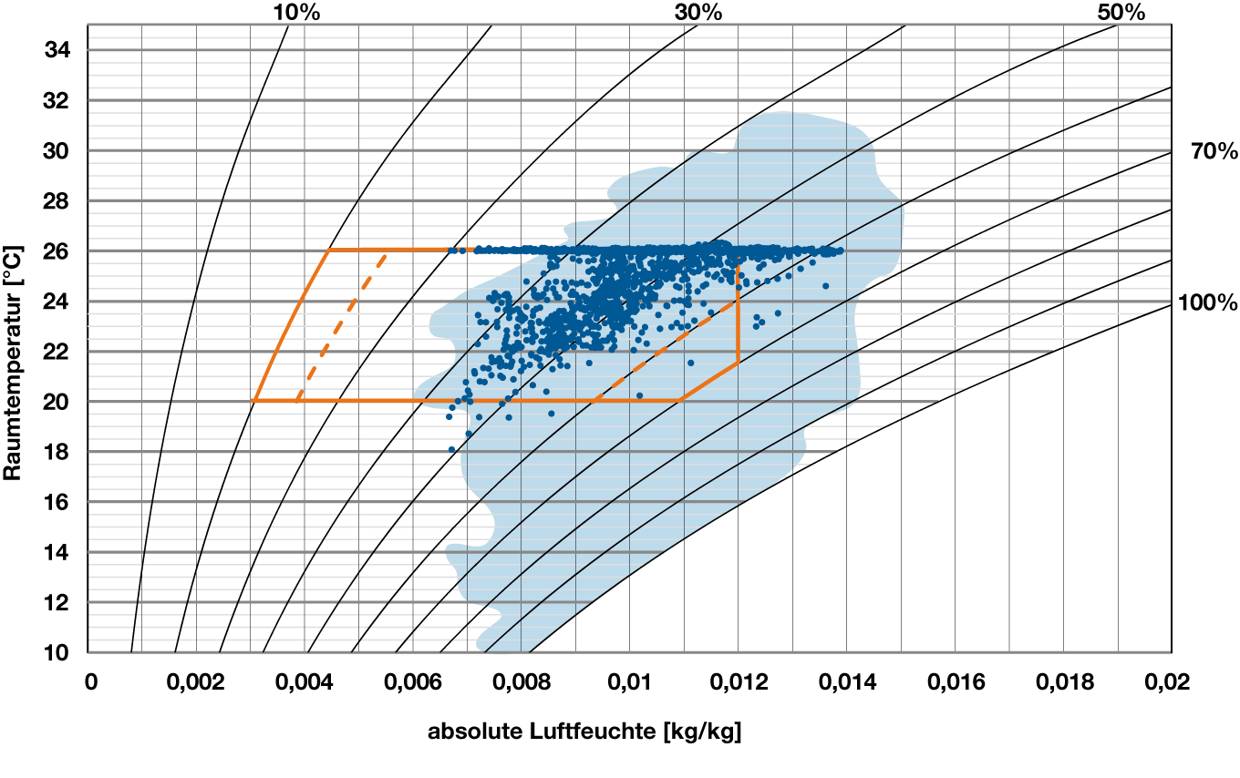
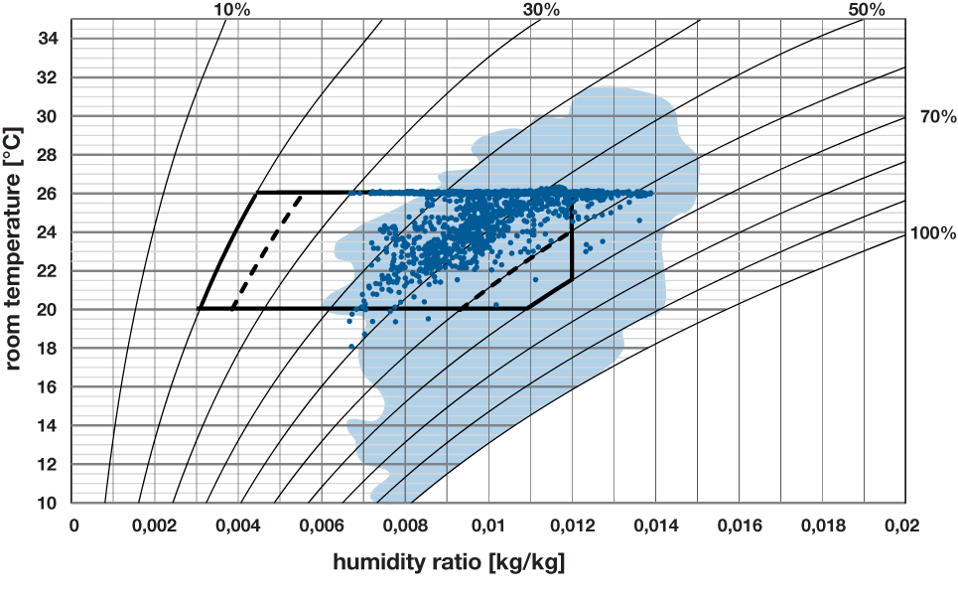
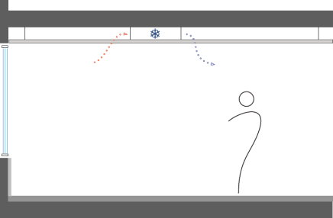
Results – cooling system
simulation time: July, August
open-plan office
lightweight construction
forced air cooling system
standard operation
outdoor conditions
measurement values

Slide 6
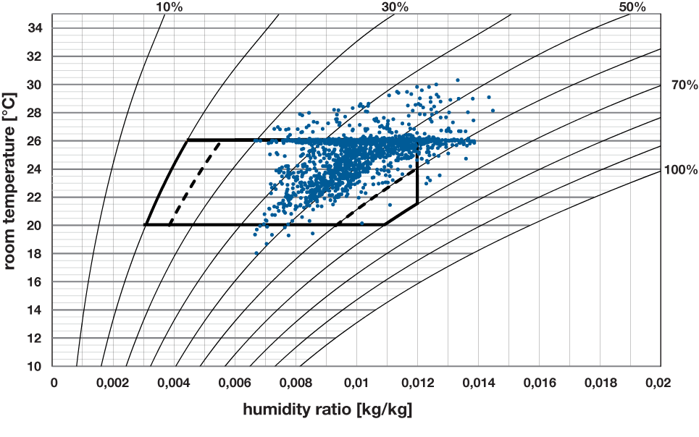
Results – cooling system
simulation time: July, August
open-plan office
lightweight construction
forced air cooling system
discontinued operation: 30 min.
measurement values

Slide 7
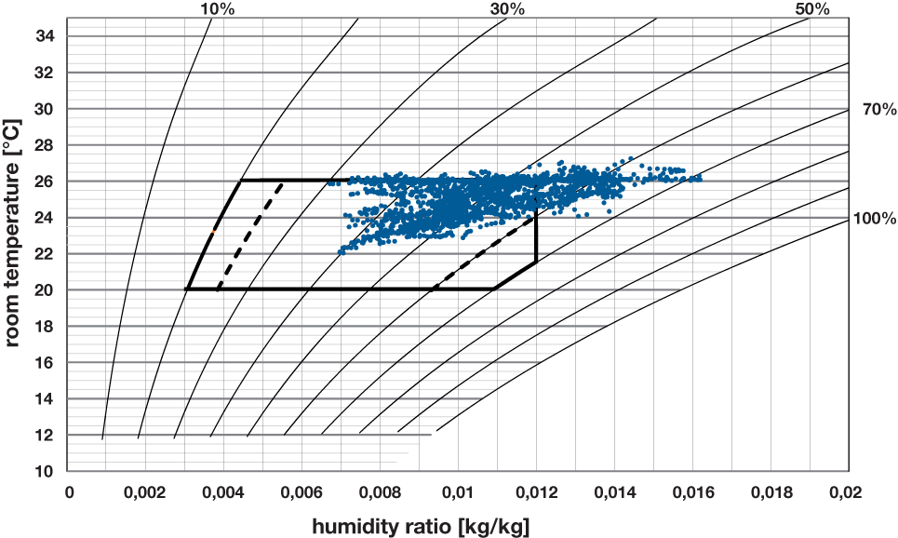
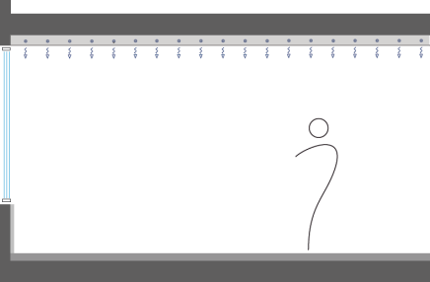
Results – cooling system
simulation time: July, August
open-plan office
heavy construction
chilled ceiling system
discontinued
operation: 30 min.
measuerment values

Slide 8
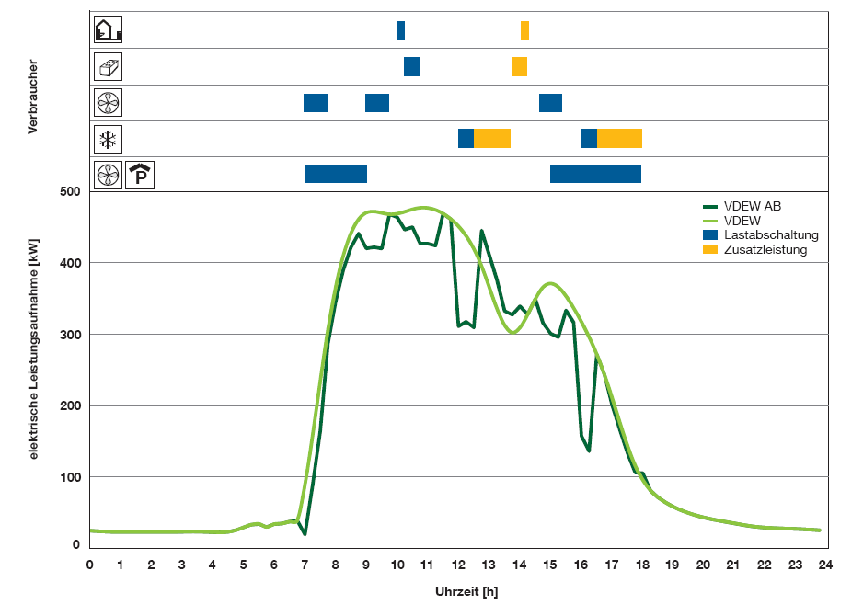
Conclusion
consumer
load reduction
standard
switch off
switch on
electrical power [kW]
DSM potential available, but an intelligent control system is needed
Development of control strategies to implement a DSM
time

Slide 9
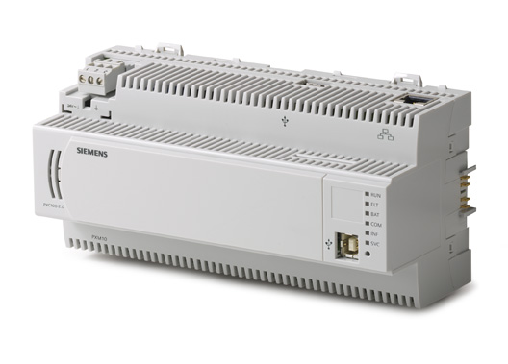
Outlook:
Smart Buildings in a Smart Grid
Innovative control strategies that allow a Demand Side Management with building automation systems
Source: EC

Slide 10
Thanks for your Attention!
Dipl.-Ing.
Johannes
Jungwirth
Lehrstuhl für Energiewirtschaft
und Anwendungstechnik
Technische Universität München
Fakultät für Elektrotechnik und Informationstechnik
Arcisstraße 21
80333 München
Tel +49 89 289-23935
Fax +49 89 289-28313
johannes.jungwirth@tum.de

