Slide 1

Implementation of a test microgrid in Barcelona
Ignasi Cairó – SP – Session ….. – 0342

Slide 2

Catalonia Research Institute of Energy
TECHNOLOGICAL AND RESEARCH AREAS
Reference Area: ENERGY EFFICIENCY
Zero Emission Buildings and cities (NZEB)
Lightning
Microgrids and Electrical Vehicle
Technological and Knowledge Areas:
Advanced Materials
Power Electronics
Bioenergy
Offshore Wind

Slide 3
Components of the microgrid
  Emulated systems: Photovoltaic, Wind power, battery (4 kVA), linear and non-linear load (100 kVA), Power Grid (200 kW);
  Real systems: photovoltaic generator (2 x 2.5 kW), Urban windmill (2 x 1 kVA), lithium-ion battery, ultracapacitors and flywheel storage (5 kW), PEV chargers (3.7kW, 50kW & 5 kW^{V2M});
  Semi-emulated systems: Wind emulator (SCIM) and real generator (SCIG, DFIG, PMSG) (5 -5.5 kW)

Slide 4
Power Balance:
Emulated systems
Real Systems
EV charging

Slide 5
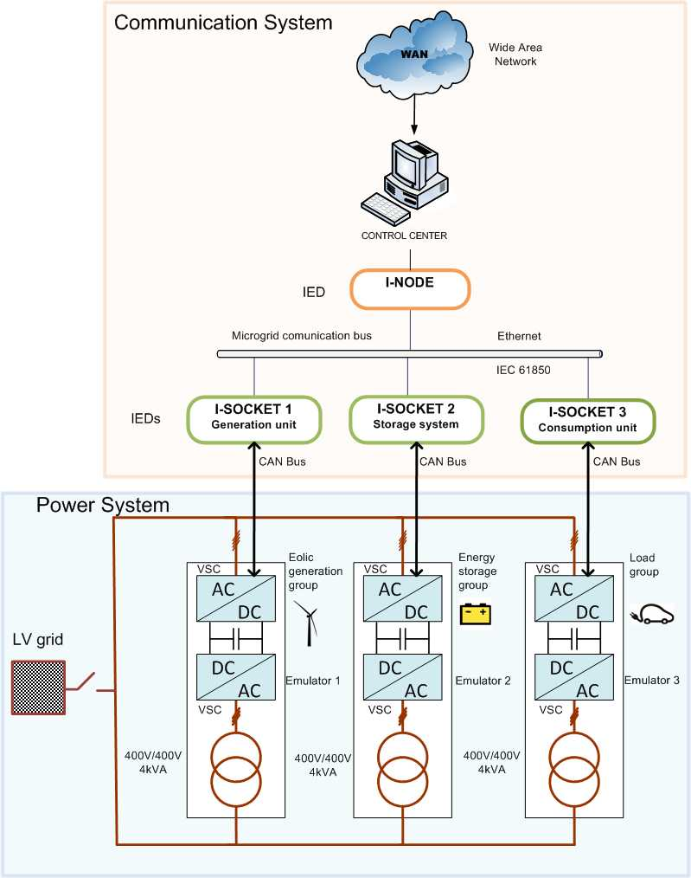
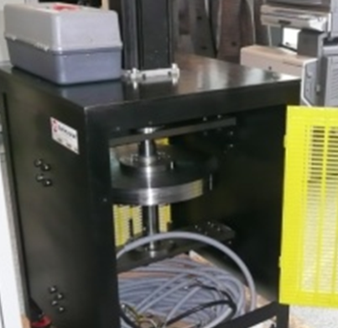

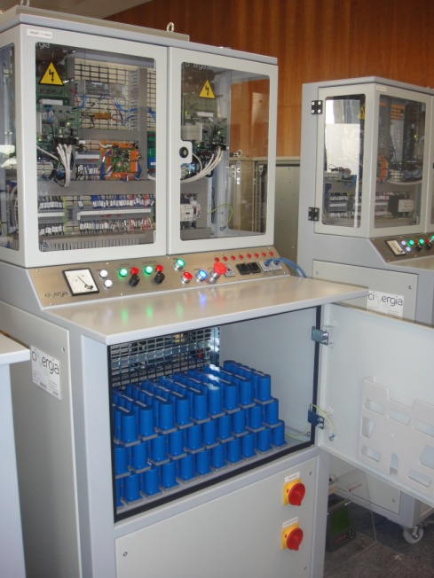
Hybrid uG concept
At the hybrid microgrid, it is possible to test either emulated and real DER devices
DC
DC

Slide 6
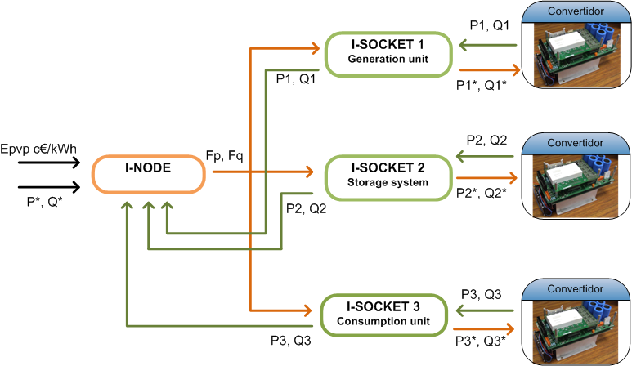
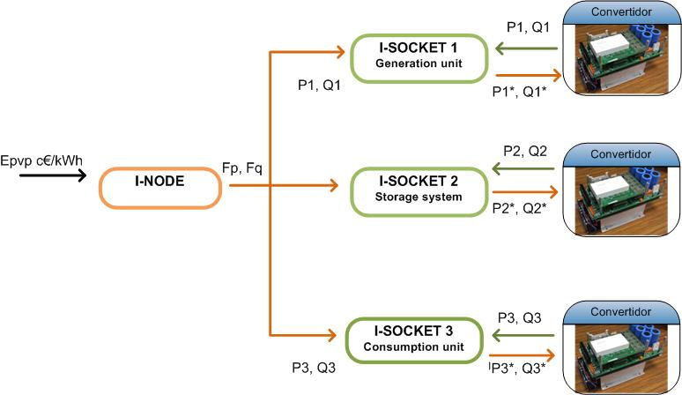
Operating the microgrid
Control algorithm can handle centralized and distributed control. Independent control P/Q & €

Slide 7
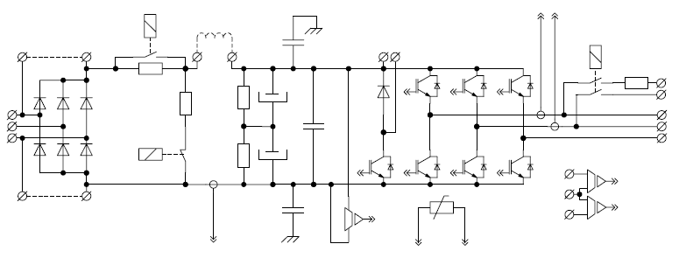
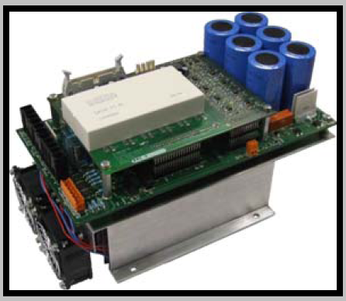
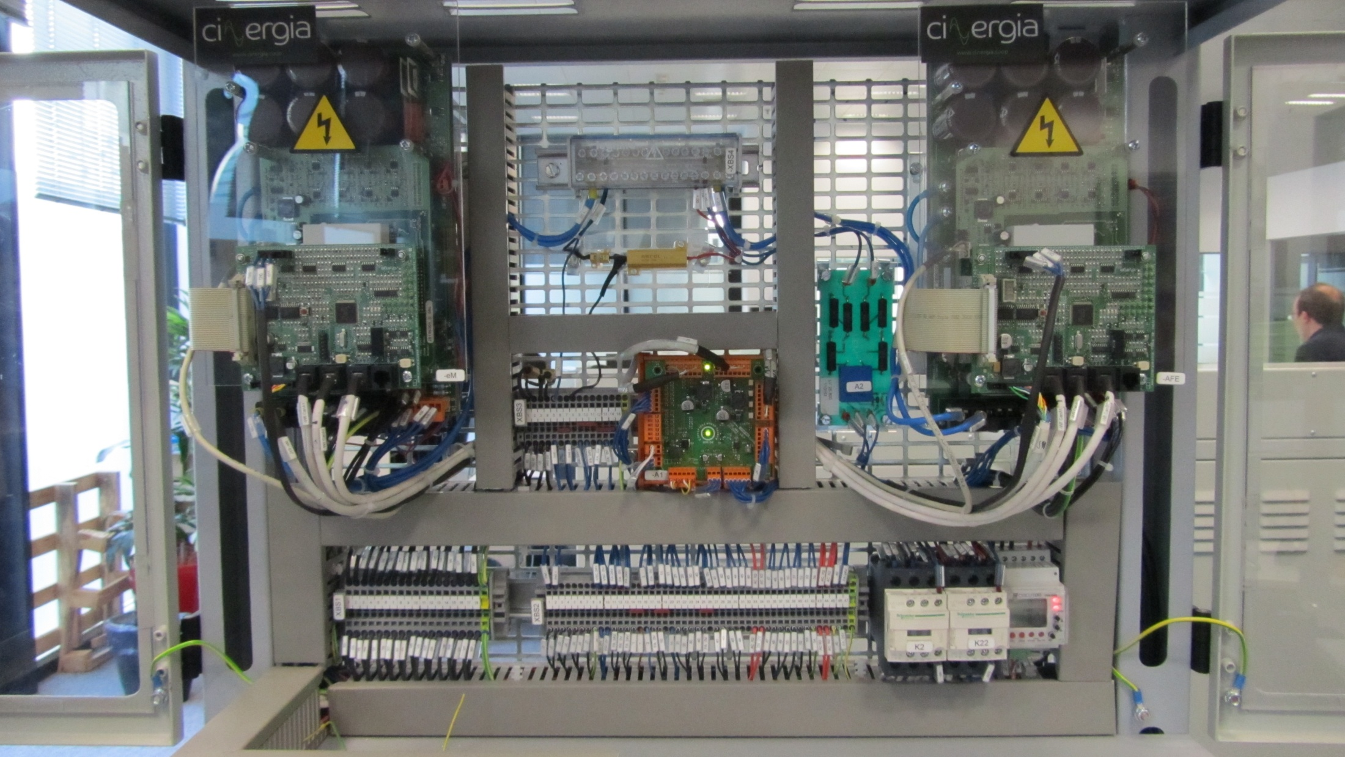
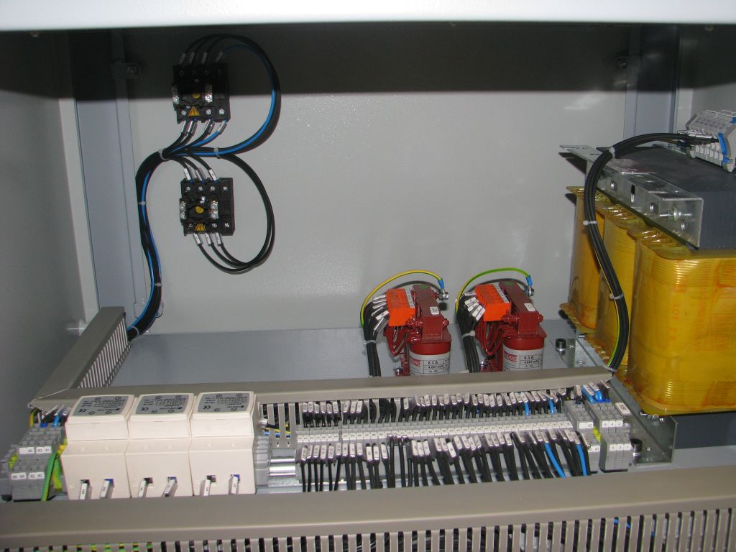
Power electronics converters are used to interface energy sources and Energy Storage Systems (ESS), between them and the grid

Slide 8
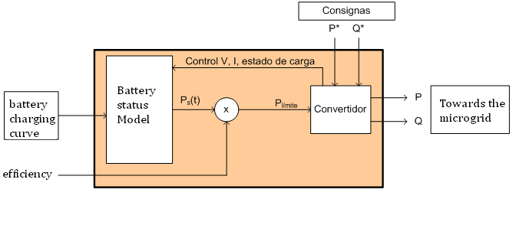
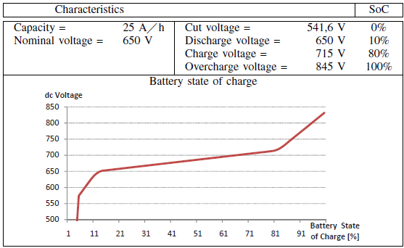

4 batteries are considered: Lead-acid, Li-ion, Ni-Cd. Ni-Hidrur Metal. Also Supercaps & Flywheel

Slide 9
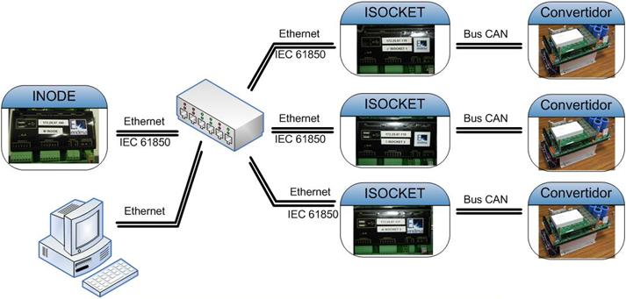
Communications network is established in the uG
  IEC 61850 from iNode to iSocket (Ethernet)
  Bus CAN from iSocket to converter physical variables,
  Modbus Ethernet network between measurement equipment.
Also developing; CHAdeMO, PLC, zigBee, 3G (GSM-UMTS)

Slide 10
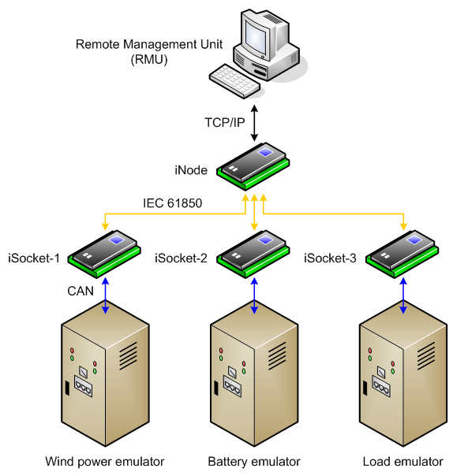
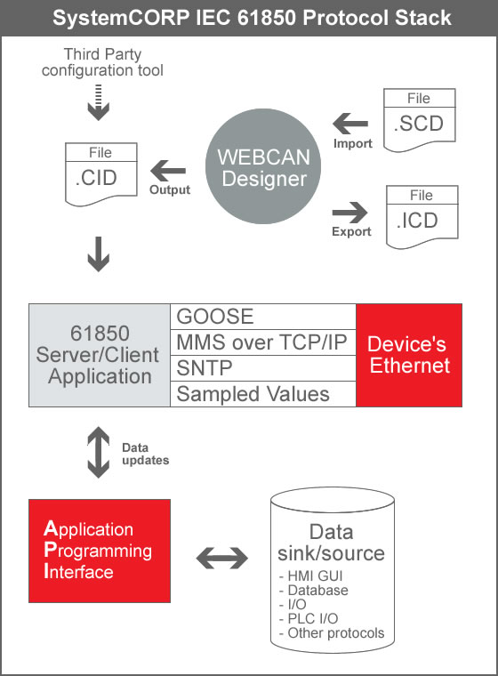
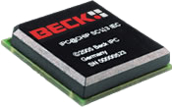
We must provide communications in the power electronics → iNode + iSocket
IEC 61850 one possibility

Slide 11

The IEC 61850 standard
The IEC 61850 in an international standard related with communications in Automation Systems for Substations (ASS).
In 1994, Technical Committee 57 of the IEC started the IEC 61850, taking as a reference the Utility Communications
First protocol published at 2001. Today, the standard has already been extended to DER and hydro plants.

Slide 12
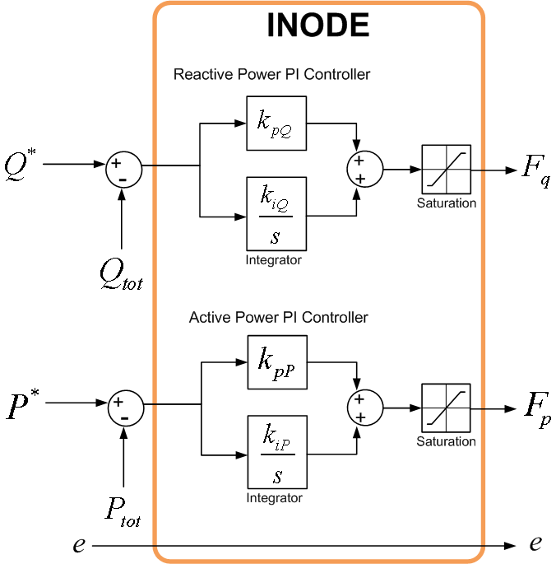

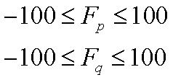
Control algorithm

Slide 13
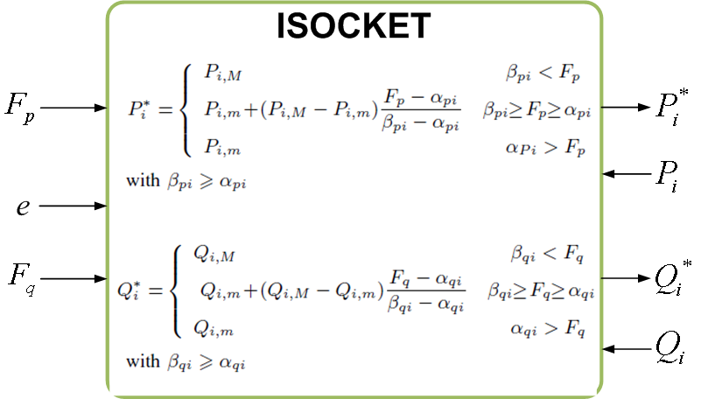


Slide 14
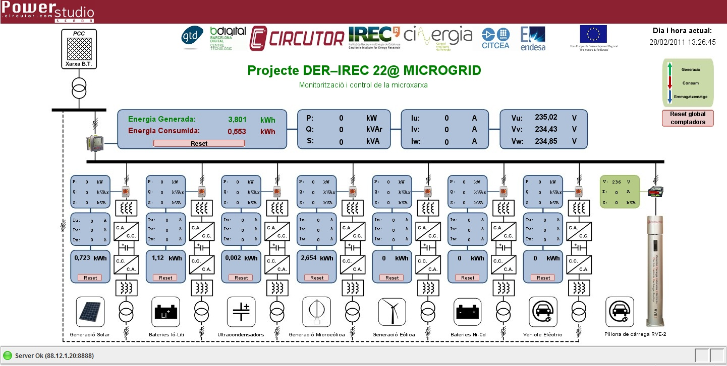
Monitoring the microgrid
http://www.irec.cat/index.php/ca/els-projectes/19-projectes-electronica-de-potencia

Slide 15
Thank you for your attention.
Questions ??

