Slide 1
Connection and Management of DG using Phasor Measurements and DMS
Douglas Wilson
Psymetrix Ltd, UK
Eric Goutard
Alstom Grid, France
Contributions gratefully acknowledged from
Avnaesh Jayantilal and John Sell, Alstom Grid, US
D. Wilson – UK – Session 4 – Paper ID 0497

Slide 2
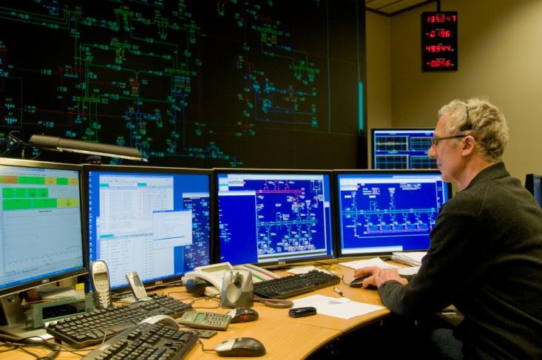
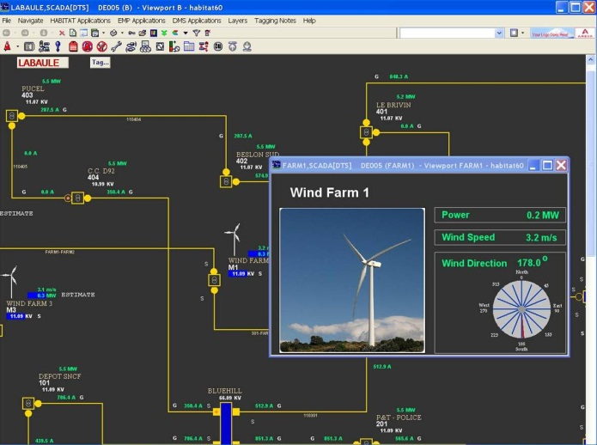

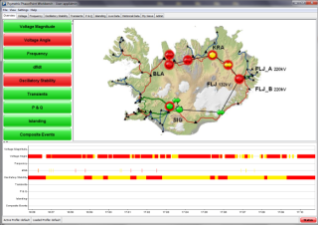
Introduction
Synchrophasor measurement background
Integrated Distribution Management Systems (IDMS)
Autonomous & Centralised DG control

Slide 3


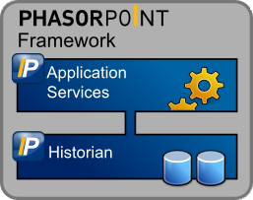


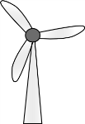
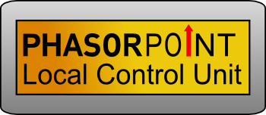
Synchrophasor System Structure
Client Applications
C37.118 PMU/PDC Data Streams
DMS Integration
IEC 60870-5-104
Synchrophasor Applications
  Increase energy delivery
  Improve reliability
  System analysis
  Manage renewables
Autonomous Control
Standards published 1995, 2005
Extensive use in transmission

Slide 4
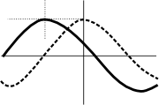
Synchrophasor Measurement
Phase
Magnitude
1
2
3
4
With PMUs, segment is fully observed from 2 locations, all 3 phases
GPS
Timestamp
Synchrophasors: Key Features
  Synchronised V&I measurements
  50/60Hz data captures dynamics
  3-phase measurements
  Real-time streaming
Full per-cycle detail

Slide 5
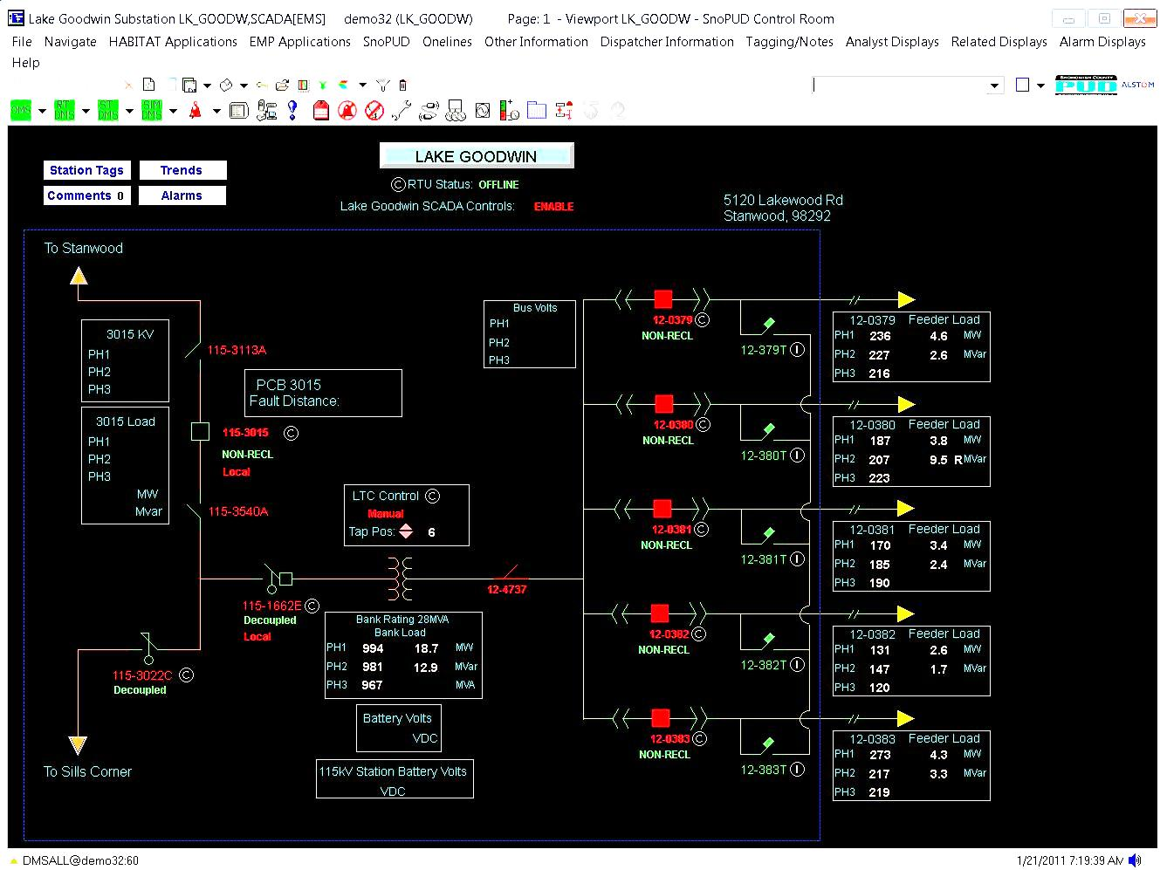
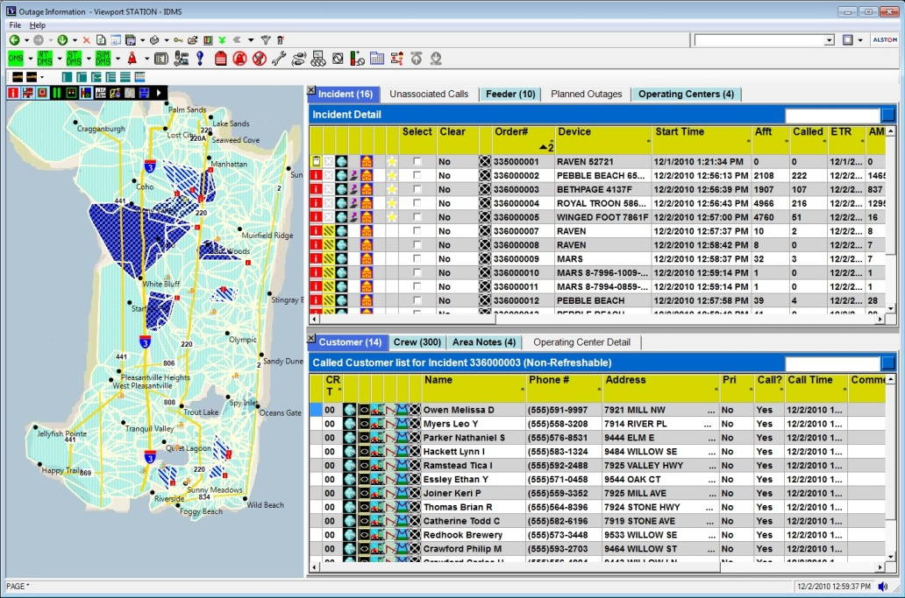
Integrated Distribution Management System
DMS Model-Based Analytics Enable
Distribution Optimization
  Fault Location & Service Restoration
  Reduce Outage Time by 30%
  Reduce System Losses by 3-5%
  Peak Load Shaving of 5%
3-phase Power Flow Analysis
  Control Centre View
  Voltage and Thermal Management
  Safety and Reliability
Integrated SCADA and
Outage Management

Slide 6
DERMS Integration with Integrated DMS
Distributed Energy Resource Management (DERMS)
PMU Benefits
Model Verification
State Estimation
Load Flow / Control
DR, DG -
DERMS
Outage
Management
Analysis &
Optimization
System
Simulator
Switching
Operations
Network View
Network Operations
User Interface
Network Operations
Model
Call
Center
Customer
Model (CIS)
Equipment
Models
GIS, Graphical
Editor
Automated
Metering
(AMI)
e-terrascada
System
Workforce
Management
Distribution
Automation

Slide 7
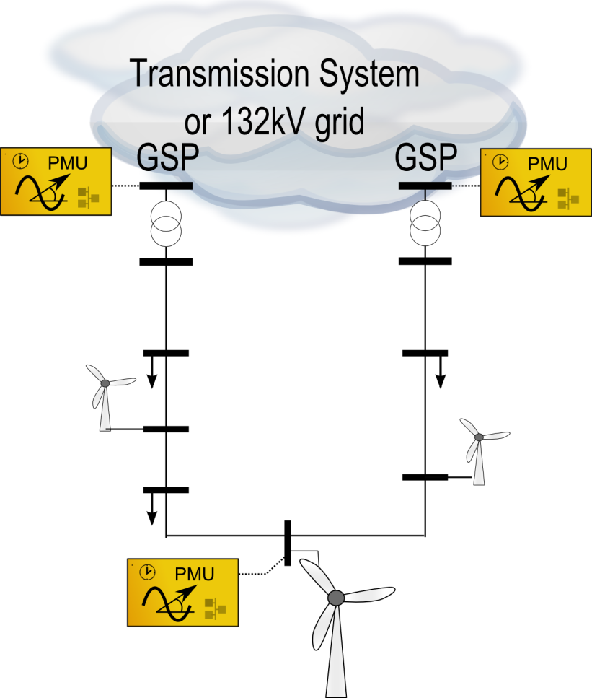
Distribution Network Modelling
HV-connected PMUs to define the boundary conditions: subsystem can be assessed independently.
Change of angle relative to the change of currents can be used to identify the generator or load.
Effects of common-mode events on the load and generation can be observed.
More generation capacity can be made available by determining the true limits of secure operation

Slide 8
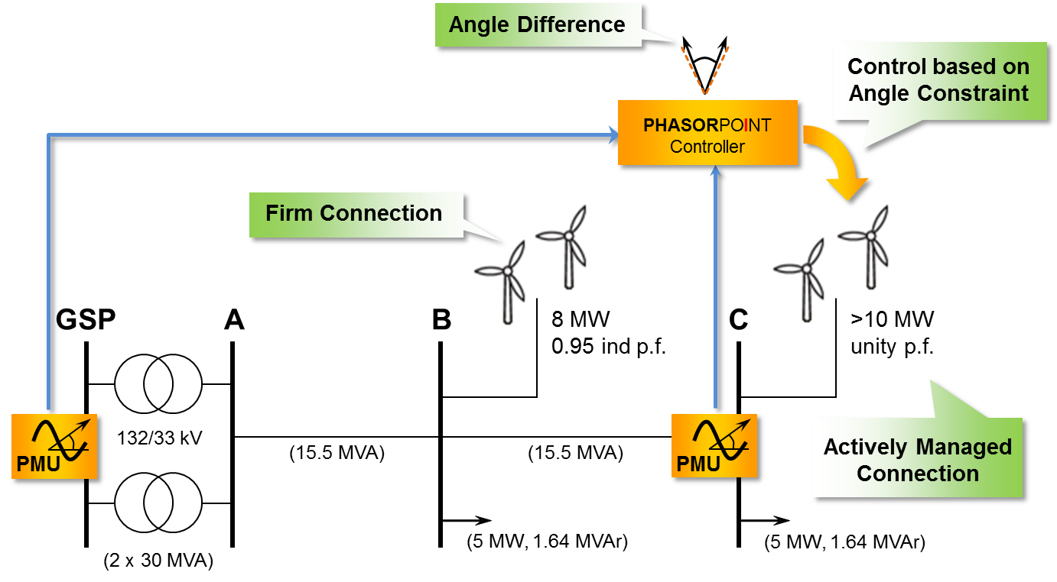
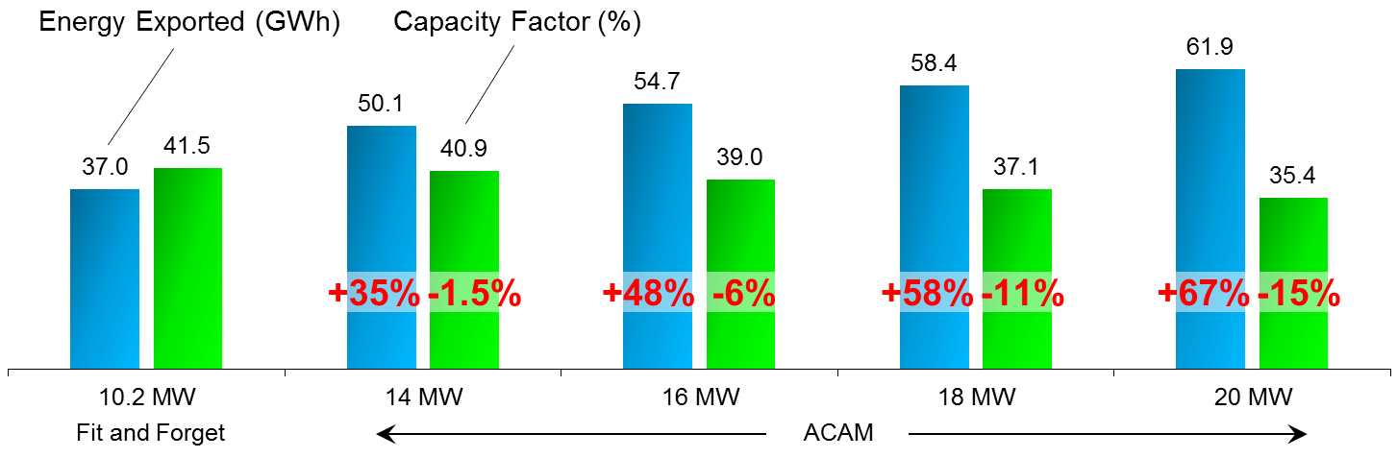
Distribution Connections
Increase capacity by constraining angle:
Manage multiple constraints
Simple control logic
Minimal comms
Generalised
connect & manage
Applicable to Loss-of-Mains solution
Marginal reduction of capacity factor
More capacity
More energy
Notes:
[Key points]
Angle differences reflect the stress of the grid . This concept can be applied in a mashed system (distribution systems)
Windfarm optimal dispatch control based on angle difference measurements (Actively Managed Connection)
Increasing of the Capacity Factor
[ACAM]

Slide 9

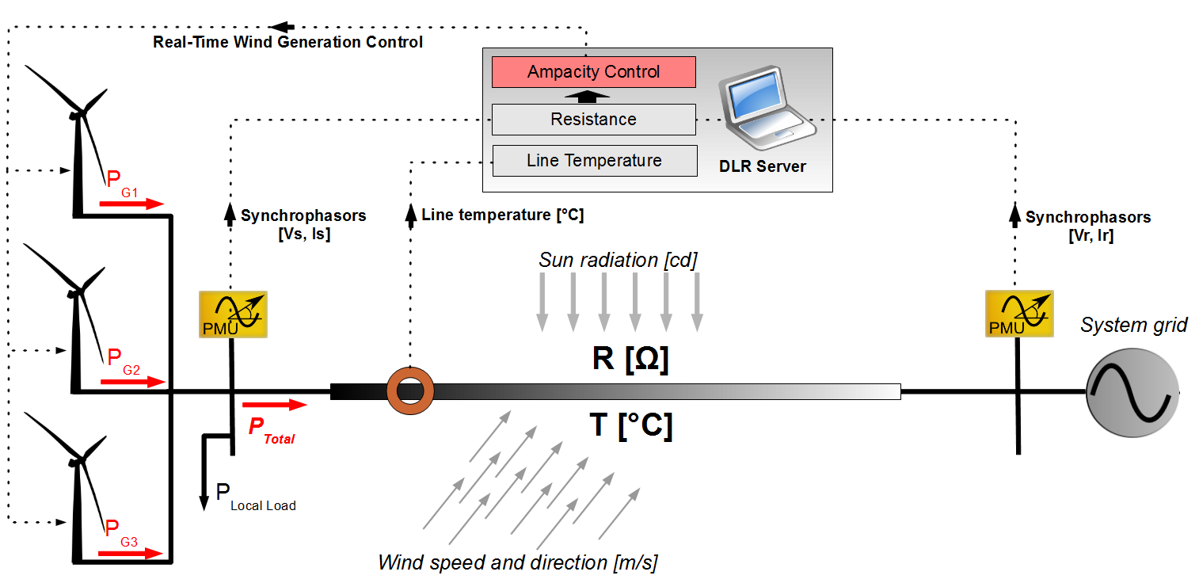
PMU-based Dynamic Line Ratings
Enable More Transfer Capacity

Slide 10
Conclusion
Central control benefits from PMU inputs
Autonomous control with PMUs
  Reduced complexity
  Ramp control / trip as required
  Generalised methods
Co-ordinated central & distributed control
Autonomous
Control
Centralised Management

