Slide 1
SCHEDULING CHARGING OF ELECTRIC VEHICLES FOR OPTIMAL DISTRIBUTION SYSTEMS PLANNING AND OPERATION
David STEEN* Anh Tuan LE* Miguel ORTEGA-VAZQUEZ*
Ola CARLSON* Lina BERTLING* Viktoria NEIMANE†
* Chalmers University of Technology – Sweden
† Vattenfall R & D – Sweden
The work is financed by Göteborg Energi’s Forskingsstiftelse
David Steen – Sweden – RIF 4b – 1104

Slide 2
Outline
Introduction
Method
Results
Conclusions
David Steen – Sweden – RIF 4b – 1104
2 of 12

Slide 3
Introduction
Investigate the impact of PEVs charging on representative Swedish distribution systems
Two distribution system simulated:
  Residential
  Commercial
Two different charge scenarios:
  Uncontrolled
  Optimal
David Steen – Sweden – RIF 4b – 1104
3 of 12

Slide 4
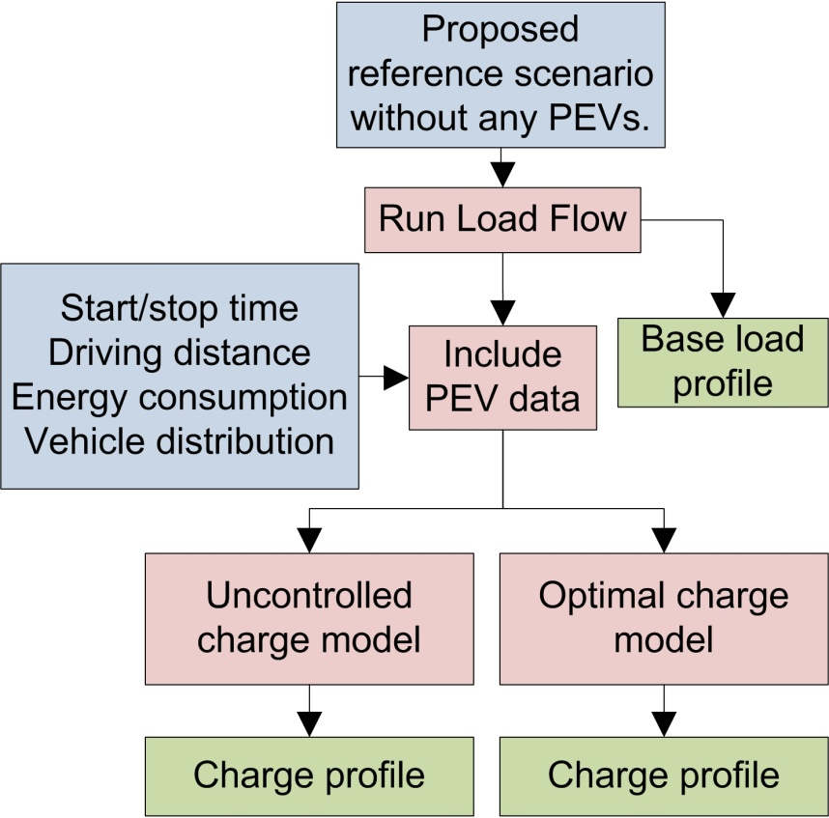
Method
Propose a reference scenario without PEVs
  Grid data obtained from Göteborg Energi
  Calculate losses using OPF
Find data for vehicle utilization
  National travel survey
  Regional statistics
Calculate the maximum
penetration and losses
  Uncontrolled charging
  Optimal charging
David Steen – Sweden – RIF 4b – 1104
4 of 12

Slide 5
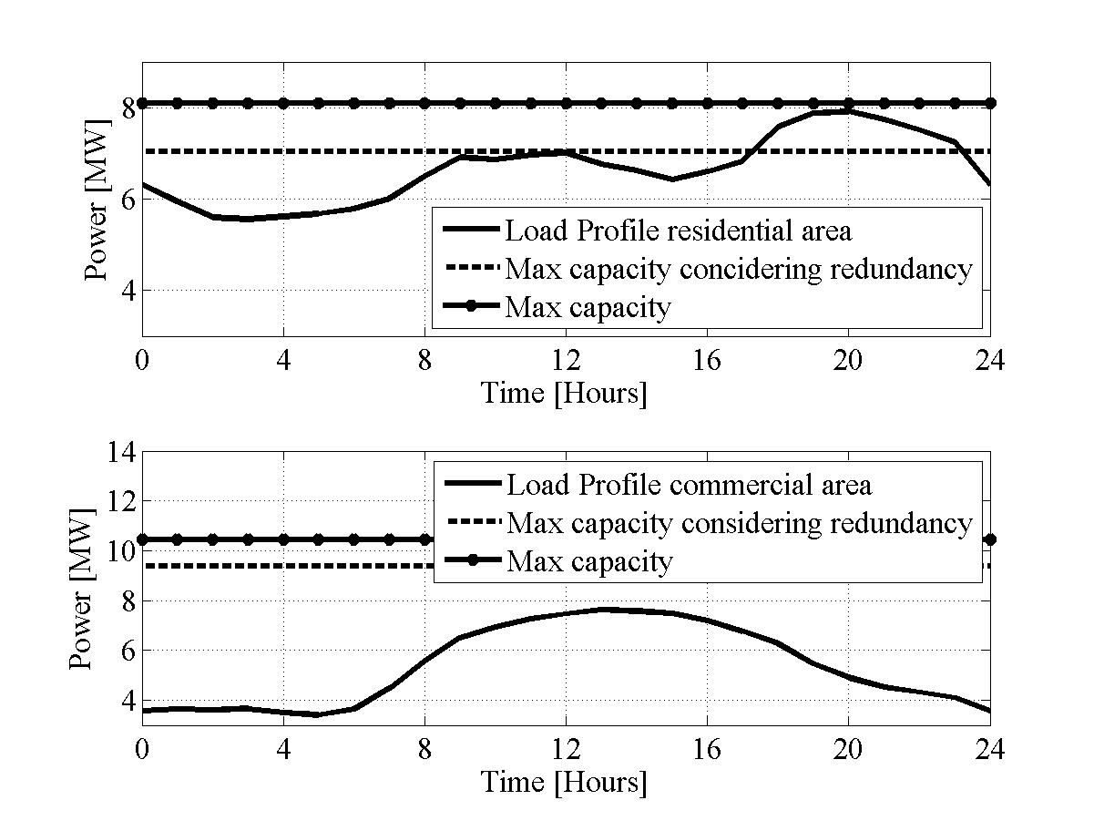
Distribution system
Residential distribution network:
130/10 kV
10/0.4 kV
David Steen – Sweden – RIF 4b – 1104
5 of 12

Slide 6
Distribution system
130/10 kV
Commercial distribution network:
10/0.4 kV
David Steen – Sweden – RIF 4b – 1104
6 of 12

Slide 7
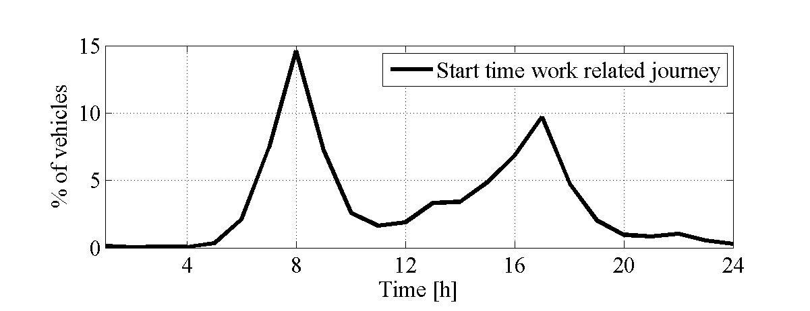
Drive behavior
Average driving distance 30 km
Average driving time 39 min
Average energy consumption 0.2 kWh/km
Charge power 3.68 kVA, PF 0.95
Charging conducted twice a day
David Steen – Sweden – RIF 4b – 1104
7 of 12

Slide 8
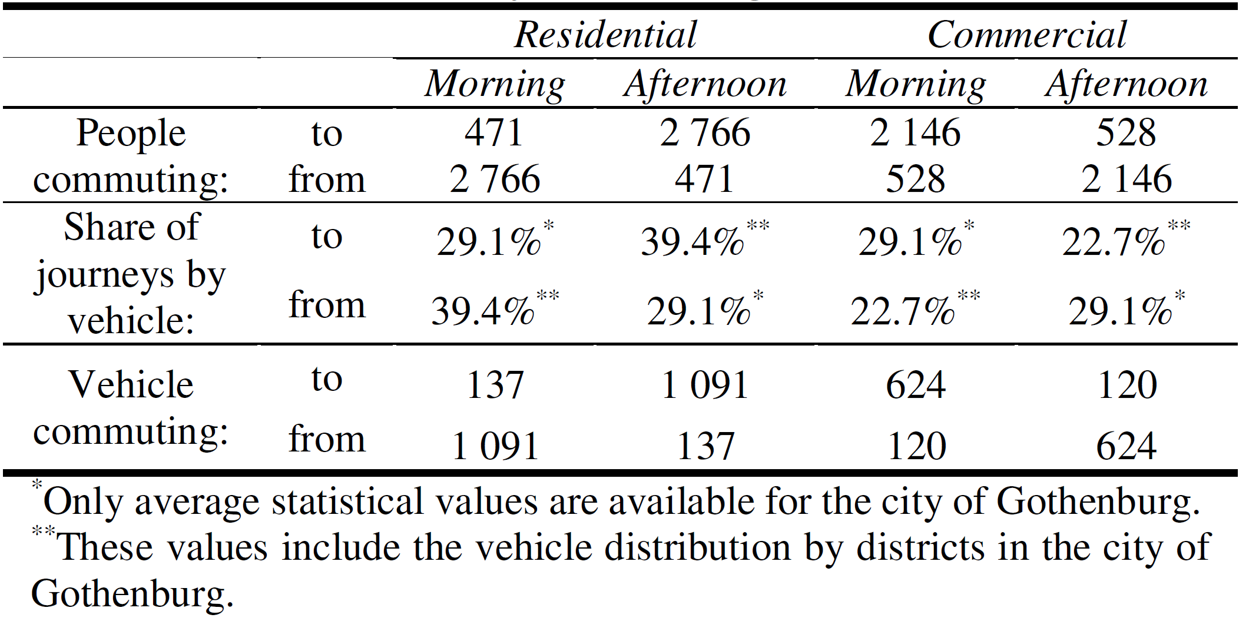
Drive behavior
The number of vehicle varies during the day between the different areas.
David Steen – Sweden – RIF 4b – 1104
8 of 12

Slide 9
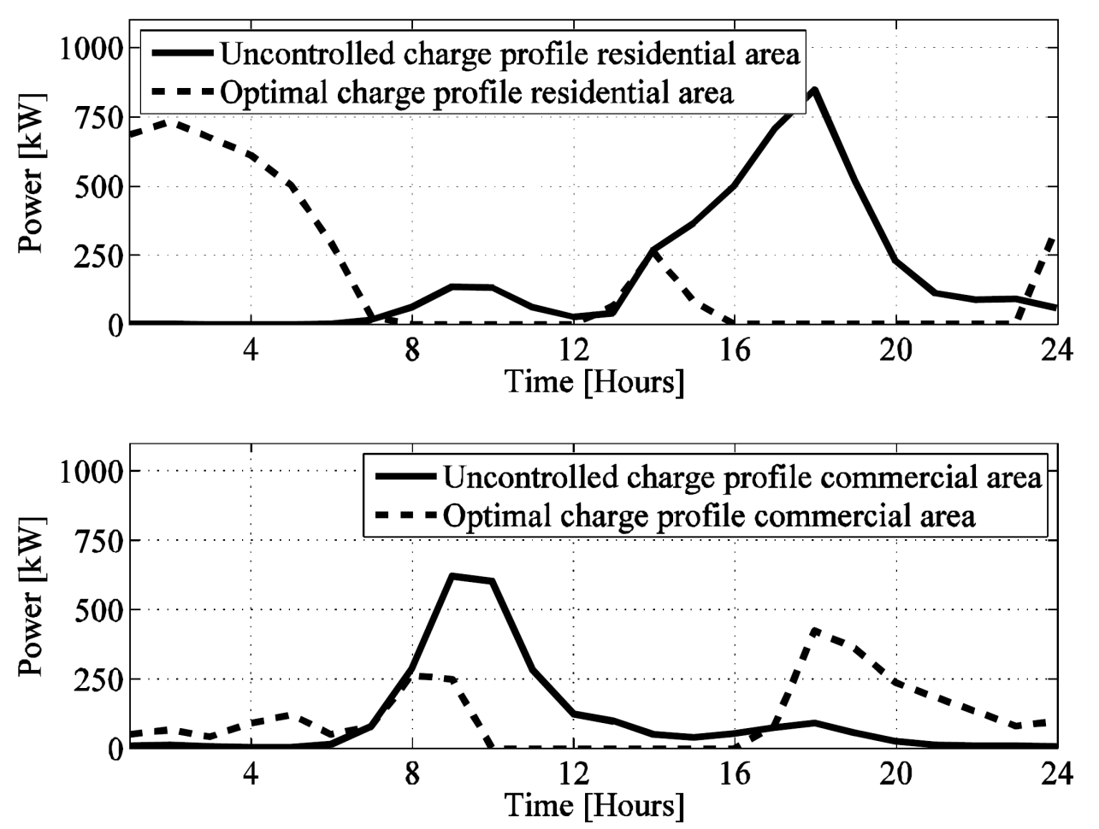
Results – Charge Profile
David Steen – Sweden – RIF 4b – 1104
9 of 12

Slide 10
Results – Load Profile
David Steen – Sweden – RIF 4b – 1104
10 of 12

Slide 11
Results - Losses
Residential area
Commercial area
PEV penetration | 0% | 100% | 288%
Uncontrolled charging [kWh] | 2673 | 2844 | ---
Optimal charging [kWh] | 2673 | 2806 | 3089
PEV penetration | 0% | 100% | 400%
Uncontrolled charging [kWh] | 691 | 723 | 832
Optimal charging [kWh] | 691 | 712 | 784
David Steen – Sweden – RIF 4b – 1104
11 of 12

Slide 12
Conclusions
By deploying controlled charging schemes a larger amount of vehicles can be accommodated in the system.
The vehicles geographical distribution is of high importance for drawing meaningful conclusions.
Optimal charging schedule reduces the losses and increase the system’s reliability.
More realistic scenarios by consider driving distance and not only battery capacity.
David Steen – Sweden – RIF 4b – 1104
12 of 12

Slide 13
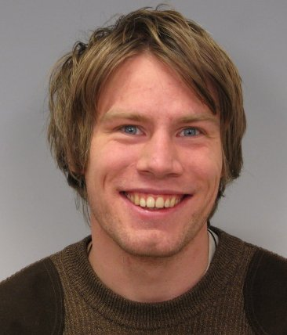
Contact information
David Steen
Division of Electric Power Engineering
Department of Energy and Environment
Chalmers University of Technology
SE-412 96 Göteborg, Sweden
Phone: +46(0)31 - 772 16 63
Mobile: +46(0)739 - 16 95 96
E-mail: david.steen@chalmers.se
www.chalmers.se/ee/SV/personal/steen-david

