Slide 1
LONG TERM PLANNING BASED ON THE PREDICTION AND ANALYSIS OF SPATIAL LOAD
Marcus R. Carvalho – Brazil – RIF Session 5 – Paper ID 0728

Slide 2
Motivation
Increasing regulation of the Brazilian electrical sector.
Mandatory Submission of the Power Distribution System Works Plan to the regulatory agency (ANEEL).
Design a technical and economically efficient plan.
For that the required investments will not overtax the customers.
Marcus R. Carvalho – Brazil – RIF Session 5 – Paper ID 0728

Slide 3
Objectives
Spatial Electric Load Forecasting.
Load Centers: Optimal Substations’ Influence Areas.
Optimal Allocation and Sizing for New Substations.
Marcus R. Carvalho – Brazil – RIF Session 5 – Paper ID 0728

Slide 4
Planning Methodology Flowchart
Network Data
Consumption Data
Grids Definition
Demand Projection
Linking the Grids With the Substations
Analysis and Work Proposition
Marcus R. Carvalho – Brazil – RIF Session 5 – Paper ID 0728

Slide 5
Planning Methodology Flowchart
Network Data
Consumption Data
Grids Definition
Linking the Grids With the Substations
Analysis and Work Proposition
Demand Projection
Demand Projection
Marcus R. Carvalho – Brazil – RIF Session 5 – Paper ID 0728

Slide 6
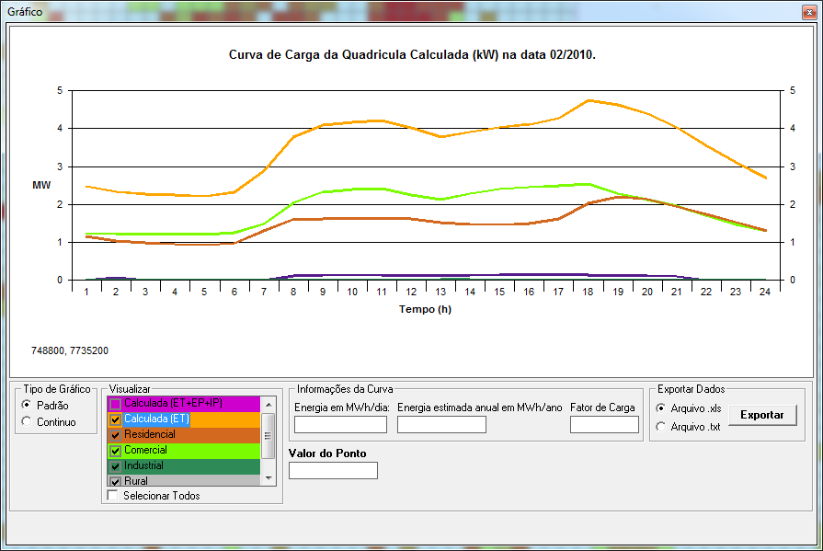
Spatial Electric Load Forecasting
Demand calculated by Energy and Typical Load Curves of each Customer Category:
Residential;
Commercial;
Industrial;
Others.
Marcus R. Carvalho – Brazil – RIF Session 5 – Paper ID 0728

Slide 7
Spatial Electric Load Forecasting
New Load Prediction Model:
Calculates the growing rate for each grid;
Through the extrapolation of the consumption history of each category;
Calculates two different rates:
Global Rate;
Grid Rate;
Marcus R. Carvalho – Brazil – RIF Session 5 – Paper ID 0728

Slide 8
Spatial Electric Load Forecasting
Global Rate use of SARIMA models to forecast load growth:
SARIMA model is auto-regressive of (p) order ;
Its main objective is to calculate (predict) the value for an instant t (Yt);
Based on the combination of the past values;
With a random variable, the error;
Marcus R. Carvalho – Brazil – RIF Session 5 – Paper ID 0728

Slide 9
Spatial Electric Load Forecasting
Global Rate:
SARIMA: Moving average concept:
Series are built through a combination of past errors
Which are the differences between the actual real and the estimated one
Historical consumption data from the whole region is used;
Co-integrated with: region's GNP, number of customers, network length, climate factor and others.
Marcus R. Carvalho – Brazil – RIF Session 5 – Paper ID 0728

Slide 10
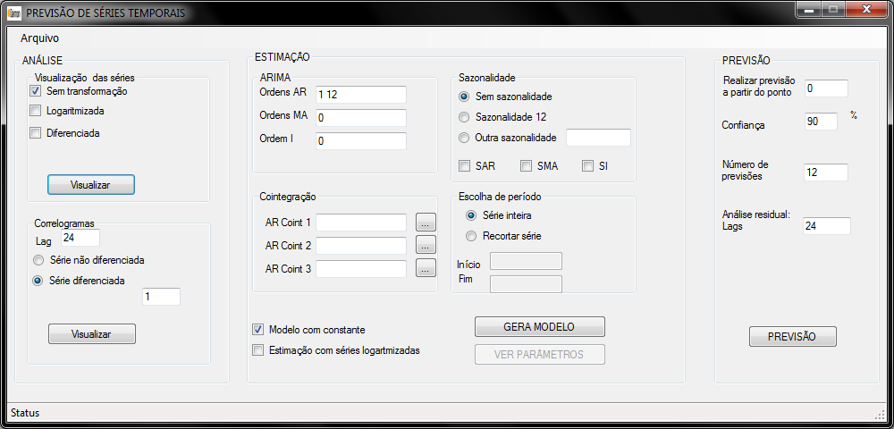
Spatial Electric Load Forecasting
Marcus R. Carvalho – Brazil – RIF Session 5 – Paper ID 0728

Slide 11
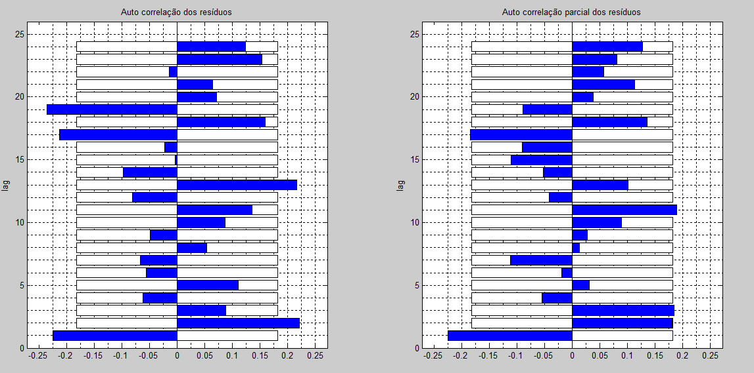
Spatial Electric Load Forecasting
Marcus R. Carvalho – Brazil – RIF Session 5 – Paper ID 0728

Slide 12
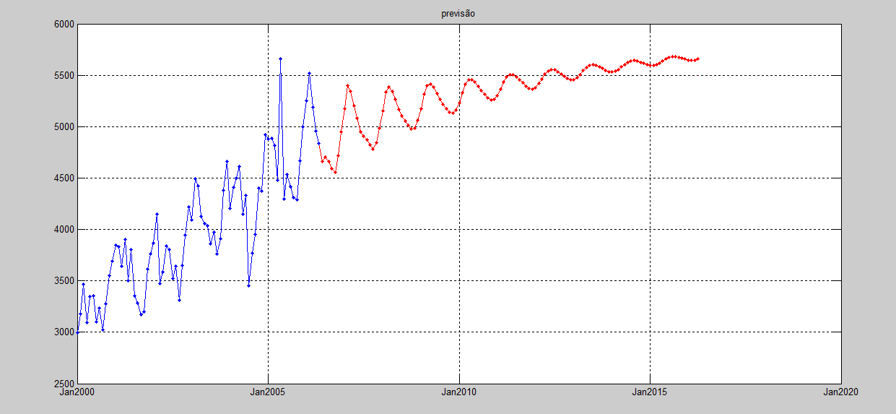
Spatial Electric Load Forecasting
Marcus R. Carvalho – Brazil – RIF Session 5 – Paper ID 0728

Slide 13
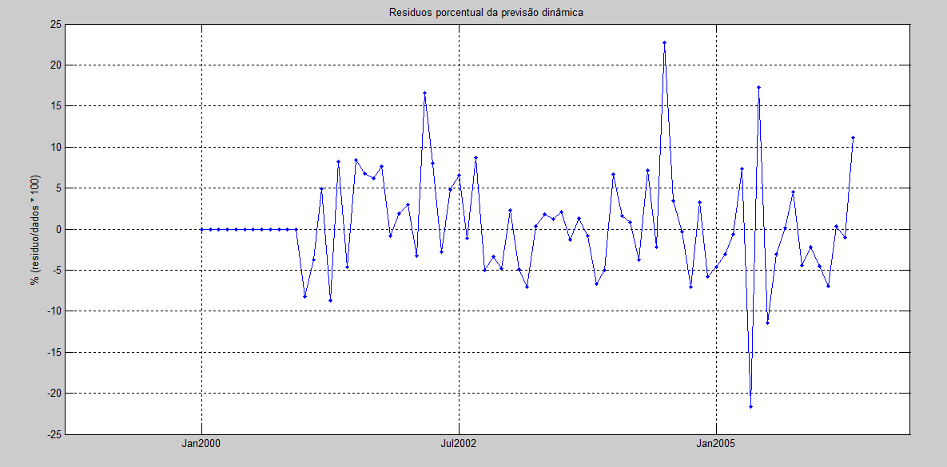
Spatial Electric Load Forecasting
Marcus R. Carvalho – Brazil – RIF Session 5 – Paper ID 0728

Slide 14
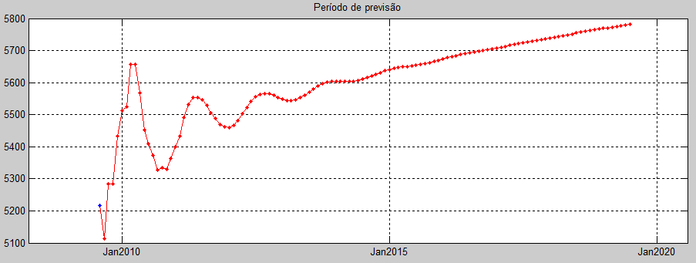
Spatial Electric Load Forecasting
Marcus R. Carvalho – Brazil – RIF Session 5 – Paper ID 0728

Slide 15
Spatial Electric Load Forecasting
Grid Rate:
The grid load prediction is made by simple linear regression
Calculated for each grid separately:
Historical consumption for each grid is used;
Marcus R. Carvalho – Brazil – RIF Session 5 – Paper ID 0728

Slide 16
LONG TERM PLANNING BASED ON THE PREDICTION AND ANALYSIS OF SPATIAL LOAD
Residential
Commercial
Consumption historical data
Industrial
Marcus R. Carvalho – Brazil – RIF Session 5 – Paper ID 0728

Slide 17
Spatial Electric Load Forecasting
Effective Growing Rate :
The grid growth rate is then adjusted to become compatible with the global rate.
The weighting between the global rate and the rate for each grid:
Marcus R. Carvalho – Brazil – RIF Session 5 – Paper ID 0728

Slide 18
Spatial Electric Load Forecasting
Through this approach, one can generate theme maps to illustrate:
Load density;
Load curves per consumption category;
Growing rates per region;
Spatial Load Migration Vectors;
Idle Areas Identification;
Marcus R. Carvalho – Brazil – RIF Session 5 – Paper ID 0728

Slide 19
Planning Methodology Flowchart
Network Data
Consumption Data
Grids Definition
Demand Projection
Linking the Grids With the Substations
Analysis and Work Proposition
Linking the Grids With the Substations
Marcus R. Carvalho – Brazil – RIF Session 5 – Paper ID 0728

Slide 20
Substations’ Influence Area
Before proposing the increase of the existent substations;
Aiming to postpone the investments in the substations capacity increase or built new one;
Optimization for the load supplied in each region.
Marcus R. Carvalho – Brazil – RIF Session 5 – Paper ID 0728

Slide 21
Substations’ Influence Area
Three methodologies was developed for linking the grids to the substations:
Minimizing the Load*Distance Products;
Shortest Geographic Distance with penalization;
Shortest Network Path;
Marcus R. Carvalho – Brazil – RIF Session 5 – Paper ID 0728

Slide 22
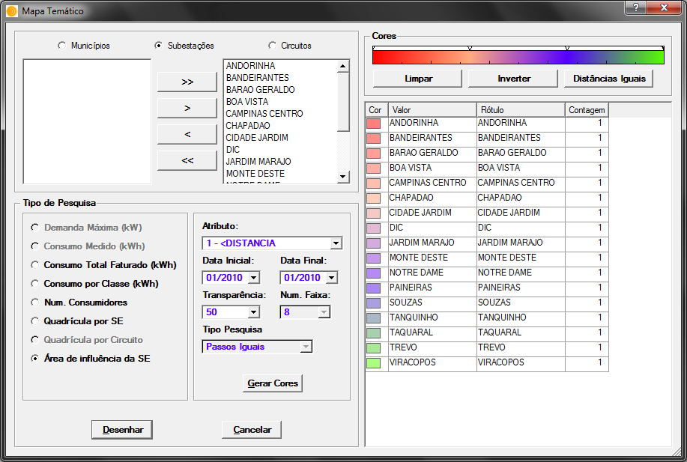
Substations’ Influence Area
Marcus R. Carvalho – Brazil – RIF Session 5 – Paper ID 0728

Slide 23
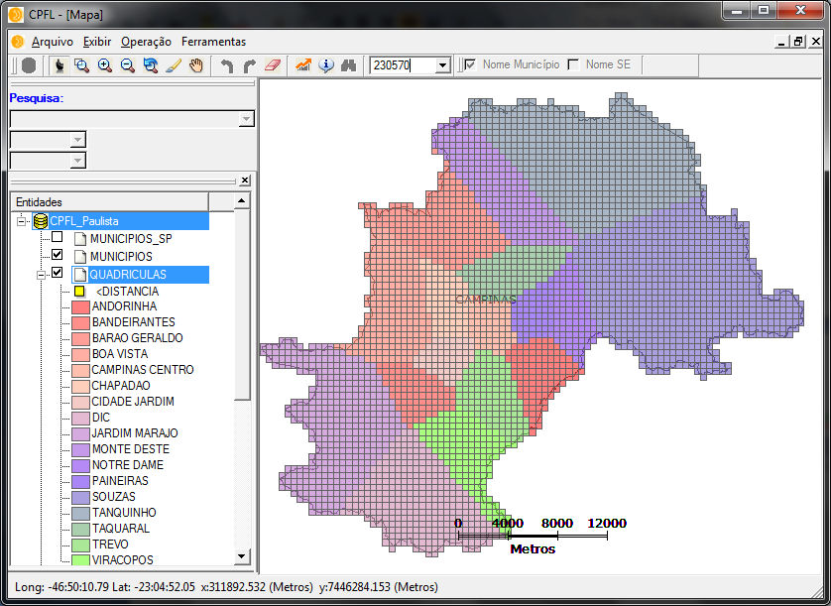
Substations’ Influence Area
Marcus R. Carvalho – Brazil – RIF Session 5 – Paper ID 0728

Slide 24
Planning Methodology Flowchart
Network Data
Consumption Data
Grids Definition
Demand Projection
Linking the Grids With the Substations
Analysis and Work Proposition
Analysis and Work Proposition
Marcus R. Carvalho – Brazil – RIF Session 5 – Paper ID 0728

Slide 25
Allocation and Sizing for New Substations
Methodologies capable to determine:
When the existing substation should be increased or new ones should be built;
Where it should be built;
How much power should be installed.
Marcus R. Carvalho – Brazil – RIF Session 5 – Paper ID 0728

Slide 26
Allocation and Sizing for New Substations
Methodologies developed for Indication of proposed substation position and sizing:
Active-Set Algorithm;
Hill Climbing Algorithm;
Particle Swarm Optimization (PSO).
Marcus R. Carvalho – Brazil – RIF Session 5 – Paper ID 0728

Slide 27
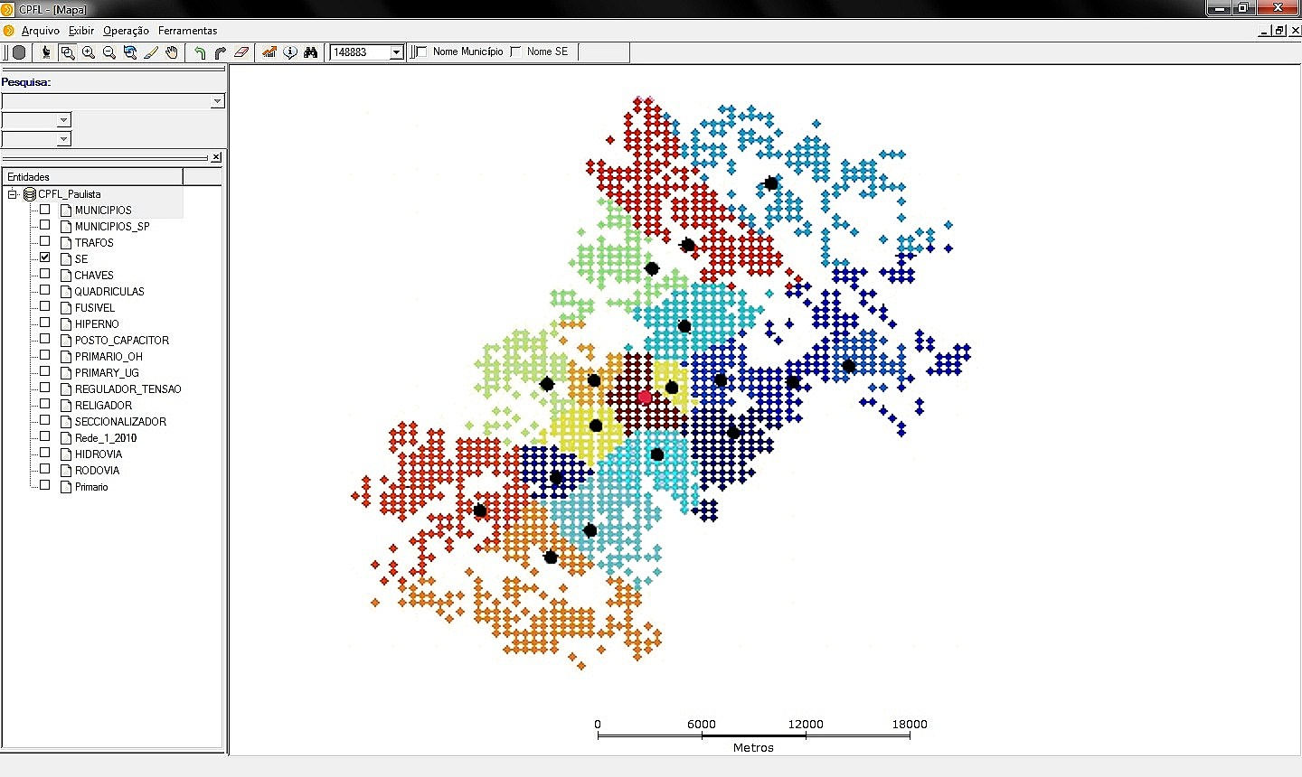
Allocation and Sizing for New Substations
Marcus R. Carvalho – Brazil – RIF Session 5 – Paper ID 0728

Slide 28
Tests and Results
The presented algorithms were tested with the network from Campinas city:
17 substations;
729.45 MVA total installed power.
388,612 customers
246.76 MVA load.
In order to evaluate the algorithm’s robustness, a high growing rate of 11.6% per year was considered.
Marcus R. Carvalho – Brazil – RIF Session 5 – Paper ID 0728

Slide 29
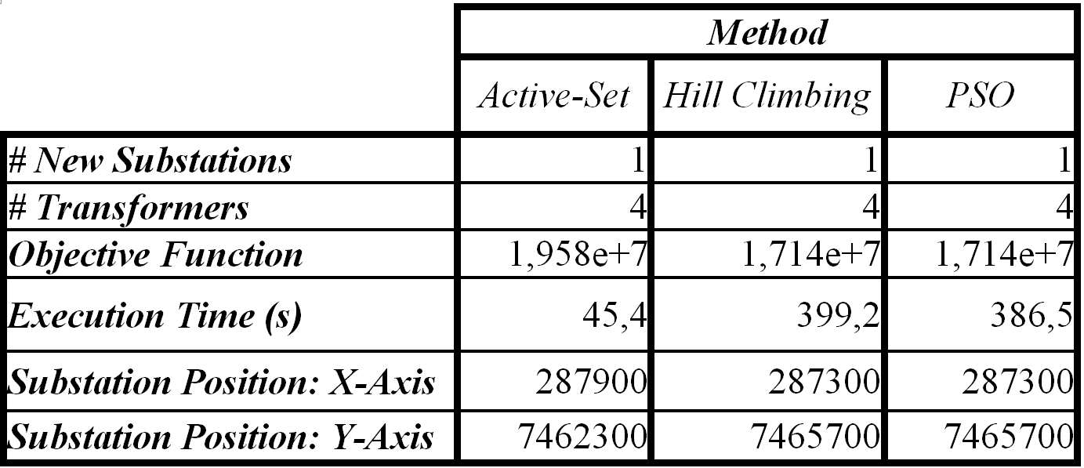
Tests and Results
Marcus R. Carvalho – Brazil – RIF Session 5 – Paper ID 0728

Slide 30
Conclusions
Chronological indication of when new substations should be installed and which of the existing ones should have their capacities increased.
Indication of the areas where management actions regarding the demand or offer sides are needed.
Indication of areas where induction actions are necessary.
Marcus R. Carvalho – Brazil – RIF Session 5 – Paper ID 0728

Slide 31
LONG TERM PLANNING BASED ON THE PREDICTION AND ANALYSIS OF SPATIAL LOAD
Questions?
Marcus R. Carvalho – Brazil – RIF Session 5 – Paper ID 0728

