Slide 1
Trend of Distribution Network in Shanghai
SMEPC
6-9 June 2011
May 23

Slide 2
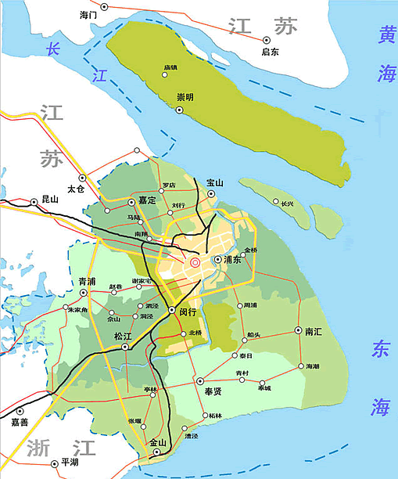
1. Overview of Distribution Network in Shanghai
Fundamental Data
  Service Area, 6600 km²
  Meters in the Service Area, 8M
  10kV Substations, 9533
  10kV Pad Mounted Trs, 29344
  10kV Pole Mounted Trs, 49216
  10kV OHL, 18439 km
  10kV Cables, 27604 km
  LV OHL, 31474 km
  LV Cables, 24347 km

Slide 3
1. Overview of Distribution Network in Shanghai
Power Consumption and Peak Load
  Consumption
  Peak Load
  Load Density
2010 | Core | Outer | Suburban
Density MW/km² | 40 | 12.7 | 2.3
Area km² | 116 | 540 | 4340

Slide 4
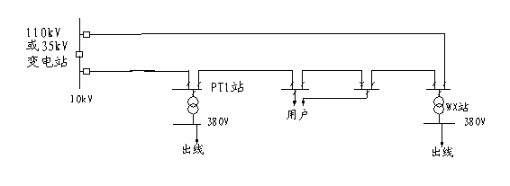
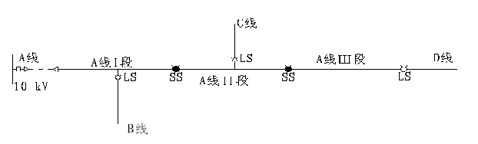
1. Overview of Distribution Network in Shanghai
Feature of The Network
  OHL Network
  Cable Network
Coverage Ratio of DA @2010
  DA without Self-healing, 30.90%
  DA with Self-healing, 1.46%
Cable Network
OHL Network

Slide 5
1. Overview of Distribution Network in Shanghai
SADI(min) & SAFI(times)

Slide 6
1. Overview of Distribution Network in Shanghai
Factors of Blackout @2010

Slide 7
2. The Main Influence as SmartGrid to Be Introduced
Higher Reliability
Infrastructure of EV
Smart Distribution and Power Consumption
Interactive Experience on Demand Side & DR
Connect-in of DG & DS

Slide 8
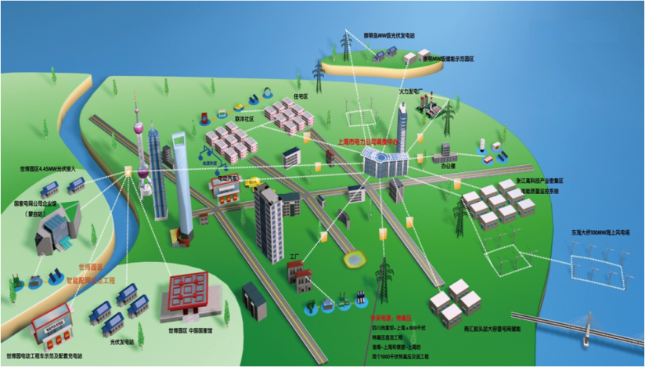
3. Solutions We Will Adopt
Pilot Project at Shanghai EXPO 2010
Solar
Mill
PQ Monitoring
AMI
iDispatching
V2G
iS/S
iBuilding
iCommunity
Wind Mill
DA
TCM
UHVDC
Power Storage

Slide 9
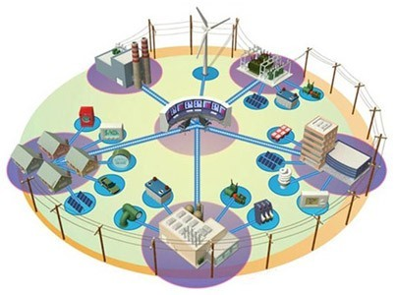
3. Solutions We Will Adopt
High Reliability
  DA Criteria issued by SGCC
  DG and DS
  Micro-Grid
  TCM

Slide 10
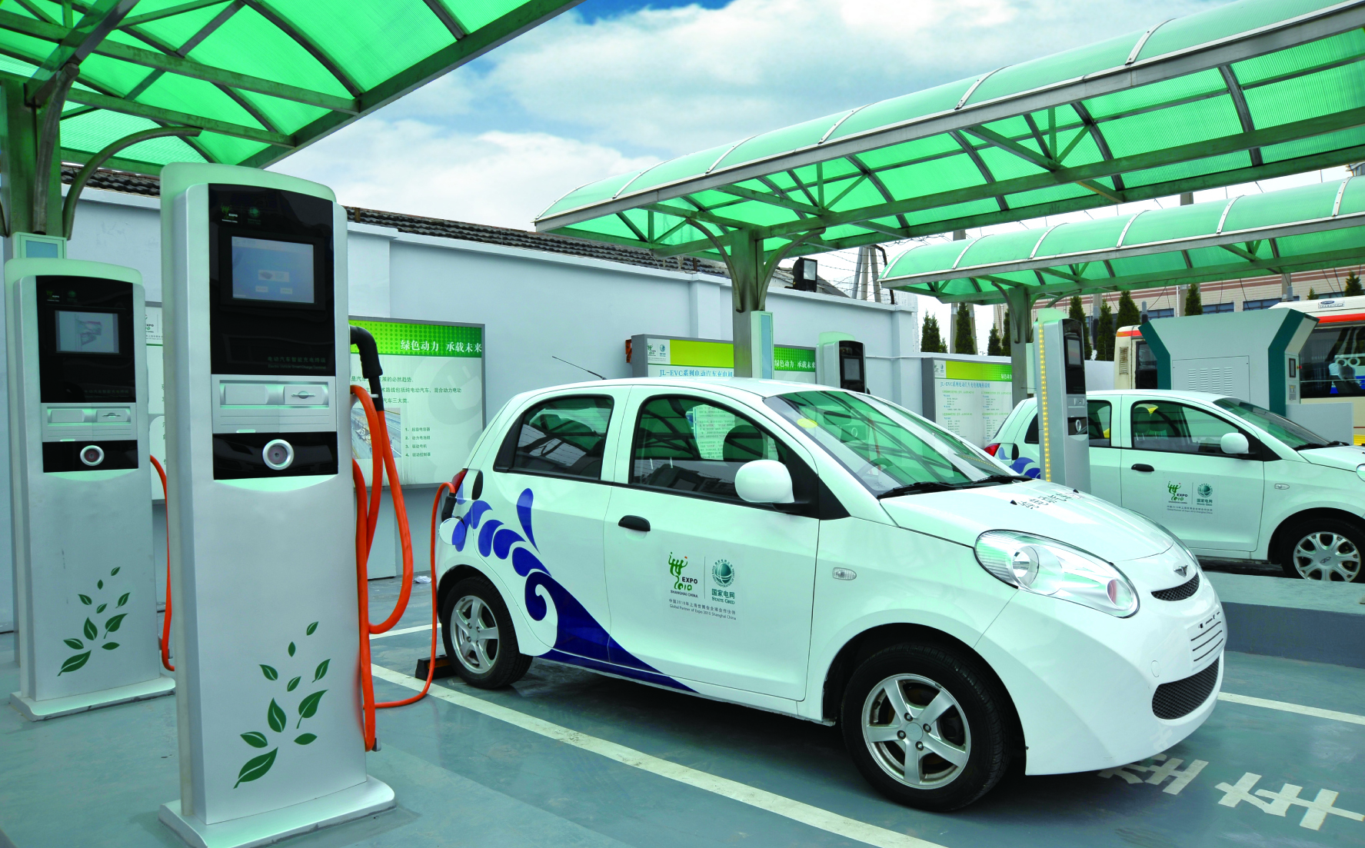

3. Solutions We Will Adopt
Infrastructure of EV Service
  Public Transportation
  Personal EV
  Predication of the Next Five Yrs

Slide 11
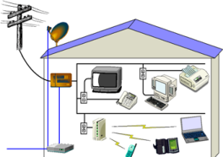
3. Solutions We Will Adopt
Demand Side Application
  Smart Metering
  Smart Building and Community
  DR and Virtual Power Plant

Slide 12
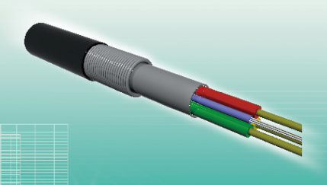
3. Solutions We Will Adopt
Communication Infrastructure
  Cost of Communication Infrastructure
  OPLC (Optical Fiber Composite Low-Voltage Cable)
  How to Cope with the Huge Investment of Communication Infrastructure

Slide 13
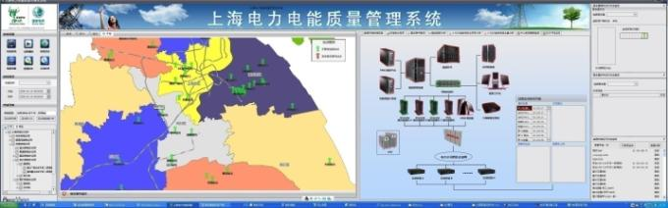
3. Solutions We Will Adopt
Power Quality
  The Impact Factors
  PQ Monitoring System
  Solving the Power Pollution

Slide 14



4. Challenges
Policy
Cost
Market
The END

