Slide 1
Collecting PQ Economic Data
CIRED 2011
Round Table 2b
Frankfurt

Slide 2
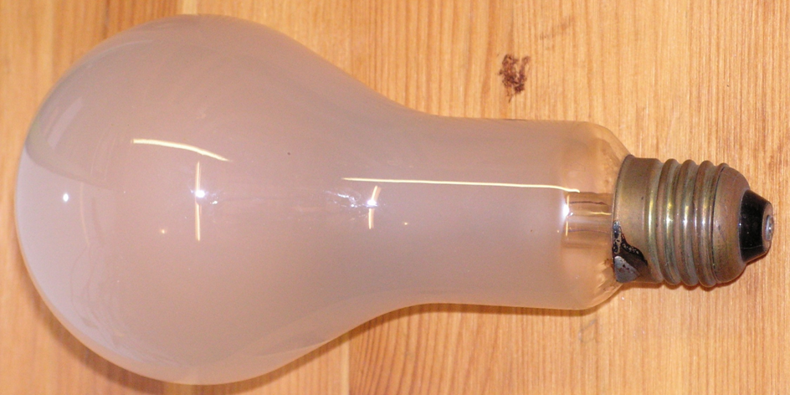
If around 1900 power failed for one minute
it was dark for one minute
If the power failed for one second
it was dark for one second

Slide 3
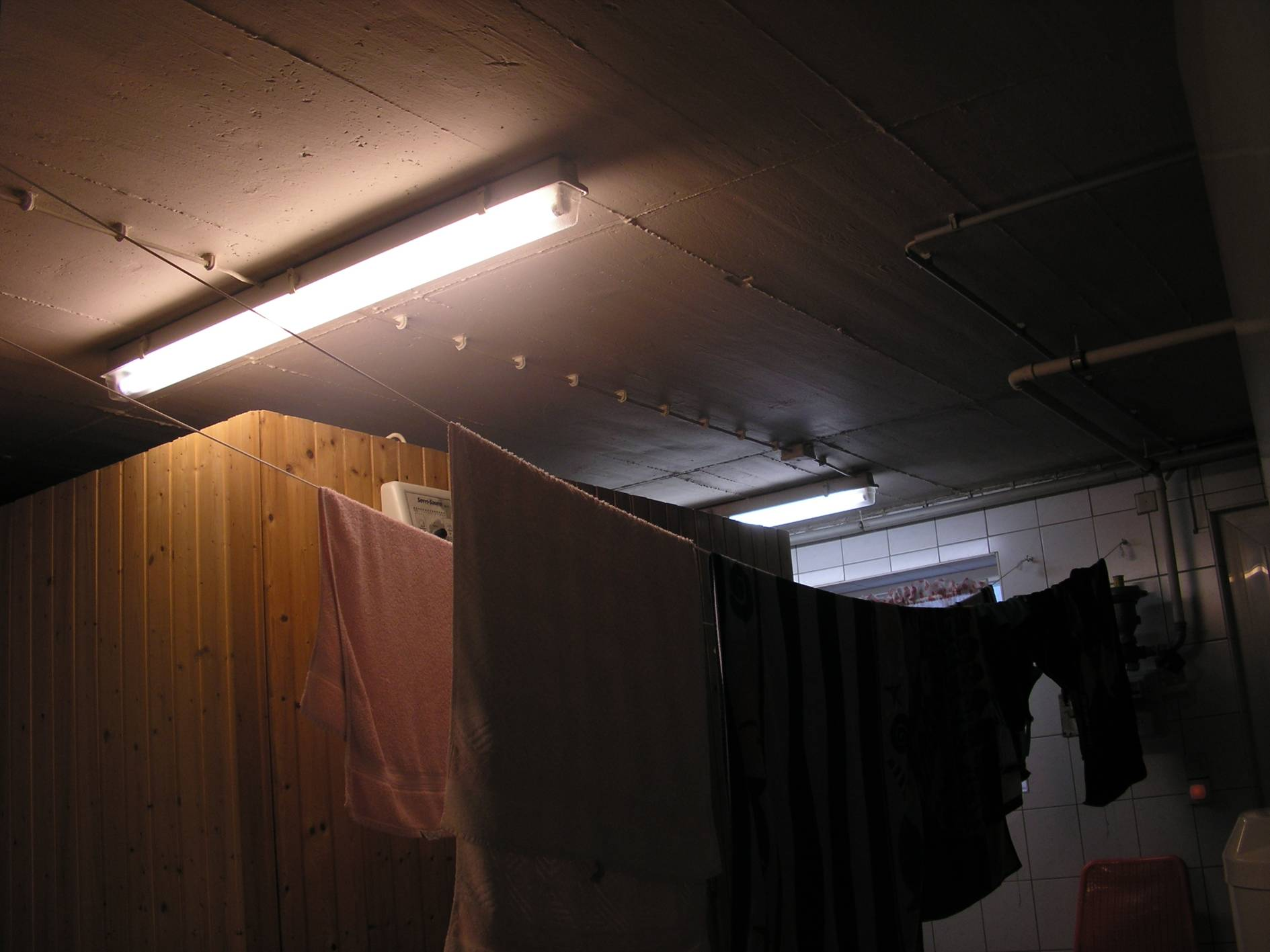


If around 1950 power failed for one second
it was dark for three seconds

Slide 4

If power fails today for only 50 ms
data gets lost,
the PC has crushed,
it takes minutes or even hours to resume normal operation.
Morals:
Power must never ever fail, not even in case of a power failure!

Slide 5
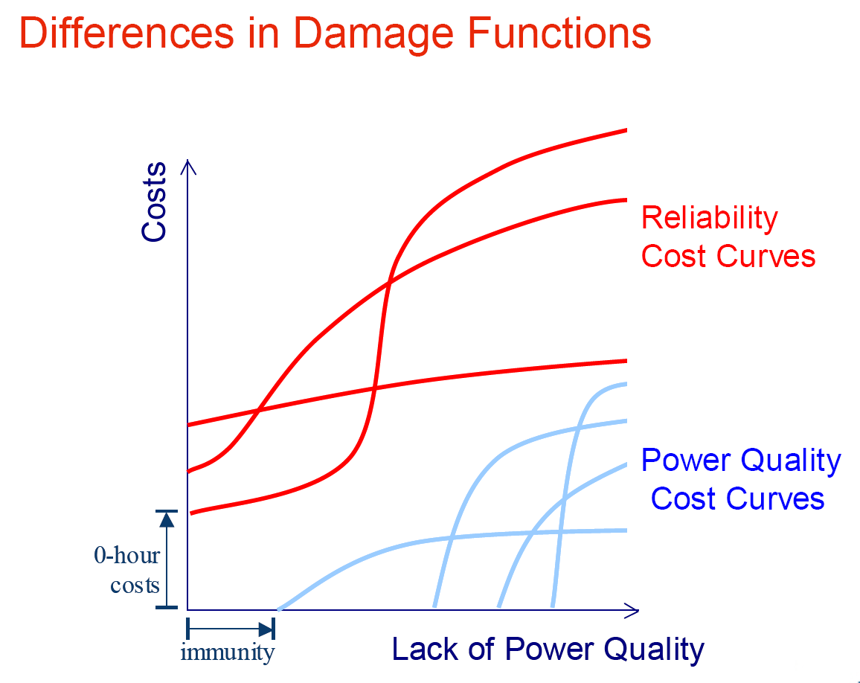
Reliability / VQ damage functions

Slide 6
Percieved reliability level
Generally: the higher the reliability level, the more severe the impact of an interruption will be.
  A study in Nepal showed that 38% of residential consumers considered the number of interruption to be “low” or “very low” although the average number of outages was 4 a week.
  50% of the interviewed residential consumers in Brazilian valued the quality of service provided as “good” although half of these consumers experienced at least one interruption a week.
In most Western countries such interruption frequencies would not have produces such high consumer satisfaction ratings.
  Within the NL a street had 6 interruptions in one year.
  This was not accepted and caused heavy protests.
KEMA 2005

Slide 7





Comparison of interruption costs
Source: Regulation beyond price (2005), National Technical University Greece
KEMA 2005

Slide 8
Leonardo Polish seminar
2003 questionnaire
During seminars the participants were requested to fill up the questionnaire.
Main targets for the survey were:
PQ awareness
PQ threats – ranking of problems, solutions
Electricity supplier user relations
Leonardo campaign appraisal.
The survey was inspired by AGH and executed together with PCPM
Out of more then 1000 seminar participants totally 307 filled up the questionnaire. Respondents filled up questionnaire during seminar - 97% and in a few cases sent them after going home.

Slide 9
Survey results (1)
Occupation
No answer
15,3%
Not applicable
0,7%
Electrical sector - mostly utilities
35,5%
Services or other
28,0%
Industry
20,5%

Slide 10
Survey results (2)
PQ problem frequency
No answer
4,2%
Difficult to say
Very rarely or never
7,2%
10,1%
Every day or more freqently
Once a year
7,8%
7,2%
Once a week
9,4%
Once a month
9,8%
Few times a year
44,3%

Slide 11
Survey results (3)
Less important
PQ today and 10 years ago
No answer
3,3%
3,3%
Equally important
8,1%
More important
85,3%

Slide 12
Survey results (4)
PQ guaranted by the supplier today and 10 years ago:
No answer
Worse
4,2%
7,2%
Similar
18,6%
Better
70,0%

Slide 13
Survey results (5)
Cost of one single short interruption in your company
No answer
No cost at all
13,4%
8,1%
>100000 PLN
3,6%
<100000 PLN
4,6%
<10000 PLN
7,2%
<1000 PLN
Difficult to say
7,8%
50,5%
<100 PLN
4,9%

Slide 14
Survey results (6)
Causes of main PQ problems
instalation itself (e.g. cable downsizing, faulty protection, earthing)
fFrequency changes
Voltage unbalance
Voltage value
Flicker / frequent voltage fluctuation
Harmonics
Voltage dips and swells, transients
Interruptions > 1 min.
Interruptions < 1 min.
No answer
0,00%
10,00%
20,00%
30,00%
40,00%
50,00%

Slide 15
Survey results (7)
Main sources of PQ problems
Other
Welding, melting (fluctuating load)
Motors (e.g. during start up)
Lighting
Computers (electronics)
UPS
Converters, VSDs
No answer
0,00%
10,00%
20,00%
30,00%
40,00%
50,00%

Slide 16
Survey results (8)
Loads most sensitive to PQ deterioration
Other
Switches; contactors and relays
Motors
Capacitors
Computers (controls)
UPS
Converters, VSDs
No answer
0,00%
10,00%
20,00%
30,00%
40,00%

Slide 17
Survey results (9)
PQ mitigation equipment in your company
Other
Overvoltage protection
Harmonic filtration
UPS
Stanby generator
No equipment
No answer
0,00%
10,00%
20,00%
30,00%
40,00%
50,00%
60,00%
70,00%

Slide 18
Survey results (10)
Desired information on the equipment nameplate
Emissions level
Immunity to dips
and swells
Immunity to
voltage distortion
Immunity to
short interruptions
No answer
0,00%
10,00%
20,00%
30,00%
40,00%
50,00%
60,00%

Slide 19
Survey results (11)
Desired supplier guaranteed PQ parameters
Frequency
Voltage value
Unbalance
Flicker
No. of dips and swells
Voltage distortion
No. and time of interruptions
No answer
0,00%
10,00%
20,00%
30,00%
40,00%
50,00%
60,00%
70,00%

Slide 20
Investigating relations between answers to questions – hypotesis checks (1)
Independent variable | Correlation | Dependent variable
Frequency of PQ problem occurence | (+)→ | Voltage value as the main cause of PQ problems
Frequency of PQ problem occurence | No | Other PQ disturbances as the main causes of PQ problems
Frequency of PQ problem occurence | (-)→ | Utility contacted primarily when experiencing PQ problems
Frequency of PQ problem occurence | (+)→ | Own technical staff contacted primarily when experiencing PQ problems
Frequency of PQ problem occurence | (-)→ | Supplier is very formal – relates to contract only and is not helpful
Frequency of PQ problem occurence | (+)→ | User is interested in higher prices of electricity at improved level of PQ

Slide 21
Investigating relations between answers to questions – hypotesis checks (2)
Independent variable | Correlation | Dependent variable
Cost of single short interruption | (+)→ | Supplier is responsible for main PQ problems
Short power interruption as the main PQ problem | (+)→ | Cost of single short interruption
Number of selected causes of PQ problems | (+)↔ | Number of applied soultions of PQ problems

Slide 22
Investigating relations between answers to questions – hypotesis checks (3)
Independent variable | Correlation | Dependent variable
Harmonics as the main PQ problem | → No No → | Equipment which is the main source of PQ problems Converters and VSDs UPS Computers and electronics Lighting
Harmonics as the main PQ problem | ←(+) | Harmonic filtration as the PQ solution

Slide 23
LPQI online survey Survey - pilot

Slide 24
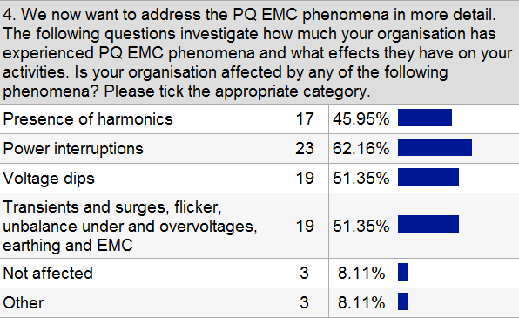
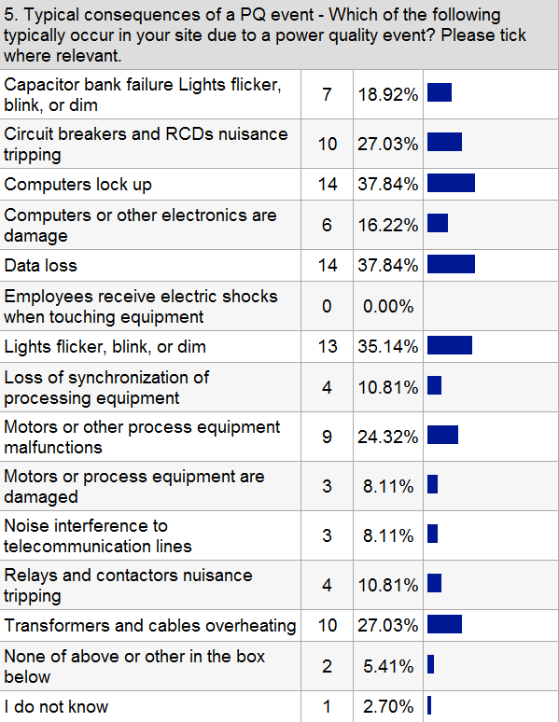

Slide 25
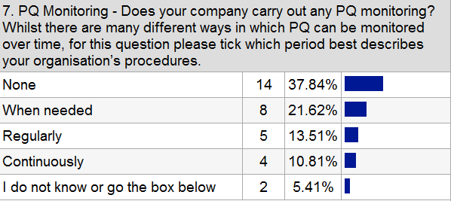
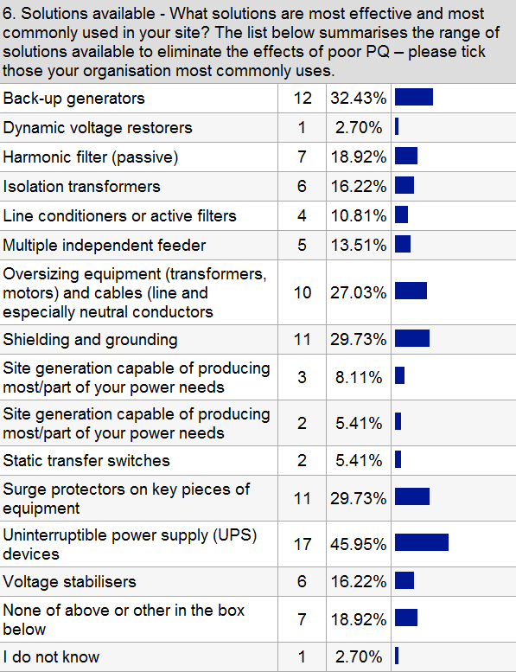

Slide 26
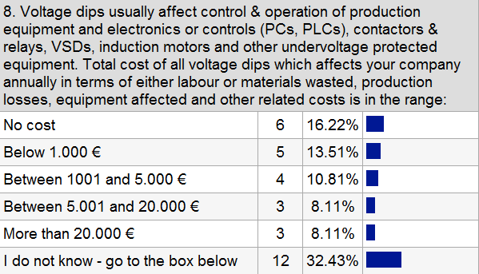
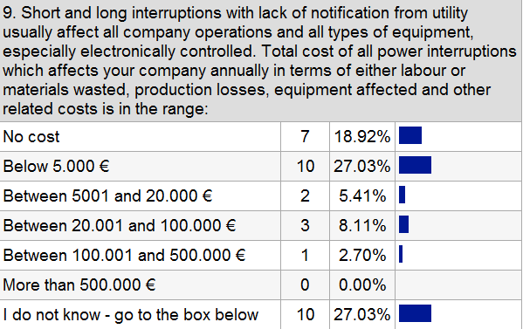
It is hard to estimate the costs of data and experimental results losses due to the shutdowns of PCs and other electronics equipment.
The teaching and research is affected
In some cases analysed the cost by each event was about 20.000 Euro
depending on the size of company, various investigations have revealed losses from 1000 to 150000 Euro!
I do not think voltage dips are the cause of big losses in my company
It is hard to estimate the costs of data and experimental results losses due to the shutdowns of PCs and other electronics equipment.
We have our own power generation and even export to the public network. But serious disturbances in the grid, like short circuits, can also affect us because the Island Operation reaction is not 100 % effective. But I have put these situations in Question 8 about voltage dips.
less than dips I hope (high reliability of the Belgian HV MV networks)
In cases involving interruptions, we did not measure interruption costs
Customer are notified of planned switch outs. 3rd party cable hits major problem.

Slide 27
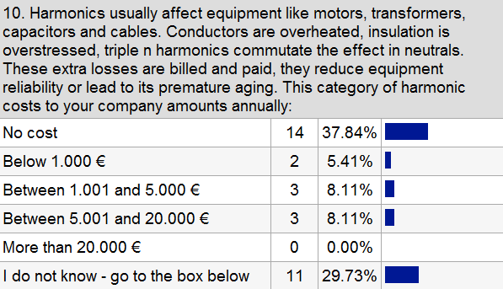
Our equipment and electrical network are normally oversized. Because it is usual in process industry, and short circuit powers are very high, etc. So we don´t notice directly the costs of harmonics.
Comes for us more and more important to find global economical solutions
In an industrial illumination system using halide lamps the solution to harmonic problem cost more than 20.000 Euro
one case involved loss of PF capacitors, but generally harmonics are seldom the real issue (I know, contrary to popular belief!).

Slide 28
LPQI Survey
PQ cost indices (industry)
 | Total cost per kWh €/kWh | Total cost per kW peak €/kW | Total cost per turnover (ratio) | Total cost per electricity bill (ratio) | Total cost per employment €/employee | Cost / kWh dip & short interruption €/kWh | Cost / kWh long interrupt. €/kWh | Cost / peak kW dip & short interrupt. €/kW | Cost per peak kW long interruption €/kW
Mean | 0,625 | 730,37 | 0,0374 | 7,530 | 8158 | 0,1352 | 0,0802 | 147 | 323
Std. Error of Mean | 0,459 | 298,24 | 0,0089 | 5,330 | 2995 | 0,0922 | 0,0469 | 57 | 260
Median | 0,031 | 95,57 | 0,0109 | 0,413 | 1218 | 0,0098 | 0,0012 | 28 | 4,18
Std. Deviation | 2,939 | 1909,72 | 0,0574 | 34,163 | 19181 | 0,5903 | 0,3008 | 371 | 1670
Variance | 8 | 3 647 060 | 0,0030 | 1 167,000 | 367 922 790 | 0,3490 | 0,0910 | 137 717 | 2 789 088
Minimum | 0 | 0 | 0 | 0 | 0 | 0 | 0 | 0 | 0
Maximum | 18,861 | 10 681 | 0,2375 | 218,552 | 113 638 | 3,7720 | 1,7090 | 1 771 | 10 681

Slide 29
LPQI - Frequency of PQ events
Frequency of PQ disturbances | number of events |  |  |  | annual %
 | Voltage dips | Short interruptions | Long interruptions | Surges and transients | Harmonics
Industry | 15,7 | 6,9 | 2,2 | 13,0 | 9,0%
Services | 7,7 | 5,4 | 2,1 | 6,7 | 7,5%
Average | 13,2 | 6,4 | 2,2 | 11,3 | 8,5%
Notes:
The frequency of PQ events reported in the survey can be characterized shortly as follows. On average the MAIFI that has been measured by this Survey is approximately 6; this is 3 times bigger than SAIFI. The number of recorded voltage dips, that is identified by the respondents, is approximately twice the number of short interruptions (MAIFI). This ratio is somewhat less for the services sectors.

Slide 30
Technical conclusions from LPQI survey
Although there is no significant correlation between value of solutions investments and real PQ cost, a strong correlation exists between investment in PQ solutions and the hypothetical (mitigated) to real (unmitigated) PQ cost ratio.
One side effect of UPS’ use is the increased cost of harmonics.
There is rather poor correlation between perceived consequences of PQ and PQ solutions used. In other cases relation of these is difficult to justify from technical point of view. This somehow proves certain suboptimum in choosing PQ solution in particular case.
PQ solutions for all sectors covered [extrapolated from the €300 million identified by the Survey] ~ €13bn or less than 10% of PQ losses & 1% of the average estimated net profit.
In general “Services” apply a higher frequency of different PQ solutions than found in “Industry”. “Industry” tends to favour less costly, but also less universal - more tailored solutions whenever possible.
Notes:
Although there is no significant correlation between value of solutions investments and real PQ cost, a strong correlation exists between investment in PQ solutions and the hypothetical (mitigated) to real (unmitigated) PQ cost ratio. Apart from specifying real PQ cost of wastage, respondents also defined those hypothetical costs that would be the potential losses and risk avoided by power systems that had been immunized against the PQ disturbances under review. The increase in the ratio between hypothetic and real (mitigated / unmitigated) is particularly visible in case of UPS.
One side effect of UPS’ use is the increased cost of harmonics. This can be explained by suboptimal use of UPS systems that are based on diffused small units without active power wave modulation, which in turn generates significant input current distortion.
There is rather poor correlation between perceived consequences of PQ and PQ solutions used. In other cases relation of these is difficult to justify from technical point of view. This somehow proves certain suboptimum in choosing PQ solution in particular case.
PQ solutions for all sectors covered [extrapolated from the €300 million identified by the Survey] ~ €13bn or less than 10% of PQ losses & 1% of the average estimated net profit.
In general “Services” apply a higher frequency of different PQ solutions than found in “Industry”. “Industry” tends to favour less costly, but also less universal - more tailored solutions whenever possible.

Slide 31
PQ cost summary

Slide 32
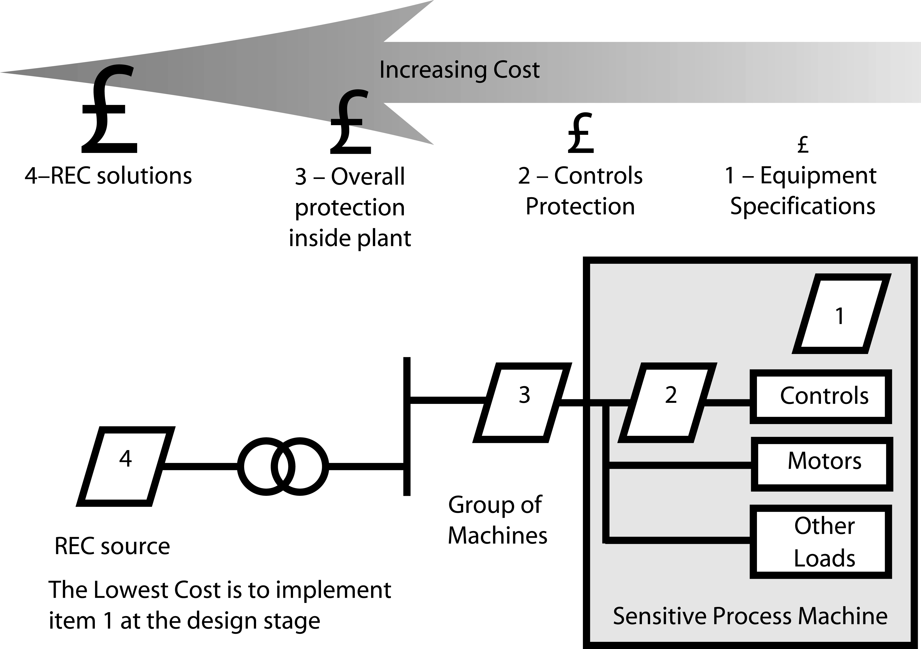
Philosophy of selecting PQ solution
Mitigation of voltage dips
Dynamic voltage
restorer (DVR)
Grid upgrade
Large static UPS
Rotary UPS
Small UPS
CVT
Voltage regulator
Notes:
The last stage, 4, is to protect the whole plant by, for example a grid upgrade, a dual grid supply or perhaps a dynamic voltage restorer. Here we are talking about hundreds of thousands of Euro upwards.

Slide 33
PQ consequence / solution correlation
PQ consequence | PQ solution | Relation
Relays and contactors nuisance tripping | Harmonic filter (passive) | significant
Noise interference to telecommunication lines | Multiple independent feeder | significant
Motors or process equipment are damaged | Shielding and grounding | significant
Motors or other process equipment malfunctions | Back up generator | very significant
Loss of synchronization of processing equipment | Surge protection on key pieces of equipment | significant
Loss of synchronization of processing equipment | Harmonic filter (passive) | very significant
Circuit breakers or RCD’s nuisance tripping | Line conditioner or active filter | significant
Circuit breakers or RCD’s nuisance tripping | Back up generator | significant
Capacitors bank failure | Shielding and grounding | very significant

Slide 34
PQ investment effectivenes

Slide 35
Perceived presence of disturbances

Slide 36
(Perceived) PQ problem source

Slide 37
(Perceived) PQ consequences

Slide 38
Equipment being affected

Slide 39
PQ solutions (perceived)

Slide 40
PQ measurement

Slide 41
PQ blame

Slide 42
PQ investment / PQ cost per turnover

Slide 43
PQ solution load coverage

Slide 44
Power Quality Solutions adopted
“Services” sectors tend to invest more into original designs
“Industry” sectors often have to adapt existing possibly older installations to cope with current demands
Sectors that cannot allow for power interruptions tend to design reliability & resilience into their systems.
Notes:
The broad picture that we have found is that “services” sectors tend to invest more before the event into design systems that ensure greater reliability and resilience for their electrical power systems; the in a sense “older” industrial sectors for understandable reasons are often faced with having to adapt and upgrade existing electrical power installations to modernize them and mitigate the lack of reliability they experience from the existing system design.
But then we should now be saying that these organisations, being so dependent on continuity of electrical power supply for their very survival in this increasing demanding world, through correct and systematic measurement are aware of what the power quality issues are within their electrical installations and are therefore ahead of the game in applying correctly defined and proportioned solutions to avoid them.
We have to say that unfortunately we did not find the result that we had hoped for – rather and paradoxically the reverse seemed truer.

Slide 45
Questionnaire - collecting economic data

Slide 46
The questionnaire – pilot + attributes

Slide 47
Scenarios

Slide 48
The questionnaire – process

Slide 49
The questionnaire – process 2

Slide 50
The questionnaire – non process oriented

Slide 51
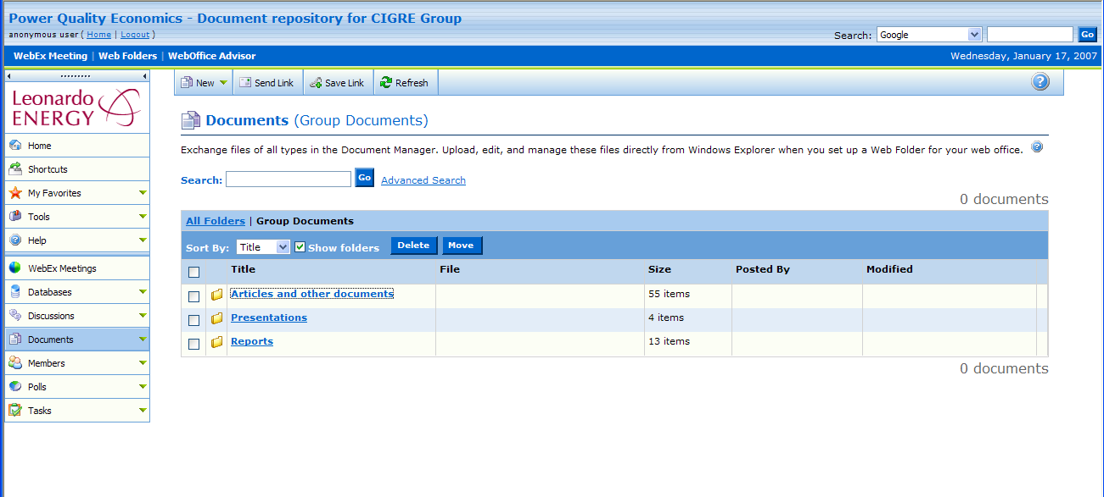
CIGRE C4.107 Documents repository
All together > 400 documents

Slide 52
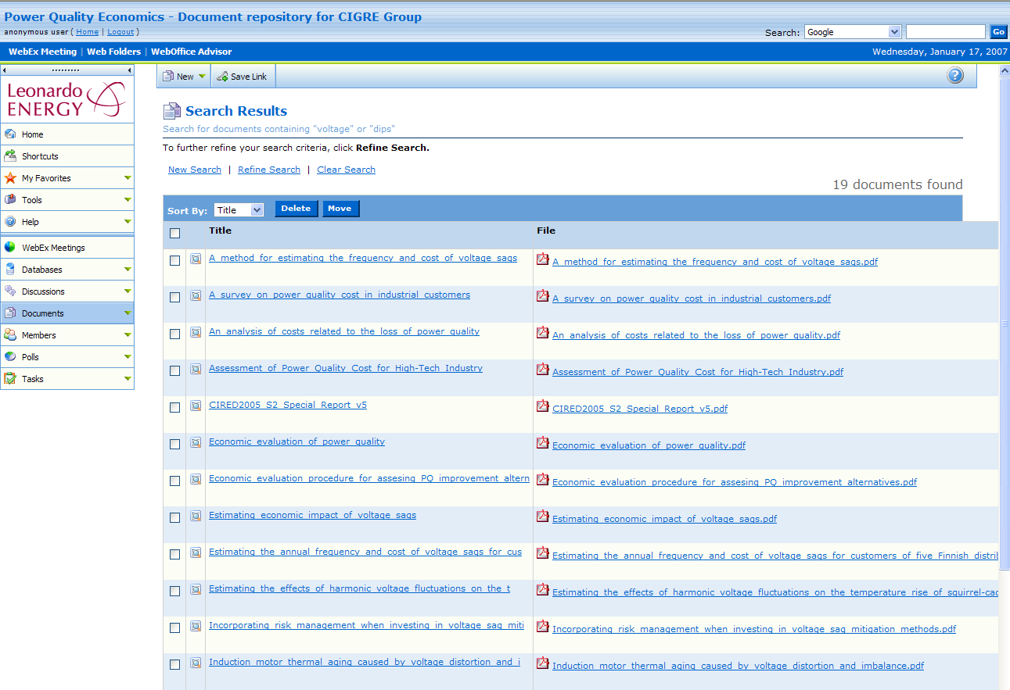
Documents – Search; „voltage” or „dips”

Slide 53
Conclusion - The reasons for investigating the cost of PQ
to build awareness of the potential magnitude of PQ costs which may affect the productivity of the company
while statistics and previous experiences are helpful, no two companies, even when operating in the same sector, will be equally vulnerable to PQ disturbances
as PQ becomes subject to contract between a user and a supplier, the cost of PQ needs to be quantified to establish the so-called ‘Willingness to Pay or Accept’ as is a measure of a value of improved PQ for which the user is going to pay a premium or receive compensation for inadequate quality
in case of failure caused by a PQ event for which the supplier is contractually liable, the amount of compensation will need to be determined. A previous cost survey will help to establish the methodology, allowing a prompt and accurate determination of the amount.
awareness of the cost of PQ will help to minimise it. Once their potential contribution is recognised, many small and simple incremental improvements are possible without significant investment.
Finally PQ cost knowledge is a tool for regulators to set incentives for suppliers. The benefit should retain for the whole society but primarily for energy sector it should be adjusted so, as the retention period is sufficiently long to encourage companies to undertake investments
  Setting limits
    Based on the actual figures during a sufficiently long historic period
    Using some form of benchmarking (relative to the performance of other companies) or using a reference network model

