Slide 1

SCHEDULING
& DISPATCHING
OPTIMIZATION
The right person, in the right place at the right time
Giorgio Bizzarri – IT – 3a– 0458

Slide 2
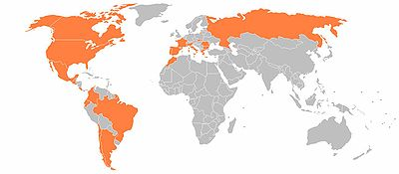
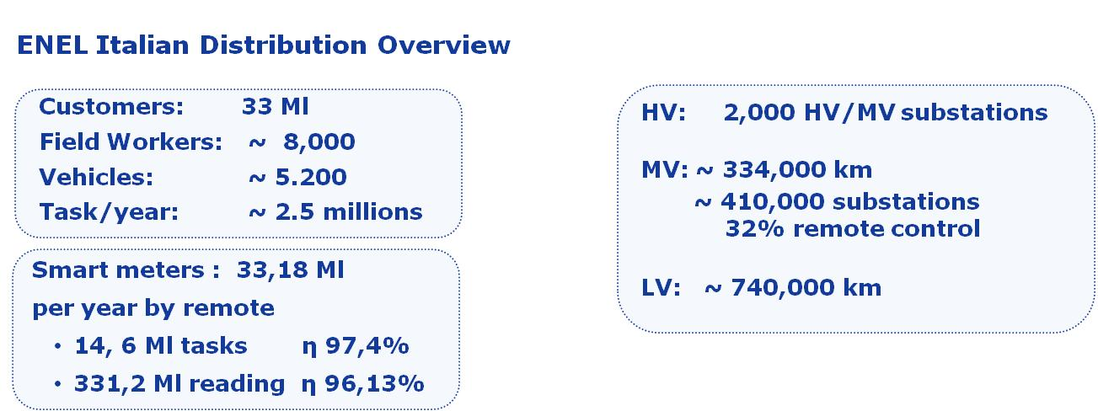

Enel is Italy’s largest power company, and Europe’s second listed utility by installed capacity.
Enel operates in 40 countries with 61 Ml customers and ~95,000 MW of net installed capacity
32 Ml
Giorgio Bizzarri – IT – 3a– 0458

Slide 3
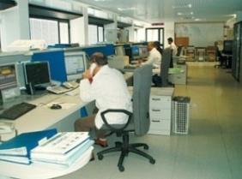
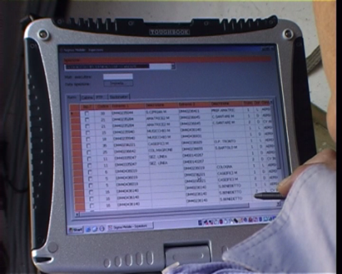





… and on the field we started with the Workforce Management Project in the 2005
Work in progress ...
Suite of mobile applications
Meters and concentrators installation
Enterprise Platform
Common User Interface
Tablet in place
Work to Customers
Outage management
GPRS
Inspections
work plans for network operation
Geo-localized field workers
Accounting activities
update maps and network
What is left to do ?
Documentation, mail, various tools
Optimized scheduling …
Giorgio Bizzarri – IT – 3a– 0458

Slide 4

Goals
Optimized scheduling
Increase efficiency of business processes
Reduction of travel time and fuel usage
Homogenization of processes
Full awareness on field operations
All kind of tasks (from HV to the meter)
SLA compliance
Reduction of costs
Many more …
Giorgio Bizzarri – IT – 3a– 0458

Slide 5





As Is
ENEL Distribution is present in Italy with 114 Zone and 388 Territorial Units with almost 800 teams.
Scheduling & Dispatching
  Customers & Quality
  Maintenance
  MV - HV
  Smart Meters
  Ticketing
  Maintenance Pool
Team
  Customers
  Expert Crew
Giorgio Bizzarri – IT – 3a– 0458

Slide 6


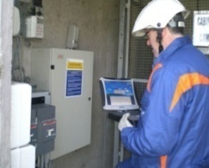

To Be
The dispacher defines the working day, considering:
  Priority & Position of the task
Supervisor of the crews
confirms the assignment
Working day tasks are sent just to the laptop of the Safety Responsible of the crew
Time for getting the car ready
Driving time
Preparing
time
  Time for
  activity
Giorgio Bizzarri – IT – 3a– 0458

Slide 7

To Be
During or at the end of the working day:
Tasks perfomed
Total miles driven
Automatic updating of the performed tasks on the System
Giorgio Bizzarri – IT – 3a– 0458

Slide 8


DEVELOPMENT STRATEGY
Define Requir.
ASSISTED
DINAMIC
Pilot & Lab Units
From Unit to Zone
ROLL OUT
Building on site
Feb ‘09
May ‘09
Apr ‘11
Jun ‘11
Dec ‘11
Giorgio Bizzarri – IT – 3a– 0458

Slide 9

Critical Success Factor 1/2
A bit of ICT …
(Very) (extremely) (and quick)
Nice and easy to use GUI
  Based on Microsoft Silverlight & Bing Maps
  Drag & Drop task Assignment
  Free form Task search engine
  Tooltip everywhere
  Early feedback from real users
Giorgio Bizzarri – IT – 3a– 0458
Notes:
E’ importante che:
l’utente sia a suo agio con l’applicazione
Ne intraveda le opportunità
Stimoli l’ingordigia di volere nuove funzionalità
Semplifichi realmente il lavoro

Slide 10

Assisted Assignment: internals …
Working folder
Step 1: High Priority Tasks
Step 2: Maintenance Tasks
Step 3: Automated Meter Management Tasks
Step 4: Potential (incoming) High Priority Tasks
Step 5: Quantitative Non Time Related Tasks
Step 6: Occasional Low Priority Tasks
Recommended filling
of crew capacity: 130%
The system proposes the best choice for each step but the final decision is up to the user
Giorgio Bizzarri – IT – 3a– 0458

Slide 11

Critical Success Factor 2/2
… and a lot of Change Management
Strong synergy IT – Business
Key Performance Indicators (WFM KPI)
Involvement of the Unions
Performance related rewards
Positive climate amongst fields engineers
A direct involvement of the final users from the very beginning , experimentation through “pilot” Units, promotion of workshops, suggestions and feedback
Personal involvement at all levels of organization
Specialist training
Communication and informative campaign
Real Goal: users must trust the system
Giorgio Bizzarri – IT – 3a– 0458

Slide 12
Thank YOU for the attention
Giorgio Bizzarri – IT – 3a– 0458

