Slide 1
RT 3 b
Smart Grid Protection
SMART GRIDS: new possible approaches to adapt protection and automation systems and to match electric system security, quality of supply needs and generators features
Alberto Cerretti
ENEL DISTRIBUZIONE
ITALY

Slide 2
Main problems for DSOs related to high penetration of DG – Impact on protection and automation system
Short circuit current values increase
  Problems
    Limited problems for short term withstand current (maintaining previous network configuration) due to wide adoption of inverters to interface generators with distribution network. Max Icc ∼ 1,2 In
    Problems with MV feeder maximum current protections (50-51). Inverters may be compared to current generators (short circuit current constant during fault, completely different from behaviour of synchronous generators). Short circuit current direction inversion may result with non correct tripping (expecially with 50 relays)
  Possible solutions
    Adoption of directional protections against overcurrents (67) (both feeder and Customer General Protection Relay)
    Introduction of a minimum time delay to avoid non correct tripping and to allow logic selectivity
    Wide adoption of inverters as generators interface with the distribution network ?
Alberto Cerretti– Italy – RT3b – Papers 463, 465, 507, 1134

Slide 3
Incompatibility with MV network automation system
  Problems
    Non correct fault detection from FPIs with short circuits (with no directional detection)
    Possible island operation (reduction of effectiveness of automatic reclosing cycle or of automation cycle, worsening of quality of supply, possible damages to generators/inverters in case of automatic reclosing with excessive phase shift)
    Problems of network security: automation cycle has to disconnect minimum amount of DG during fault selection, i.e. fault selection and clearing has to be performed, preferably, opening Switch Disconnector or Circuit Breakers just upstream the faulty section
  Possible solutions
    Adoption of directional protection function against overcurrents (67) on FPIs besides against phase to earth fault (67N)
    Adoption of innovative FPIs completely coordinated (detection algorithms, sensitivity, etc) with protection relays and with IEC 61850 protocol, without confirmation of the fault from voltage absence detection (caused from CB tripping in HV/MV substation)
Alberto Cerretti– Italy – RT3b – Papers 463, 465, 507, 1134

Slide 4
Incompatibility with MV network automation system
  Possible solutions
    Adoption of logic selectivity among FPIs along the feeders and among FPIs and MV feeder protections (logic selectivity also extended to internal Customer plant protections ?)
    Adoption of transfer trip among FPIs / MV feeder protection relays and Interface Protection Relay of DG connected in MV besides wide adoption of CBs instead of switch disconnector along the feeders ?
    Wide adoption of CBs along MV feeders instead of SDs, so to open directly the faulty section, not only in case of a phase to earth fault (possible only in MV compensated neutral nets), but also in case of short circuits, to increase network securitity level besides Quality of Supply.
Alberto Cerretti– Italy – RT3b – Papers 463, 465, 507, 1134

Slide 5
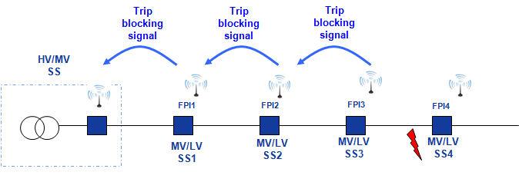
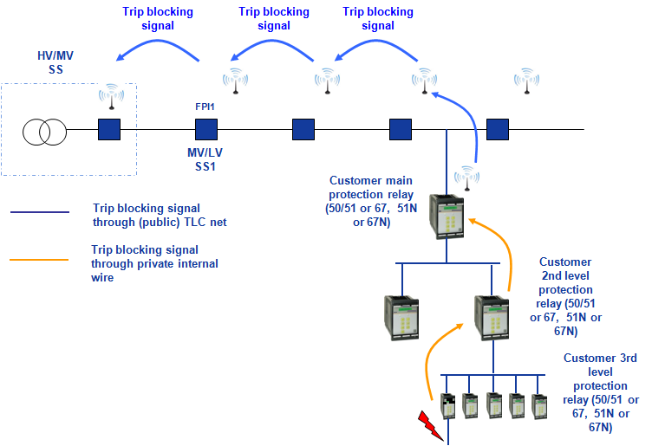
Transfer trip scheme adopted by ENEL
(protection relays and FPIs)
Logic selectivity along a MV feeder
Logic selectivity along a MV feeder and inside a MV Customer plant
With logic selectivity and CBs instead of SDs only faulty section of the feeder and sections dowstream result interested from an interruption (transient or short or long)
Alberto Cerretti– Italy – RT3b – Papers 463, 465, 507, 1134

Slide 6
Interface Protection Relay and possible island operation
  Problems
    Usually IPR are installed at DG’s PCC and based on local measurements. In Italy:
    Main loss of mains protections are 81> & 81<
    A Non Detective Zone (NDZ) is always present: in case of real power balance between load and generation, relay’s thresholds (whatever loss of mains detection principle is) may be not violated during islanding depending on thresholds regulations and waiting time for fast reclosing operation (if present)
    More restricted regulation of the thresholds may result in a worsening of electric system security (nuisance tripping, with unnecessarry loss of large amount of DG)
    Less restricted regulation of the thresholds may be dangerous for generators: damages to axys for rotating machines – due to excessive toques – and damages to electronic components of inverters result at Fast Reclosing Operation (ENEL standard FRO waiting time is 400 ms at the moment, 600 ms in the next future)
Alberto Cerretti– Italy – RT3b – Papers 463, 465, 507, 1134

Slide 7
Interface Protection Relay and possible island operation
  Problems
    Frequency and voltage for LV Customers during island operation may exceed limits of Standard (EN 50160) and of Contract with important damages
  Possible solutions
    Adoption of transfer trip among FPIs/feeder protection relays and Interface Protection Relay of DG as main Loss of Mains protection. Disconnection time of generators not longer than 500 ms, including CB operation time, with waiting time for first reclosing operation = 600 ms (100 ms for fault self extinguishment)
    Loss of mains back up protection realized with an improved version of actual IPR, with less sensitive regulations of the frequency thresholds
    With absence of communication network (even temporary) automatic change of IPR frequency thresholds regulations so to assure higher sensitivity (no island)
    Coordination of IPR voltage thresholds regulations with generator LVFRT (it is the capability of the generators to overcome voltage sags due to a network contingency or a short-circuit) to avoid nuisance tripping
Alberto Cerretti– Italy – RT3b – Papers 463, 465, 507, 1134

Slide 8
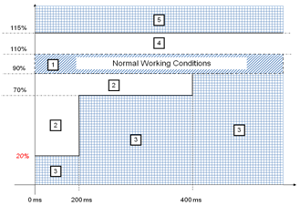
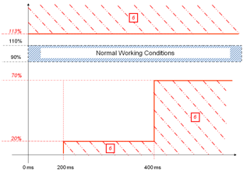
Generator LVFRT and IPR voltage thresholds regulations
    zone of normal operation,
    zone in which DG unit has to remain connected to the grid, at worst without supplying energy; once the voltage reaches 90% of rated value generator has to restart to inject power into the network,
    zone where DG plants can be isolated from the network by means of each own protections,
    zone in which the generator has to remain connected to the grid and to absorb reactive power until its own power factory limits,
    zone in which internal protections have to act in order to disconnect generator from the grid.
Zone of 27/59 IPR thresholds intervention
Alberto Cerretti– Italy – RT3b – Papers 463, 465, 507, 1134

Slide 9
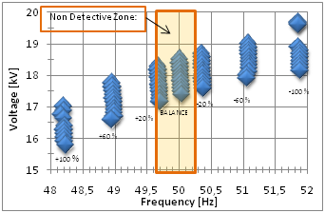
NDZ of Interface Protection Relay - possible island operation
Voltage and frequency oscillations during islanding
Alberto Cerretti– Italy – RT3b – Papers 463, 465, 507, 1134

Slide 10
Interface Protection Relay and possible island operation
  Possible IPR (with transfer trip) scheme
Transfer trip
Voltage at Pcc
0,2 Vn
IPR trip (gen. disconnection within 500 ms)
81.S2
47,5 – 51,5 Hz
81.S2
49,7 – 50,3 Hz
Communication network presence
Alberto Cerretti– Italy – RT3b – Papers 463, 465, 507, 1134

Slide 11
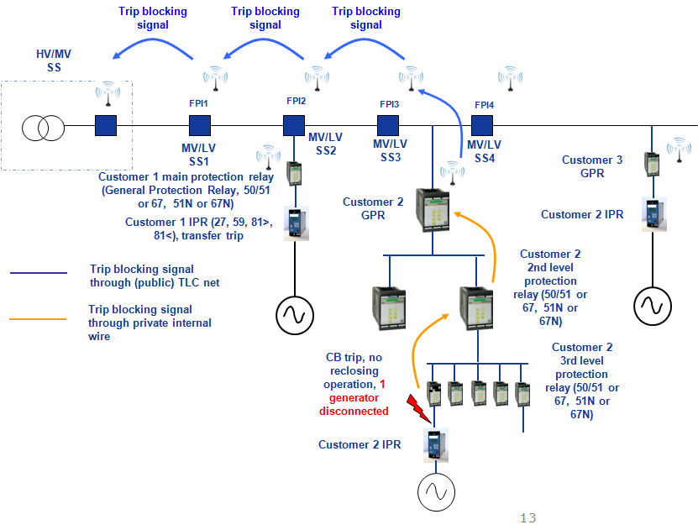
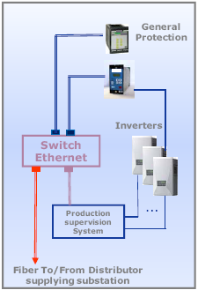
Interface Protection Relay and possible island operation
  Logic selectivity complete scheme (transfer trip + network automation)
Production Supervision System also receives and trasmit to generators request from DSO for P&Q set points
Alberto Cerretti– Italy – RT3b – Papers 463, 465, 507, 1134

Slide 12
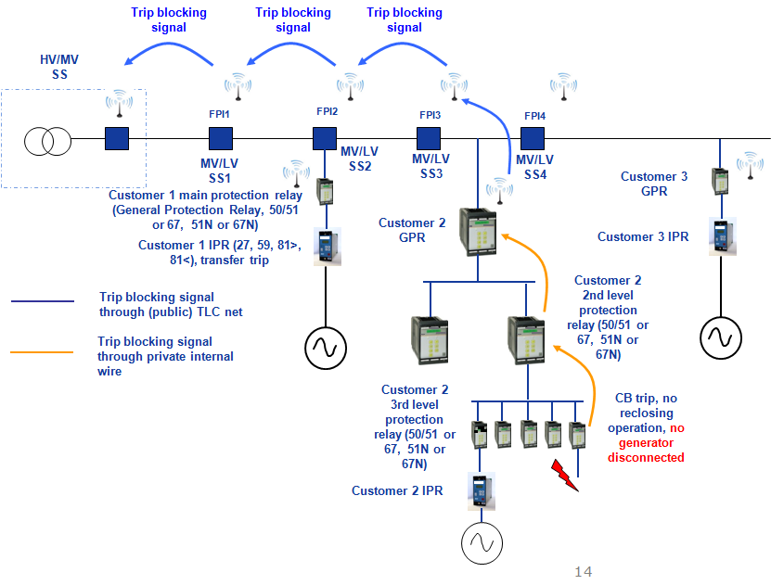
Interface Protection Relay and possible island operation
  Logic selectivity complete scheme (transfer trip + network automation)
Alberto Cerretti– Italy – RT3b – Papers 463, 465, 507, 1134

Slide 13
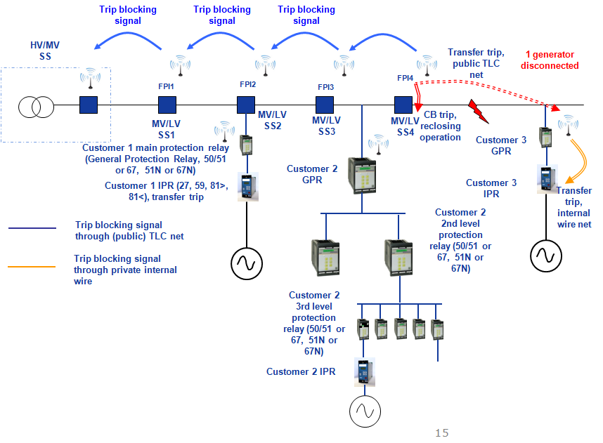
Interface Protection Relay and possible island operation
  Logic selectivity complete scheme (transfer trip + network automation)
Alberto Cerretti– Italy – RT3b – Papers 463, 465, 507, 1134

Slide 14
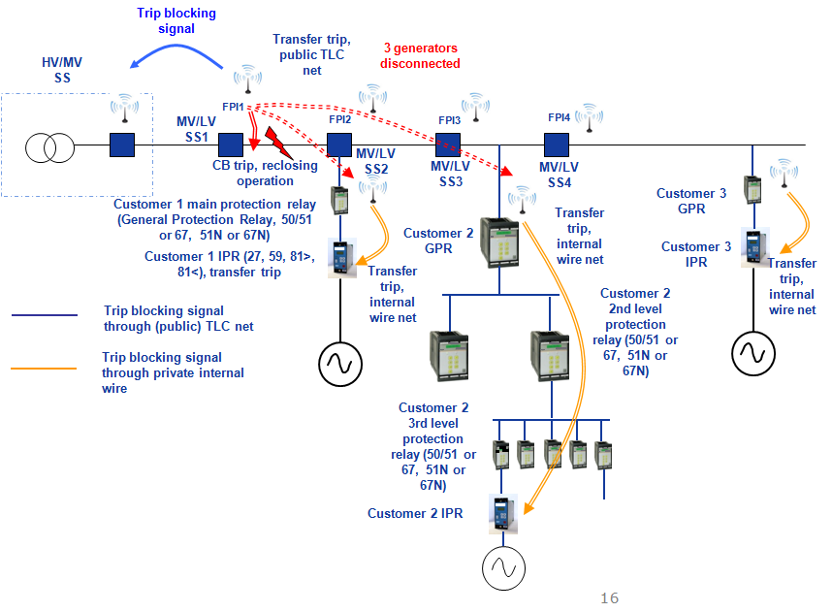
Interface Protection Relay and possible island operation
  Logic selectivity complete scheme (transfer trip + network automation)
Alberto Cerretti– Italy – RT3b – Papers 463, 465, 507, 1134

Slide 15
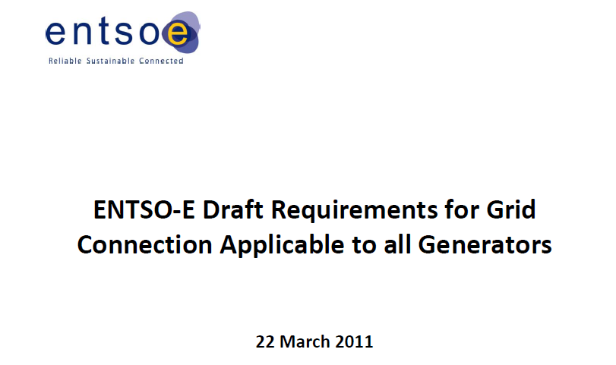
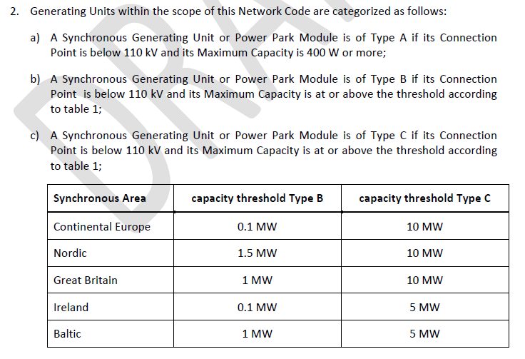
Interface Protection Relay and possible island operation
  Comments
    ENEL Distribuzione solution (for MV net only, at present time) guarantee Quality of Supply, security of electric system and generators (non island operation/damages after FRO)
    Nevertheless, other subjects are defining requirements with consequences on Distribution networks, taking into account only some points of the whole problem

Slide 16
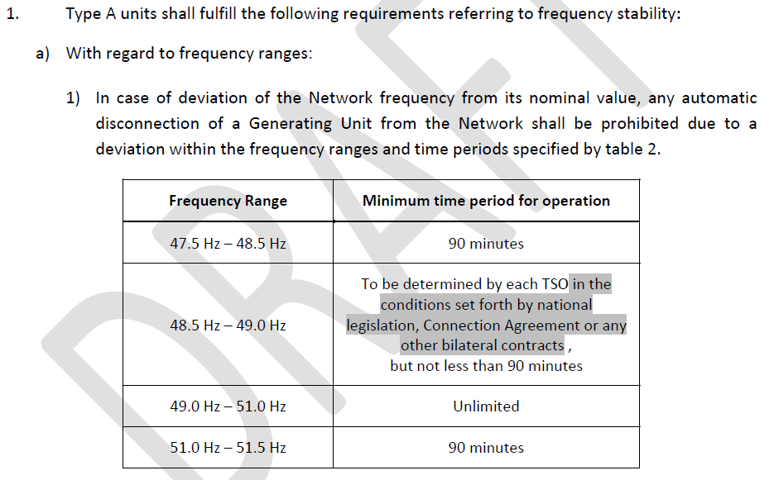
Interface Protection Relay and possible island operation

Slide 17
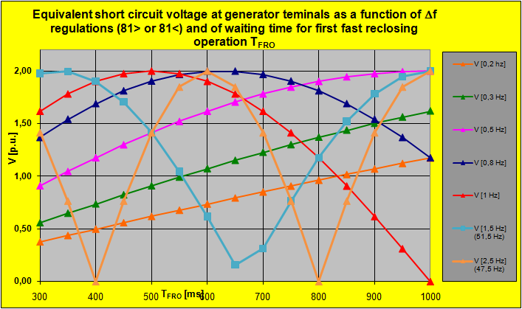
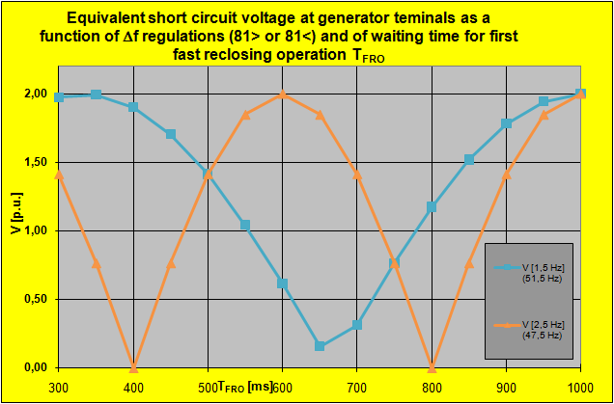
Network safety vs quality of supply/damages to generators
As a function of 81>/81< thresholds regulations and of waiting time for FRO an equivalent short circuit voltage may appear at generator terminals, causing short circuit currents limited only by internal impedance of the generators and mechanical torques on rotating genarators axys. Serious damages may derive. Do product standards (all generators, including inverters, PV, wind, etc., correctly deal this ? Many damages occur on rotating machines also in case of simply voltage dips !
Alberto Cerretti– Italy – RT3b – Papers 463, 465, 507, 1134

Slide 18
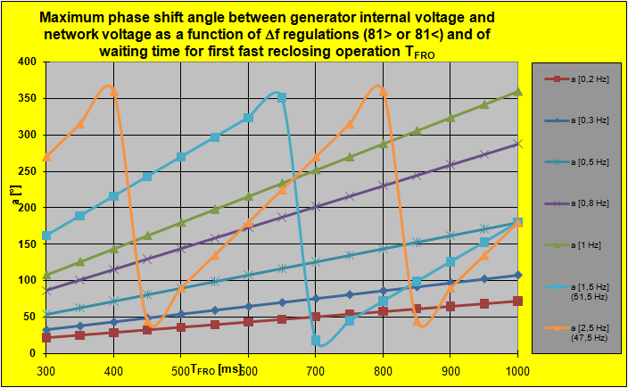
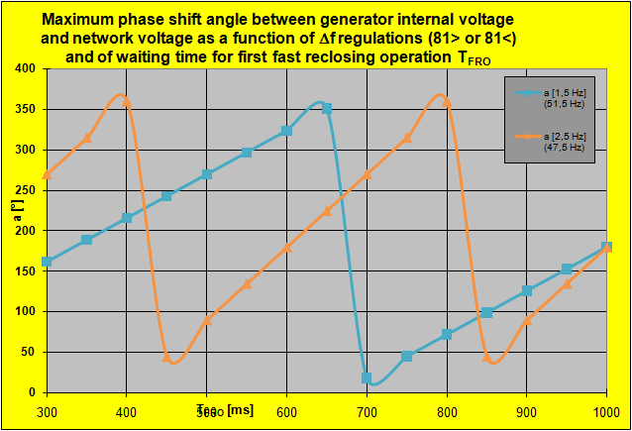
Network safety vs quality of supply/damages to generators
In case of SD/CB intentional opening, no automatic FRO is present, but island operation is possible for long time. In case of short circuits on the feeder IPR should trip for 27 threshold before FRO. In case of phase to earth faults island operation is possible for long time and FRO may be present for quality of supply reasons. Will distributors have to eliminate FRO in case of phase to earth faults to allow IPR tripping ? Will Regulators allow this ?
Alberto Cerretti– Italy – RT3b – Papers 463, 465, 507, 1134

Slide 19
Network safety vs quality of supply/damages to generators
In case of intentional operations on the net, no significative electric parameter disturbance may appear (it depends only from the unbaslance between generation and load) without island detection from IPR (whatever is the adopted algortithm). Long island operation is possible.
Considering PV inverters, no fully standardized loss of mains protection function is defined, as well as proper test procedures taking into account the mutual influence of different generators.
Embedded IPR is not at all tested like a traditional protection relay (under TC 95 responsibility).
In addition, loss of mains should have to be detected BEFORE FRO, and this is peculiar of each single distributor.
Alberto Cerretti– Italy – RT3b – Papers 463, 465, 507, 1134

Slide 20
Network safety vs quality of supply/damages to generators
  Further considerations
    It seems that needs of electric system security may be in contrast with needs of quality of supply set by some Regulators and, possibly, with some product standards (generators, expecially PV ones). More cooperation and integration among all the involved Subjects and Technical Committees is necessary ? On features of each kind of generators, on type tests and procedures (including possible embedded IPR on inverters), etc ?
    In case of phase to earth faults it would be possible to eliminate FRO or to perform it with some tens seconds of delay (to increase island condition detection from IPR - embedded or not) without significative decrease of quality of supply level only with compensated networks (more than 90% of transient interruptions due to phase to earth faults are eliminate by the coil). In case of insulated networks (or earthed through resistors), some reclosing operations are necessary to avoid long interruptions. In these nets a decrease of QoS will appear. Is it preferrable to accept a decrease of QoS (with propoer modifications of the rules set by the Regulators) or to widely adopt compensated neutral MV net ?
Alberto Cerretti– Italy – RT3b – Papers 463, 465, 507, 1134

Slide 21
Network safety vs quality of supply/damages to generators
  Further considerations
    In case of wide regulation of frequency/voltage thresholds, safety problems may be present in case of non expected island operation of network parts
    IPR thresholds regulations and LVFRT coordination implies that all eventual generator protections (included embedded ones in PV inverters) have to be properly set (type test on LVFRT with all embedded protection functions activated !)
    LV net is even more subject to possible island condition, PLC seem to be a proper communication system , but times are non compatible with a 600 ms delay for FRO. Which solution ?
    Island operation: is it better to allow and correctly deal it or is it preferrable to continue avoiding it? In Italy, cumulative duration of long interruptions fo LV Customers due to faults is about 45,1 minutes. Make it any any sense to consider a possible island operation to face a condition which represent ∼ 0086% of the total year duration ? Nothing is defined, at the moment, concerning subjects responsible of Quality of Supply and/or of respect of contract paramenters during island operation
Alberto Cerretti– Italy – RT3b – Papers 463, 465, 507, 1134

Slide 22
Voltage/cos ϕ regulation Vs hosting capacity
  Problems
    Regulation law on on-load tap chanher of HV/MV TR
    Slow voltage variations: main limit to hosting capacity along a feeder (expecially medium/high lenght and overhead) !
    Possible requests from TSOs to have a cos ϕ ≥ 0,9 lagging at PCC on HV net
  Possible solutions
    Cos ϕ in the range 0,95 leading ÷ 0,9 lagging for rotating generators (at the moment 0,95 leading ÷ 0,98 lagging)
    Cos ϕ AT LEAST in the range 0,9 leading ÷ 0,9 lagging for inverters (expecially PV ones) (at the moment cos ϕ = 1)
    Adoption, from DSOs, of a DMS using real time voltage measurements to calculate load flows and send proper P & Q set points to main generators. Communication network may be the same for logic selectivity and transfer trip
    Fail safe voltage control algorithm: local control law in absence (even temporary) of communication net
Alberto Cerretti– Italy – RT3b – Papers 463, 465, 507, 1134

Slide 23
Voltage/cos ϕ regulation Vs hosting capacity
  Possible solutions
    Widening of cos ϕ regulation range reducing also active power ? On demand ? In automatic ?
    Are product standards of generators (rotating and/or inverters, expecially PV ones) compliant with networks cos ϕ needs ?
    Are generators control systems able to deal control signals from DSOs DMS ? If not, have they to be able ? In which time ? With which protocol (IEC 61850 ?)
    Are possible requests from TSOs to have a cos ϕ ≥ 0,9 lagging at PCC with HV net to be considered or a new approach has to be defined to increase hosting capacity in the respect of contractual limits concerning voltage and of EN 50160 standard ?
    Have inverters (expecially PV ones) to absorb reactive power during night to compensate reactive power of underground cables ? (no load, possible cos ϕ ≤ 1 leading at PCC with HV, excessive voltage on MV net
Alberto Cerretti– Italy – RT3b – Papers 463, 465, 507, 1134

Slide 24
Voltage/cos ϕ regulation Vs hosting capacity
  Possible solutions
    Have DG on MV net to be connected directly to HV/MV substation MV bus (to produce reactive power with negliglible effect on voltage) or may DG to be connected on existing feeders ? (with reduction of losses)
    Have DSO to install compensation systems (Inverters ?) on HV/MV substation MV bus to regulate cos ϕ at PCC with HV net ?
Alberto Cerretti– Italy – RT3b – Papers 463, 465, 507, 1134

Slide 25
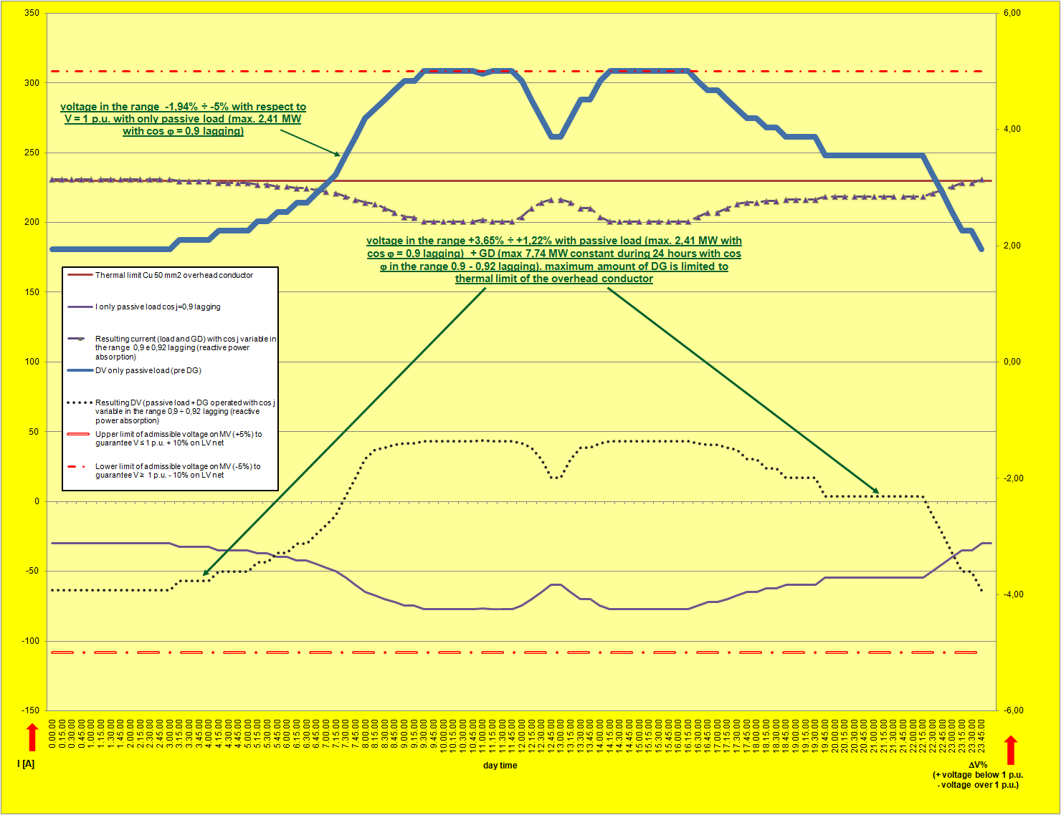
Voltage/cos ϕ regulation Vs hosting capacity
Effect of cos ϕ on voltage regulation is quite different between overhead feeders and MV underground feeder
If GD is connected along an existing overhead feeder (with passive load), it is necessary that generators absorb reative power to limit voltage increase and to maximize Hosting Capacity. With cos ϕ in the range 0,9÷0,92 it is possible to use the conductor up to its thermal limit
Alberto Cerretti– Italy – RT3b – Papers 463, 465, 507, 1134

Slide 26
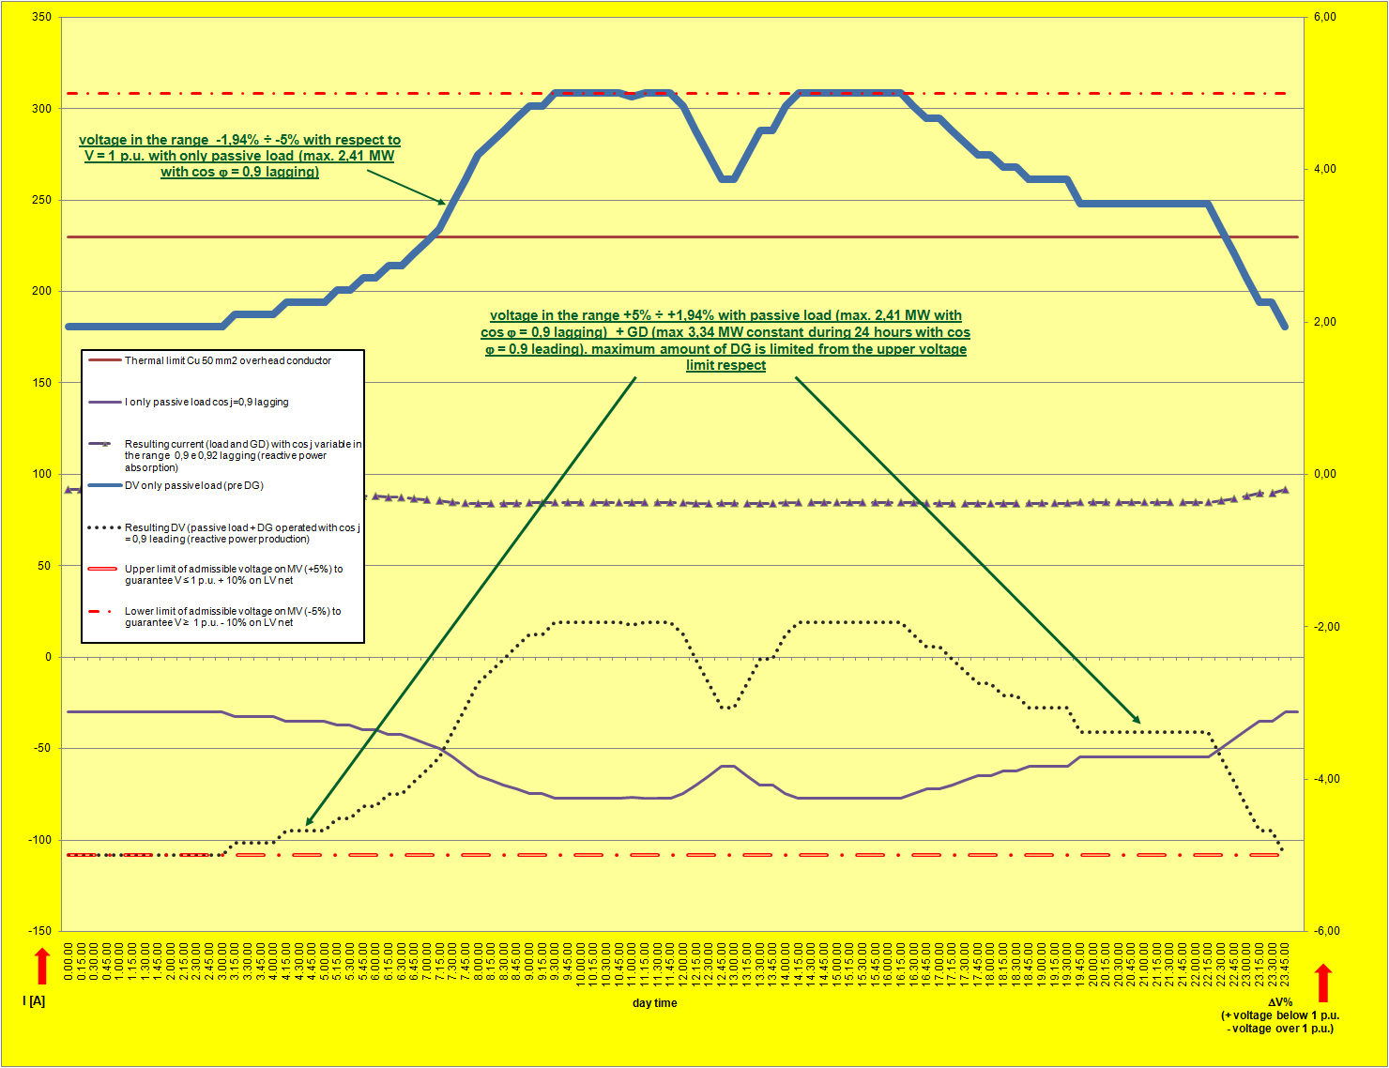
Voltage/cos ϕ regulation Vs hosting capacity
If GD produces reactive power (for instance cos ϕ = 0,9 leading) HC results drastically reduced (43% of previous condition, 3,34 MW against 7,74 MW)
Alberto Cerretti– Italy – RT3b – Papers 463, 465, 507, 1134

Slide 27
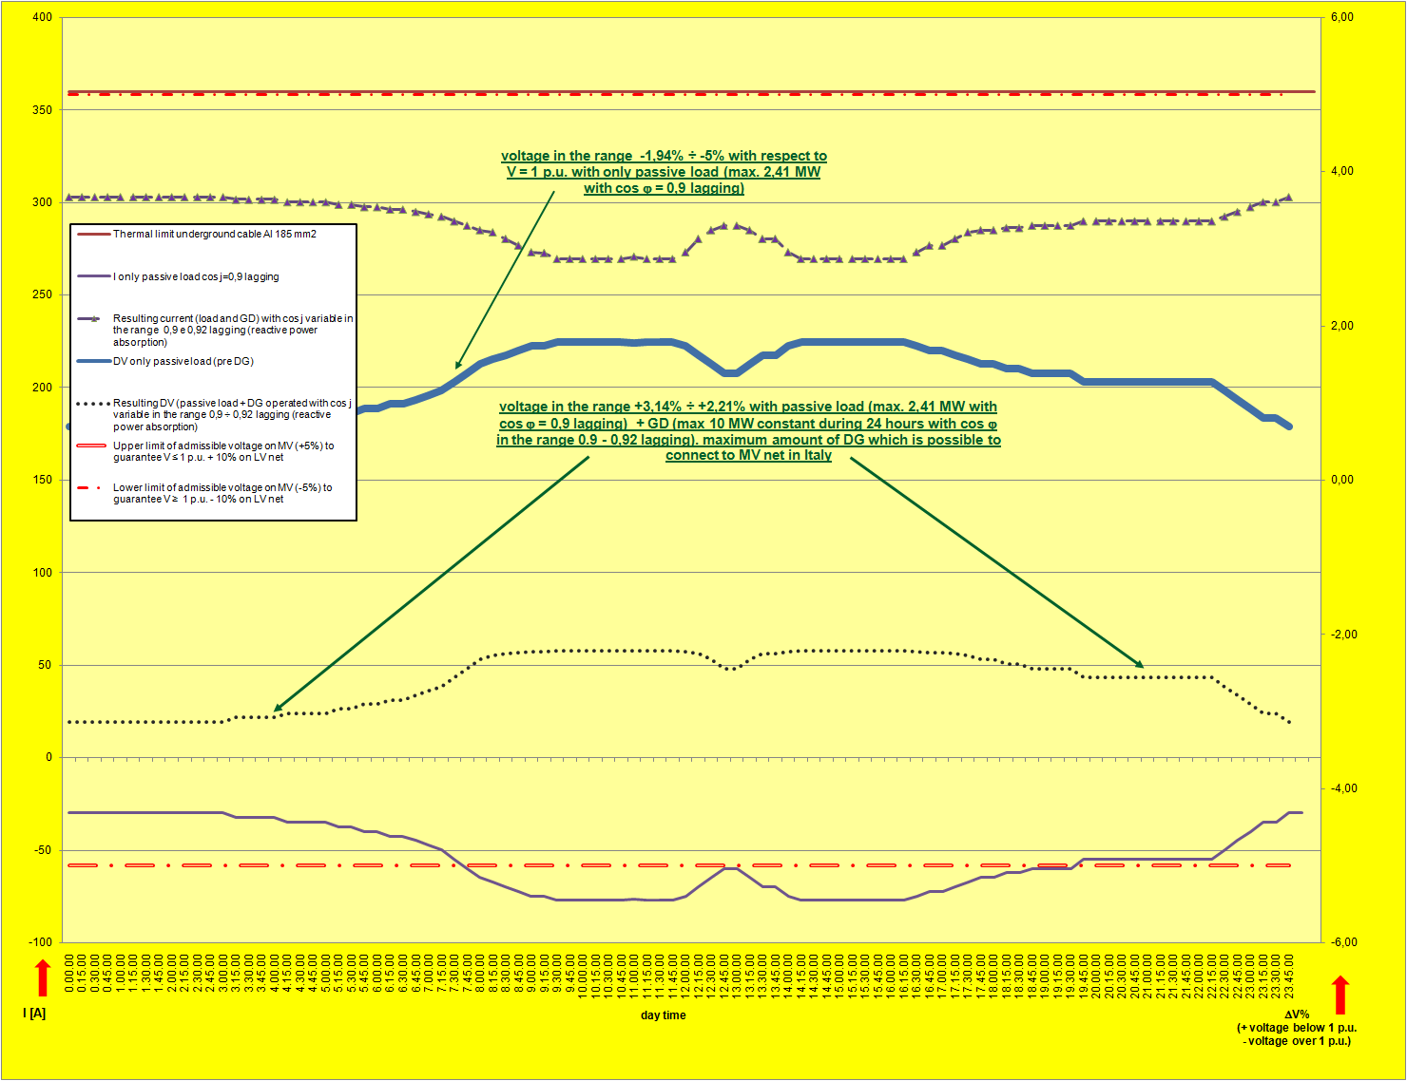
Voltage/cos ϕ regulation Vs hosting capacity
With a MV underground cable, effect on voltage regulation of cos ϕ results reduced.
Anyway, if generators absorb reative power to limit voltage increase, HC is maximized.
With cos ϕ in the range 0,9÷0,92 it is possible to reach maximum admissible limit in Italy (both for Standards and Regulations) for GD in MV nets (10 MW), with excellent voltage control.
Alberto Cerretti– Italy – RT3b – Papers 463, 465, 507, 1134

Slide 28
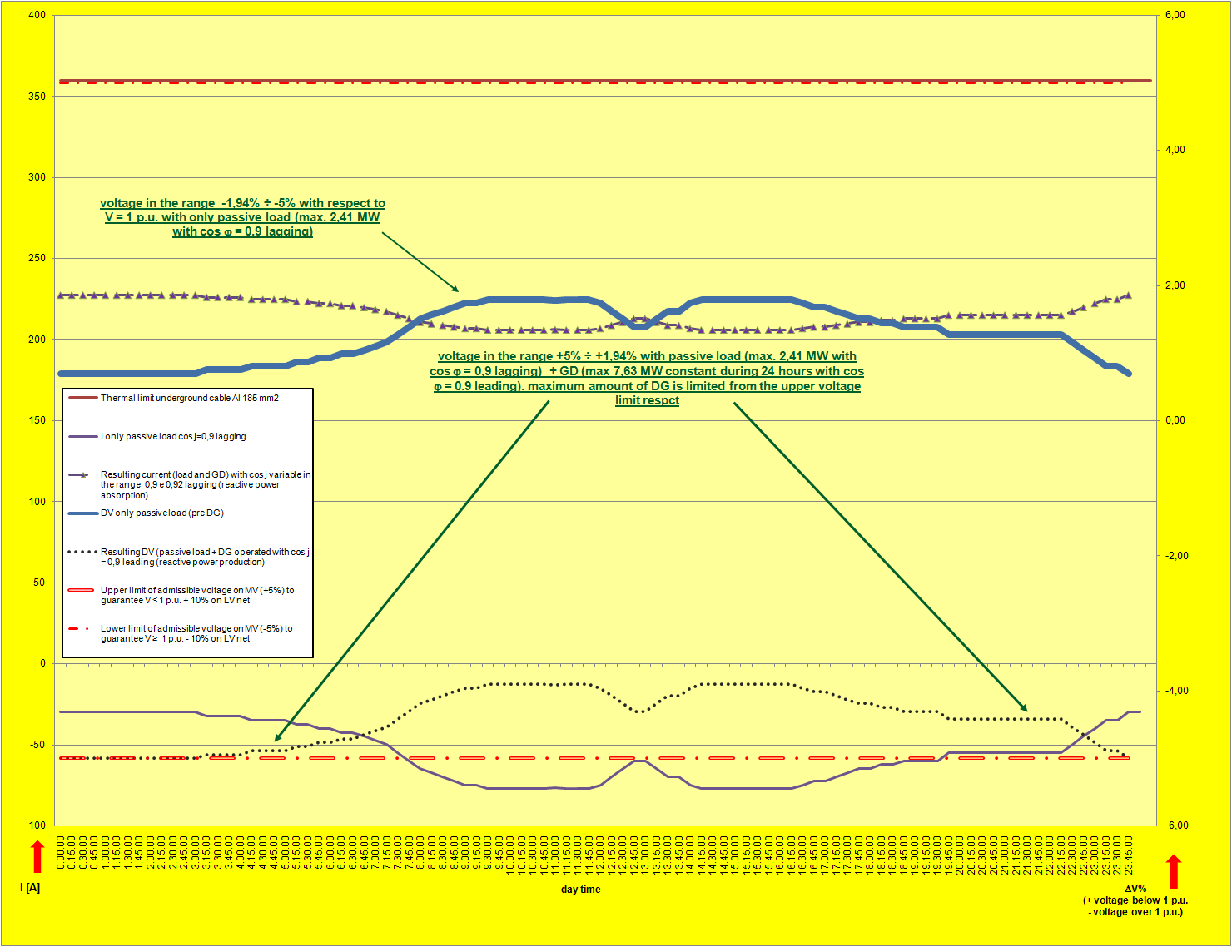
Voltage/cos ϕ regulation Vs hosting capacity
If GD produces reactive power (for instance cos ϕ = 0,9 leading) HC results reduced (76% of previous condition, 7,63 MW against 10 MW)
Alberto Cerretti– Italy – RT3b – Papers 463, 465, 507, 1134

Slide 29
New distribution network operation schemes to increase network security and to limit voltage variations (fast and slow)
    Introduction of a meshed operation scheme instead of a traditional radial one may trasform an interruption (transient, short and long, depending on protection and automation system) in a simple voltage dip. In addition, a meshed scheme reduces voltage variations and allow a higher security level for the electric system: 2 connections from each generator to a HV/MV substations would be present, so a (n-1) contingency should have no relevant effect
    Many important problems, anyway, are present:
  Problems
    In a real meshed network, short circuit current would surely result much higher than the value considered in a radial network (more current infeeds from different HV/MV TRs and from all the GD connected to the meshed networks. In Italy all MV net is realized with a short withstand current = 12,5 kA, 1 s.
    Cross section of the MV feeder conductors are not constant along the feeder, i.e. a complete 2 ways connection of GD to a HV/MV susbsation would not be generally present.
    As a conclusion, the whole network would have to be completely renewed
Alberto Cerretti– Italy – RT3b – Papers 463, 465, 507, 1134

Slide 30
  Problems
    Many problems would affect MV network protection and automation systems using a meshed configuration:
      Phase to earth faults:
        on compensated networks, directional WATTMETRIC protections would not be able to detect the fault, as well as FPIs
        on compensated networks, controller in charge of resonance point calculation and consequent coil tuning would not be able to do it any more. At the moment about 2 controller in the same HV/MV substations may correctly deal the parallel situation (both created in the SS, closing bus coupler, and along the MV net) of the MV nets they are in charge of
      Short circuits:
        Depending on the level of meshed operation, it can be extremely difficult to individuate a precise fault current path and to disconnect only the faulty section with proper timing
    As a conclusion, the whole protection and automation systems would have to be completely renewed
Alberto Cerretti– Italy – RT3b – Papers 463, 465, 507, 1134

Slide 31
  Possible solutions
    Adoption of a solid grounded configuration for MV net and installation of distance relays (21).
        MV net automation system would have to be dismatled
        Distance relay would not wotk correctly on a MV net, due to limited lenght of the feeders, the continuous change of conductor tipology (overhead, cable) and the high presence of undreground cable with very low reactance value and, finally, the continuous presence of infeed points, with completely different features
    Adoption of differential protections
        A proper and realiable communication network would be necessary, to maintain the advantages of MV net automation systema, an enormous number of differential relays would be necessary. What would happen in case of changes in the network operation scheme ?
    As a conclusion, both the whole MV distribution net and protection and automation systems would have to be completely renewed. Performances obtainable with a traditional radial distribution net, provided it is equipped with a high performance protection and automation system, are very similar, with need of extremely lower investments !
Alberto Cerretti– Italy – RT3b – Papers 463, 465, 507, 1134

Slide 32
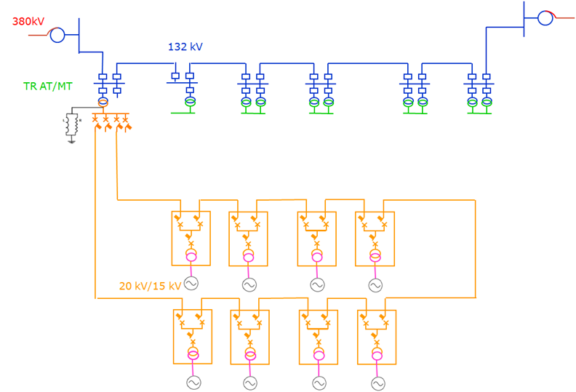
  Possible solutions
    Adoption of a “partial” meshed scheme, consisting in a closed loop configuration (2 MV feeders from the same HV/MV substation MV busbar operated with the “border” SD/CB normally closed):
        Maximum short circuit current level will remain the same as in traditional radial operation
        Protection and automation systems may be maintianed, besides resonant grounding
        Minimum intervention on the feeders may be necessary, in case of parts of feeders realized with sections having too low cross sections or too low thermal limit
May be this solution a good compromise between effectiveness and costs ?
Alberto Cerretti– Italy – RT3b – Papers 463, 465, 507, 1134

Slide 33
SCHEMA Project (closed loop on the same MV busbar)
FPR 1&2: protection relays s of the two feeder of the closed loop (67 & 67N, WATT-VAR)
MV/LV FPI: FPIs installed on CBs along the MV/LV subs. of the two feeder of closed loop (67 & 67N, WATT-VAR)
GPR: Customer General Protection Relay (51/67, 51N/67N, WATT-VAR)
Direction of “red loop”, for overcurrents, phase to earth faults and cross country faults
Direction of “blue loop”, for overcurrents, phase to earth faults and cross country faults
Direction of logic selectivity lock signal on “red loop”, for overcurrents, phase to earth faults and cross country faults
Direction of logic selectivity lock signal on “blue loop”, for overcurrents, phase to earth faults and cross country faults
FPR1
FPR2
MVLV FPI
MVLV FPI
GPR
GPR
MVLV FPI
MVLV FPI
MVLV FPI
MVLV FPI
GPR
GPR
MVLV FPI
MVLV FPI
MVLV FPI
MVLV FPI
GPR
GPR
MVLV FPI
MVLV FPI
Alberto Cerretti– Italy – RT3b – Papers 463, 465, 507, 1134

Slide 34
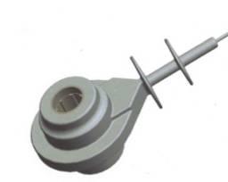
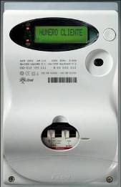
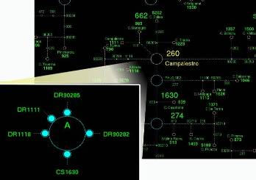
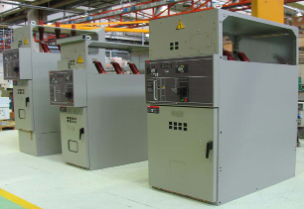
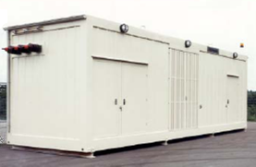
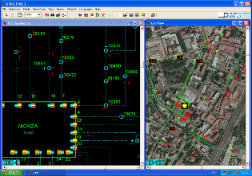
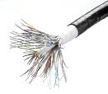

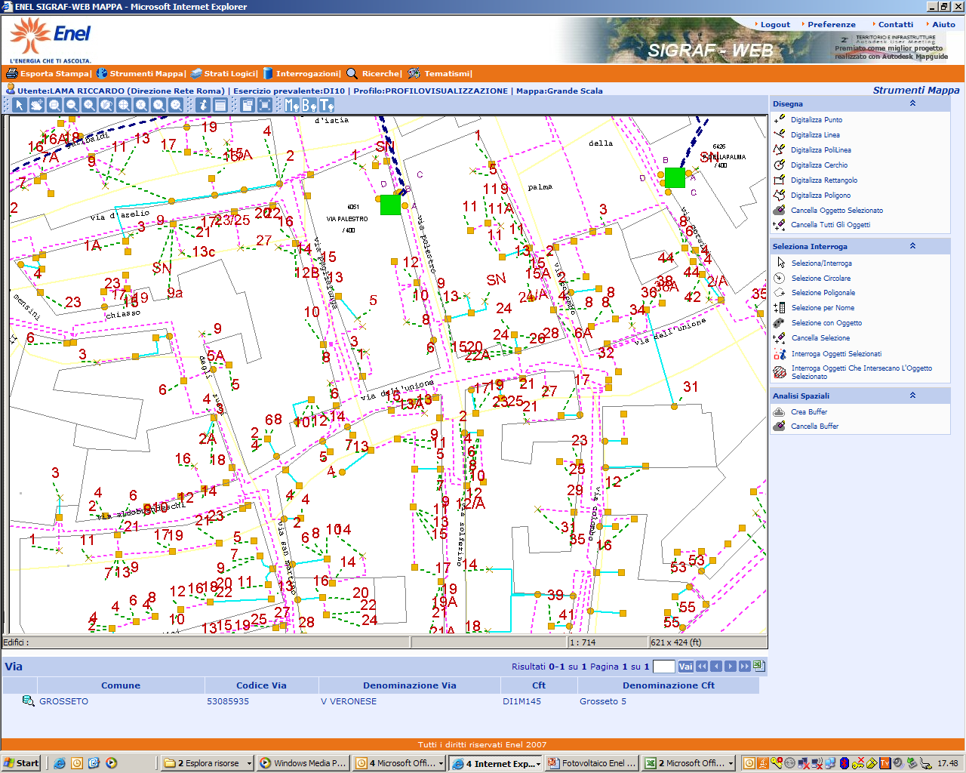
Smart Grids Key components in ENEL vision
Smart
Sensors
Smart
Protections
Smart
Meters
Smart
Components
Advanced
SCADA
Storage
Distribution Management System
Communications
GIS
Security
Alberto Cerretti– Italy – RT3b – Papers 463, 465, 507, 1134

Slide 35
…. any question.…?
Thanks for your attention
Alberto Cerretti– Italy – RT3b – Papers 463, 465, 507, 1134
Notes:
Senza parole

