Slide 1
Mission-Critical Communications essential enabler of the Smart Grid
Wim D’Hondt
Senior Manager
EALA Smart Grid Communications Technology Lead
Accenture
wim.dhondt@accenture.com
Wim D’Hondt – Accenture– RT 3c.

Slide 2
Innovation relies increasingly on Comms
Grid operations, monitoring and control are moving to a distributed architecture
Widespread adoption of EV, PV, distribution automation requires 2 way data communication
Increasing migration to IP-based technologies (SEP2.0/IEC 61850, P2030)

Slide 3
Evolving challenges
Historically | Future
Purpose-build for each application | Integrated networks that can support multiple applications
Limited network connectivity especially for distribution | Ubiquitous coverage required also in hard to reach and hazardous locations
Trickles of Data | Data Tsunami
High availability only in some locations | Support high availability throughout the grid (up to 99,999+%) Support Quality of Service
Layer 2 oriented | Layer 3 with need for QoS
Not connected to the Internet | Be connected to the Internet without jeopardizing security

Slide 4
Role of communications industry
The Telecommunication Industry can offer significant experience, knowledge and technology to support the build out of the smart grid .
But Utilities have unique needs that will test typical design principles and technologies
Typical telecommunication products do not meet utility needs and the utility business is fairly complex.

Slide 5
Concrete Challenges
Do we really understand Smart grid network requirements?
Should we build or own the communications network?
Is Smart Metering an asset or hindrance for smart grid
How can I keep the network secure?

Slide 6
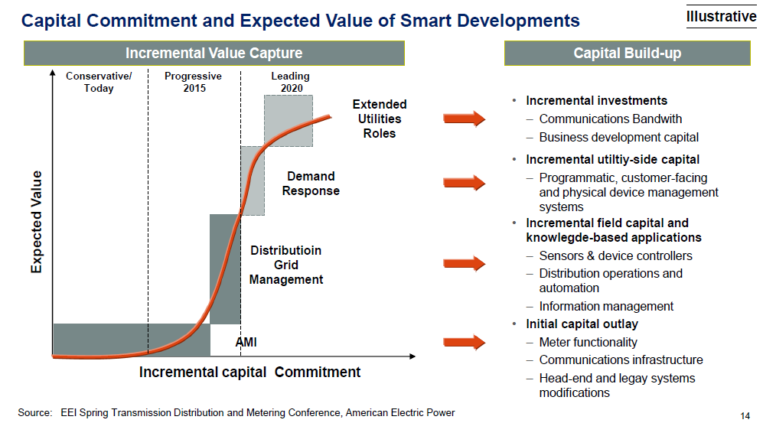
AMI is a key building block to Smart Grid
Integrated Smart Grid Programme

Slide 7
Integrated Communications

Slide 8
Utilities will need to:
Skill up and learn
Collaborate with industry and regulators
Educate suppliers on specific needs
Lead the way in standardization

