Slide 1


Smart Grids and Energy Markets (SGEM)
Research Program
Jani Valtari
CLEEN Ltd
ABB Oy Distribution Automation

Slide 2
Content
CLEEN Ltd – The vehicle for SGEM
SGEM consortium, imperatives and key facts
Connection to other SG activities and standardization
Phased evolution approach build on the Finnish Smart Grid 1.0
The systemic approach of SGEM
Jani Valtari – Finland – RT 6b

Slide 3
CLEEN Ltd – The vehicle for SGEM
Co-operative and industry driven R&D&I company for Energy and Environment founded in 2008.
  National Centre for Strategic Science, Technology and Innovation (CSTI), public funding from Tekes
28 industry and 16 research shareholders
  2010: 3 ongoing research programs, volume 27 M€
Bringing strategic focus and industry’s commitment to Finnish world class research
Jani Valtari – Finland – RT 6b
Notes:
Renewal of industry
Novel collaboration across industries
Strategic focus
Industry’s Commitment and Guidance (50% of the work)
World class competence and resources

Slide 4
SGEM Consortium – ICT Sector new to SG
Research Partners
  Aalto University
  Lappeenranta Uni of Tech
  MIKES, Centre for Metrology and Accreditation
  Tampere Uni of Tech
  Uni of Eastern Finland
  Uni of Oulu
  Uni of Vaasa
  VTT, Technical Research Centre of Finland
TSOs and DSOs
  Fingrid
  Fortum
  Helsingin Energia
  Suur-Savon Sähkö
  Vantaan Energia
  Vattenfall Verkko
ICT Industry
  Cybersoft
  Elektrobit
  Emtele
  Nokia Siemens Networks
  TeliaSonera
  There Corporation
  Viola Systems
  CLEEN Ltd
Energy Technology Industry
  ABB
  Aidon
  Alstom Grid
  Empower
  Tekla
  The Switch
R&D Cooperation – not commercial consortium
Joint sharing of Full Access Rights to all results
High level of publicity
Jani Valtari – Finland – RT 6b

Slide 5
SGEM key imperatives & facts
Create innovation foundation to enable the Smart Grids vision
Build internationally applicable solutions
Validate in real environment
Ensure competence accumulation in research and business
Utilize interactive international research environment
5 year program
57 M€ budget.
Industry total 56% ICT sector 29%
Focus on power distribution and interfaces
Jani Valtari – Finland – RT 6b

Slide 6
European Smart Grids Initiatives
Regulator
Federal (EU)
National
Private
 | Policy | Basic R&D | Industrial innovation | Demonstr. | Roll-out
EEGI
ISGAN
Int. Smart Grid
Action Netw.
EERA
Eur. Energy
Res. Alliance
KIC
Inno-
Energy
Standardisation
SGEM
Jani Valtari – Finland – RT 6b

Slide 7

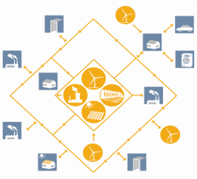
Phased evolution approach
Smart Grid 2.0
Overall Drivers
Minimizing CO₂ emissions
Energy Efficiency
Grid Reliability
Activated role of small customers
Phase 5
Next generation of management systems
Phase 4
New ICT & Automation
New Business Opportunities
Phase 3
Safe operation of SG
Smart Customer Interface
2011
Phase 2
Grid Arhcitectures
Demonstrations
Phase 1
Business Drivers
Enabling technologies
Smart Grid 1.0
2009
Jani Valtari – Finland – RT 6b

Slide 8
Systemic approach across domains
Empower Active Consumers
Improve System Reliability
Facilitate Active Resources
Real time energy markets
Utilities
operating on
deregulated
market
Leading
Energy
Technology
Providers
Demonstrating
Smart Grid 2.0
in real life grids
Leading ICT
industry
Wide
research
Co-operation
Jani Valtari – Finland – RT 6b

Slide 9
1. Empowering Active Consumers
Energy market interaction
Controllable loads
AMR
Utilities
Aggregators
Billing information
Energy data
Operational hours
Control information
Starts/stops
Operational hours
Prosumers
Demand response
Think Customers Not Meters and Create Valuable Information from Data
Jani Valtari – Finland – RT 6b

Slide 10
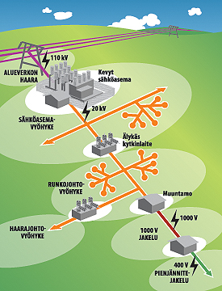
2. Improving System Reliability
Active, self-healing networks
Intended islanding
Real-time condition management
Smart HV grids
DC distribution
Improved planning and design
Cabling
Nanotechnology, MEMS
Jani Valtari – Finland – RT 6b

Slide 11
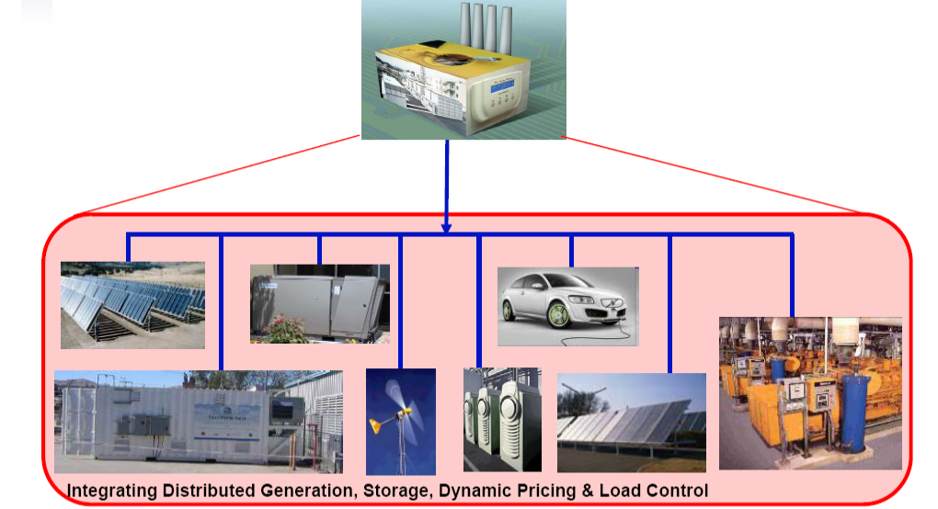
3. Facilitating Active Resources
Virtual power plants
Aggregator business models
Active customer models
Local production
Electric vehicles
Storages
Controllable loads
Demand side management
Jani Valtari – Finland – RT 6b

Slide 12

Jani Valtari
jani.valtari@cleen.fi
+358 50 3352730
http://www.cleen.fi/
Jani Valtari – Finland – RT 6b
Notes:
https://www.cleen.fi/

